Slide 1
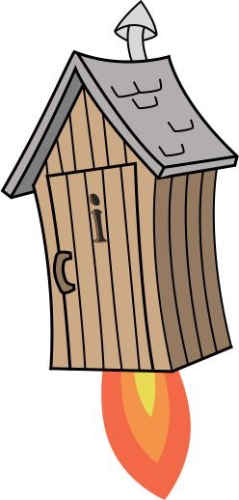
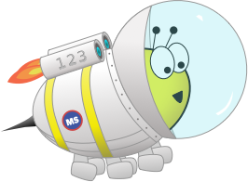
Quiz: QFKWKXZ
Stage 5 Autumn Block 4: Fractions A
Lesson 1: To be able to find fractions equivalent to a unit fraction
Autumn
Block 4 – Fractions A
1

Slide 2
To be able to find fractions equivalent to a unit fraction
Success criteria:
I can use bar models and number lines to help to find equivalent fractions of unit fractions
I can explain my reasoning when using bar models and number lines to help to find equivalent fractions of unit fractions

Slide 3
To be able to find fractions equivalent to a unit fraction
Starter:
Express the bar models below as fractions.
What’s the same and different about the bar models and their fraction form?
Explain your answer.

Slide 4
To be able to find fractions equivalent to a unit fraction
Starter:
Express the bar models below as fractions.
Both fractions are equal to each other in bar model form. In fraction form, the green bar model is $\frac{1}{3}$ and the purple bar model is $\frac{2}{6}$.

Slide 5
To be able to find fractions equivalent to a unit fraction
Talking Time:
Use the bar models to help you complete the number sentence below.
$\frac{1}{2}$ = $\frac{2}{4}$

Slide 6
To be able to find fractions equivalent to a unit fraction
Talking Time:
Use the bar models to help you complete the number sentence below.
$\frac{1}{2}$ = $\frac{2}{4}$

Slide 7
To be able to find fractions equivalent to a unit fraction
Talking Time:
Use the bar models to help you complete the number sentence below.
$\frac{1}{2}$ = $\frac{3}{6}$

Slide 8
To be able to find fractions equivalent to a unit fraction
Talking Time:
Use the bar models to help you complete the number sentence below.
$\frac{1}{2}$ = $\frac{3}{6}$

Slide 9
To be able to find fractions equivalent to a unit fraction
Talking Time:
Use the bar models to help you complete the number sentence below.
$\frac{1}{4}$ = $\frac{2}{8}$

Slide 10
To be able to find fractions equivalent to a unit fraction
Talking Time:
Use the bar models to help you complete the number sentence below.
$\frac{1}{4}$ = $\frac{2}{8}$

Slide 11
To be able to find fractions equivalent to a unit fraction
Activity 1:
Use the bar models to help you complete the number sentences below them.
$\frac{1}{4}$ = $\frac{3}{12}$
$\frac{1}{5}$ = $\frac{4}{20}$

Slide 12
To be able to find fractions equivalent to a unit fraction
Activity 1:
Use the bar models to help you complete the number sentences below them.
$\frac{1}{4}$ = $\frac{3}{12}$
$\frac{1}{5}$ = $\frac{4}{20}$
$\frac{1}{4}$ = $\frac{3}{12}$
$\frac{1}{5}$ = $\frac{4}{20}$

Slide 13
To be able to find fractions equivalent to a unit fraction
Talking Time:
Use the bar models to help you complete the number sentence below.
$\frac{1}{5}$ = $\frac{2}{10}$

Slide 14
To be able to find fractions equivalent to a unit fraction
Talking Time:
Use the bar models to help you complete the number sentence below.
$\frac{1}{5}$ = $\frac{2}{10}$
$\frac{1}{5}$ = $\frac{2}{10}$

Slide 15
To be able to find fractions equivalent to a unit fraction
Talking Time:
Use the bar models to help you complete the number sentence below.
$\frac{1}{4}$ = $\frac{4}{16}$

Slide 16
To be able to find fractions equivalent to a unit fraction
Talking Time:
Use the bar models to help you complete the number sentence below.
$\frac{1}{4}$ = $\frac{4}{16}$
$\frac{1}{4}$ = $\frac{4}{16}$

Slide 17
To be able to find fractions equivalent to a unit fraction
Talking Time:
Use the bar models to help you complete the number sentence below.
$\frac{1}{6}$ = $\frac{3}{18}$

Slide 18
To be able to find fractions equivalent to a unit fraction
Talking Time:
Use the bar models to help you complete the number sentence below.
$\frac{1}{6}$ = $\frac{3}{18}$
$\frac{1}{6}$ = $\frac{3}{18}$

Slide 19
To be able to find fractions equivalent to a unit fraction
Activity 2:
Use the bar models to help you complete the number sentences below them.
$\frac{1}{4}$ = $\frac{5}{20}$
$\frac{1}{5}$ = $\frac{3}{15}$

Slide 20
To be able to find fractions equivalent to a unit fraction
Activity 2:
Use the bar models to help you complete the number sentences below them.
$\frac{1}{4}$ = $\frac{5}{20}$
$\frac{1}{4}$ = $\frac{5}{20}$
$\frac{1}{5}$ = $\frac{3}{15}$
$\frac{1}{5}$ = $\frac{3}{15}$

Slide 21
To be able to find fractions equivalent to a unit fraction
Talking Time:
Use the number line to help you complete the number sentence below.
0
$\frac{1}{2}$
1
$\frac{1}{2}$ = $\frac{2}{4}$

Slide 22
To be able to find fractions equivalent to a unit fraction
Talking Time:
Use the number line to help you complete the number sentence below.
$\frac{1}{4}$
$\frac{2}{4}$
$\frac{3}{4}$
$\frac{4}{4}$
0
$\frac{1}{2}$
1
$\frac{1}{2}$ = $\frac{2}{4}$
$\frac{1}{2}$ = $\frac{2}{4}$

Slide 23
To be able to find fractions equivalent to a unit fraction
Talking Time:
Use the number line to help you complete the number sentence below.
0
$\frac{1}{2}$
1
$\frac{1}{2}$ = $\frac{2}{4}$

Slide 24
To be able to find fractions equivalent to a unit fraction
Talking Time:
Use the number line to help you complete the number sentence below.
$\frac{1}{6}$
$\frac{2}{6}$
$\frac{3}{6}$
$\frac{4}{6}$
$\frac{5}{6}$
$\frac{6}{6}$
0
$\frac{1}{2}$
1
$\frac{1}{2}$ = $\frac{3}{6}$
$\frac{1}{2}$ = $\frac{3}{6}$

Slide 25
To be able to find fractions equivalent to a unit fraction
Talking Time:
Use the number line to help you complete the number sentence below.
0
$\frac{1}{3}$
$\frac{2}{3}$
1
$\frac{1}{3}$ = $\frac{2}{6}$

Slide 26
To be able to find fractions equivalent to a unit fraction
Talking Time:
Use the number line to help you complete the number sentence below.
$\frac{1}{6}$
$\frac{2}{6}$
$\frac{3}{6}$
$\frac{4}{6}$
$\frac{5}{6}$
$\frac{6}{6}$
0
$\frac{1}{3}$
$\frac{2}{3}$
1
$\frac{1}{3}$ = $\frac{2}{6}$
$\frac{1}{3}$ = $\frac{2}{6}$

Slide 27
To be able to find fractions equivalent to a unit fraction
Activity 3:
Use the number line to help you complete the number sentence below.
0
$\frac{1}{3}$
$\frac{2}{3}$
1
$\frac{1}{3}$ = $\frac{2}{6}$

Slide 28
To be able to find fractions equivalent to a unit fraction
Activity 3:
Use the number line to help you complete the number sentence below.
$\frac{1}{9}$
$\frac{2}{9}$
$\frac{3}{9}$
$\frac{4}{9}$
$\frac{5}{9}$
$\frac{6}{9}$
$\frac{7}{9}$
$\frac{8}{9}$
$\frac{9}{9}$
0
$\frac{1}{3}$
$\frac{2}{3}$
1
$\frac{1}{3}$ = $\frac{3}{9}$
$\frac{1}{3}$ = $\frac{2}{6}$

Slide 29
To be able to find fractions equivalent to a unit fraction
Talking Time:
Chen says, “To find equivalent fractions to a unit fraction, I multiply the numerator and denominator by the same number.”
Use Chen’s method to solve the following number sentence:
× 8
$\frac{1}{2}$ =
× 8

Slide 30
To be able to find fractions equivalent to a unit fraction
Talking Time:
Chen says, “To find equivalent fractions to a unit fraction, I multiply the numerator and denominator by the same number.”
Use Chen’s method to solve the following number sentence:
× 8
$\frac{1}{2}$ =
$\frac{8}{16}$
× 8

Slide 31
To be able to find fractions equivalent to a unit fraction
Talking Time:
Chen says, “To find equivalent fractions to a unit fraction, I multiply the numerator and denominator by the same number.”
Use Chen’s method to solve the following number sentence:
× 5
$\frac{1}{4}$ =
× 5

Slide 32
To be able to find fractions equivalent to a unit fraction
Talking Time:
Chen says, “To find equivalent fractions to a unit fraction, I multiply the numerator and denominator by the same number.”
Use Chen’s method to solve the following number sentence:
× 5
$\frac{1}{4}$ =
$\frac{5}{20}$
× 5

Slide 33
To be able to find fractions equivalent to a unit fraction
Talking Time:
Chen says, “To find equivalent fractions to a unit fraction, I multiply the numerator and denominator by the same number.”
Use Chen’s method to solve the following number sentence:
× 3
$\frac{1}{6}$ =
× 3

Slide 34
To be able to find fractions equivalent to a unit fraction
Talking Time:
Chen says, “To find equivalent fractions to a unit fraction, I multiply the numerator and denominator by the same number.”
Use Chen’s method to solve the following number sentence:
× 3
$\frac{1}{6}$ =
$\frac{3}{18}$
× 3

Slide 35
To be able to find fractions equivalent to a unit fraction
Activity 4:
Chen says, “To find equivalent fractions to a unit fraction, I multiply the numerator and denominator by the same number.”
Use Chen’s method to solve the following number sentences:
× 9
× 6
$\frac{1}{3}$ =
$\frac{1}{8}$ =
× 9
× 6

Slide 36
To be able to find fractions equivalent to a unit fraction
Activity 4:
Chen says, “To find equivalent fractions to a unit fraction, I multiply the numerator and denominator by the same number.”
Use Chen’s method to solve the following number sentences:
× 9
× 6
$\frac{1}{3}$ =
$\frac{9}{27}$
$\frac{1}{8}$ =
$\frac{6}{48}$
× 9
× 6

Slide 37
To be able to find fractions equivalent to a unit fraction
Talking Time:
Ruth says, “To find equivalent fractions to a unit fraction, I look at the relationship between the numerator and denominator.”
Use Ruth’s method to solve the following number sentences:
$\frac{1}{2}$ =
$\frac{6}{12}$
$\frac{1}{2}$ =
$\frac{6}{10}$
× 2
× 2
÷ 2
÷ 2

Slide 38
To be able to find fractions equivalent to a unit fraction
Talking Time:
Ruth says, “To find equivalent fractions to a unit fraction, I look at the relationship between the numerator and denominator.”
Use Ruth’s method to solve the following number sentences:
$\frac{6}{12}$
$\frac{5}{10}$
$\frac{1}{2}$ =
$\frac{6}{12}$
$\frac{1}{2}$ =
$\frac{6}{10}$
× 2
× 2
÷ 2
÷ 2

Slide 39
To be able to find fractions equivalent to a unit fraction
Talking Time:
Ruth says, “To find equivalent fractions to a unit fraction, I look at the relationship between the numerator and denominator.”
Use Ruth’s method to solve the following number sentences:
$\frac{1}{3}$ =
$\frac{5}{12}$
$\frac{1}{3}$ =
$\frac{6}{12}$
× 3
× 3
÷ 3
÷ 3

Slide 40
To be able to find fractions equivalent to a unit fraction
Talking Time:
Ruth says, “To find equivalent fractions to a unit fraction, I look at the relationship between the numerator and denominator.”
Use Ruth’s method to solve the following number sentences:
$\frac{5}{15}$
$\frac{4}{12}$
$\frac{1}{3}$ =
$\frac{5}{12}$
$\frac{1}{3}$ =
$\frac{6}{12}$
× 3
× 3
÷ 3
÷ 3

Slide 41
To be able to find fractions equivalent to a unit fraction
Talking Time:
Ruth says, “To find equivalent fractions to a unit fraction, I look at the relationship between the numerator and denominator.”
Use Ruth’s method to solve the following number sentences:
$\frac{1}{3}$ =
$\frac{10}{12}$
$\frac{1}{3}$ =
$\frac{6}{18}$
× 3
× 3
÷ 3
÷ 3

Slide 42
To be able to find fractions equivalent to a unit fraction
Talking Time:
Ruth says, “To find equivalent fractions to a unit fraction, I look at the relationship between the numerator and denominator.”
Use Ruth’s method to solve the following number sentences:
$\frac{10}{30}$
$\frac{6}{18}$
$\frac{1}{3}$ =
$\frac{10}{12}$
$\frac{1}{3}$ =
$\frac{6}{18}$
× 3
× 3
÷ 3
÷ 3

Slide 43
To be able to find fractions equivalent to a unit fraction
Activity 5:
Ruth says, “To find equivalent fractions to a unit fraction, I look at the relationship between the numerator and denominator.”
Use Ruth’s method to solve the following number sentences:
$\frac{1}{4}$ =
$\frac{6}{24}$
$\frac{1}{4}$ =
$\frac{7}{28}$
× 4
× 4
÷ 4
÷ 4

Slide 44
To be able to find fractions equivalent to a unit fraction
Activity 5:
Ruth says, “To find equivalent fractions to a unit fraction, I look at the relationship between the numerator and denominator.”
Use Ruth’s method to solve the following number sentences:
$\frac{6}{24}$
$\frac{7}{28}$
$\frac{1}{4}$ =
$\frac{6}{24}$
$\frac{1}{4}$ =
$\frac{7}{28}$
× 4
× 4
÷ 4
÷ 4

Slide 45
To be able to find fractions equivalent to a unit fraction
Talking Time:
Use your preferred method to solve the following:
.
.
.
.
.
.
.
.
.
$\frac{1}{3}$ = $\frac{6}{18}$
$\frac{1}{5}$ = $\frac{7}{35}$
$\frac{1}{3}$ = $\frac{11}{33}$
$\frac{1}{5}$ = $\frac{5}{25}$
$\frac{1}{6}$ = $\frac{4}{24}$
$\frac{1}{12}$ = $\frac{12}{144}$
$\frac{1}{6}$ = $\frac{4}{24}$
$\frac{1}{2}$ = $\frac{6}{12}$
$\frac{1}{5}$ = $\frac{10}{50}$

Slide 46
To be able to find fractions equivalent to a unit fraction
Talking Time:
Use your preferred method to solve the following:
.
.
.
.
.
.
.
.
.
$\frac{1}{3}$ = $\frac{6}{18}$
$\frac{1}{5}$ = $\frac{7}{35}$
$\frac{1}{3}$ = $\frac{11}{33}$
$\frac{1}{5}$ = $\frac{5}{25}$
$\frac{1}{6}$ = $\frac{4}{24}$
$\frac{1}{12}$ = $\frac{12}{144}$
$\frac{1}{6}$ = $\frac{4}{24}$
$\frac{1}{2}$ = $\frac{6}{12}$
$\frac{1}{5}$ = $\frac{10}{50}$

Slide 47
To be able to find fractions equivalent to a unit fraction
Talking Time:
Use your preferred method to solve the following:
.
.
.
.
.
.
.
.
.
$\frac{1}{3}$ = $\frac{6}{18}$
$\frac{1}{5}$ = $\frac{7}{35}$
$\frac{1}{3}$ = $\frac{11}{33}$
$\frac{1}{5}$ = $\frac{5}{25}$
$\frac{1}{6}$ = $\frac{4}{24}$
$\frac{1}{12}$ = $\frac{12}{144}$
$\frac{1}{6}$ = $\frac{4}{24}$
$\frac{1}{2}$ = $\frac{6}{12}$
$\frac{1}{5}$ = $\frac{10}{50}$

Slide 48
To be able to find fractions equivalent to a unit fraction
Talking Time:
Use your preferred method to solve the following:
.
.
.
.
.
.
.
.
.
$\frac{1}{3}$ = $\frac{11}{33}$
$\frac{1}{3}$ = $\frac{6}{18}$
$\frac{1}{5}$ = $\frac{7}{35}$
$\frac{1}{3}$ = $\frac{11}{33}$
$\frac{1}{3}$ = $\frac{6}{18}$
$\frac{1}{5}$ = $\frac{7}{35}$
$\frac{1}{12}$ = $\frac{12}{144}$
$\frac{1}{5}$ = $\frac{5}{25}$
$\frac{1}{6}$ = $\frac{4}{24}$
$\frac{1}{12}$ = $\frac{12}{144}$
$\frac{1}{5}$ = $\frac{5}{25}$
$\frac{1}{6}$ = $\frac{4}{24}$
$\frac{1}{5}$ = $\frac{10}{50}$
$\frac{1}{6}$ = $\frac{4}{24}$
$\frac{1}{2}$ = $\frac{6}{12}$
$\frac{1}{5}$ = $\frac{10}{50}$
$\frac{1}{6}$ = $\frac{4}{24}$
$\frac{1}{2}$ = $\frac{6}{12}$

Slide 49
To be able to find fractions equivalent to a unit fraction
Activity 6:
Use your preferred method to solve the following:
.
.
.
.
.
.
.
.
.
$\frac{1}{4}$ = $\frac{7}{28}$
$\frac{1}{8}$ = $\frac{7}{56}$
$\frac{1}{4}$ = $\frac{12}{48}$
$\frac{1}{6}$ = $\frac{6}{36}$
$\frac{1}{7}$ = $\frac{7}{49}$
$\frac{1}{11}$ = $\frac{11}{121}$
$\frac{1}{7}$ = $\frac{6}{42}$
$\frac{1}{3}$ = $\frac{8}{24}$
$\frac{1}{4}$ = $\frac{25}{100}$

Slide 50
To be able to find fractions equivalent to a unit fraction
Activity 6:
Use your preferred method to solve the following:
.
.
.
.
.
.
.
.
.
$\frac{1}{4}$ = $\frac{12}{48}$
$\frac{1}{4}$ = $\frac{7}{28}$
$\frac{1}{4}$ = $\frac{12}{48}$
$\frac{1}{4}$ = $\frac{7}{28}$
$\frac{1}{8}$ = $\frac{7}{56}$
$\frac{1}{8}$ = $\frac{7}{56}$
$\frac{1}{11}$ = $\frac{11}{121}$
$\frac{1}{6}$ = $\frac{6}{36}$
$\frac{1}{11}$ = $\frac{11}{121}$
$\frac{1}{6}$ = $\frac{6}{36}$
$\frac{1}{7}$ = $\frac{7}{49}$
$\frac{1}{7}$ = $\frac{7}{49}$
$\frac{1}{4}$ = $\frac{25}{100}$
$\frac{1}{7}$ = $\frac{6}{42}$
$\frac{1}{4}$ = $\frac{25}{100}$
$\frac{1}{7}$ = $\frac{6}{42}$
$\frac{1}{3}$ = $\frac{8}{24}$
$\frac{1}{3}$ = $\frac{8}{24}$

Slide 51
To be able to find fractions equivalent to a unit fraction
Talking Time:
How many fractions can you think of that are equivalent to $\frac{1}{2}$ ?

Slide 52
To be able to find fractions equivalent to a unit fraction
Talking Time:
How many fractions can you think of that are equivalent to $\frac{1}{2}$ ?
Various answers, e.g.:
$\frac{2}{4}$ , $\frac{3}{6}$ , $\frac{10}{20}$ , $\frac{20}{40}$ …

Slide 53
To be able to find fractions equivalent to a unit fraction
Talking Time:
How many fractions can you think of that are equivalent to $\frac{1}{3}$ ?

Slide 54
To be able to find fractions equivalent to a unit fraction
Talking Time:
How many fractions can you think of that are equivalent to $\frac{1}{3}$ ?
Various answers, e.g.:
$\frac{2}{6}$ , $\frac{3}{9}$ , $\frac{10}{30}$ , $\frac{30}{90}$ …

Slide 55
To be able to find fractions equivalent to a unit fraction
Talking Time:
How many fractions can you think of that are equivalent to $\frac{1}{4}$ ?

Slide 56
To be able to find fractions equivalent to a unit fraction
Talking Time:
How many fractions can you think of that are equivalent to $\frac{1}{4}$ ?
Various answers, e.g.:
$\frac{2}{8}$ , $\frac{3}{12}$ , $\frac{5}{20}$ , $\frac{10}{40}$ …

Slide 57
To be able to find fractions equivalent to a unit fraction
Activity 7:
How many fractions can you think of that are equivalent to $\frac{1}{5}$ ?

Slide 58
To be able to find fractions equivalent to a unit fraction
Activity 7:
How many fractions can you think of that are equivalent to $\frac{1}{5}$ ?
Various answers, e.g.:
$\frac{2}{10}$ , $\frac{3}{15}$ , $\frac{4}{20}$ , $\frac{10}{50}$ …

Slide 59
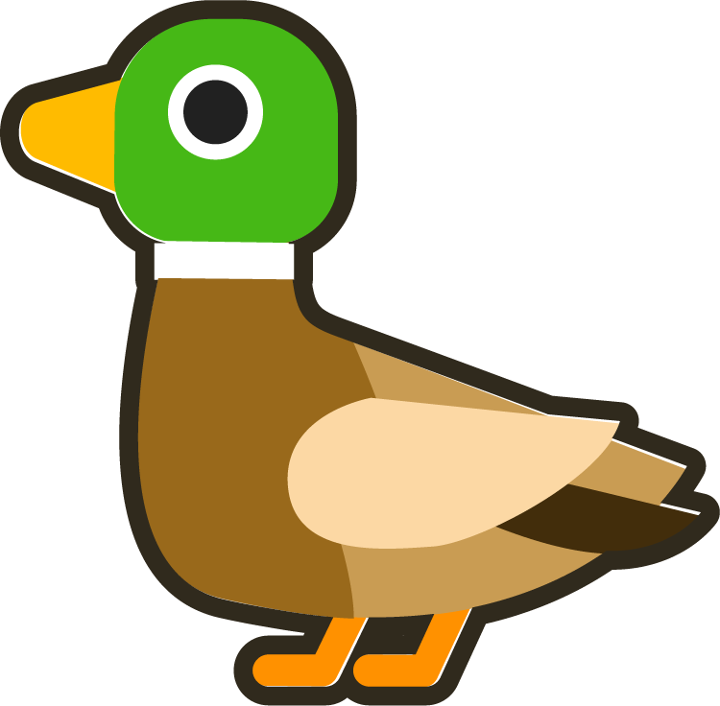
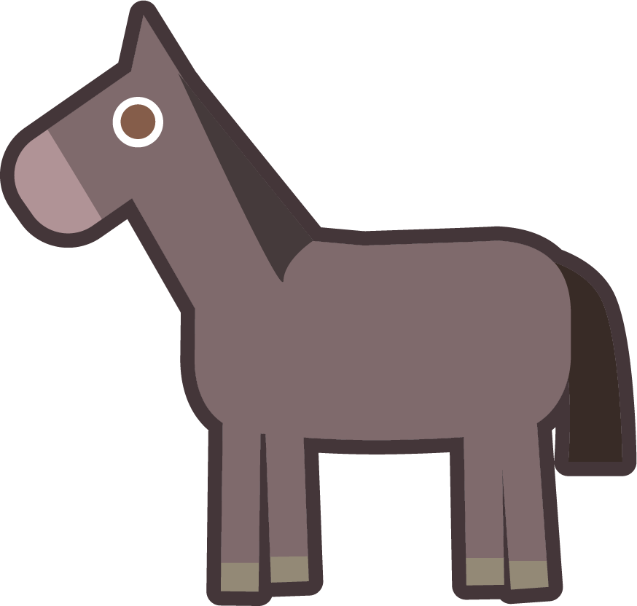
To be able to find fractions equivalent to a unit fraction
Activity 8:
Use your knowledge of equivalent fractions to a unit fraction to decide which number each of the animals represent. Pick from the number cards below.
$\frac{1}{2}$ = $\frac{XX}{XX}$ = $\frac{XX}{XX}$ = $\frac{XX}{XX}$
+
= 6
=
2
4
8
16
is double

Slide 60
To be able to find fractions equivalent to a unit fraction
Activity 8:
Use your knowledge of equivalent fractions to a unit fraction to decide which number each of the animals represent. Pick from the number cards below.
$\frac{1}{2}$ = $\frac{4}{8}$ = $\frac{2}{4}$ = $\frac{8}{16}$
+
= 6
=
2
4
8
16
is double

Slide 61
To be able to find fractions equivalent to unit fractions
Evaluation:
Do you agree with Astrobee?
Explain your answer.
I have found the following equivalent fractions:
$\frac{1}{5}$ = $\frac{3}{7}$

Slide 62
To be able to find fractions equivalent to unit fractions
Evaluation:
No, I do not agree with Astrobee. Astrobee has added two to both the numerator and the denominator, rather than multiplying them by the same number.
I have found the following equivalent fractions:
$\frac{1}{5}$ = $\frac{3}{7}$

Slide 63
To be able to find fractions equivalent to unit fractions
Success criteria:
I can use bar models and number lines to help to find equivalent fractions of unit fractions
I can explain my reasoning when using bar models and number lines to help to find equivalent fractions of unit fractions

