Slide 1
1
31
To be able to segment words into the correct syllables and phonemes
To spell words with the trigraph ‘igh’
This week’s words: high, night, light, bright, right, sight, tight, mighty, fright, midnight

Slide 2
Starter
Can you add the sound buttons to these
words from last week?
thief
grief
handkerchief
belief
shield

Slide 3
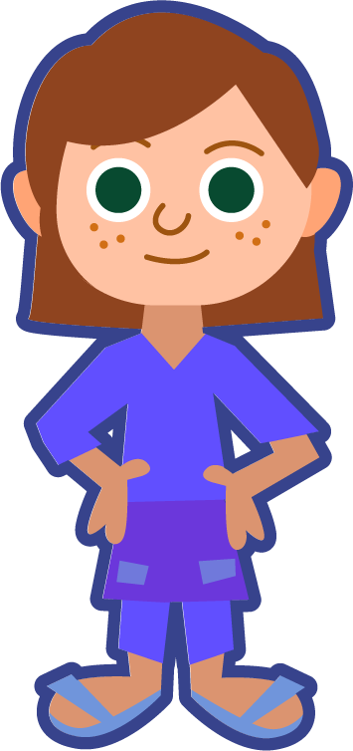
This Week’s Words
Do you know what they all mean?
What have they got in common?
high
night
light
This week’s words all have the trigraph ‘igh’. What sound does it make?
bright
right
sight
This week’s sound is a trigraph. Three letters make the sound /igh/.
tight
mighty
fright
might|y
midnight
Are there any words with two syllables?
mid|night
Notes:
Most of this week’s words have one syllable. ‘mighty’ and ‘midnight’ have two syllables.

Slide 4
Word Sort
Can you sort the words according to which digraph or trigraph is making the /igh/ sound?
night
high
light
bright
sight
midnight
mice
tried
spied
right
mighty
fine
pie
tight
fright
‘igh’
Can we think of any more ‘igh’ words?
‘ie’
‘i_e’
sunlight
sigh
flight
knight
highlight
starlight
delight
tonight

Slide 5
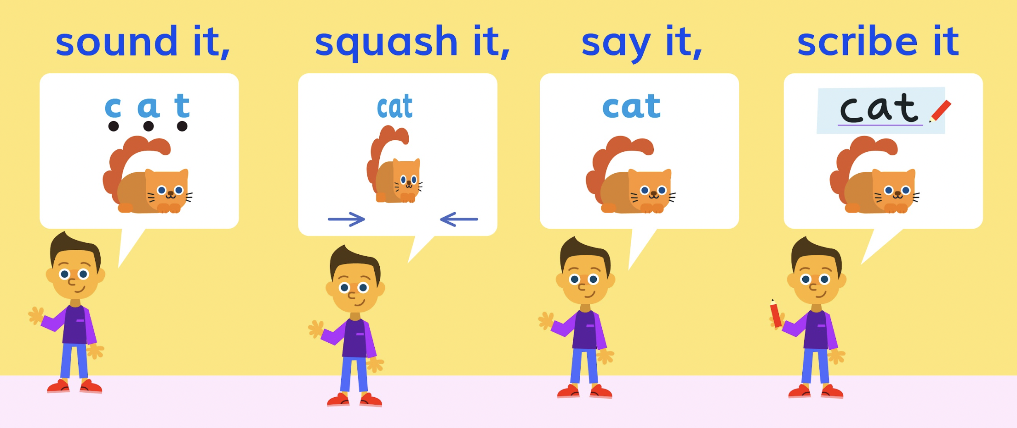
Sound It, Squash It, Say It, Scribe It
Write the word and
the correct phoneme
map.
I can’t
decide which phoneme maps are correct. Can you
help me?
a
b
right
right
How can we
help Chen
so he gets it right each time? Any tips for him to remember?
high
high
mighty
mighty

Slide 6
Words with the trigraph ‘igh’
To be able to segment words into the correct syllables and phonemes
To spell words with the trigraph ‘igh’
Look at the different phoneme maps. Write the correct word next to its phoneme map.

Slide 7
Words with the trigraph ‘igh’
Answers
Look at the different phoneme maps. Write the correct word next to its phoneme map.
sight
night
high
light
tight
right
mighty
bright
fright
midnight

Slide 8
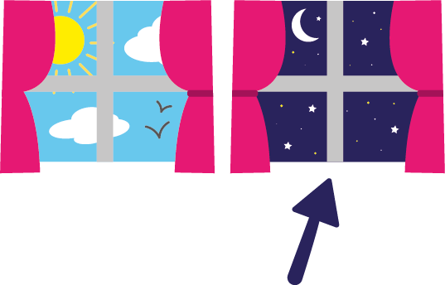
Words with the trigraph ‘igh’
To be able to segment words into the correct syllables and phonemes
To spell words with the trigraph ‘igh’
Identify the correct spelling of this week’s words in each row, then complete the sentence activities.
1 | hie | high | hi
2 | nighte | nite | night
3 | light | liet | lite
4 | brite | bright | briet
5 | right | rite | righte
6 | site | sight | siet
7 | tiet | tight | tighte
8 | mighty | mightee | miety
9 | frite | fright | friet
10 | midnighte | midnite | midnight
Write the word ‘night’ in a sentence.
Choose another two or three words to write
in one sentence.

Slide 9
Words with the trigraph ‘igh’
Answers
1 | hie | high | hi
2 | nighte | nite | night
3 | light | liet | lite
4 | brite | bright | briet
5 | right | rite | righte
6 | site | sight | siet
7 | tiet | tight | tighte
8 | mighty | mightee | miety
9 | frite | fright | friet
10 | midnighte | midnite | midnight
Write the word ‘night’ in a sentence.
Owls and badgers come out at night.
Choose another two or three words to write
in one sentence.
At midnight, I saw a bright light
through the trees.

Slide 10
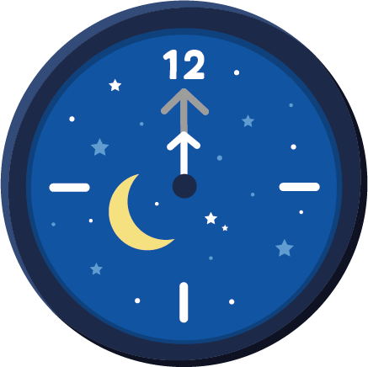
Words with the trigraph ‘igh’
To be able to segment words into the correct syllables and phonemes
To spell words with the trigraph ‘igh’
Write a sentence about the pictures below. Remember to include the word in your sentence.
night
light
right
midnight

Slide 11
Words with the trigraph ‘igh’
To be able to segment words into the correct syllables and phonemes
To spell words with the trigraph ‘igh’
Read the mixed-up sentences and replace the blue word with one of this week’s words so that the sentence makes sense.
Mixed-up Sentences | Correct Word
I needed new shoes because my old one were too sight.
The children all wore fright colours for the disco.
The mountain at sunset was a beautiful mighty.
The lion gave a bright roar.
The wolf stepped out from behind a tree and Little Red dropped her basked in high.
They were tight up on the top of the mountain.

Slide 12
Words with the trigraph ‘igh’
Possible Answers
night
light
Owls and badgers come out at night.
I turn the light on in my room if I feel scared.
right
midnight
I don’t always get the right answer, but I try.
At midnight I saw a bright light through the trees.

Slide 13
Words with the trigraph ‘igh’
Answers
Mixed-Up Sentences | Correct Word
I needed new shoes because my old one were too sight.
The children all wore fright colours for the disco.
The mountain at sunset was a beautiful mighty.
The lion gave a bright roar.
The wolf stepped out from behind a tree and Little Red dropped her basked in high.
They were tight up on the top of the mountain.
tight
bright
sight
mighty
fright
high

Slide 14
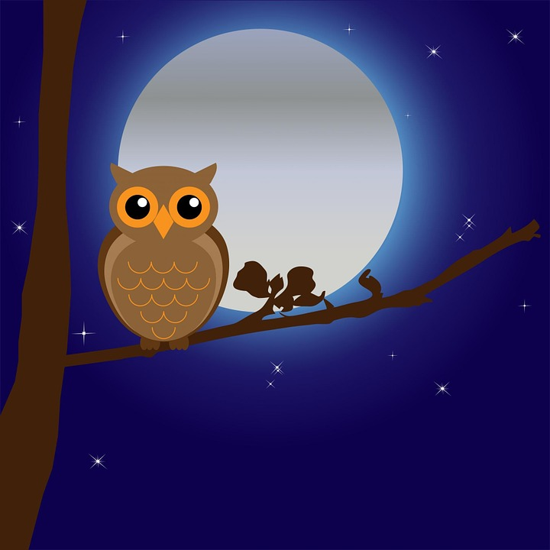
Missing Words
Can you write the missing words to finish the sentence?
Midnight
right
sight
_________ is the _____ time to catch _____ of an owl.
Did you spell them like this? Did you remember
the ‘igh’
trigraph?
midnight
right
sight

Slide 15
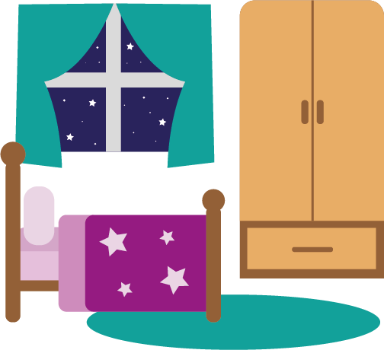
Missing Words
Can you write the missing words to finish the sentence?
I have a _______ _____ in my bedroom to stop me from getting a ______.
bright
light
fright
Did you spell them like this? Did you remember
the ‘igh’
trigraph?
bright
light
fright

Slide 16
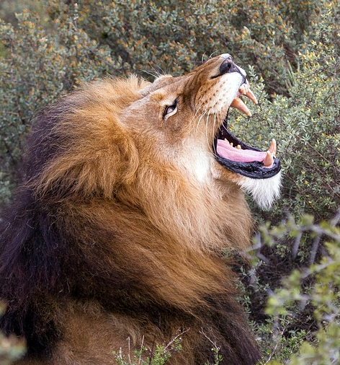
Missing Words
Can you write the missing words to finish the sentence?
In the _____ , I heard a lion give a ________ roar.
night
mighty
Did you spell them like this? Did you remember
the ‘igh’
trigraph?
night
mighty

Slide 17
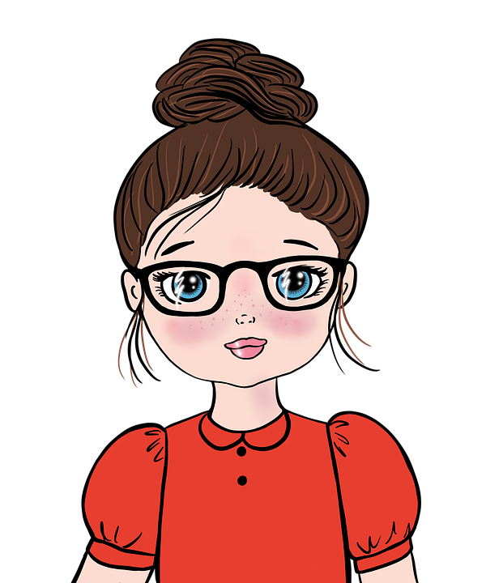
Missing Words
Can you write the missing words to finish the sentence?
She put her hair into a _____ bun, ____
on top of her head.
tight
high
Did you spell them like this? Did you remember
the ‘igh’
trigraph?
tight
high

Slide 18
Words for Continuous Provision (Optional)
night | bright | sight | mighty | midnight
high | light | right | tight | fright

Slide 19
Words for Continuous Provision (Optional)
‘i_e’ Words from Lesson 12
slide | like | time | side | trike
spike | ride | five | fire | mice

Slide 20
Words for Continuous Provision (Optional)
‘ie’ Words from Lesson 29
pie | cried | died | fried | tied
lie | tie | tried | spied | dried

Slide 21
Sorting Mat
Place the words onto the correct pile.
‘i_e’
‘ie’
‘igh’
Can you add any of your own words to the lists?
When they have been sorted, see how fast you can read them.

