Slide 1
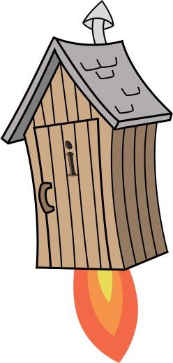
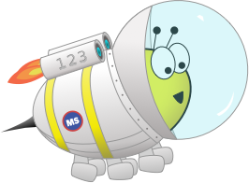
Quiz: QFSPJEF
Stage 4 Autumn Block 4 - Multiplication and Division
Lesson 1: To be able to recall multiples of 3
Autumn
Block 4 – Multiplication and Division
1

Slide 2
To be able to recall multiples of 3
Success criteria:
I can use mathematical equipment to recall multiples of 3.
I can explain my reasoning when using mathematical equipment to recall multiples of 3 and use my knowledge to problem solve.

Slide 3
To be able to recall multiples of 3
Starter:
Which number below is not a multiple of 3?
3
30
15
24
8
9
18

Slide 4
To be able to recall multiples of 3
Starter:
Which number below is not a multiple of 3?
8 is not in the 3 times table.
3
30
15
24
8
9
18

Slide 5
To be able to recall multiples of 3
Talking Time:
Use a counting stick to practice the two times table as a class…
0
1
2
3
4
5
6
7
8
9
10

Slide 6
To be able to recall multiples of 3
Talking Time:
Use a counting stick to practice the two times table as a class…
0
30
0
1
2
3
4
5
6
7
8
9
10
What is 1 x 3?

Slide 7
To be able to recall multiples of 3
Talking Time:
Use a counting stick to practice the two times table as a class…
0
3
30
0
1
2
3
4
5
6
7
8
9
10
What is 2 x 3?

Slide 8
To be able to recall multiples of 3
Talking Time:
Use a counting stick to practice the two times table as a class…
0
3
6
30
0
1
2
3
4
5
6
7
8
9
10
Should I put 9 in the 4 x 3 place?

Slide 9
To be able to recall multiples of 3
Talking Time:
Use a counting stick to practice the two times table as a class…
0
3
6
12
30
0
1
2
3
4
5
6
7
8
9
10
If 8 is double 4, how can we use that information to work out what 8 x 3 is?

Slide 10
To be able to recall multiples of 3
Talking Time:
Use a counting stick to practice the two times table as a class…
0
3
6
12
24
30
0
1
2
3
4
5
6
7
8
9
10
We know 2 x 3 and 4 x 3, what is 3 x 3?

Slide 11
To be able to recall multiples of 3
Talking Time:
Use a counting stick to practice the two times table as a class…
0
3
6
9
12
24
30
0
1
2
3
4
5
6
7
8
9
10
If 6 is double 3, how can we use that information to work out what 6 x 3 is?

Slide 12
To be able to recall multiples of 3
Talking Time:
Use a counting stick to practice the two times table as a class…
0
3
6
9
12
18
24
30
0
1
2
3
4
5
6
7
8
9
10
Where should I place 15 on the stick?

Slide 13
To be able to recall multiples of 3
Talking Time:
Use a counting stick to practice the two times table as a class…
0
3
6
9
12
15
18
24
30
0
1
2
3
4
5
6
7
8
9
10
Where should I place 21 on the stick?

Slide 14
To be able to recall multiples of 3
Talking Time:
Use a counting stick to practice the two times table as a class…
0
3
6
9
12
15
18
21
24
30
0
1
2
3
4
5
6
7
8
9
10
What is 9 x 3? How did you figure it out?

Slide 15
To be able to recall multiples of 3
Talking Time:
Use a counting stick to practice the two times table as a class… Let’s play a game of ‘Around the World’ with the number stick on the board until we are ready to take it off the board…
0
3
6
9
12
15
18
21
24
27
30
0
1
2
3
4
5
6
7
8
9
10
Notes:
Around the World is a game where the first child goes head to head with the next child in a race to be the first to give the product of a multiplication calculation, e.g. Teacher says, ”What is 3 x 2?” Child 1 responds, “6!” first.
The winner stays on until they are beaten when the winner continues going head to head with other class members until they are beaten.
Also include division sentences for extra challenge, e.g. If I had 10 cookies and shared them between two people, how many cookies would each person get?
Or questions such as, “How many 2s go into 12?”

Slide 16
To be able to recall multiples of 3
Talking Time:
Can you complete the number line?
0
3
6
12
21
30

Slide 17
To be able to recall multiples of 3
Talking Time:
Can you complete the number line?
0
3
6
9
12
15
18
21
24
27
30

Slide 18
To be able to recall multiples of 3
Talking Time:
Can you complete the number line?
30
33
36
42
51
60

Slide 19
To be able to recall multiples of 3
Talking Time:
Can you complete the number line?
30
33
36
39
42
45
48
51
54
57
60

Slide 20
To be able to recall multiples of 3
Talking Time:
Can you complete the number line?
27
33
36
45
48
57

Slide 21
To be able to recall multiples of 3
Talking Time:
Can you complete the number line?
27
30
33
36
39
42
45
48
51
54
57

Slide 22
To be able to recall multiples of 3
Activity 1:
Can you complete the number line?
60
66
69
78
81
90

Slide 23
To be able to recall multiples of 3
Activity 1:
Can you complete the number line?
60
63
66
69
72
75
78
81
84
87
90

Slide 24
To be able to recall multiples of 3
Talking Time:
Complete the calculations.
3 x 12 =
4 x 3 + 2 x 3 =
9 x 3 =
1 x 3 + 10 x 3 =

Slide 25
To be able to recall multiples of 3
Talking Time:
Complete the calculations.
3 x 12 =
36
4 x 3 + 2 x 3 =
18
9 x 3 =
27
1 x 3 + 10 x 3 =
33

Slide 26
To be able to recall multiples of 3
Activity 2:
Complete the calculations.
3 x 6 =
1 x 3 + 5 x 3 =
7 x 3 =
1 x 3 + 11 x 3 =

Slide 27
To be able to recall multiples of 3
Activity 2:
Complete the calculations.
3 x 6 =
18
1 x 3 + 5 x 3 =
18
7 x 3 =
21
1 x 3 + 11 x 3 =
36

Slide 28
To be able to recall multiples of 3
Talking Time:
These are all multiples of 3. Find the sum of the digits of each number.
What do you notice?
60
18
33
15
102
57

Slide 29
To be able to recall multiples of 3
Talking Time:
These are all multiples of 3. Find the sum of the digits of each number.
What do you notice?
60
6
18
9
33
6
6
102
12
57
12
15

Slide 30
To be able to recall multiples of 3
Activity 3:
These are all multiples of 3. Find the sum of the digits of each number.
What do you notice?
45
54
72
63
123
87

Slide 31
To be able to recall multiples of 3
Activity 3:
These are all multiples of 3. Find the sum of the digits of each number.
What do you notice?
45
9
54
9
72
9
9
123
6
87
15
63

Slide 32
To be able to recall multiples of 3
Talking Time:
Astrobee says, “I know that 10 x 3 = 30 and 3 x 3 = 9, so 13 x 3 = 39.
Use Astrobee’s method to work out the following:
15 x 3 =
21 x 3 =
19 x 3 =
20 x 3 =

Slide 33
To be able to recall multiples of 3
Talking Time:
Astrobee says, “I know that 10 x 3 = 30 and 3 x 3 = 9, so 13 x 3 = 39.
Use Astrobee’s method to work out the following:
15 x 3 =
21 x 3 =
19 x 3 =
20 x 3 =

Slide 34
To be able to recall multiples of 3
Talking Time:
Astrobee says, “I know that 10 x 3 = 30 and 3 x 3 = 9, so 13 x 3 = 39.
Use Astrobee’s method to work out the following:
15 x 3 =
45
21 x 3 =
63
19 x 3 =
57
20 x 3 =
60

Slide 35
To be able to recall multiples of 3
Activity 4:
Astrobee says, “I know that 10 x 3 = 30 and 3 x 3 = 9, so 13 x 3 = 39.
Use Astrobee’s method to work out the following:
14 x 3 =
17 x 3 =
16 x 3 =
18 x 3 =

Slide 36
To be able to recall multiples of 3
Activity 4:
Astrobee says, “I know that 10 x 3 = 30 and 3 x 3 = 9, so 13 x 3 = 39.
Use Astrobee’s method to work out the following:
14 x 3 =
42
17 x 3 =
51
16 x 3 =
48
18 x 3 =
54

Slide 37
To be able to recall multiples of 3
Talking Time:
James has a teddy bear that is 5cm tall.
Ruth’s teddy bear is three times the height of James’s.
How much taller is Ruth’s teddy bear than James’s?

Slide 38
To be able to recall multiples of 3
Talking Time:
James has a teddy bear that is 5cm tall.
Ruth’s teddy bear is three times the height of James’s.
How much taller is Ruth’s teddy bear than James’s?
3 x 5cm = 15cm (height of Ruth’s teddy bear)
15cm – 5cm = 10cm
10cm

Slide 39
To be able to recall multiples of 3
Talking Time:
Chen has a tower that is 8cm tall.
Astrobee’s tower is three times the height of Chen’s.
How much taller is Astrobee’s tower than Chen’s?

Slide 40
To be able to recall multiples of 3
Talking Time:
Chen has a tower that is 8cm tall.
Astrobee’s tower is three times the height of Chen’s.
How much taller is Astrobee’s tower than Chen’s?
3 x 8cm = 24cm (height of Astrobee’s tower)
24cm – 8cm = 16cm
16cm

Slide 41
To be able to recall multiples of 3
Activity 5:
Chen has a tower that is 9cm tall.
Astrobee’s tower is three times the height of Chen’s.
How much taller is Astrobee’s tower than Chen’s?

Slide 42
To be able to recall multiples of 3
Activity 5:
Chen has a tower that is 9cm tall.
Astrobee’s tower is three times the height of Chen’s.
How much taller is Astrobee’s tower than Chen’s?
3 x 9cm = 27cm (height of Astrobee’s tower)
27cm – 9cm = 18cm
18cm

Slide 43
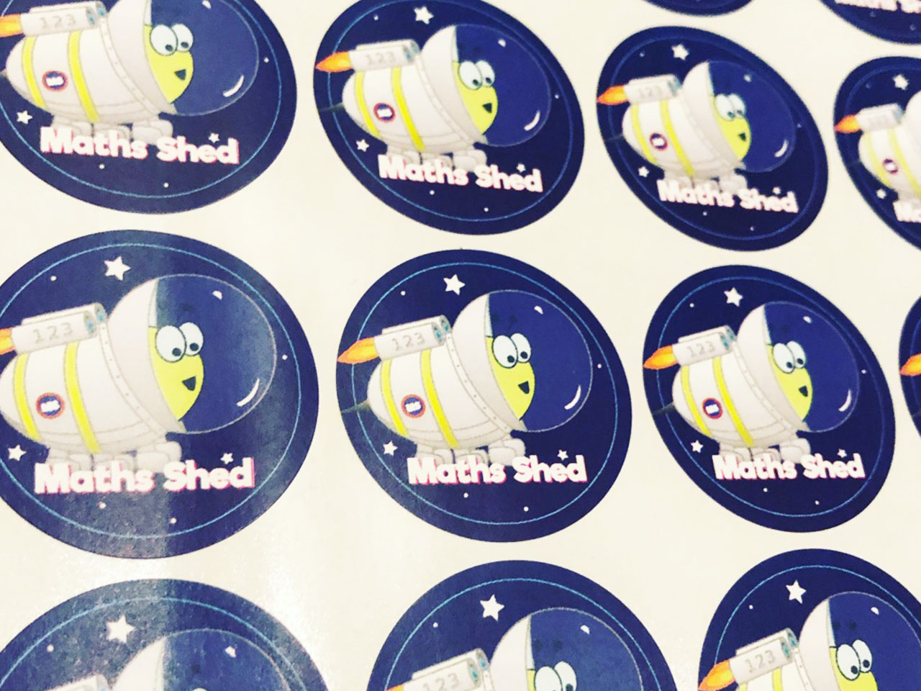
To be able to recall multiples of 3
Talking Time:
James has three times as many stickers as Yasmin.
Yasmin has three times as many stickers as Ruth.
Yasmin has 30 stickers.
How many stickers do they have in total?

Slide 44
To be able to recall multiples of 3
Talking Time:
James has three times as many stickers as Yasmin.
Yasmin has three times as many stickers as Ruth.
Yasmin has 30 stickers.
How many stickers do they have in total?
30 ÷ 3 = 10 (Ruth’s amount of stickers)
30 x 3 = 90 (James’s amount of stickers)
90 + 30 + 10 = 130 stickers in total

Slide 45
To be able to recall multiples of 3
Talking Time:
James has three times as many stickers as Yasmin.
Yasmin has three times as many stickers as Ruth.
Yasmin has 24 stickers.
How many stickers do they have in total?

Slide 46
To be able to recall multiples of 3
Talking Time:
James has three times as many stickers as Yasmin.
Yasmin has three times as many stickers as Ruth.
Yasmin has 24 stickers.
How many stickers do they have in total?
24 ÷ 3 = 8 (Ruth’s amount of stickers)
24 x 3 = 72 (James’s amount of stickers)
72 + 24 + 8 = 104 stickers in total

Slide 47
To be able to recall multiples of 3
Activity 6:
James has three times as many stickers as Ruth.
Ruth has three times as many stickers as Yasmin.
Ruth has 18 stickers.
How many stickers do they have in total?

Slide 48
To be able to recall multiples of 3
Activity 6:
James has three times as many stickers as Ruth.
Ruth has three times as many stickers as Yasmin.
Ruth has 18 stickers.
How many stickers do they have in total?
18 ÷ 3 = 6 (Yasmin’s amount of stickers)
18 x 3 = 54 (James’s amount of stickers)
54 + 6 + 18 = 78 stickers in total

Slide 49
To be able to recall multiples of 3
Evaluation:
What could Astrobee’s numbers be?
I am thinking of three multiples of 3 between 0 and 30. The sum of my numbers is 39.

Slide 50
To be able to recall multiples of 3
Evaluation:
What could Astrobee’s numbers be?
24 + 3 + 12 9 + 6 + 24 30 + 3 + 6 15 + 6 + 18 (teacher assess)
I am thinking of three multiples of 3 between 0 and 30. The sum of my numbers is 39.

Slide 51
To be able to recall multiples of 3
Success criteria:
I can use mathematical equipment to recall multiples of 3.
I can explain my reasoning when using mathematical equipment to recall multiples of 3 and use my knowledge to problem solve.

