Slide 1
Year 3 Term 1 Block 1: Place Value Lesson 1: To be able to explore Roman Numerals up to 100
1
Block 1 – Place Value
1

Slide 2
To be able to explore Roman Numerals up to 100
Success criteria:
I can remember the numbers 3, 6, 9 and 12 in Roman Numerals
I can explain my reasoning when identifying Roman Numerals up to 100

Slide 3
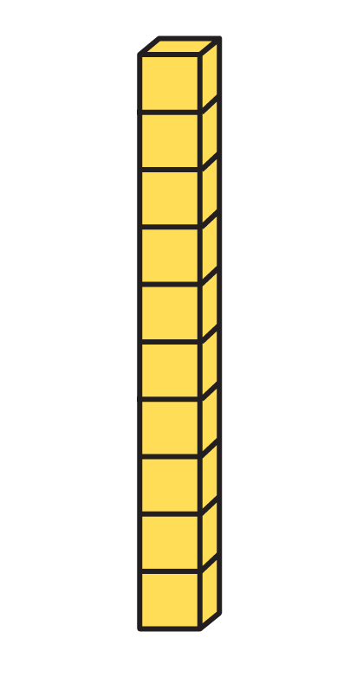
To be able to explore Roman Numerals up to 100
Starter:
Which one doesn’t belong?
Explain your answer.
X

Slide 4
To be able to explore Roman Numerals up to 100
Starter:
Which one doesn’t belong?
The Numicon Shape doesn’t belong as it is blue. Otherwise, all the objects match as they all show values of 10.
X

Slide 5
To be able to explore Roman Numerals up to 100
Talking Time:
Spend a couple of minutes revising some Roman Numerals facts…
1 = I 10 = X 11 = XI
2 = II 20 = XX 22 = XXII
3 = III 30 = XXX 33 = XXXIII
4 = IV 40 = XL 44 = XLIV
5 = V 50 = L 55 = LV
6 = VI 60 = LX 66 = LXVI
7 = VII 70 = LXX 77 = LXXVII
8 = VIII 80 = LXXX 88 = LXXXVIII
9 = IX 90 = XC 99 = XCIX
10 = X 100 = C 111 = CXI

Slide 6
To be able to explore Roman Numerals up to 100
Talking Time:
Using sticks, twigs or rulers, make the following numbers as Roman Numerals…

Slide 7
To be able to explore Roman Numerals up to 100
Talking Time:
Using sticks, twigs or rulers, make the following numbers as Roman Numerals…
III

Slide 8
To be able to explore Roman Numerals up to 100
Talking Time:
Using sticks, twigs or rulers, make the following numbers as Roman Numerals…

Slide 9
To be able to explore Roman Numerals up to 100
Talking Time:
Using sticks, twigs or rulers, make the following numbers as Roman Numerals…
V

Slide 10
To be able to explore Roman Numerals up to 100
Talking Time:
Using sticks, twigs or rulers, make the following numbers as Roman Numerals…

Slide 11
To be able to explore Roman Numerals up to 100
Talking Time:
Using sticks, twigs or rulers, make the following numbers as Roman Numerals…
IX

Slide 12
To be able to explore Roman Numerals up to 100
Talking Time:
Using sticks, twigs or rulers, make the following numbers as Roman Numerals…

Slide 13
To be able to explore Roman Numerals up to 100
Talking Time:
Using sticks, twigs or rulers, make the following numbers as Roman Numerals…
XII

Slide 14
To be able to explore Roman Numerals up to 100
Talking Time:
Using sticks, twigs or rulers, make the following numbers as Roman Numerals…

Slide 15
To be able to explore Roman Numerals up to 100
Talking Time:
Using sticks, twigs or rulers, make the following numbers as Roman Numerals…
XXIX

Slide 16
To be able to explore Roman Numerals up to 100
Talking Time:
Using sticks, twigs or rulers, make the following numbers as Roman Numerals…

Slide 17
To be able to explore Roman Numerals up to 100
Talking Time:
Using sticks, twigs or rulers, make the following numbers as Roman Numerals…
LI

Slide 18
To be able to explore Roman Numerals up to 100
Talking Time:
Using sticks, twigs or rulers, make the following numbers as Roman Numerals…

Slide 19
To be able to explore Roman Numerals up to 100
Talking Time:
Using sticks, twigs or rulers, make the following numbers as Roman Numerals…
XLIV

Slide 20
To be able to explore Roman Numerals up to 100
Talking Time:
Using sticks, twigs or rulers, make the following numbers as Roman Numerals…

Slide 21
To be able to explore Roman Numerals up to 100
Talking Time:
Using sticks, twigs or rulers, make the following numbers as Roman Numerals…
XCIX

Slide 22
To be able to explore Roman Numerals up to 100
Talking Time:
Using sticks, twigs or rulers, make the following numbers as Roman Numerals…

Slide 23
To be able to explore Roman Numerals up to 100
Talking Time:
Using sticks, twigs or rulers, make the following numbers as Roman Numerals…
LXXIV

Slide 24
To be able to explore Roman Numerals up to 100
Talking Time:
Using sticks, twigs or rulers, make the following numbers as Roman Numerals…

Slide 25
To be able to explore Roman Numerals up to 100
Talking Time:
Using sticks, twigs or rulers, make the following numbers as Roman Numerals…
CXI

Slide 26
To be able to explore Roman Numerals up to 100
Talking Time:
The diagrams below show a number in Roman Numerals, numerals and words. Complete the missing sections.
XII
12
twelve
twenty -one
XLII
22

Slide 27
To be able to explore Roman Numerals up to 100
Talking Time:
The diagrams below show a number in Roman Numerals, numerals and words. Complete the missing sections.
XII
XXI
12
twelve
21
twenty -one
XXII
XLII
22
twenty -two
42
forty-
two

Slide 28
To be able to explore Roman Numerals up to 100
Activity 1:
The diagrams below show a number in Roman Numerals, numerals and words.
Complete the missing sections.
XIV
twenty -four
14
fourteen
XCIV
44

Slide 29
To be able to explore Roman Numerals up to 100
Activity 1:
The diagrams below show a number in Roman Numerals, numerals and words. Complete the missing sections.
XIV
XXIV
24
twenty -four
14
fourteen
XLIV
XCIV
44
forty -four
94
ninety-
four

Slide 30
To be able to explore Roman Numerals up to 100
Talking Time:
Complete the function machines:
LXXIV
+ 1
LXXV
LXXIV
- 1
LXXIV
+ 10
LXXXIV
LXXIV
- 10

Slide 31
To be able to explore Roman Numerals up to 100
Talking Time:
Complete the function machines:
LXXIV
+ 1
LXXV
LXXIV
- 1
LXXIII
LXXIV
+ 10
LXXXIV
LXXIV
- 10

Slide 32
To be able to explore Roman Numerals up to 100
Talking Time:
Complete the function machines:
LXXIV
+ 1
LXXV
LXXIV
- 1
LXXIII
LXXIV
+ 10
LXXXIV
LXXIV
- 10
LXIV

Slide 33
To be able to explore Roman Numerals up to 100
Activity 2:
Complete the function machines:
XLIX
+ 1
L
XLIX
- 1
XLIX
+ 10
XLIX
- 10

Slide 34
To be able to explore Roman Numerals up to 100
Activity 2:
Complete the function machines:
XLIX
+ 1
L
XLIX
- 1
XLVIII
XLIX
+ 10
LIX
XLIX
- 10
XXXIX

Slide 35
To be able to explore Roman Numerals up to 100
Activity 3:
Complete the calculation below:
How many more Roman Numerals addition sentences that total the same amount can you think of?
XXVI
+
LXXIV
=

Slide 36
To be able to explore Roman Numerals up to 100
Activity 3:
Complete the calculation below:
How many more Roman Numerals addition sentences that total the same amount can you think of?
XXVI
+
LXXIV
=
C

Slide 37
To be able to explore Roman Numerals up to 100
Activity 3:
Complete the calculation below:
How many more Roman Numerals addition sentences that total the same amount can you think of?
Other number sentences include: XC + X = C, XCIX + I = C, XXXV + LXV = C…
XXVI
+
LXXIV
=
C

Slide 38
To be able to explore Roman Numerals up to 100
Evaluation:
Is Astrobee’s statement always true, sometimes true or never true?
Explain your answer.
Multiples of 10 end in an X when written in Roman Numerals.

Slide 39
To be able to explore Roman Numerals up to 100
Evaluation:
Astrobee’s statement is sometimes true – although most multiples of 10 will end in an X when written in Roman Numerals, there are exceptions, like C = 100, XL = 40, L = 50, XC = 90…
Multiples of 10 end in an X when written in Roman Numerals.

Slide 40
To be able to explore Roman Numerals up to 100
Success criteria:
I can remember the numbers 3, 6, 9 and 12 in Roman Numerals
I can explain my reasoning when identifying Roman Numerals up to 100

