Slide 1


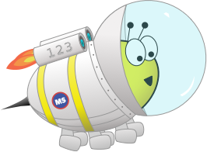

Stage 6 Autumn Block 4: Fractions B
Lesson 1: To be able to multiply fractions by integers
Autumn
Block 4 – Fractions B
1

Slide 2
To be able to multiply fractions by integers
Success criteria:
I can use pictorial representations and various strategies, including partitioning and converting between mixed numbers and improper fractions, to multiply fractions and mixed numbers by integers
I can explain my reasoning when using pictorial representations and various strategies, including partitioning and converting between mixed numbers and improper fractions, to multiply fractions and mixed numbers by integers

Slide 3
To be able to multiply fractions by integers
Starter:
If the two bar models below represent the 2nd and 3rd steps in a sequence, what would come before? What would come after?
Explain your answer.

Slide 4
To be able to multiply fractions by integers
Starter:
If the two bar models below represent the 2nd and 3rd steps in a sequence, what would come before? What would come after?
The first step would be a bar model with eight parts with one purple part; the fourth step would be a bar model with eight parts with seven purple parts.
Two eighths are being added on each time.

Slide 5




To be able to multiply fractions by integers
Talking Time:
Use the representation below to help you calculate
3 × $\frac{3}{4}$
$\frac{3}{4}$
$\frac{3}{4}$
$\frac{3}{4}$

Slide 6
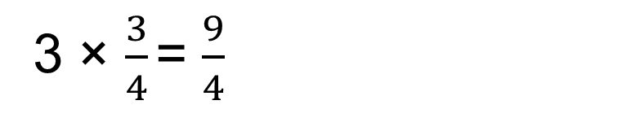
To be able to multiply fractions by integers
Talking Time:
Use the representation below to help you calculate
3 × $\frac{3}{4}$
$\frac{3}{4}$
$\frac{3}{4}$
3 × $\frac{3}{4}$ = $\frac{9}{4}$
$\frac{3}{4}$

Slide 7
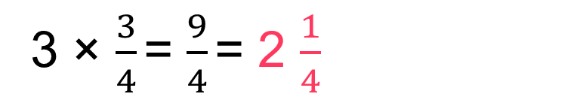
To be able to multiply fractions by integers
Talking Time:
Use the representation below to help you calculate
3 × $\frac{3}{4}$
$\frac{3}{4}$
$\frac{3}{4}$
3 × $\frac{3}{4}$ = $\frac{9}{4}$ = 2 $\frac{1}{4}$
$\frac{3}{4}$

Slide 8



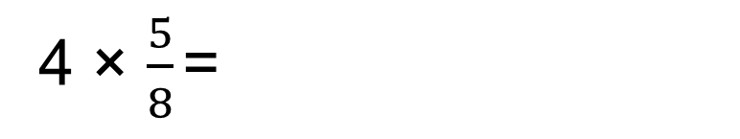


To be able to multiply fractions by integers
Talking Time:
Use the representation below to help you calculate
4 × $\frac{5}{8}$
$\frac{5}{8}$
$\frac{5}{8}$
4 × $\frac{5}{8}$ =
$\frac{5}{8}$
$\frac{5}{8}$

Slide 9
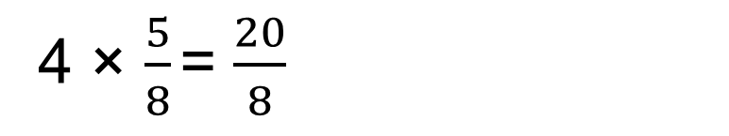
To be able to multiply fractions by integers
Talking Time:
Use the representation below to help you calculate
4 × $\frac{5}{8}$
$\frac{5}{8}$
$\frac{5}{8}$
4 × $\frac{5}{8}$ = $\frac{20}{8}$
$\frac{5}{8}$
$\frac{5}{8}$

Slide 10
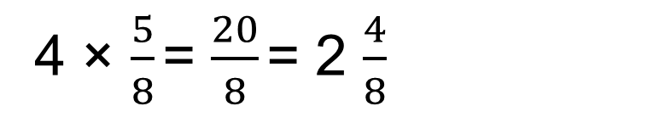
To be able to multiply fractions by integers
Talking Time:
Use the representation below to help you calculate
4 × $\frac{5}{8}$
$\frac{5}{8}$
$\frac{5}{8}$
4 × $\frac{5}{8}$ = $\frac{20}{8}$ = 2 $\frac{4}{8}$
$\frac{5}{8}$
$\frac{5}{8}$

Slide 11
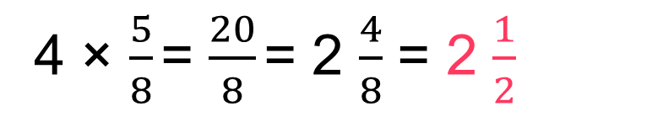
To be able to multiply fractions by integers
Talking Time:
Use the representation below to help you calculate
4 × $\frac{5}{8}$
$\frac{5}{8}$
$\frac{5}{8}$
4 × $\frac{5}{8}$ = $\frac{20}{8}$ = 2 $\frac{4}{8}$ = 2 $\frac{1}{2}$
$\frac{5}{8}$
$\frac{5}{8}$

Slide 12
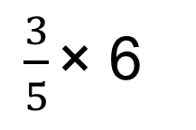
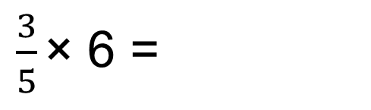
To be able to multiply fractions by integers
Talking Time:
Use the representation below to help you calculate
$\frac{3}{5}$ × 6
$\frac{3}{5}$ × 6 =

Slide 13
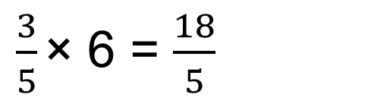
To be able to multiply fractions by integers
Talking Time:
Use the representation below to help you calculate
$\frac{3}{5}$ × 6
$\frac{3}{5}$ × 6 = $\frac{18}{5}$

Slide 14
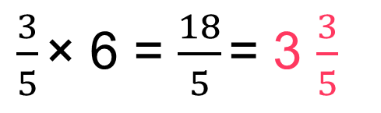
To be able to multiply fractions by integers
Talking Time:
Use the representation below to help you calculate
$\frac{3}{5}$ × 6
$\frac{3}{5}$ × 6 = $\frac{18}{5}$ = 3 $\frac{3}{5}$

Slide 15
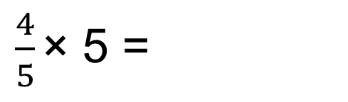
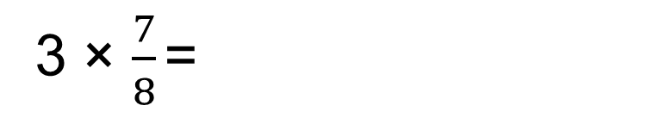
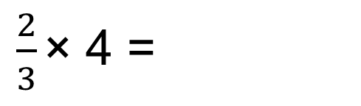
To be able to multiply fractions by integers
Activity 1:
Use the representations below to help you calculate the following…
$\frac{2}{3}$ × 4 =
$\frac{4}{5}$ × 5 =
3 × $\frac{7}{8}$ =
Notes:
Extend children by asking them to create their own number line / bar model / bar chart multiplying a fraction by an integer questions.

Slide 16
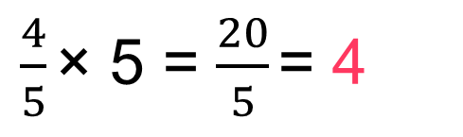
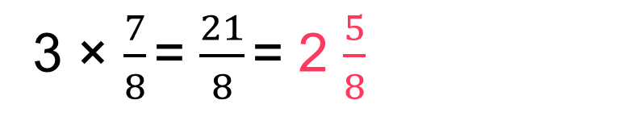
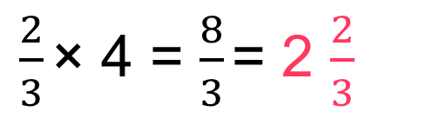
To be able to multiply fractions by integers
Activity 1:
Use the representations below to help you calculate the following…
$\frac{2}{3}$ × 4 = $\frac{8}{3}$ = 2 $\frac{2}{3}$
$\frac{4}{5}$ × 5 = $\frac{20}{5}$ = 4
3 × $\frac{7}{8}$ = $\frac{21}{8}$ = 2 $\frac{5}{8}$

Slide 17

To be able to multiply fractions by integers
Talking Time:
Yasmin uses partitioning to help her calculate
2 $\frac{3}{4}$ × 3 =

Slide 18

To be able to multiply fractions by integers
Talking Time:
Yasmin uses partitioning to help her calculate
2 $\frac{3}{4}$ × 3 =
2 × 3 = 6

Slide 19

To be able to multiply fractions by integers
Talking Time:
Yasmin uses partitioning to help her calculate
2 $\frac{3}{4}$ × 3 =
2 × 3 = 6
$\frac{3}{4}$ × 3 = $\frac{9}{4}$ = 2 $\frac{1}{4}$

Slide 20

To be able to multiply fractions by integers
Talking Time:
Yasmin uses partitioning to help her calculate
2 $\frac{3}{4}$ × 3 =
2 × 3 = 6
$\frac{3}{4}$ × 3 = $\frac{9}{4}$ = 2 $\frac{1}{4}$
6 + 2 $\frac{1}{4}$ = 8 $\frac{1}{4}$

Slide 21

To be able to multiply fractions by integers
Talking Time:
Yasmin uses partitioning to help her calculate
Use her strategy to calculate:
2 $\frac{3}{4}$ × 3 =
2 × 3 = 6
$\frac{3}{4}$ × 3 = $\frac{9}{4}$ = 2 $\frac{1}{4}$
6 + 2 $\frac{1}{4}$ = 8 $\frac{1}{4}$
2 $\frac{4}{5}$ × 3 =

Slide 22
To be able to multiply fractions by integers
Talking Time:
Yasmin uses partitioning to help her calculate
Use her strategy to calculate:
2 $\frac{3}{4}$ × 3 =
2 × 3 = 6
$\frac{3}{4}$ × 3 = $\frac{9}{4}$ = 2 $\frac{1}{4}$
6 + 2 $\frac{1}{4}$ = 8 $\frac{1}{4}$
2 $\frac{4}{5}$ × 3 =
2 × 3 = 6

Slide 23

To be able to multiply fractions by integers
Talking Time:
Yasmin uses partitioning to help her calculate
Use her strategy to calculate:
2 $\frac{3}{4}$ × 3 =
2 × 3 = 6
$\frac{3}{4}$ × 3 = $\frac{9}{4}$ = 2 $\frac{1}{4}$
6 + 2 $\frac{1}{4}$ = 8 $\frac{1}{4}$
2 $\frac{4}{5}$ × 3 =
2 × 3 = 6
$\frac{4}{5}$ × 3 = $\frac{12}{5}$ = 2 $\frac{2}{5}$

Slide 24

To be able to multiply fractions by integers
Talking Time:
Yasmin uses partitioning to help her calculate
Use her strategy to calculate:
2 $\frac{3}{4}$ × 3 =
2 × 3 = 6
$\frac{3}{4}$ × 3 = $\frac{9}{4}$ = 2 $\frac{1}{4}$
6 + 2 $\frac{1}{4}$ = 8 $\frac{1}{4}$
2 $\frac{4}{5}$ × 3 =
2 × 3 = 6
$\frac{4}{5}$ × 3 = $\frac{12}{5}$ = 2 $\frac{2}{5}$
6 + 2 $\frac{2}{5}$ = 8 $\frac{2}{5}$

Slide 25

To be able to multiply fractions by integers
Talking Time:
Yasmin uses partitioning to help her calculate
Use her strategy to calculate:
2 $\frac{3}{4}$ × 3 =
2 × 3 = 6
$\frac{3}{4}$ × 3 = $\frac{9}{4}$ = 2 $\frac{1}{4}$
6 + 2 $\frac{1}{4}$ = 8 $\frac{1}{4}$
3 $\frac{5}{6}$ × 4 =

Slide 26
To be able to multiply fractions by integers
Talking Time:
Yasmin uses partitioning to help her calculate
Use her strategy to calculate:
2 $\frac{3}{4}$ × 3 =
2 × 3 = 6
$\frac{3}{4}$ × 3 = $\frac{9}{4}$ = 2 $\frac{1}{4}$
6 + 2 $\frac{1}{4}$ = 8 $\frac{1}{4}$
3 $\frac{5}{6}$ × 4 =
3 × 4 = 12

Slide 27

To be able to multiply fractions by integers
Talking Time:
Yasmin uses partitioning to help her calculate
Use her strategy to calculate:
2 $\frac{3}{4}$ × 3 =
2 × 3 = 6
$\frac{3}{4}$ × 3 = $\frac{9}{4}$ = 2 $\frac{1}{4}$
6 + 2 $\frac{1}{4}$ = 8 $\frac{1}{4}$
3 $\frac{5}{6}$ × 4 =
3 × 4 = 12
$\frac{5}{6}$ × 4 = $\frac{20}{6}$ = 3 $\frac{2}{6}$ = 3 $\frac{1}{3}$

Slide 28

To be able to multiply fractions by integers
Talking Time:
Yasmin uses partitioning to help her calculate
Use her strategy to calculate:
2 $\frac{3}{4}$ × 3 =
2 × 3 = 6
$\frac{3}{4}$ × 3 = $\frac{9}{4}$ = 2 $\frac{1}{4}$
6 + 2 $\frac{1}{4}$ = 8 $\frac{1}{4}$
3 $\frac{5}{6}$ × 4 =
3 × 4 = 12
$\frac{5}{6}$ × 4 = $\frac{20}{6}$ = 3 $\frac{2}{6}$ = 3 $\frac{1}{3}$
12 + 3 $\frac{1}{3}$ = 15 $\frac{1}{3}$

Slide 29




To be able to multiply fractions by integers
2 × 3 = 6
$\frac{3}{4}$ × 3 = $\frac{9}{4}$ = 2 $\frac{1}{4}$
6 + 2 $\frac{1}{4}$ = 8 $\frac{1}{4}$
Activity 2:
Yasmin uses partitioning to help her calculate
Use her strategy to calculate:
2 $\frac{3}{4}$ × 3 =
3 $\frac{7}{8}$ × 3 =
2 $\frac{5}{7}$ × 8 =
4 × 2 $\frac{2}{6}$ =

Slide 30
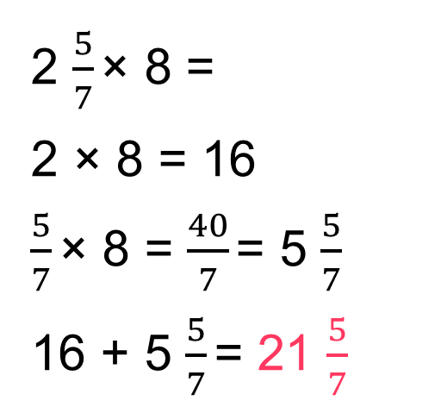
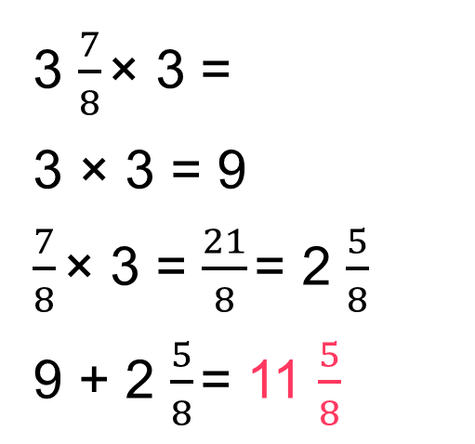

To be able to multiply fractions by integers
2 × 3 = 6
$\frac{3}{4}$ × 3 = $\frac{9}{4}$ = 2 $\frac{1}{4}$
6 + 2 $\frac{1}{4}$ = 8 $\frac{1}{4}$
Activity 2:
Yasmin uses partitioning to help her calculate
2 $\frac{3}{4}$ × 3 =
3 $\frac{7}{8}$ × 3 =
3 × 3 = 9
$\frac{7}{8}$ × 3 = $\frac{21}{8}$ = 2 $\frac{5}{8}$
9 + 2 $\frac{5}{8}$ = 11 $\frac{5}{8}$
2 $\frac{5}{7}$ × 8 =
2 × 8 = 16
$\frac{5}{7}$ × 8 = $\frac{40}{7}$ = 5 $\frac{5}{7}$
16 + 5 $\frac{5}{7}$ = 21 $\frac{5}{7}$
4 × 2 $\frac{2}{6}$ =
4 × 2 = 8
$\frac{2}{6}$ × 4 = $\frac{8}{6}$ = 1 $\frac{2}{6}$ = 1 $\frac{1}{3}$
8 + 1 $\frac{1}{3}$ = 9 $\frac{1}{3}$

Slide 31
To be able to multiply fractions by integers
Talking Time:
Ruth converts the mixed number to an improper fraction when multiplying mixed number by an integer.
For example:
3 $\frac{2}{5}$ × 3 =

Slide 32
To be able to multiply fractions by integers
Talking Time:
Ruth converts the mixed number to an improper fraction when multiplying mixed number by an integer.
For example:
3 $\frac{2}{5}$ × 3 = $\frac{17}{5}$ × 3 =

Slide 33
To be able to multiply fractions by integers
Talking Time:
Ruth converts the mixed number to an improper fraction when multiplying mixed number by an integer.
For example:
3 $\frac{2}{5}$ × 3 = $\frac{17}{5}$ × 3 = $\frac{51}{5}$ =

Slide 34
To be able to multiply fractions by integers
Talking Time:
Ruth converts the mixed number to an improper fraction when multiplying mixed number by an integer.
For example:
3 $\frac{2}{5}$ × 3 = $\frac{17}{5}$ × 3 = $\frac{51}{5}$ = 10$\frac{1}{5}$

Slide 35
To be able to multiply fractions by integers
Talking Time:
Ruth converts the mixed number to an improper fraction when multiplying mixed number by an integer.
For example:
Use her strategy to calculate:
3 $\frac{2}{5}$ × 3 = $\frac{17}{5}$ × 3 = $\frac{51}{5}$ = 10$\frac{1}{5}$
3 $\frac{5}{8}$ × 3 =

Slide 36
To be able to multiply fractions by integers
Talking Time:
Ruth converts the mixed number to an improper fraction when multiplying mixed number by an integer.
For example:
Use her strategy to calculate:
3 $\frac{2}{5}$ × 3 = $\frac{17}{5}$ × 3 = $\frac{51}{5}$ = 10$\frac{1}{5}$
3 $\frac{5}{8}$ × 3 = $\frac{29}{8}$ × 3 =

Slide 37
To be able to multiply fractions by integers
Talking Time:
Ruth converts the mixed number to an improper fraction when multiplying mixed number by an integer.
For example:
Use her strategy to calculate:
3 $\frac{2}{5}$ × 3 = $\frac{17}{5}$ × 3 = $\frac{51}{5}$ = 10$\frac{1}{5}$
3 $\frac{5}{8}$ × 3 = $\frac{29}{8}$ × 3 = $\frac{87}{8}$ =

Slide 38
To be able to multiply fractions by integers
Talking Time:
Ruth converts the mixed number to an improper fraction when multiplying mixed number by an integer.
For example:
Use her strategy to calculate:
3 $\frac{2}{5}$ × 3 = $\frac{17}{5}$ × 3 = $\frac{51}{5}$ = 10$\frac{1}{5}$
3 $\frac{5}{8}$ × 3 = $\frac{29}{8}$ × 3 = $\frac{87}{8}$ = 10$\frac{7}{8}$

Slide 39
To be able to multiply fractions by integers
Talking Time:
Ruth converts the mixed number to an improper fraction when multiplying mixed number by an integer.
For example:
Use her strategy to calculate:
3 $\frac{2}{5}$ × 3 = $\frac{17}{5}$ × 3 = $\frac{51}{5}$ = 10$\frac{1}{5}$
4 $\frac{3}{4}$ × 5 =

Slide 40
To be able to multiply fractions by integers
Talking Time:
Ruth converts the mixed number to an improper fraction when multiplying mixed number by an integer.
For example:
Use her strategy to calculate:
3 $\frac{2}{5}$ × 3 = $\frac{17}{5}$ × 3 = $\frac{51}{5}$ = 10$\frac{1}{5}$
4 $\frac{3}{4}$ × 5 = $\frac{19}{4}$ × 5 =

Slide 41
To be able to multiply fractions by integers
Talking Time:
Ruth converts the mixed number to an improper fraction when multiplying mixed number by an integer.
For example:
Use her strategy to calculate:
3 $\frac{2}{5}$ × 3 = $\frac{17}{5}$ × 3 = $\frac{51}{5}$ = 10$\frac{1}{5}$
4 $\frac{3}{4}$ × 5 = $\frac{19}{4}$ × 5 = $\frac{95}{4}$ =

Slide 42
To be able to multiply fractions by integers
Talking Time:
Ruth converts the mixed number to an improper fraction when multiplying mixed number by an integer.
For example:
Use her strategy to calculate:
3 $\frac{2}{5}$ × 3 = $\frac{17}{5}$ × 3 = $\frac{51}{5}$ = 10$\frac{1}{5}$
4 $\frac{3}{4}$ × 5 = $\frac{19}{4}$ × 5 = $\frac{95}{4}$ = 23$\frac{3}{4}$

Slide 43
To be able to multiply fractions by integers
Activity 3:
Use Ruth’s strategy to calculate the following:
Ex.
.
.
.
3 $\frac{2}{5}$ × 3 = $\frac{17}{5}$ × 3 = $\frac{51}{5}$ = 10$\frac{1}{5}$
3 × 3 $\frac{3}{5}$ =
2 $\frac{3}{7}$ × 4 =
3 $\frac{1}{6}$ × 3 =

Slide 44
To be able to multiply fractions by integers
Activity 3:
Use Ruth’s strategy to calculate the following:
Ex.
.
.
.
3 $\frac{2}{5}$ × 3 = $\frac{17}{5}$ × 3 = $\frac{51}{5}$ = 10$\frac{1}{5}$
3 × 3 $\frac{3}{5}$ = $\frac{18}{5}$ × 3 = $\frac{54}{5}$ = 10$\frac{4}{5}$
2 $\frac{3}{7}$ × 4 = $\frac{17}{7}$ × 4 = $\frac{68}{7}$ = 9$\frac{5}{7}$
3 $\frac{1}{6}$ × 3 = $\frac{19}{6}$ × 3 = $\frac{57}{6}$ = 9$\frac{3}{6}$ = 9$\frac{1}{2}$

Slide 45
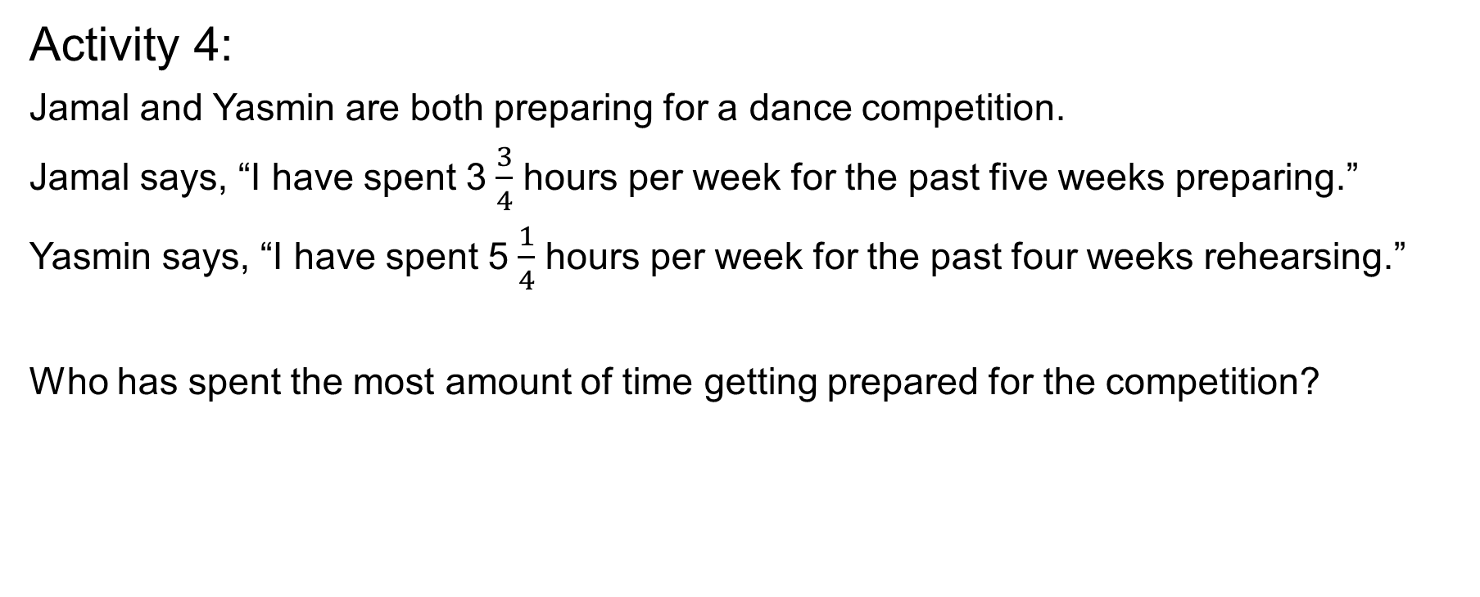
To be able to multiply fractions by integers
Activity 4:
Jamal and Yasmin are both preparing for a dance competition.
Jamal says, “I have spent 3$\frac{3}{4}$ hours per week for the past five weeks preparing.”
Yasmin says, “I have spent 5$\frac{1}{4}$ hours per week for the past four weeks rehearsing.”
Who has spent the most amount of time getting prepared for the competition?
Notes:
Extend children by asking them to write their own word problems.

Slide 46
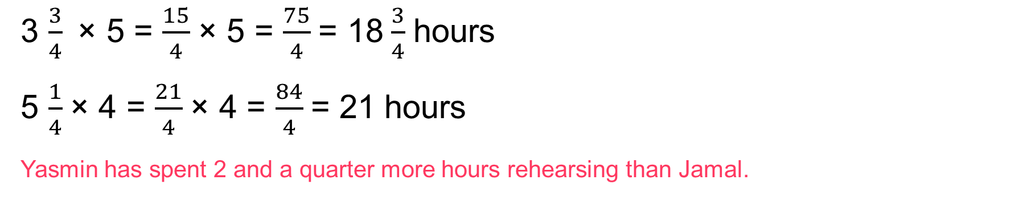
To be able to multiply fractions by integers
Activity 4:
Jamal and Yasmin are both preparing for a dance competition.
Jamal says, “I have spent 3$\frac{3}{4}$ hours per week for the past five weeks preparing.”
Yasmin says, “I have spent 5$\frac{1}{4}$ hours per week for the past four weeks rehearsing.”
Who has spent the most amount of time getting prepared for the competition?
3 $\frac{3}{4}$ × 5 = $\frac{15}{4}$ × 5 = $\frac{75}{4}$ = 18$\frac{3}{4}$ hours
5 $\frac{1}{4}$ × 4 = $\frac{21}{4}$ × 4 = $\frac{84}{4}$ = 21 hours
Yasmin has spent 2 and a quarter more hours rehearsing than Jamal.

Slide 47
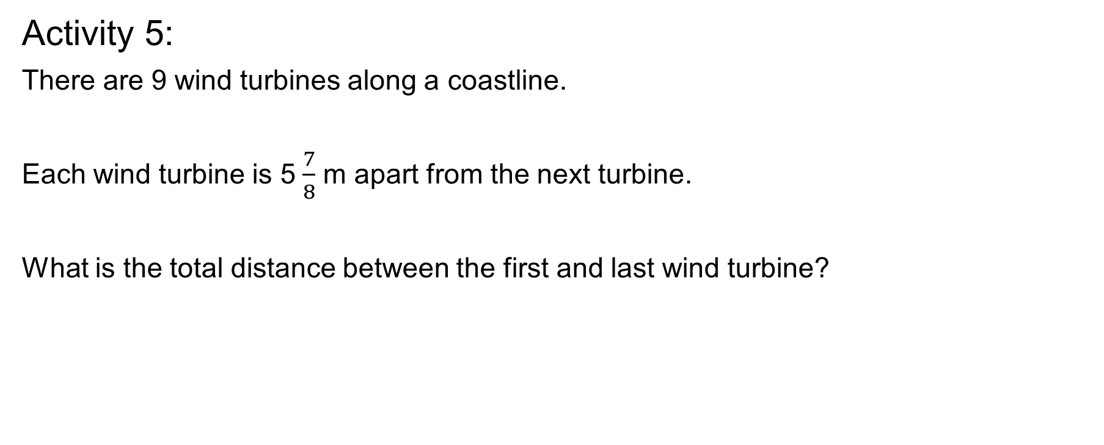
To be able to multiply fractions by integers
Activity 5:
There are 9 wind turbines along a coastline.
Each wind turbine is 5$\frac{7}{8}$ m apart from the next turbine.
What is the total distance between the first and last wind turbine?
Notes:
Extend children by asking them to write their own word problems.

Slide 48

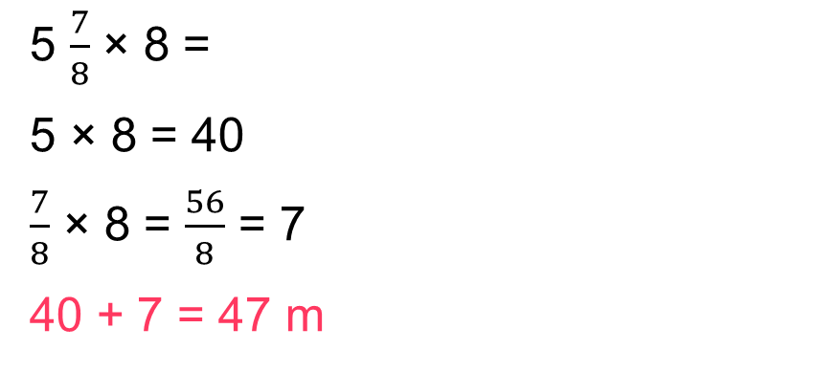
To be able to multiply fractions by integers
Activity 5:
There are 9 wind turbines along a coastline.
Each wind turbine is 5$\frac{7}{8}$ m apart from the next turbine.
What is the total distance between the first and last wind turbine?
5 $\frac{7}{8}$ × 8 = $\frac{47}{8}$ × 8 = $\frac{376}{8}$ = 47 m
5 $\frac{7}{8}$ × 8 =
5 × 8 = 40
$\frac{7}{8}$ × 8 = $\frac{56}{8}$ = 7
40 + 7 = 47 m
Notes:
Have they noticed a link between the numbers within the calculation?
(The numerator for the improper fraction is the same as the final result. Why?
We have multiplied, then divided by the same number, 8.
Extend children by asking them to write their own word problems.

Slide 49
To be able to multiply fractions by integers
Evaluation:
Is Astrobee’s statement always, sometimes or never true?
Provide examples to explain your answer.
If you multiply a mixed number by a whole number, the resulting mixed number will have a greater value.

Slide 50
To be able to multiply fractions by integers
Evaluation:
Astrobee’s statement is sometimes true (most of the time!); however, if you multiply a mixed number by 1, its value will remain the same.
For example:
If you multiply a mixed number by a whole number, the resulting mixed number will have a greater value.
3 $\frac{1}{3}$ × 1 = $\frac{10}{3}$ × 1 = $\frac{10}{3}$ = 3 $\frac{1}{3}$

Slide 51
To be able to multiply fractions by integers
Success criteria:
I can use pictorial representations and various strategies, including partitioning and converting between mixed numbers and improper fractions, to multiply fractions and mixed numbers by integers
I can explain my reasoning when using pictorial representations and various strategies, including partitioning and converting between mixed numbers and improper fractions, to multiply fractions and mixed numbers by integers

