Slide 1




Quiz: QRIHFBI
Stage 6
Autumn Block 3: Fractions A
Lesson 1: To be able to simplify fractions
Autumn
Block 3 – Fractions A
1

Slide 2
To be able to simplify fractions
Success criteria:
I can use my knowledge of finding the highest common factor to simplify fractions, building on my knowledge of equivalent fractions
I can explain my reasoning when using my knowledge of finding the highest common factor to simplify fractions, building on my knowledge of equivalent fractions

Slide 3




To be able to simplify fractions
Starter:
Which one doesn’t belong?
Explain your answer.

Slide 4
To be able to simplify fractions
Starter:
Which one doesn’t belong?
The purple and white cylinder stack doesn’t belong as 2 of the 6 (or a third) of the pieces are purple, whereas the other representations each show a different part of a quarter (2 of the 8 cubes are pink; 3 of the 12 counters are red).

Slide 5

To be able to simplify fractions
Talking Time:
If Ruth eats $\frac{1}{2}$ of the apples and Jamal eats $\frac{4}{8}$ of the apples, who eats the most apples?

Slide 6
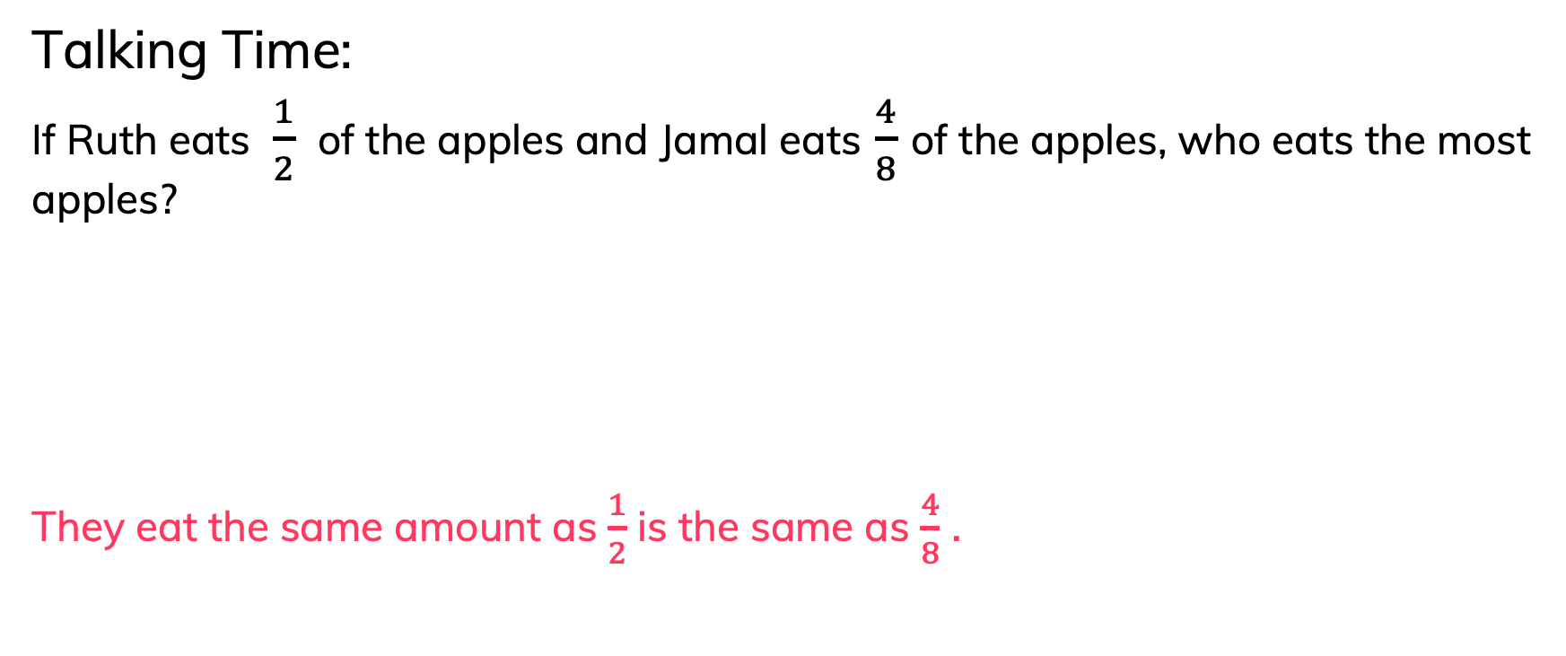
To be able to simplify fractions
Talking Time:
If Ruth eats $\frac{1}{2}$ of the apples and Jamal eats $\frac{4}{8}$ of the apples, who eats the most apples?
They eat the same amount as $\frac{1}{2}$ is the same as $\frac{4}{8}$ .

Slide 7
To be able to simplify fractions
Talking Time:
Looking at the models below, how many counters are equal in value to a cube?
Explain your answer.

Slide 8

To be able to simplify fractions
Talking Time:
Looking at the models below, how many counters are equal in value to a cube?
A cube is worth 2 counters, as $\frac{1}{4}$ cubes are red, whilst $\frac{2}{8}$ counters are red.

Slide 9
To be able to simplify fractions
Talking Time:
What’s the same and what’s different about the bar models below?

Slide 10
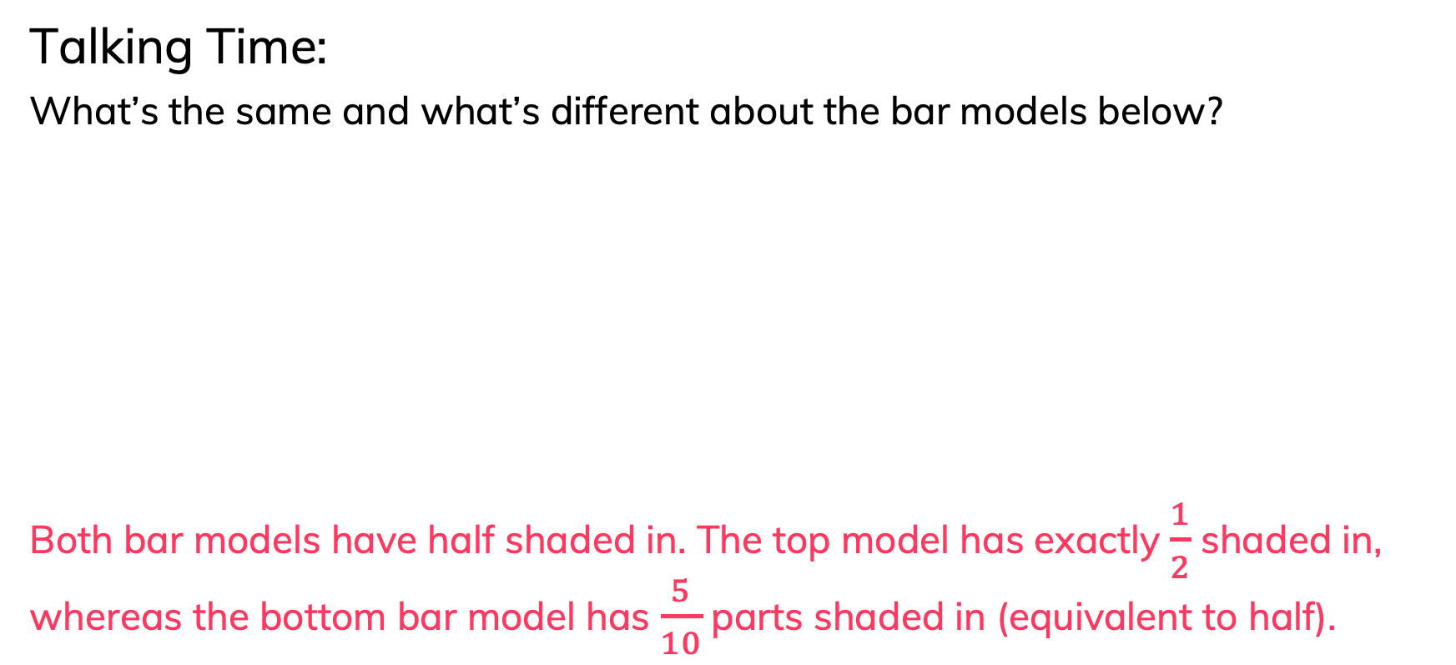
To be able to simplify fractions
Talking Time:
What’s the same and what’s different about the bar models below?
Both bar models have half shaded in. The top model has exactly $\frac{1}{2}$ shaded in, whereas the bottom bar model has $\frac{5}{10}$ parts shaded in (equivalent to half).

Slide 11
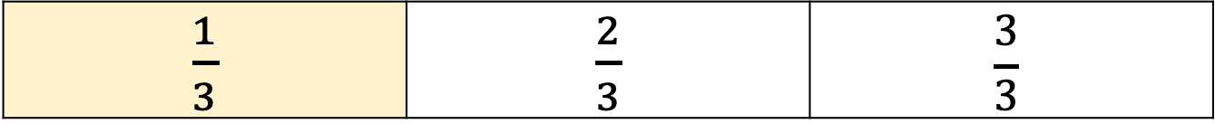
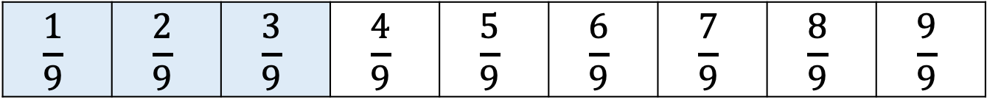
To be able to simplify fractions
Talking Time:
What’s the same and what’s different about the bar models below?
$\frac{1}{3}$ | $\frac{2}{3}$ | $$\frac{3}{3}$$
$$\frac{1}{9}$$ | $$\frac{2}{9}$$ | $$\frac{3}{9}$$ | $$\frac{4}{9}$$ | $$\frac{5}{9}$$ | $$\frac{6}{9}$$ | $$\frac{7}{9}$$ | $$\frac{8}{9}$$ | $$\frac{9}{9}$$

Slide 12
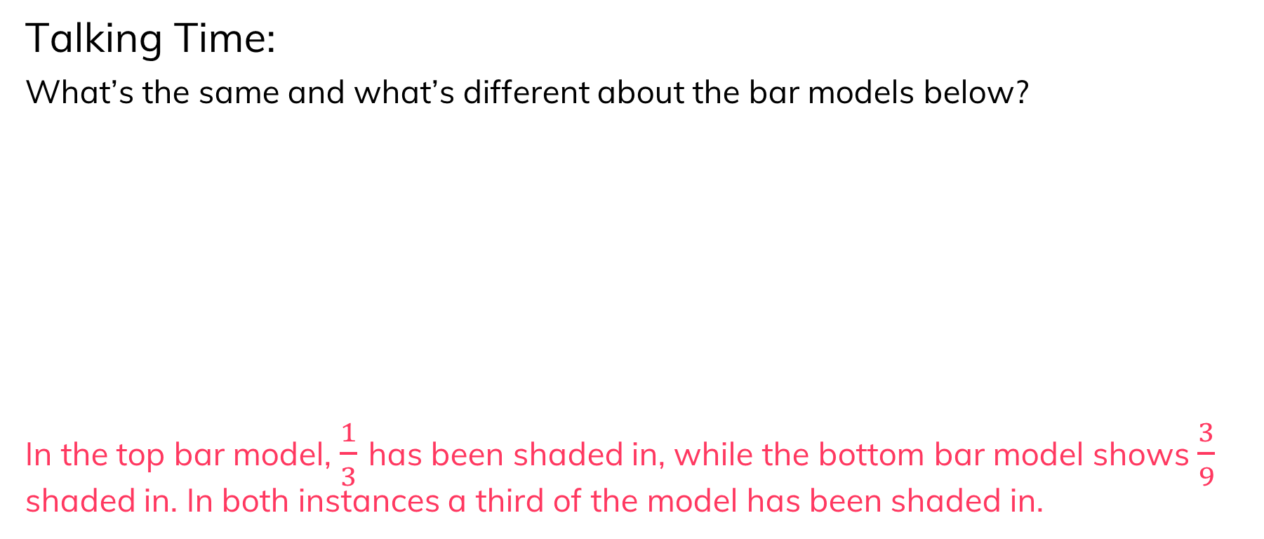
To be able to simplify fractions
Talking Time:
What’s the same and what’s different about the bar models below?
In the top bar model, $\frac{1}{3}$ has been shaded in, while the bottom bar model shows $\frac{3}{9}$ shaded in. In both instances a third of the model has been shaded in.
$\frac{1}{3}$ | $\frac{2}{3}$ | $$\frac{3}{3}$$
$$\frac{1}{9}$$ | $$\frac{2}{9}$$ | $$\frac{3}{9}$$ | $$\frac{4}{9}$$ | $$\frac{5}{9}$$ | $$\frac{6}{9}$$ | $$\frac{7}{9}$$ | $$\frac{8}{9}$$ | $$\frac{9}{9}$$

Slide 13
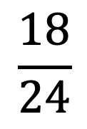
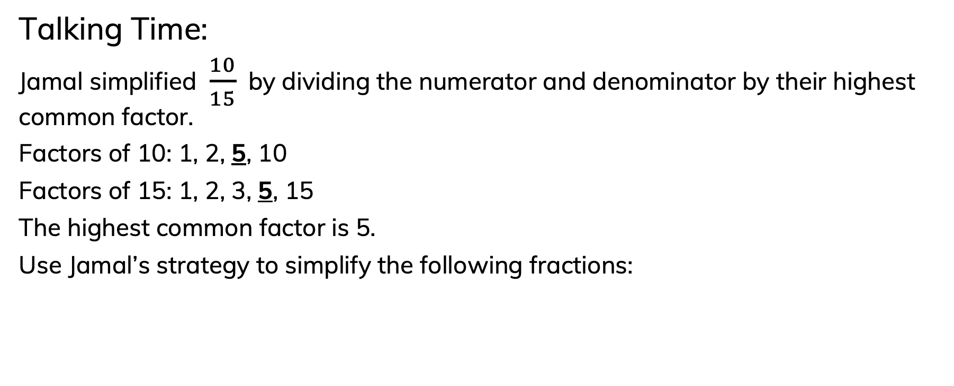
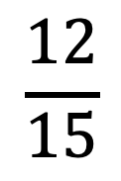
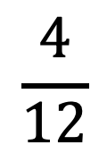

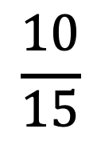
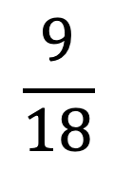
To be able to simplify fractions
Talking Time:
Jamal simplified $\frac{10}{15}$ by dividing the numerator and denominator by their highest common factor.
Factors of 10: 1, 2, 5, 10
Factors of 15: 1, 2, 3, 5, 15
The highest common factor is 5.
Use Jamal’s strategy to simplify the following fractions:
÷ 5
$$\frac{10}{15}$$
$$\frac{2}{3}$$
÷ 5
$$\frac{4}{12}$$
$$\frac{12}{15}$$
$$\frac{18}{24}$$
$$\frac{9}{18}$$

Slide 14

To be able to simplify fractions
Talking Time:
Jamal simplified $\frac{10}{15}$ by dividing the numerator and denominator by their highest common factor.
Factors of 10: 1, 2, 5, 10
Factors of 15: 1, 2, 3, 5, 15
The highest common factor is 5.
Use Jamal’s strategy to simplify the following fractions:
÷ 5
$$\frac{10}{15}$$
$$\frac{2}{3}$$
÷ 5
÷ 4
$$\frac{4}{12}$$
$$\frac{1}{3}$$
$$\frac{12}{15}$$
$$\frac{18}{24}$$
$$\frac{9}{18}$$
÷ 4

Slide 15

To be able to simplify fractions
Talking Time:
Jamal simplified $\frac{10}{15}$ by dividing the numerator and denominator by their highest common factor.
Factors of 10: 1, 2, 5, 10
Factors of 15: 1, 2, 3, 5, 15
The highest common factor is 5.
Use Jamal’s strategy to simplify the following fractions:
÷ 5
$$\frac{10}{15}$$
$$\frac{2}{3}$$
÷ 5
÷ 4
÷ 3
$$\frac{4}{12}$$
$$\frac{1}{3}$$
$$\frac{12}{15}$$
$$\frac{4}{5}$$
$$\frac{18}{24}$$
$$\frac{9}{18}$$
÷ 4
÷ 3

Slide 16

To be able to simplify fractions
Talking Time:
Jamal simplified $\frac{10}{15}$ by dividing the numerator and denominator by their highest common factor.
Factors of 10: 1, 2, 5, 10
Factors of 15: 1, 2, 3, 5, 15
The highest common factor is 5.
Use Jamal’s strategy to simplify the following fractions:
÷ 5
$$\frac{10}{15}$$
$$\frac{2}{3}$$
÷ 5
÷ 4
÷ 3
÷ 6
$$\frac{4}{12}$$
$$\frac{1}{3}$$
$$\frac{12}{15}$$
$$\frac{4}{5}$$
$$\frac{18}{24}$$
$$\frac{3}{4}$$
$$\frac{9}{18}$$
÷ 4
÷ 3
÷ 6

Slide 17

To be able to simplify fractions
Talking Time:
Jamal simplified $\frac{10}{15}$ by dividing the numerator and denominator by their highest common factor.
Factors of 10: 1, 2, 5, 10
Factors of 15: 1, 2, 3, 5, 15
The highest common factor is 5.
Use Jamal’s strategy to simplify the following fractions:
÷ 5
$$\frac{10}{15}$$
$$\frac{2}{3}$$
÷ 5
÷ 4
÷ 3
÷ 6
÷ 9
$$\frac{4}{12}$$
$$\frac{1}{3}$$
$$\frac{12}{15}$$
$$\frac{4}{5}$$
$$\frac{18}{24}$$
$$\frac{3}{4}$$
$$\frac{9}{18}$$
$$\frac{1}{2}$$
÷ 4
÷ 3
÷ 6
÷ 9

Slide 18
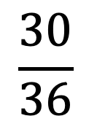
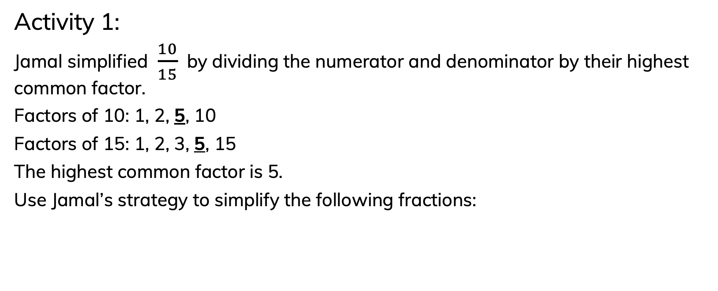
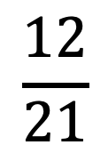
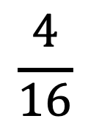
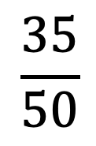
To be able to simplify fractions
Activity 1:
Jamal simplified $\frac{10}{15}$ by dividing the numerator and denominator by their highest common factor.
Factors of 10: 1, 2, 5, 10
Factors of 15: 1, 2, 3, 5, 15
The highest common factor is 5.
Use Jamal’s strategy to simplify the following fractions:
÷ 5
$$\frac{10}{15}$$
$$\frac{2}{3}$$
÷ 5
$$\frac{4}{16}$$
$$\frac{12}{21}$$
$$\frac{30}{36}$$
$$\frac{35}{50}$$

Slide 19
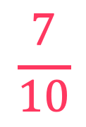



To be able to simplify fractions
Activity 1:
Jamal simplified $\frac{10}{15}$ by dividing the numerator and denominator by their highest common factor.
Factors of 10: 1, 2, 5, 10
Factors of 15: 1, 2, 3, 5, 15
The highest common factor is 5.
Use Jamal’s strategy to simplify the following fractions:
÷ 5
$$\frac{10}{15}$$
$$\frac{2}{3}$$
÷ 5
÷ 4
÷ 3
÷ 6
÷ 5
$$\frac{4}{16}$$
$$\frac{1}{4}$$
$$\frac{12}{21}$$
$$\frac{4}{7}$$
$$\frac{30}{36}$$
$$\frac{5}{6}$$
$$\frac{35}{50}$$
$$\frac{7}{10}$$
÷ 4
÷ 3
÷ 6
÷ 5

Slide 20
To be able to simplify fractions
Talking Time:
What’s the same and what’s different about the bar models below?
$$1$$ | $$2$$ | $$3$$
$$1$$ | $$2$$ | 2$\frac{1}{3}$ | 2$\frac{2}{3}$ | 2$\frac{3}{3}$
$$1$$ | $$2$$ | 2$\frac{1}{6}$ | 2$\frac{2}{6}$ | 2$\frac{3}{6}$ | 2$\frac{4}{6}$ | 2$\frac{5}{6}$ | 2$\frac{6}{6}$

Slide 21

To be able to simplify fractions
Talking Time:
What’s the same and what’s different about the bar models below?
Both of the two bar models have the same amount shaded in, the yellow bar model has 2$\frac{2}{3}$ shaded in, while the blue bar model has 2$\frac{4}{6}$ shaded in.
$$1$$ | $$2$$ | $$3$$
$$1$$ | $$2$$ | 2$\frac{1}{3}$ | 2$\frac{2}{3}$ | 2$\frac{3}{3}$
$$1$$ | $$2$$ | 2$\frac{1}{6}$ | 2$\frac{2}{6}$ | 2$\frac{3}{6}$ | 2$\frac{4}{6}$ | 2$\frac{5}{6}$ | 2$\frac{6}{6}$
. T

Slide 22
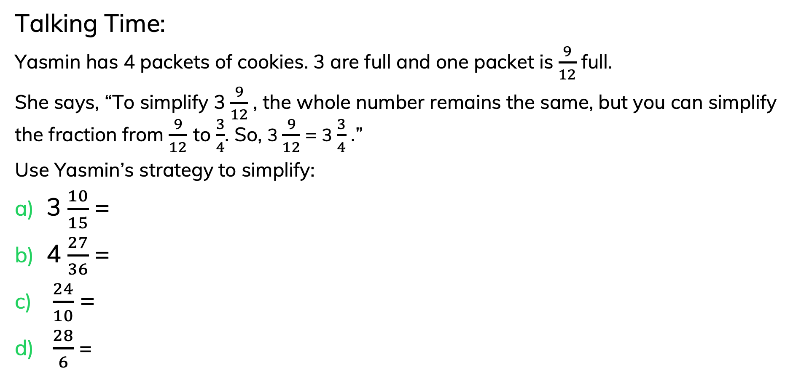
To be able to simplify fractions
Talking Time:
Yasmin has 4 packets of cookies. 3 are full and one packet is $\frac{9}{12}$ full.
She says, “To simplify 3 $\frac{9}{12}$ , the whole number remains the same, but you can simplify the fraction from $\frac{9}{12}$ to $\frac{3}{4}$. So, 3 $\frac{9}{12}$ = 3 $\frac{3}{4}$ .”
Use Yasmin’s strategy to simplify:
3 $\frac{10}{15}$ =
4 $\frac{27}{36}$ =
$\frac{24}{10}$ =
$\frac{28}{6}$ =

Slide 23
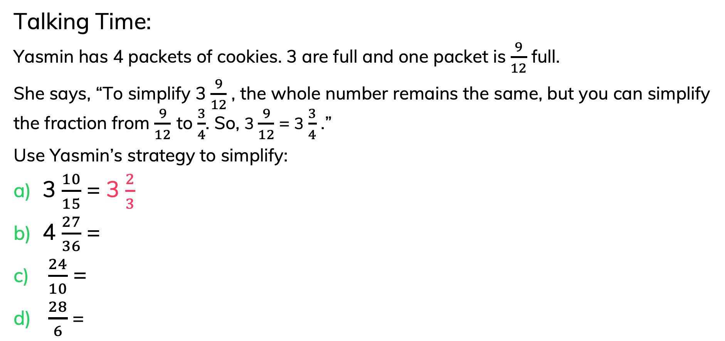
To be able to simplify fractions
Talking Time:
Yasmin has 4 packets of cookies. 3 are full and one packet is $\frac{9}{12}$ full.
She says, “To simplify 3 $\frac{9}{12}$ , the whole number remains the same, but you can simplify the fraction from $\frac{9}{12}$ to $\frac{3}{4}$. So, 3 $\frac{9}{12}$ = 3 $\frac{3}{4}$ .”
Use Yasmin’s strategy to simplify:
3 $\frac{10}{15}$ = 3 $\frac{2}{3}$
4 $\frac{27}{36}$ =
$\frac{24}{10}$ =
$\frac{28}{6}$ =

Slide 24
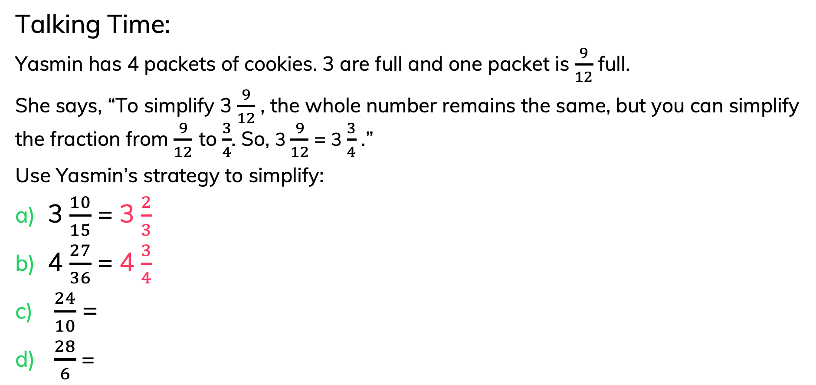
To be able to simplify fractions
Talking Time:
Yasmin has 4 packets of cookies. 3 are full and one packet is $\frac{9}{12}$ full.
She says, “To simplify 3 $\frac{9}{12}$ , the whole number remains the same, but you can simplify the fraction from $\frac{9}{12}$ to $\frac{3}{4}$. So, 3 $\frac{9}{12}$ = 3 $\frac{3}{4}$ .”
Use Yasmin’s strategy to simplify:
3 $\frac{10}{15}$ = 3 $\frac{2}{3}$
4 $\frac{27}{36}$ = 4 $\frac{3}{4}$
$\frac{24}{10}$ =
$\frac{28}{6}$ =

Slide 25
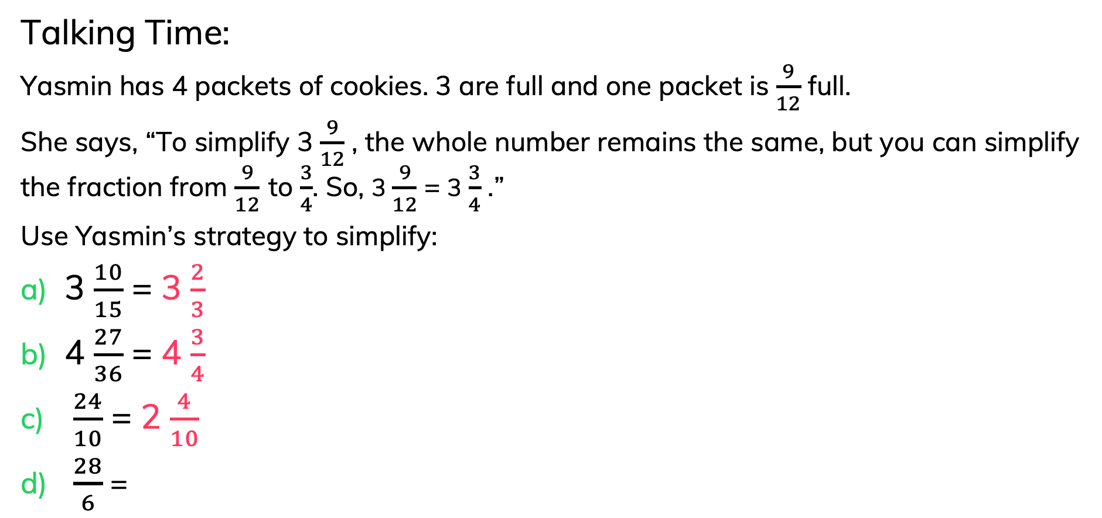
To be able to simplify fractions
Talking Time:
Yasmin has 4 packets of cookies. 3 are full and one packet is $\frac{9}{12}$ full.
She says, “To simplify 3 $\frac{9}{12}$ , the whole number remains the same, but you can simplify the fraction from $\frac{9}{12}$ to $\frac{3}{4}$. So, 3 $\frac{9}{12}$ = 3 $\frac{3}{4}$ .”
Use Yasmin’s strategy to simplify:
3 $\frac{10}{15}$ = 3 $\frac{2}{3}$
4 $\frac{27}{36}$ = 4 $\frac{3}{4}$
$\frac{24}{10}$ = 2 $\frac{4}{10}$
$\frac{28}{6}$ =

Slide 26
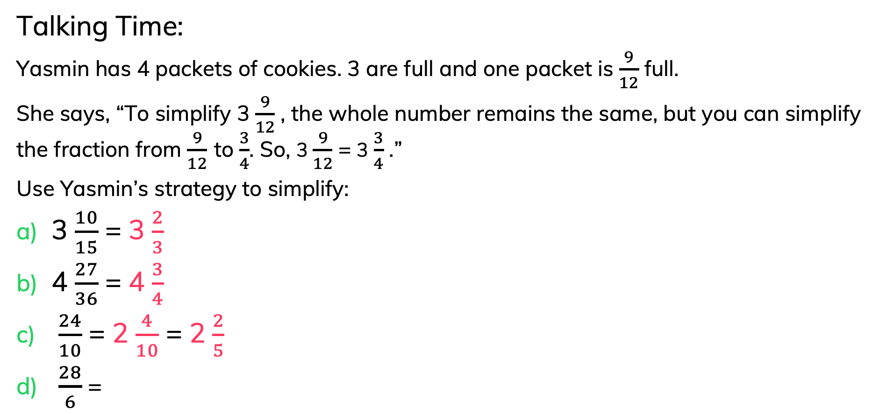
To be able to simplify fractions
Talking Time:
Yasmin has 4 packets of cookies. 3 are full and one packet is $\frac{9}{12}$ full.
She says, “To simplify 3 $\frac{9}{12}$ , the whole number remains the same, but you can simplify the fraction from $\frac{9}{12}$ to $\frac{3}{4}$. So, 3 $\frac{9}{12}$ = 3 $\frac{3}{4}$ .”
Use Yasmin’s strategy to simplify:
3 $\frac{10}{15}$ = 3 $\frac{2}{3}$
4 $\frac{27}{36}$ = 4 $\frac{3}{4}$
$\frac{24}{10}$ = 2 $\frac{4}{10}$ = 2 $\frac{2}{5}$
$\frac{28}{6}$ =

Slide 27
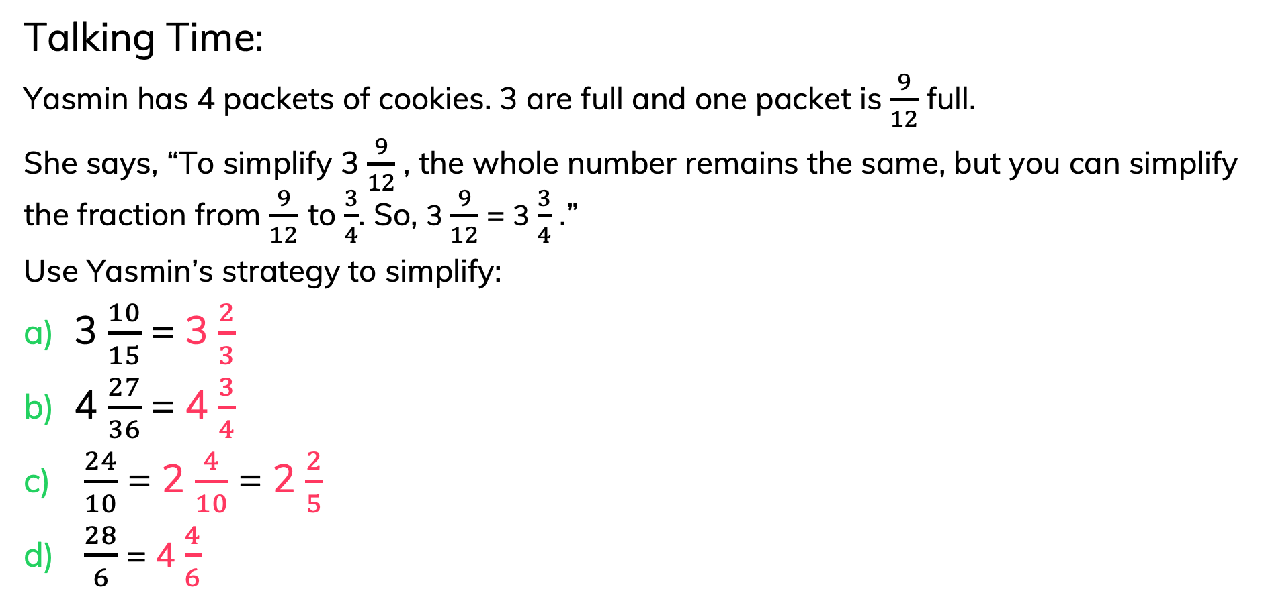
To be able to simplify fractions
Talking Time:
Yasmin has 4 packets of cookies. 3 are full and one packet is $\frac{9}{12}$ full.
She says, “To simplify 3 $\frac{9}{12}$ , the whole number remains the same, but you can simplify the fraction from $\frac{9}{12}$ to $\frac{3}{4}$. So, 3 $\frac{9}{12}$ = 3 $\frac{3}{4}$ .”
Use Yasmin’s strategy to simplify:
3 $\frac{10}{15}$ = 3 $\frac{2}{3}$
4 $\frac{27}{36}$ = 4 $\frac{3}{4}$
$\frac{24}{10}$ = 2 $\frac{4}{10}$ = 2 $\frac{2}{5}$
$\frac{28}{6}$ = 4 $\frac{4}{6}$

Slide 28
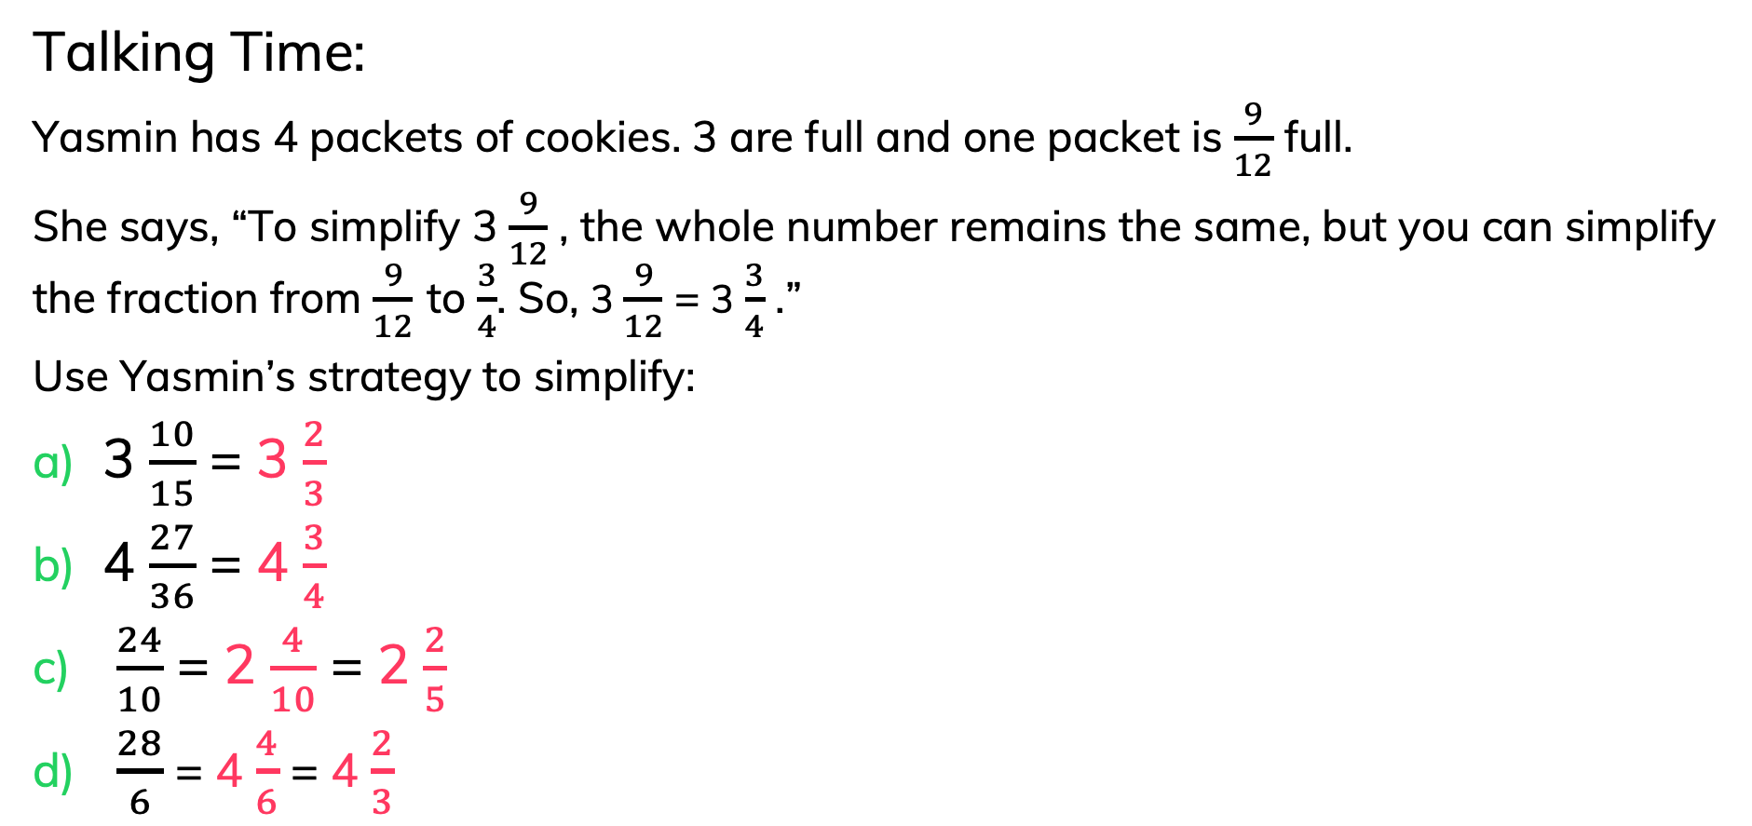
To be able to simplify fractions
Talking Time:
Yasmin has 4 packets of cookies. 3 are full and one packet is $\frac{9}{12}$ full.
She says, “To simplify 3 $\frac{9}{12}$ , the whole number remains the same, but you can simplify the fraction from $\frac{9}{12}$ to $\frac{3}{4}$. So, 3 $\frac{9}{12}$ = 3 $\frac{3}{4}$ .”
Use Yasmin’s strategy to simplify:
3 $\frac{10}{15}$ = 3 $\frac{2}{3}$
4 $\frac{27}{36}$ = 4 $\frac{3}{4}$
$\frac{24}{10}$ = 2 $\frac{4}{10}$ = 2 $\frac{2}{5}$
$\frac{28}{6}$ = 4 $\frac{4}{6}$ = 4 $\frac{2}{3}$

Slide 29

To be able to simplify fractions
Activity 2:
Yasmin has 4 packets of cookies. 3 are full and one packet is $\frac{9}{12}$ full.
She says, “To simplify 3 $\frac{9}{12}$ , the whole number remains the same, but you can simplify the fraction from $\frac{9}{12}$ to $\frac{3}{4}$. So, 3 $\frac{9}{12}$ = 3 $\frac{3}{4}$ .”
Use Yasmin’s strategy to simplify:
3 $\frac{12}{15}$ =
4 $\frac{27}{45}$ =
$\frac{36}{10}$ =
$\frac{34}{8}$ =

Slide 30
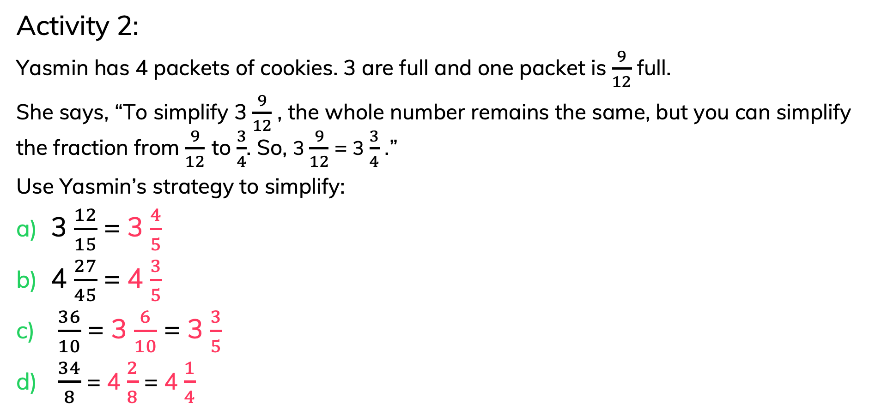
To be able to simplify fractions
Activity 2:
Yasmin has 4 packets of cookies. 3 are full and one packet is $\frac{9}{12}$ full.
She says, “To simplify 3 $\frac{9}{12}$ , the whole number remains the same, but you can simplify the fraction from $\frac{9}{12}$ to $\frac{3}{4}$. So, 3 $\frac{9}{12}$ = 3 $\frac{3}{4}$ .”
Use Yasmin’s strategy to simplify:
3 $\frac{12}{15}$ = 3 $\frac{4}{5}$
4 $\frac{27}{45}$ = 4 $\frac{3}{5}$
$\frac{36}{10}$ = 3 $\frac{6}{10}$ = 3 $\frac{3}{5}$
$\frac{34}{8}$ = 4 $\frac{2}{8}$ = 4 $\frac{1}{4}$

Slide 31
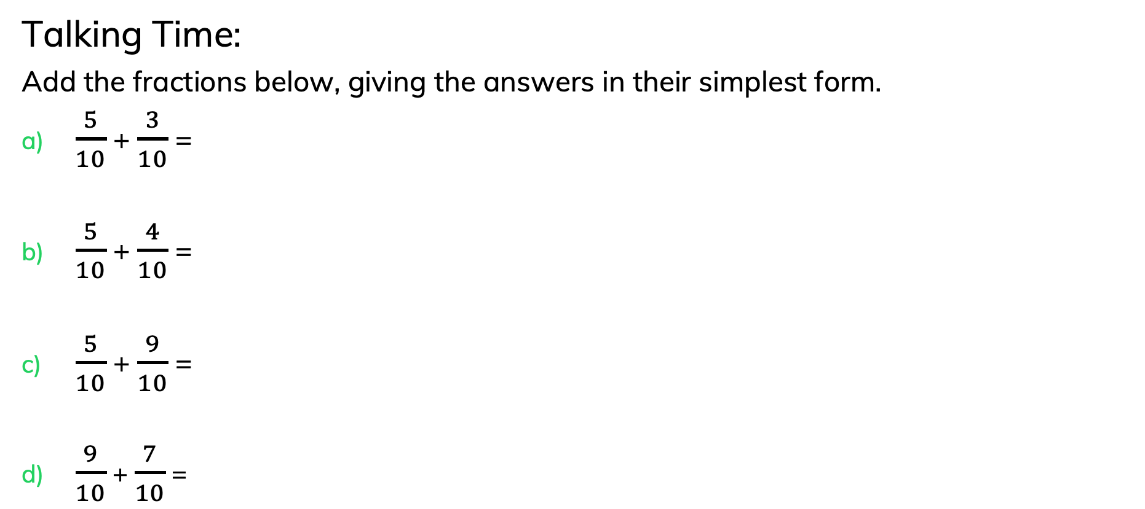
To be able to simplify fractions
Talking Time:
Add the fractions below, giving the answers in their simplest form.
$\frac{5}{10}$ + $\frac{3}{10}$ =
$\frac{5}{10}$ + $\frac{4}{10}$ =
$\frac{5}{10}$ + $\frac{9}{10}$ =
$\frac{9}{10}$ + $\frac{7}{10}$ =
Do they all need to be simplified?
Explain your answer.

Slide 32
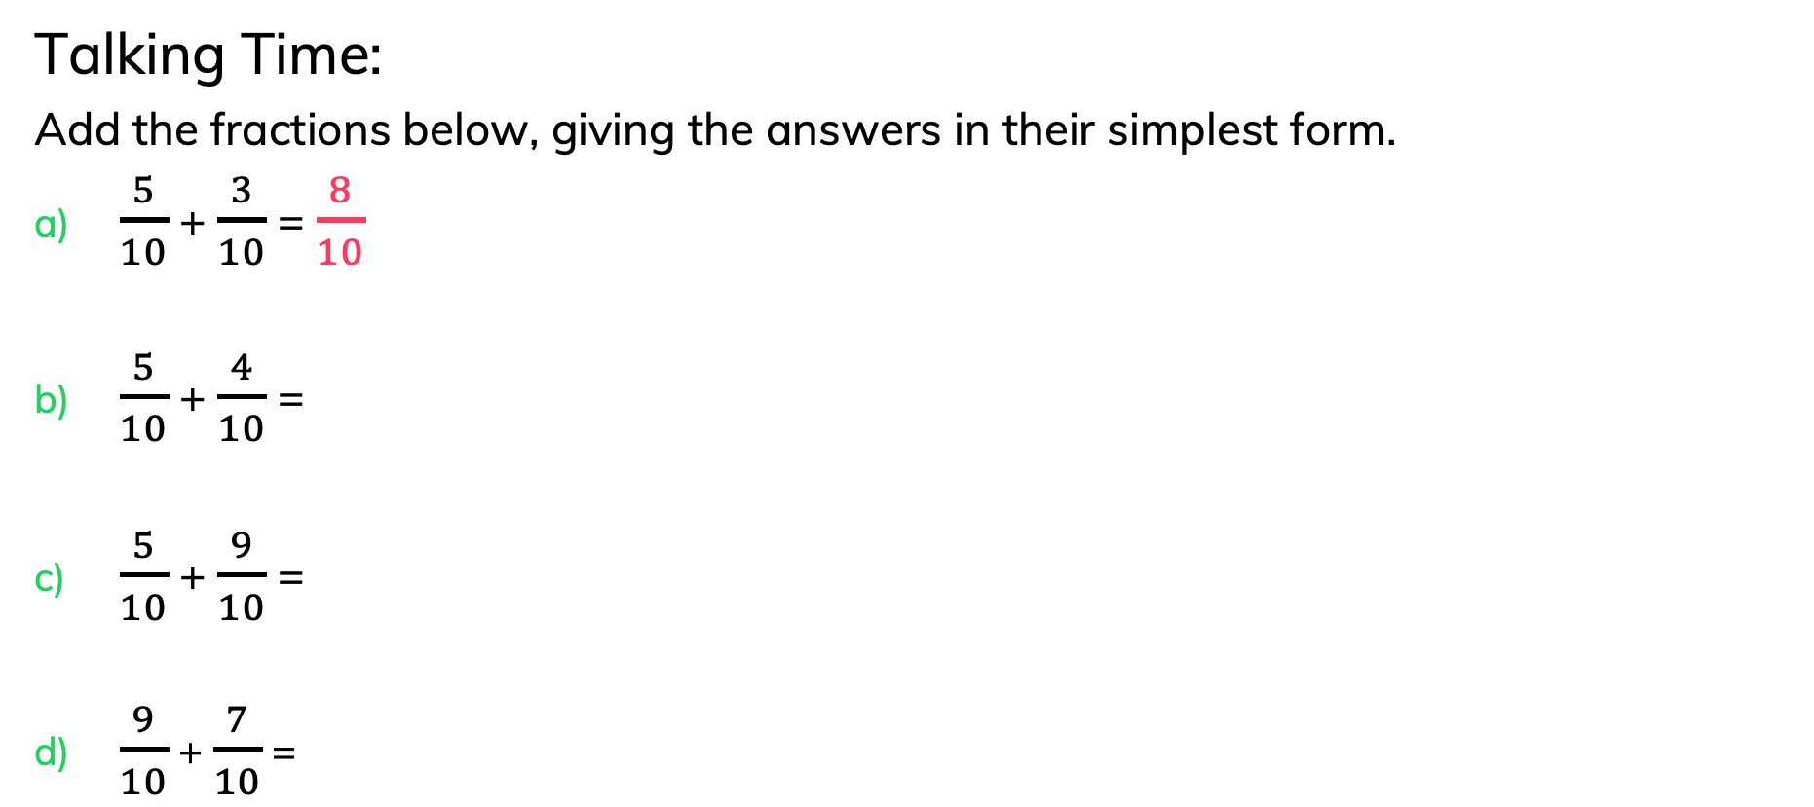
To be able to simplify fractions
Talking Time:
Add the fractions below, giving the answers in their simplest form.
$\frac{5}{10}$ + $\frac{3}{10}$ = $\frac{8}{10}$
$\frac{5}{10}$ + $\frac{4}{10}$ =
$\frac{5}{10}$ + $\frac{9}{10}$ =
$\frac{9}{10}$ + $\frac{7}{10}$ =
Do they all need to be simplified?
Explain your answer.

Slide 33
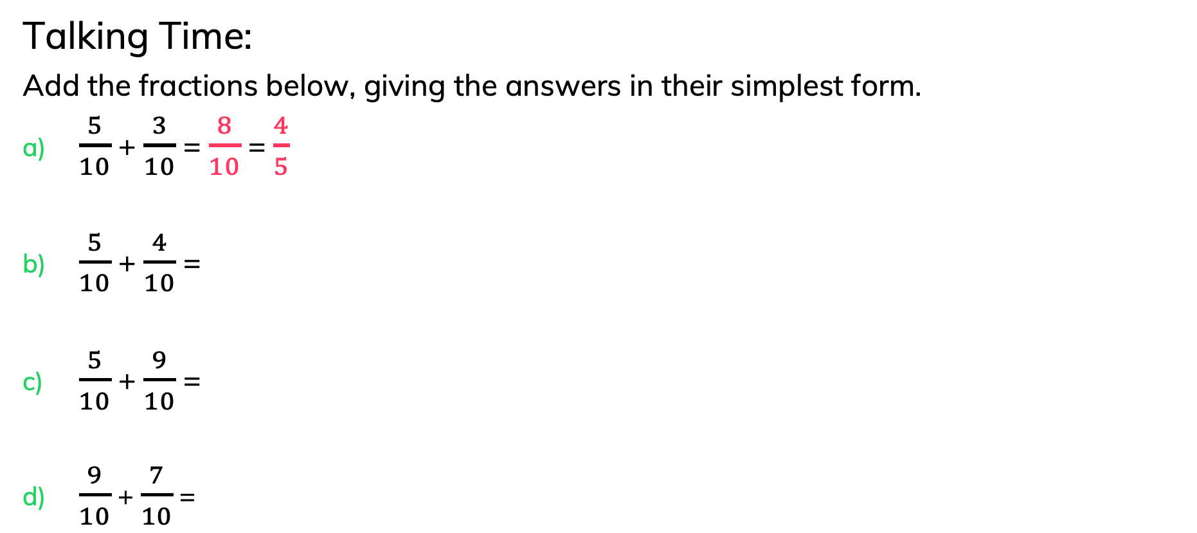
To be able to simplify fractions
Talking Time:
Add the fractions below, giving the answers in their simplest form.
$\frac{5}{10}$ + $\frac{3}{10}$ = $\frac{8}{10}$ = $\frac{4}{5}$
$\frac{5}{10}$ + $\frac{4}{10}$ =
$\frac{5}{10}$ + $\frac{9}{10}$ =
$\frac{9}{10}$ + $\frac{7}{10}$ =
Do they all need to be simplified?
Explain your answer.

Slide 34
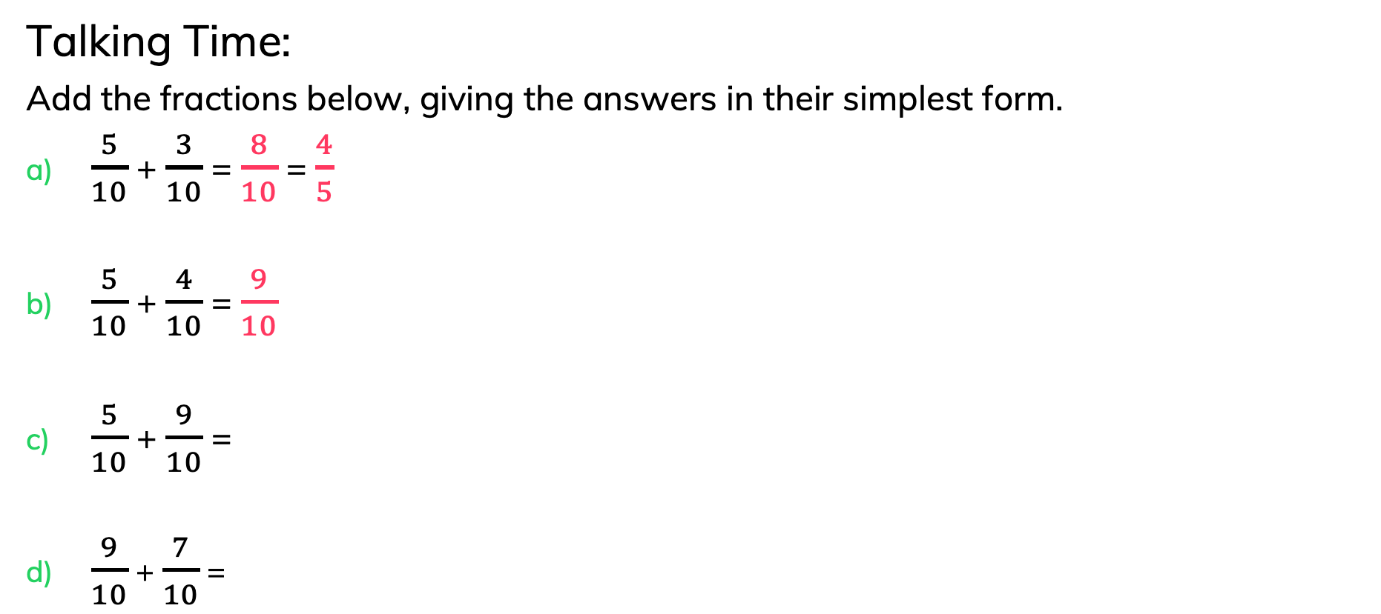
To be able to simplify fractions
Talking Time:
Add the fractions below, giving the answers in their simplest form.
$\frac{5}{10}$ + $\frac{3}{10}$ = $\frac{8}{10}$ = $\frac{4}{5}$
$\frac{5}{10}$ + $\frac{4}{10}$ = $\frac{9}{10}$
$\frac{5}{10}$ + $\frac{9}{10}$ =
$\frac{9}{10}$ + $\frac{7}{10}$ =
Do they all need to be simplified?
Explain your answer.

Slide 35
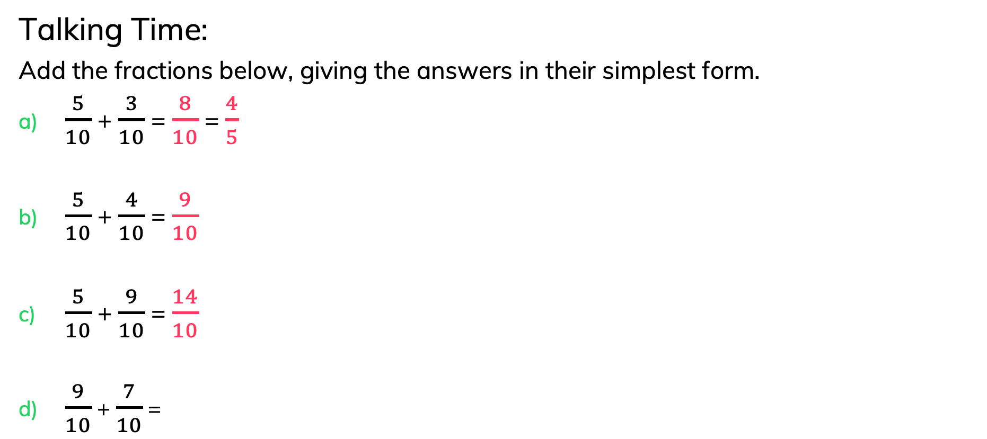
To be able to simplify fractions
Talking Time:
Add the fractions below, giving the answers in their simplest form.
$\frac{5}{10}$ + $\frac{3}{10}$ = $\frac{8}{10}$ = $\frac{4}{5}$
$\frac{5}{10}$ + $\frac{4}{10}$ = $\frac{9}{10}$
$\frac{5}{10}$ + $\frac{9}{10}$ = $\frac{14}{10}$
$\frac{9}{10}$ + $\frac{7}{10}$ =
Do they all need to be simplified?
Explain your answer.

Slide 36
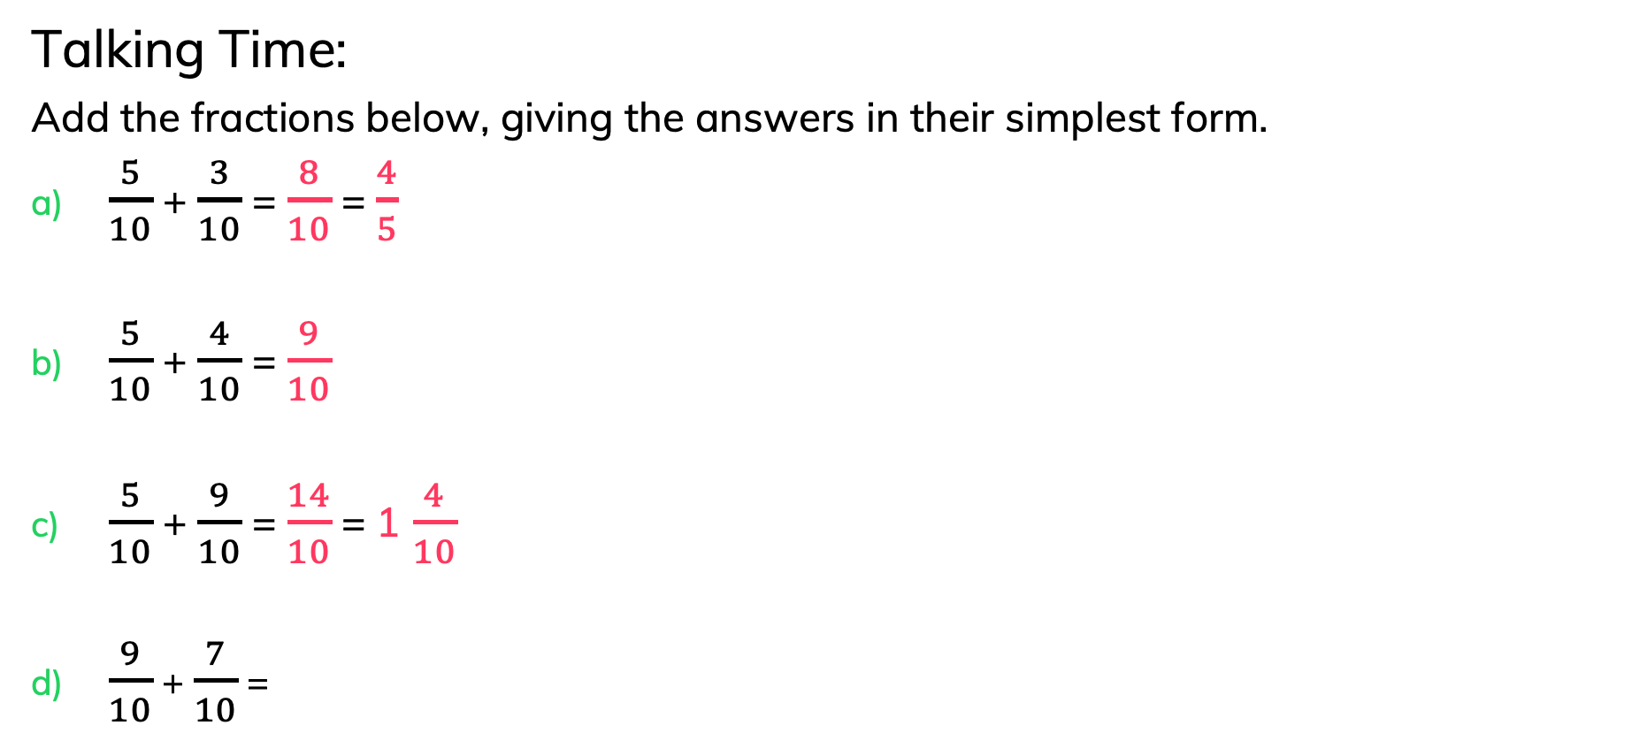
To be able to simplify fractions
Talking Time:
Add the fractions below, giving the answers in their simplest form.
$\frac{5}{10}$ + $\frac{3}{10}$ = $\frac{8}{10}$ = $\frac{4}{5}$
$\frac{5}{10}$ + $\frac{4}{10}$ = $\frac{9}{10}$
$\frac{5}{10}$ + $\frac{9}{10}$ = $\frac{14}{10}$ = 1 $\frac{4}{10}$
$\frac{9}{10}$ + $\frac{7}{10}$ =
Do they all need to be simplified?
Explain your answer.

Slide 37
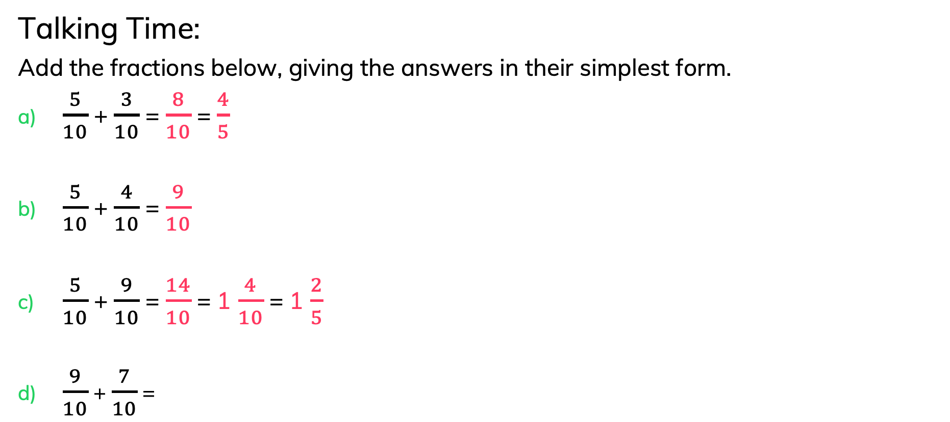
To be able to simplify fractions
Talking Time:
Add the fractions below, giving the answers in their simplest form.
$\frac{5}{10}$ + $\frac{3}{10}$ = $\frac{8}{10}$ = $\frac{4}{5}$
$\frac{5}{10}$ + $\frac{4}{10}$ = $\frac{9}{10}$
$\frac{5}{10}$ + $\frac{9}{10}$ = $\frac{14}{10}$ = 1 $\frac{4}{10}$ = 1 $\frac{2}{5}$
$\frac{9}{10}$ + $\frac{7}{10}$ =
Do they all need to be simplified?
Explain your answer.

Slide 38
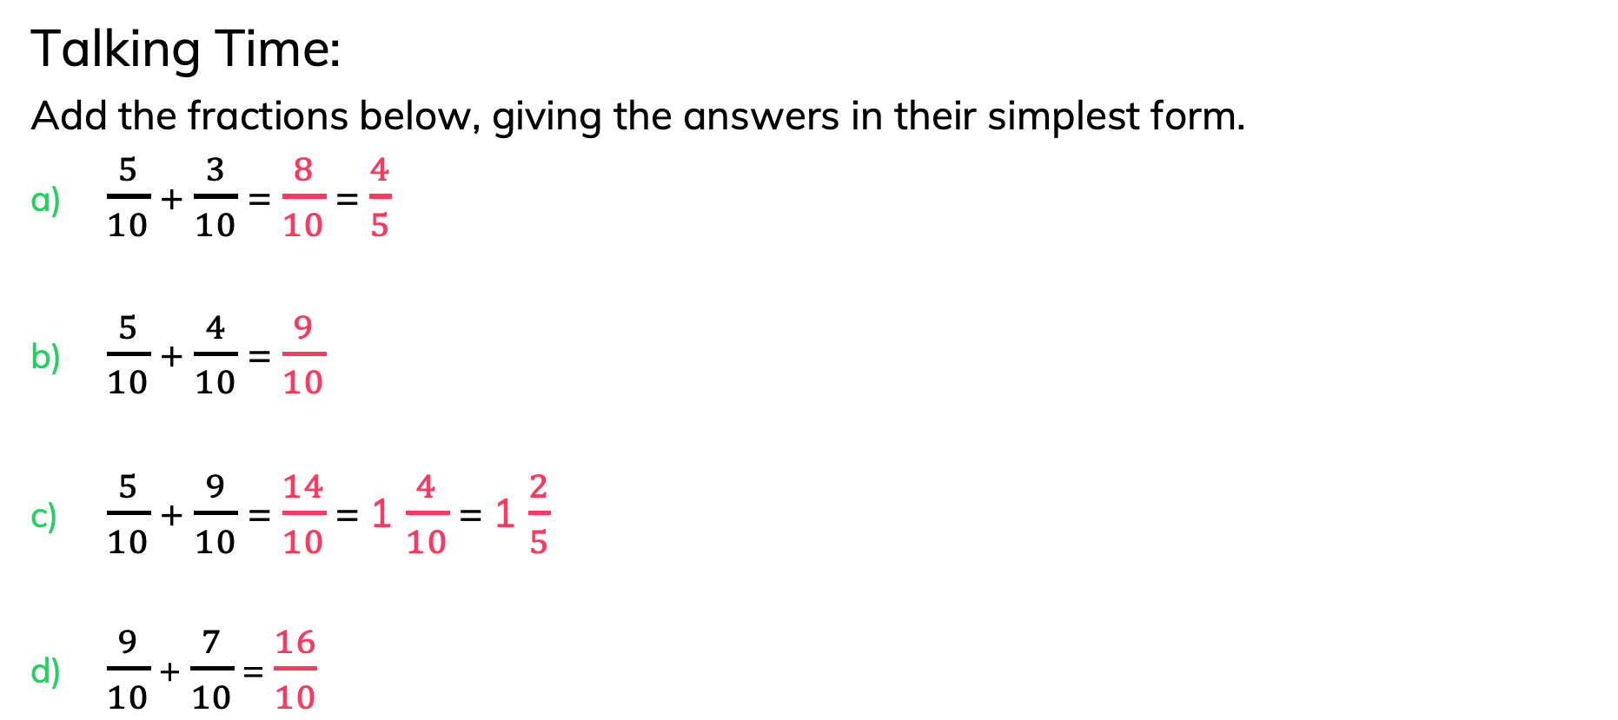
To be able to simplify fractions
Talking Time:
Add the fractions below, giving the answers in their simplest form.
$\frac{5}{10}$ + $\frac{3}{10}$ = $\frac{8}{10}$ = $\frac{4}{5}$
$\frac{5}{10}$ + $\frac{4}{10}$ = $\frac{9}{10}$
$\frac{5}{10}$ + $\frac{9}{10}$ = $\frac{14}{10}$ = 1 $\frac{4}{10}$ = 1 $\frac{2}{5}$
$\frac{9}{10}$ + $\frac{7}{10}$ = $\frac{16}{10}$
Do they all need to be simplified?
Explain your answer.

Slide 39
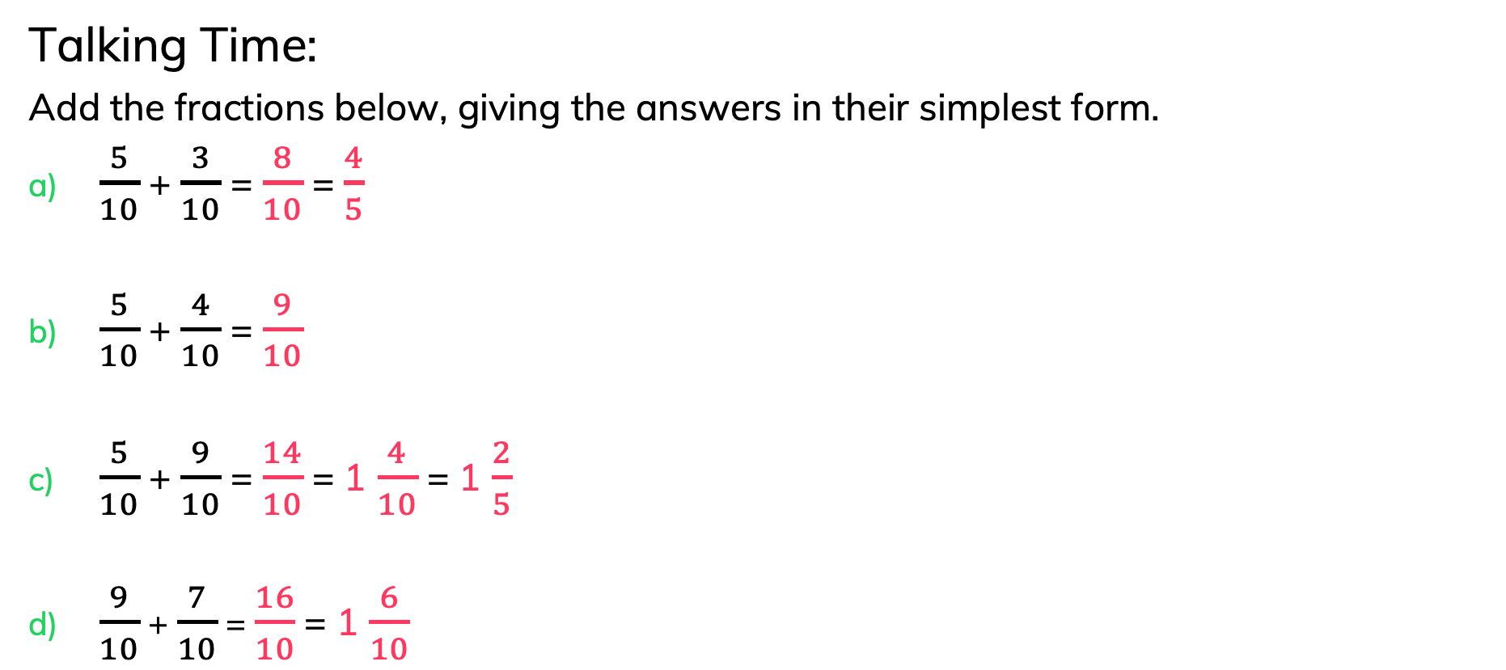
To be able to simplify fractions
Talking Time:
Add the fractions below, giving the answers in their simplest form.
$\frac{5}{10}$ + $\frac{3}{10}$ = $\frac{8}{10}$ = $\frac{4}{5}$
$\frac{5}{10}$ + $\frac{4}{10}$ = $\frac{9}{10}$
$\frac{5}{10}$ + $\frac{9}{10}$ = $\frac{14}{10}$ = 1 $\frac{4}{10}$ = 1 $\frac{2}{5}$
$\frac{9}{10}$ + $\frac{7}{10}$ = $\frac{16}{10}$ = 1 $\frac{6}{10}$
Do they all need to be simplified?
Explain your answer.

Slide 40
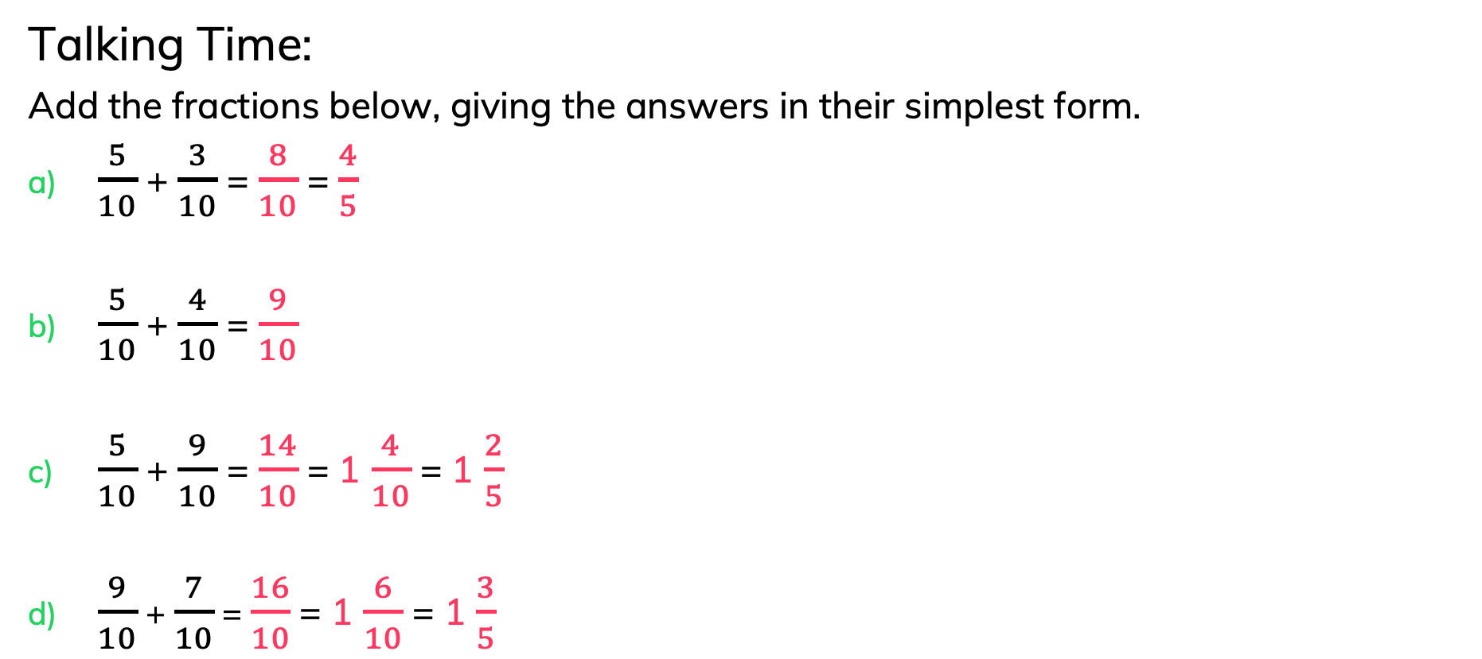
To be able to simplify fractions
Talking Time:
Add the fractions below, giving the answers in their simplest form.
$\frac{5}{10}$ + $\frac{3}{10}$ = $\frac{8}{10}$ = $\frac{4}{5}$
$\frac{5}{10}$ + $\frac{4}{10}$ = $\frac{9}{10}$
$\frac{5}{10}$ + $\frac{9}{10}$ = $\frac{14}{10}$ = 1 $\frac{4}{10}$ = 1 $\frac{2}{5}$
$\frac{9}{10}$ + $\frac{7}{10}$ = $\frac{16}{10}$ = 1 $\frac{6}{10}$ = 1 $\frac{3}{5}$
Do they all need to be simplified?
Explain your answer.

Slide 41
To be able to simplify fractions
Talking Time:
Add the fractions below, giving the answers in their simplest form.
$\frac{5}{10}$ + $\frac{3}{10}$ = $\frac{8}{10}$ = $\frac{4}{5}$
$\frac{5}{10}$ + $\frac{4}{10}$ = $\frac{9}{10}$
$\frac{5}{10}$ + $\frac{9}{10}$ = $\frac{14}{10}$ = 1 $\frac{4}{10}$ = 1 $\frac{2}{5}$
$\frac{9}{10}$ + $\frac{7}{10}$ = $\frac{16}{10}$ = 1 $\frac{6}{10}$ = 1 $\frac{3}{5}$
b) doesn’t need to be simplified as
9 and 10’s highest common factor is 1.

Slide 42

To be able to simplify fractions
Activity 3:
Add the fractions below, giving the answers in their simplest form.
$\frac{5}{12}$ + $\frac{3}{12}$ =
$\frac{7}{12}$ + $\frac{4}{12}$ =
$\frac{5}{12}$ + $\frac{9}{12}$ =
$\frac{9}{12}$ + $\frac{7}{12}$ =
Do they all need to be simplified?
Explain your answer.

Slide 43
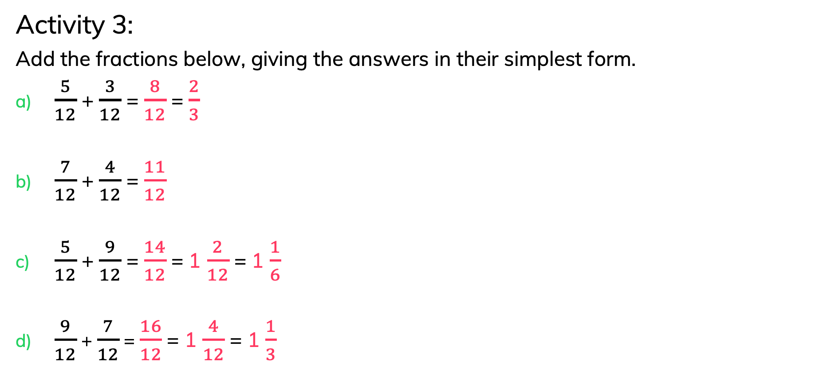
To be able to simplify fractions
Activity 3:
Add the fractions below, giving the answers in their simplest form.
$\frac{5}{12}$ + $\frac{3}{12}$ = $\frac{8}{12}$ = $\frac{2}{3}$
$\frac{7}{12}$ + $\frac{4}{12}$ = $\frac{11}{12}$
$\frac{5}{12}$ + $\frac{9}{12}$ = $\frac{14}{12}$ = 1 $\frac{2}{12}$ = 1 $\frac{1}{6}$
$\frac{9}{12}$ + $\frac{7}{12}$ = $\frac{16}{12}$ = 1 $\frac{4}{12}$ = 1 $\frac{1}{3}$
b) doesn’t need to be simplified as
11 and 12’s highest common factor is 1.

Slide 44

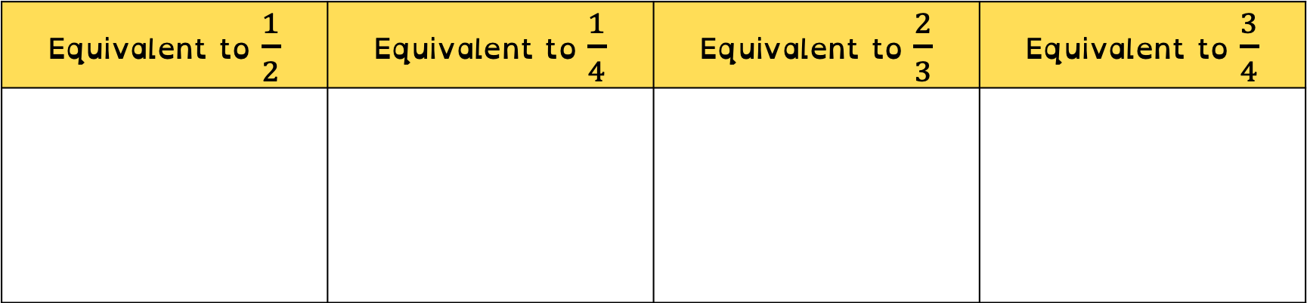







To be able to simplify fractions
Activity 4:
Place the fraction cards in the correct column.
Equivalent to $\frac{1}{2}$ | Equivalent to $\frac{1}{4}$ | Equivalent to $\frac{2}{3}$ | Equivalent to $\frac{3}{4}$
$\frac{4}{8}$
$\frac{3}{12}$
$\frac{18}{24}$
$\frac{10}{15}$
$\frac{10}{20}$
$\frac{12}{48}$
$\frac{27}{36}$
$\frac{22}{33}$

Slide 45








To be able to simplify fractions
Activity 4:
Place the fraction cards in the correct column.
Equivalent to $\frac{1}{2}$ | Equivalent to $\frac{1}{4}$ | Equivalent to $\frac{2}{3}$ | Equivalent to $\frac{3}{4}$
$\frac{4}{8}$
$\frac{10}{20}$
$\frac{3}{12}$
$\frac{12}{48}$
$\frac{10}{15}$
$\frac{22}{33}$
$\frac{18}{24}$
$\frac{27}{36}$

Slide 46

To be able to simplify fractions
Evaluation:
Is Astrobee correct?
Explain your answer.
If you simplify 4 $\frac{20}{25}$ , you will get 1 $\frac{4}{5}$ .

Slide 47

To be able to simplify fractions
Evaluation:
Astrobee has simplified the fraction correctly, as 20 and 25’s highest common factor is 5; however, the whole number should stay the same, but Astrobee has reduced the whole number from 4 to 1. The correct simplification is 4 $\frac{4}{5}$ .
If you simplify 4 $\frac{20}{25}$ , you will get 1 $\frac{4}{5}$ .

Slide 48
To be able to simplify fractions
Success criteria:
I can use my knowledge of finding the highest common factor to simplify fractions, building on my knowledge of equivalent fractions
I can explain my reasoning when using my knowledge of finding the highest common factor to simplify fractions, building on my knowledge of equivalent fractions

