Slide 1




Stage 3
Autumn Block 2: Addition and Subtraction
Lesson 1: To be able to apply number bonds within 10
Autumn
Block 2 – Addition and Subtraction
1

Slide 2
To be able to apply number bonds within 10
Success criteria:
I can use mathematical equipment and pictorial representations to apply my knowledge of number bonds within 10
I can explain my reasoning when using mathematical equipment, pictorial and abstract representations when applying my knowledge of number bonds within 10

Slide 3
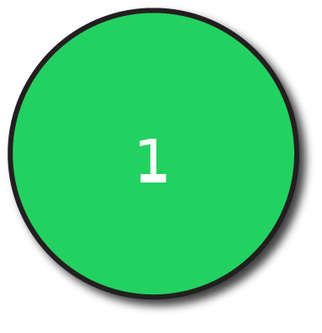
To be able to apply number bonds within 10
Starter:
What’s the same? What’s different?
Explain your answer.
+ =
__ ones + __ ones = __ ones
+ =
__ ones + __ ones = __ ones

Slide 4
To be able to apply number bonds within 10
Starter:
What’s the same? What’s different?
The sums are the same; however, the addends are different in each number sentence. So, they represent different number bonds to 7.
+ =
__ ones + __ ones = __ ones
+ =
__ ones + __ ones = __ ones
4
3
7
5
2
7

Slide 5

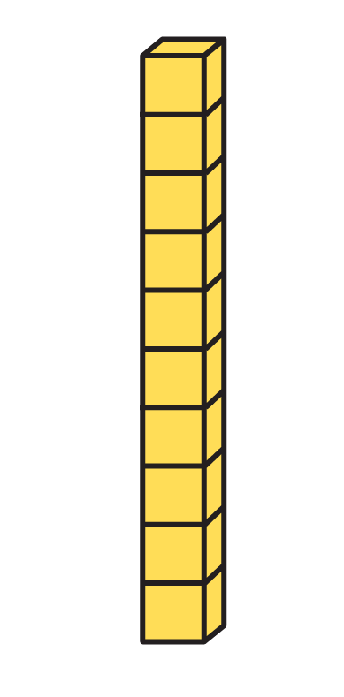
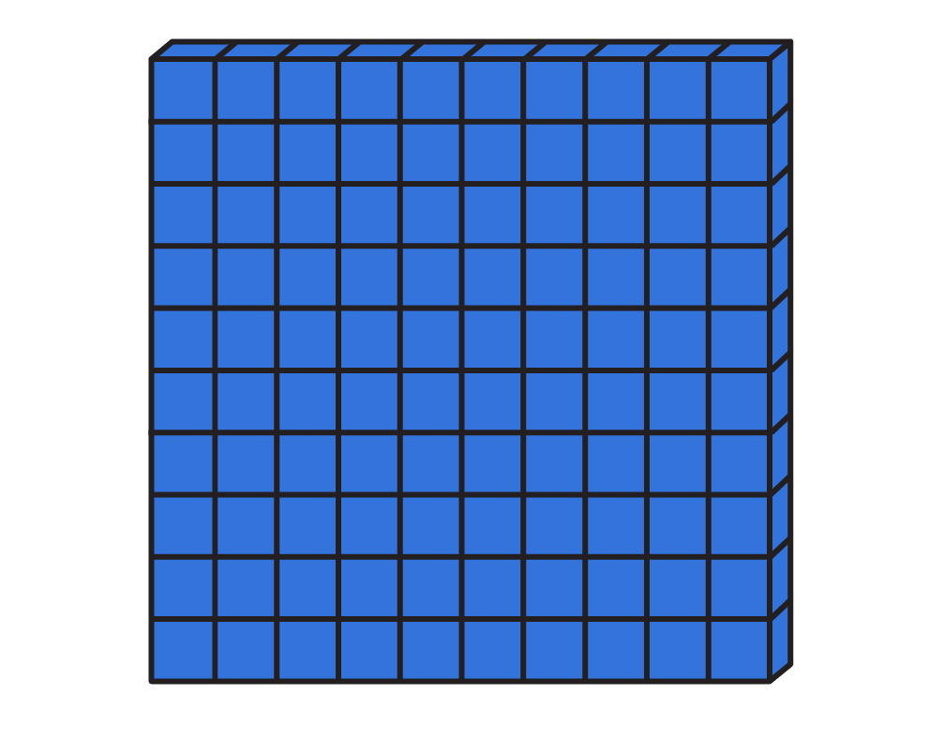
To be able to apply number bonds within 10
Talking Time:
Complete the following.
+ = 3 ones + 2 ones = __ ones
+ = 3 tens + 2 tens = __ tens
+ = 3 hundreds + 2 hundreds = __ hundreds

Slide 6
To be able to apply number bonds within 10
Talking Time:
Complete the following.
+ = 3 ones + 2 ones = __ ones
5
+ = 3 tens + 2 tens = __ tens
5
+ = 3 hundreds + 2 hundreds = __ hundreds
5

Slide 7
To be able to apply number bonds within 10
Talking Time:
Complete the following.
+ = 5 ones + 3 ones = __ ones
+ = 5 tens + 3 tens = __ tens
+ = 5 hundreds + 3 hundreds = __ hundreds

Slide 8
To be able to apply number bonds within 10
Talking Time:
Complete the following.
+ = 5 ones + 3 ones = __ ones
8
+ = 5 tens + 3 tens = __ tens
8
+ = 5 hundreds + 3 hundreds = __ hundreds
8

Slide 9
To be able to apply number bonds within 10
Talking Time:
Complete the following.
+ = 2 ones + 4 ones = __ ones
+ = 2 tens + 4 tens = __ tens
+ = 2 hundreds + 4 hundreds = __ hundreds

Slide 10
To be able to apply number bonds within 10
Talking Time:
Complete the following.
+ = 2 ones + 4 ones = __ ones
6
+ = 2 tens + 4 tens = __ tens
6
+ = 2 hundreds + 4 hundreds = __ hundreds
6

Slide 11
To be able to apply number bonds within 10
Activity 1:
Complete the following.
+ = 6 ones + 2 ones = __ ones
+ = 6 tens + 2 tens = __ tens
+ = 6 hundreds + 2 hundreds = __ hundreds

Slide 12
To be able to apply number bonds within 10
Activity 1:
Complete the following.
+ = 6 ones + 2 ones = __ ones
8
+ = 6 tens + 2 tens = __ tens
8
+ = 6 hundreds + 2 hundreds = __ hundreds
8

Slide 13
To be able to apply number bonds within 10
Talking Time:
Complete the following.
300 − 100 = ____

Slide 14
To be able to apply number bonds within 10
Talking Time:
Complete the following.
300 − 100 = ____
200

Slide 15
To be able to apply number bonds within 10
Talking Time:
Complete the following.
600 − 300 = ____

Slide 16
To be able to apply number bonds within 10
Talking Time:
Complete the following.
600 − 300 = ____
300

Slide 17
To be able to apply number bonds within 10
Talking Time:
Complete the following.
500 − 200 = ____

Slide 18
To be able to apply number bonds within 10
Talking Time:
Complete the following.
500 − 200 = ____
300

Slide 19
To be able to apply number bonds within 10
Activity 2:
Complete the following.
700 − 300 = ____

Slide 20
To be able to apply number bonds within 10
Activity 2:
Complete the following.
700 − 300 = ____
400

Slide 21
To be able to apply number bonds within 10
Talking Time:
Complete the following addition calculations.
2 + 1 = _____
20 + 10 = _____
200 + 100 = _____
20 + 10 = _____
20 + 20 = _____
20 + 30 = _____
20 + 40 = _____

Slide 22
To be able to apply number bonds within 10
Talking Time:
Complete the following addition calculations.
2 + 1 = _____
20 + 10 = _____
200 + 100 = _____
20 + 10 = _____
20 + 20 = _____
20 + 30 = _____
20 + 40 = _____
3
30
40
30
50
300
60

Slide 23
To be able to apply number bonds within 10
Talking Time:
Complete the following addition calculations.
1 + 6 = _____
10 + 60 = _____
100 + 600 = _____
60 + 10 = _____
60 + 20 = _____
60 + 30 = _____
60 + 40 = _____

Slide 24
To be able to apply number bonds within 10
Talking Time:
Complete the following addition calculations.
1 + 6 = _____
10 + 60 = _____
100 + 600 = _____
60 + 10 = _____
60 + 20 = _____
60 + 30 = _____
60 + 40 = _____
7
70
80
70
90
700
100

Slide 25
To be able to apply number bonds within 10
Activity 3:
Complete the following addition calculations.
4 + 2 = _____
40 + 20 = _____
400 + 200 = _____
50 + 10 = _____
50 + 20 = _____
50 + 30 = _____
50 + 40 = _____
50 + 50 = _____

Slide 26
To be able to apply number bonds within 10
Activity 3:
Complete the following addition calculations.
4 + 2 = _____
40 + 20 = _____
400 + 200 = _____
50 + 10 = _____
50 + 20 = _____
50 + 30 = _____
50 + 40 = _____
50 + 50 = _____
6
60
70
60
80
600
90
100

Slide 27
To be able to apply number bonds within 10
Talking Time:
Complete the following subtraction calculations.
4 − 2 = _____
40 − 20 = _____
400 − 200 = _____
40 − 40 = _____
40 − 30 = _____
40 − 20 = _____
40 − 10 = _____
40 − 0 = _____

Slide 28
To be able to apply number bonds within 10
Talking Time:
Complete the following subtraction calculations.
4 − 2 = _____
40 − 20 = _____
400 − 200 = _____
40 − 40 = _____
40 − 30 = _____
40 − 20 = _____
40 − 10 = _____
40 − 0 = _____
2
0
10
20
20
200
30
40

Slide 29
To be able to apply number bonds within 10
Talking Time:
Complete the following subtraction calculations.
6 − 3 = _____
60 − 30 = _____
600 − 300 = _____
50 − 40 = _____
50 − 30 = _____
50 − 20 = _____
50 − 10 = _____
50 − 0 = _____

Slide 30
To be able to apply number bonds within 10
Talking Time:
Complete the following subtraction calculations.
6 − 3 = _____
60 − 30 = _____
600 − 300 = _____
50 − 40 = _____
50 − 30 = _____
50 − 20 = _____
50 − 10 = _____
50 − 0 = _____
3
10
20
30
30
300
40
50

Slide 31
To be able to apply number bonds within 10
Activity 4:
Complete the following subtraction calculations.
9 − 4 = _____
90 − 40 = _____
900 − 400 = _____
70 − 40 = _____
70 − 30 = _____
70 − 20 = _____
70 − 10 = _____
70 − 0 = _____

Slide 32
To be able to apply number bonds within 10
Activity 4:
Complete the following subtraction calculations.
9 − 4 = _____
90 − 40 = _____
900 − 400 = _____
70 − 40 = _____
70 − 30 = _____
70 − 20 = _____
70 − 10 = _____
70 − 0 = _____
5
30
40
50
50
500
60
70

Slide 33
To be able to apply number bonds within 10
Talking Time:
Solve the word problem.
Yasmin has 400 paper straws.
She buys 3 more tubs of paper straws.
How many paper straws does she have now?

Slide 34
To be able to apply number bonds within 10
Talking Time:
Solve the word problem.
Yasmin has 400 paper straws.
She buys 3 more tubs of paper straws.
How many paper straws does she have now?
400 + 300 = 700
So, Yasmin now has 700 straws.

Slide 35
To be able to apply number bonds within 10
Talking Time:
Solve the word problem.
Yasmin has 200 paper straws.
She buys 1 more tub of paper straws.
How many paper straws does she have now?

Slide 36
To be able to apply number bonds within 10
Talking Time:
Solve the word problem.
Yasmin has 200 paper straws.
She buys 1 more tub of paper straws.
How many paper straws does she have now?
200 + 100 = 300
So, Yasmin now has 300 straws.

Slide 37
To be able to apply number bonds within 10
Talking Time:
Solve the word problem.
Yasmin has 300 paper straws.
She buys 2 more tubs of paper straws.
How many paper straws does she have now?

Slide 38
To be able to apply number bonds within 10
Talking Time:
Solve the word problem.
Yasmin has 300 paper straws.
She buys 2 more tubs of paper straws.
How many paper straws does she have now?
300 + 200 = 500
So, Yasmin now has 500 straws.

Slide 39
To be able to apply number bonds within 10
Activity 5:
Solve the word problem.
Yasmin has 500 paper straws.
She buys 4 more tubs of paper straws.
How many paper straws does she have now?

Slide 40
To be able to apply number bonds within 10
Activity 5:
Solve the word problem.
Yasmin has 500 paper straws.
She buys 4 more tubs of paper straws.
How many paper straws does she have now?
500 + 400 = 900
So, Yasmin now has 900 straws.

Slide 41
To be able to apply number bonds within 10
Talking Time:
Using the part-whole model, write as many number sentences as you can…
40
30
10

Slide 42
To be able to apply number bonds within 10
Talking Time:
Using the part-whole model, write as many number sentences as you can…
40 − 10 = 30
40 − 30 = 10
10 + 30 = 40
30 + 10 = 40
40 = 10 + 30
40 = 30 + 10
40
30
10

Slide 43
To be able to apply number bonds within 10
Talking Time:
Using the part-whole model, write as many number sentences as you can…
50
20
30

Slide 44
To be able to apply number bonds within 10
Talking Time:
Using the part-whole model, write as many number sentences as you can…
50 − 20 = 30
50 − 30 = 20
20 + 30 = 50
30 + 20 = 50
50 = 20 + 30
50 = 30 + 20
50
20
30

Slide 45
To be able to apply number bonds within 10
Talking Time:
Using the part-whole model, write as many number sentences as you can…
70
10
60

Slide 46
To be able to apply number bonds within 10
Talking Time:
Using the part-whole model, write as many number sentences as you can…
70 − 10 = 60
70 − 60 = 10
10 + 60 = 70
60 + 10 = 70
70 = 10 + 60
70 = 60 + 10
70
10
60

Slide 47
To be able to apply number bonds within 10
Activity 6:
Using the part-whole model, write as many number sentences as you can…
90
40
50

Slide 48
To be able to apply number bonds within 10
Activity 6:
Using the part-whole model, write as many number sentences as you can…
90 − 40 = 50
90 − 50 = 40
50 + 40 = 90
40 + 50 = 90
90 = 50 + 40
90 = 40 + 50
90
40
50

Slide 49
To be able to apply number bonds within 10
Talking Time:
Complete the bar models below.
100
30
100
60
20 | 50 | 30
10 | 30 | 20

Slide 50
To be able to apply number bonds within 10
Talking Time:
Complete the bar models below.
100
30
100
30 | 70
100
60
100
60 | 40
20 | 50 | 30
100
20 | 50 | 30
10 | 30 | 20
60
10 | 30 | 20

Slide 51
To be able to apply number bonds within 10
Activity 7:
Complete the bar models below.
100
 | 20
100
40 | 30 | 30
30 | 10 | 50

Slide 52
To be able to apply number bonds within 10
Activity 7:
Complete the bar models below.
100
 | 20
100
80 | 20
100
100
50 | 50
40 | 30 | 30
100
40 | 30 | 30
30 | 10 | 50
90
30 | 10 | 50

Slide 53
To be able to apply number bonds within 10
Talking Time:
Complete the addition and subtraction calculations below.
200 + 100 = _____
600 − 100 = _____
400 + _____ = 600
500 + _____ = 600
_____ − 300 = 300
900 = 400 + _____
100 + 300 + 100 = ____
600 = 100 + ____ + 300
600 − 300 - 200 = ____
400 − _____ = 0

Slide 54
To be able to apply number bonds within 10
Talking Time:
Complete the addition and subtraction calculations below.
200 + 100 = _____
600 − 100 = _____
400 + _____ = 600
500 + _____ = 600
_____ − 300 = 300
900 = 400 + _____
100 + 300 + 100 = ____
600 = 100 + ____ + 300
600 − 300 - 200 = ____
400 − _____ = 0
300
500
500
500
200
200
100
100
600
400

Slide 55
To be able to apply number bonds within 10
Activity 8:
Complete the addition and subtraction calculations below.
100 + 400 = _____
900 − 100 = _____
500 + _____ = 800
200 + _____ = 800
_____ − 400 = 300
800 = 500 + _____
200 + 300 + 400 = ____
700 = 200 + ____ + 100
800 − 300 - 200 = ____
700 − _____ = 0

Slide 56
To be able to apply number bonds within 10
Activity 8:
Complete the addition and subtraction calculations below.
100 + 400 = _____
900 − 100 = _____
500 + _____ = 800
200 + _____ = 800
_____ − 400 = 300
800 = 500 + _____
200 + 300 + 400 = ____
700 = 200 + ____ + 100
800 − 300 - 200 = ____
700 − _____ = 0
500
300
800
900
300
400
600
300
700
700

Slide 57

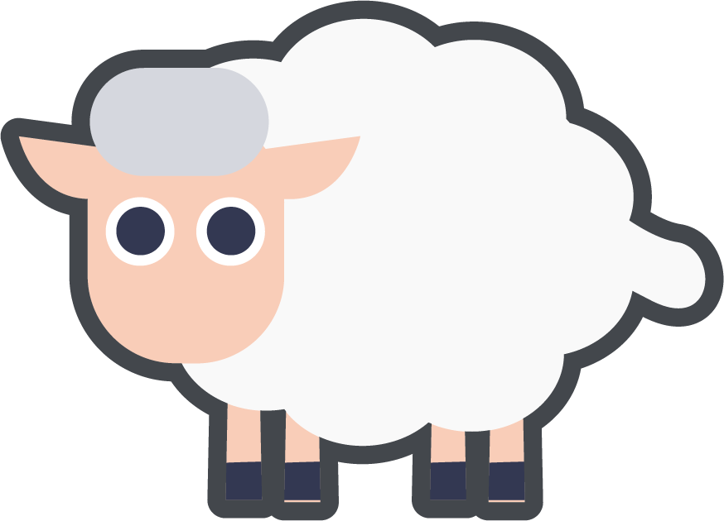
To be able to apply number bonds within 10
Activity 9:
Complete the word problem below.
There are 500 sheep on a farm.
There are 100 more sheep than cows.
In total, how many sheep and cows are there on the farm?

Slide 58
To be able to apply number bonds within 10
Activity 9:
Complete the word problem below.
There are 500 sheep on a farm.
There are 100 more sheep than cows.
In total, how many sheep and cows are there on the farm?
500 − 100 = 400
500 + 400 = 900
So, 900 sheep and cows on the farm altogether.

Slide 59
To be able to apply number bonds within 10
Evaluation:
Do you agree with Astrobee?
Explain your answer.
If the sum is 800, an addend pair is 700 and 200.

Slide 60
To be able to apply number bonds within 10
Evaluation:
No, I do not agree. If the sum is 800, then possible addend pairs are 800 + 0, 100 + 700, 200 + 600, 300 + 500 and 400 + 400 (and in reverse order, too!).
If the sum is 800, an addend pair is 700 and 200.

Slide 61
To be able to apply number bonds within 10
Success criteria:
I can use mathematical equipment and pictorial representations to apply my knowledge of number bonds within 10
I can explain my reasoning when using mathematical equipment, pictorial and abstract representations when applying my knowledge of number bonds within 10

