Slide 1




Quiz: QOVBUNE
Stage 4
Spring Block 3: Fractions
Lesson 1: To be able to explore fractions in different representations
Spring
Block 3 – Fractions
1

Slide 2
To be able to explore fractions in different representations
Success criteria:
I can explore fractions presented within various forms, using terms like numerator, denominator, unit fraction and non-unit fraction
I can explain my reasoning when exploring fractions presented within various forms, and when using terms like numerator, denominator, unit fraction and non-unit fraction

Slide 3


To be able to explore fractions in different representations
Starter:
Which one doesn’t belong?
Explain your answer.

Slide 4
To be able to explore fractions in different representations
Starter:
Which one doesn’t belong?
The stars representation doesn’t belong as it shows a quarter of the stars as green and three quarters of the stars as grey. Whereas, the other representations show half and another half.

Slide 5
To be able to explore fractions in different representations
Talking Time:
What does the representation below show?

Slide 6
To be able to explore fractions in different representations
Talking Time:
What does the representation below show?
Either one fifth (green) or four fifths (blue).

Slide 7
To be able to explore fractions in different representations
Talking Time:
What does the representation below show?

Slide 8
To be able to explore fractions in different representations
Talking Time:
What does the representation below show?
Either five eighths (yellow) or three eighths (purple).

Slide 9
To be able to explore fractions in different representations
Talking Time:
What does the representation below show?

Slide 10
To be able to explore fractions in different representations
Talking Time:
What does the representation below show?
Either one quarter (pink) or three quarters (blue).

Slide 11
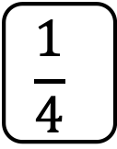
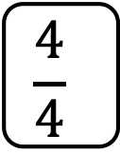
To be able to explore fractions in different representations
Talking Time:
What does the representation below show?
0
$$\frac{1}{4}$$
$$\frac{4}{4}$$

Slide 12
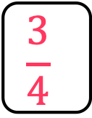
To be able to explore fractions in different representations
Talking Time:
What does the representation below show?
Three quarters
0
$$\frac{1}{4}$$
$$\frac{3}{4}$$
$$\frac{4}{4}$$

Slide 13
To be able to explore fractions in different representations
Talking Time:
What does the representation below show?

Slide 14
To be able to explore fractions in different representations
Talking Time:
What does the representation below show?
Either one third (black) or two thirds (white).

Slide 15


To be able to explore fractions in different representations
Talking Time:
What does the representation below show?

Slide 16
To be able to explore fractions in different representations
Talking Time:
What does the representation below show?
Both a half (red or white).

Slide 17


To be able to explore fractions in different representations
Talking Time:
What does the representation below show?

Slide 18
To be able to explore fractions in different representations
Talking Time:
What does the representation below show?
Either one fifth (yellow) or four fifths (pink).

Slide 19
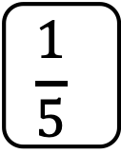
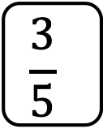
To be able to explore fractions in different representations
Talking Time:
What does the representation below show?
0
$$\frac{1}{5}$$
$$\frac{3}{5}$$

Slide 20
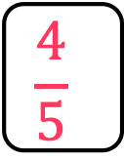
To be able to explore fractions in different representations
Talking Time:
What does the representation below show?
Four fifths
0
$$\frac{1}{5}$$
$$\frac{3}{5}$$
$$\frac{4}{5}$$

Slide 21
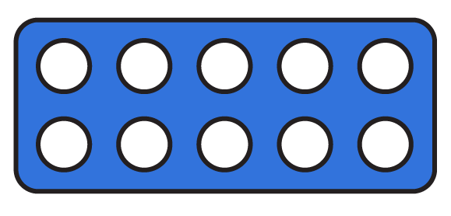
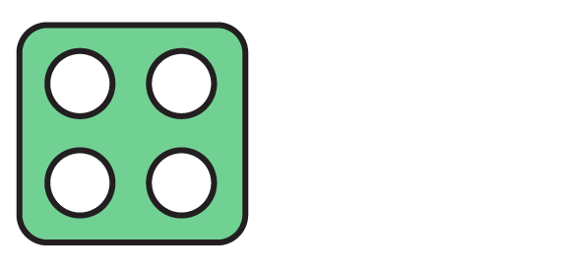
To be able to explore fractions in different representations
Talking Time:
What does the representation below show?

Slide 22
To be able to explore fractions in different representations
Talking Time:
What does the representation below show?
Either two fifths (green) or three fifths (blue).

Slide 23
To be able to explore fractions in different representations
Talking Time:
What does the representation below show?

Slide 24
To be able to explore fractions in different representations
Talking Time:
What does the representation below show?
Either one third (white) or two thirds (purple).

Slide 25
To be able to explore fractions in different representations
Activity 1:
Match the following fraction cards.
three
quarters
three
fifths

Slide 26
To be able to explore fractions in different representations
Activity 1:
Match the following fraction cards.
three
quarters
three
fifths

Slide 27
To be able to explore fractions in different representations
Activity 2:
Create your own fraction matching card game.

Slide 28
To be able to explore fractions in different representations
Activity 2:
Teacher / peer assessment
three
quarters
three
fifths

Slide 29

To be able to explore fractions in different representations
Talking Time:
Which digit is the numerator?
$$\frac{1}{3}$$

Slide 30

To be able to explore fractions in different representations
Talking Time:
Which digit is the numerator?
$$\frac{1}{3}$$

Slide 31

To be able to explore fractions in different representations
Talking Time:
Which digit is the numerator?
$$\frac{2}{5}$$

Slide 32

To be able to explore fractions in different representations
Talking Time:
Which digit is the numerator?
$$\frac{2}{5}$$

Slide 33

To be able to explore fractions in different representations
Talking Time:
Which digit is the denominator?
$$\frac{2}{3}$$

Slide 34

To be able to explore fractions in different representations
Talking Time:
Which digit is the denominator?
$$\frac{2}{3}$$

Slide 35

To be able to explore fractions in different representations
Talking Time:
Which digit is the denominator?
$$\frac{3}{5}$$

Slide 36

To be able to explore fractions in different representations
Talking Time:
Which digit is the denominator?
$$\frac{3}{5}$$

Slide 37

To be able to explore fractions in different representations
Talking Time:
Which digit is the numerator?
$$\frac{3}{4}$$

Slide 38

To be able to explore fractions in different representations
Talking Time:
Which digit is the numerator?
$$\frac{3}{4}$$

Slide 39

To be able to explore fractions in different representations
Talking Time:
Which digit is the denominator?
$$\frac{8}{9}$$

Slide 40

To be able to explore fractions in different representations
Talking Time:
Which digit is the denominator?
$$\frac{8}{9}$$

Slide 41

To be able to explore fractions in different representations
Talking Time:
Which digit is the numerator?
$$\frac{7}{10}$$

Slide 42

To be able to explore fractions in different representations
Talking Time:
Which digit is the numerator?
$$\frac{7}{10}$$

Slide 43

To be able to explore fractions in different representations
Talking Time:
Which digit is the numerator?
$$\frac{1}{5}$$

Slide 44

To be able to explore fractions in different representations
Talking Time:
Which digit is the numerator?
$$\frac{1}{5}$$

Slide 45
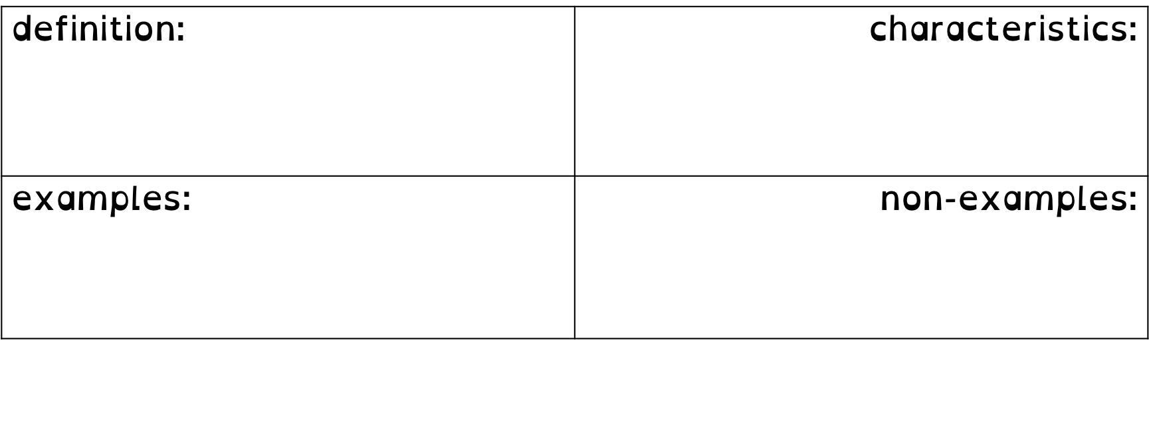
To be able to explore fractions in different representations
Talking Time:
Complete the Frayer model below.
definition: The digit within a fraction that is above the vinculum (or fraction bar). | characteristics: A digit or whole number that is placed above another number and vinculum.
examples: $1/3$, $2/3$, $1/5$, $3/5$ | non-examples: $1/3$, $2/5$, $1/4$, $3/7$ £3, 27 p, 35 kg
numerator

Slide 46
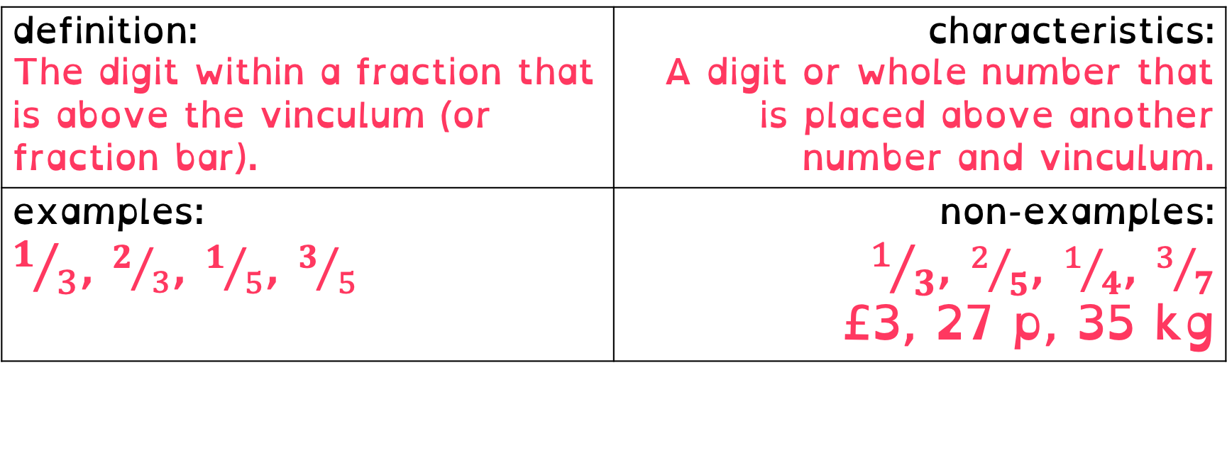
To be able to explore fractions in different representations
Talking Time:
Complete the Frayer model below.
definition: The digit within a fraction that is above the vinculum (or fraction bar). | characteristics: A digit or whole number that is placed above another number and vinculum.
examples: $1/3$, $2/3$, $1/5$, $3/5$ | non-examples: $1/3$, $2/5$, $1/4$, $3/7$ £3, 27 p, 35 kg
numerator

Slide 47


To be able to explore fractions in different representations
Talking Time:
Which fraction is a unit fraction?
$$\frac{1}{5}$$
$$\frac{3}{5}$$

Slide 48

To be able to explore fractions in different representations
Talking Time:
Which fraction is a unit fraction?
$$\frac{1}{5}$$
$$\frac{3}{5}$$

Slide 49


To be able to explore fractions in different representations
Talking Time:
Which fraction is a unit fraction?
$$\frac{1}{2}$$
$$\frac{2}{3}$$

Slide 50

To be able to explore fractions in different representations
Talking Time:
Which fraction is a unit fraction?
$$\frac{1}{2}$$
$$\frac{2}{3}$$

Slide 51


To be able to explore fractions in different representations
Talking Time:
Which fraction is a unit fraction?
$$\frac{3}{5}$$
$$\frac{1}{4}$$

Slide 52

To be able to explore fractions in different representations
Talking Time:
Which fraction is a unit fraction?
$$\frac{3}{5}$$
$$\frac{1}{4}$$

Slide 53


To be able to explore fractions in different representations
Talking Time:
Which fraction is a unit fraction?
$$\frac{1}{10}$$
$$\frac{3}{4}$$

Slide 54

To be able to explore fractions in different representations
Talking Time:
Which fraction is a unit fraction?
$$\frac{1}{10}$$
$$\frac{3}{4}$$

Slide 55


To be able to explore fractions in different representations
Talking Time:
Which fraction is a unit fraction?
$$\frac{2}{7}$$
$$\frac{1}{9}$$

Slide 56

To be able to explore fractions in different representations
Talking Time:
Which fraction is a unit fraction?
$$\frac{2}{7}$$
$$\frac{1}{9}$$

Slide 57
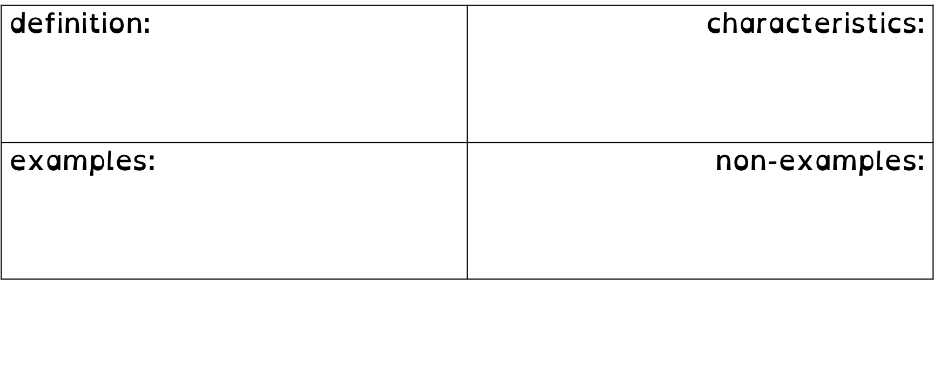
To be able to explore fractions in different representations
Activity 3:
Complete the Frayer model below.
definition: The digit within a fraction that is below the vinculum (or fraction bar). | characteristics: A digit or whole number that is placed beneath another number and vinculum.
examples: $1/3$, $2/5$, $1/4$, $3/7$ | non-examples: $1/3$, $2/3$, $1/5$, $3/5$ £3, 27 p, 35 kg
denominator

Slide 58
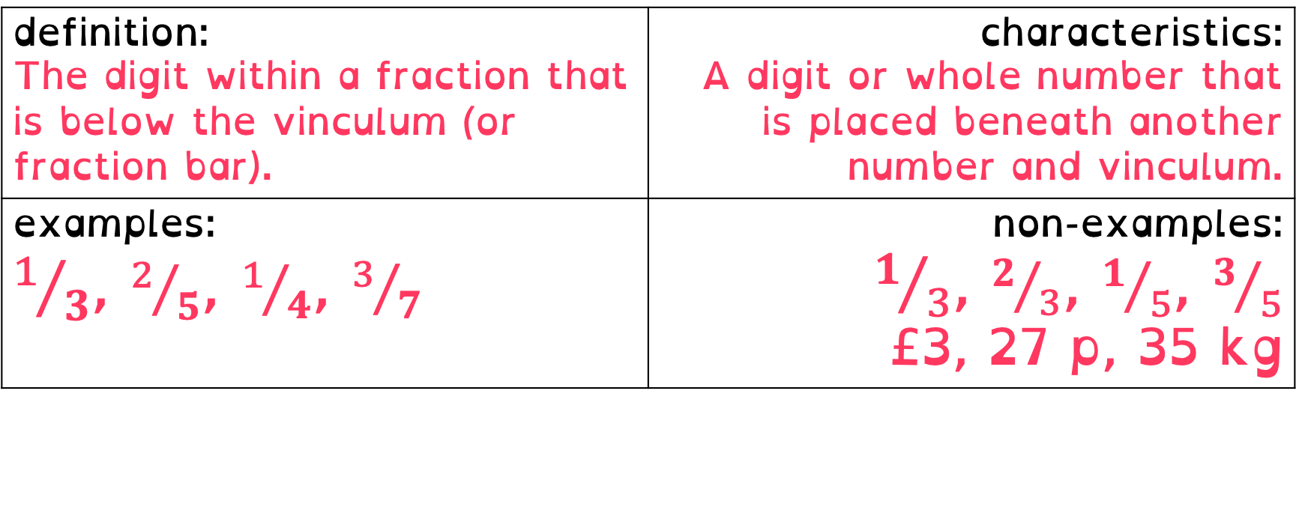
To be able to explore fractions in different representations
Activity 3:
Complete the Frayer model below.
definition: The digit within a fraction that is below the vinculum (or fraction bar). | characteristics: A digit or whole number that is placed beneath another number and vinculum.
examples: $1/3$, $2/5$, $1/4$, $3/7$ | non-examples: $1/3$, $2/3$, $1/5$, $3/5$ £3, 27 p, 35 kg
denominator

Slide 59
To be able to explore fractions in different representations
Talking Time:
Complete the Frayer model below.
definition: | characteristics:
examples: | non-examples:
unit fraction

Slide 60

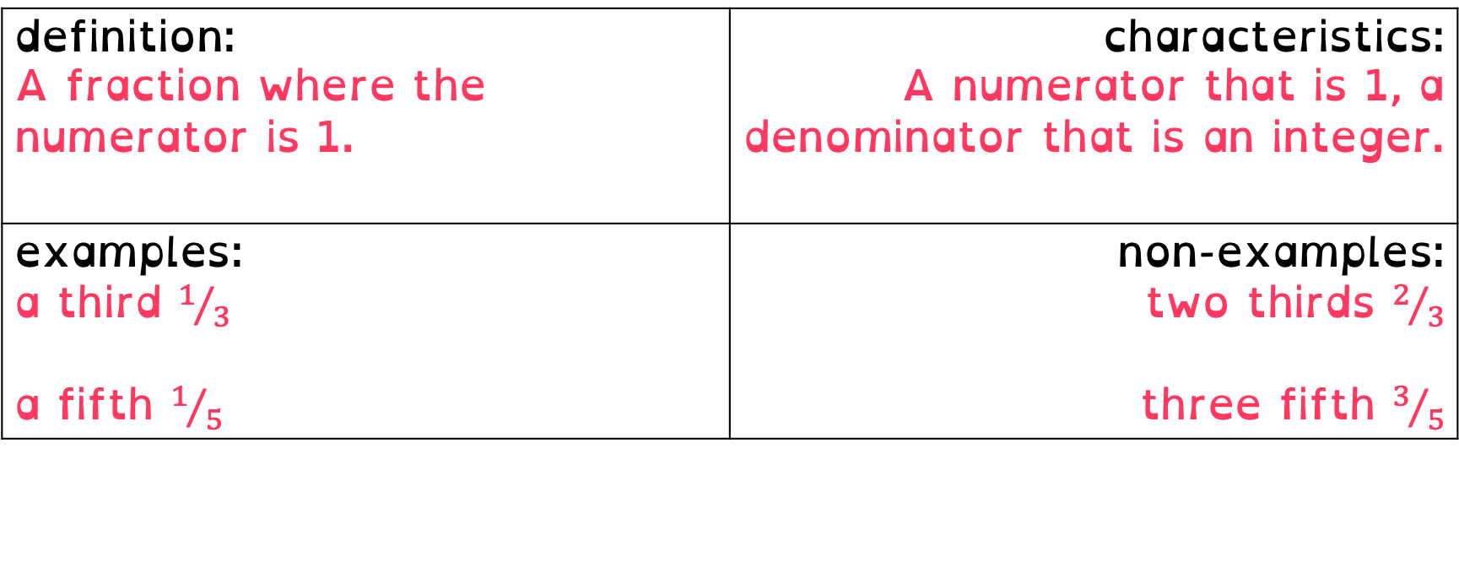
To be able to explore fractions in different representations
Talking Time:
Complete the Frayer model below.
definition: A fraction where the numerator is 1. | characteristics: A numerator that is 1, a denominator that is an integer.
examples: a third $1/3$ a fifth $1/5$ | non-examples: two thirds $2/3$ three fifth $3/5$
unit fraction

Slide 61
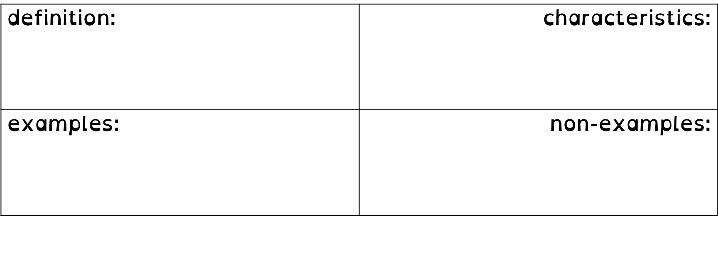
To be able to explore fractions in different representations
Activity 4:
Complete the Frayer model below.
definition: A fraction where the numerator is not 1. | characteristics: A numerator that is not 1, a denominator that is an integer.
examples: two thirds $2/3$ three fifths $3/5$ | non-examples: one third $1/3$ one fifth $1/5$
non-unit fraction

Slide 62
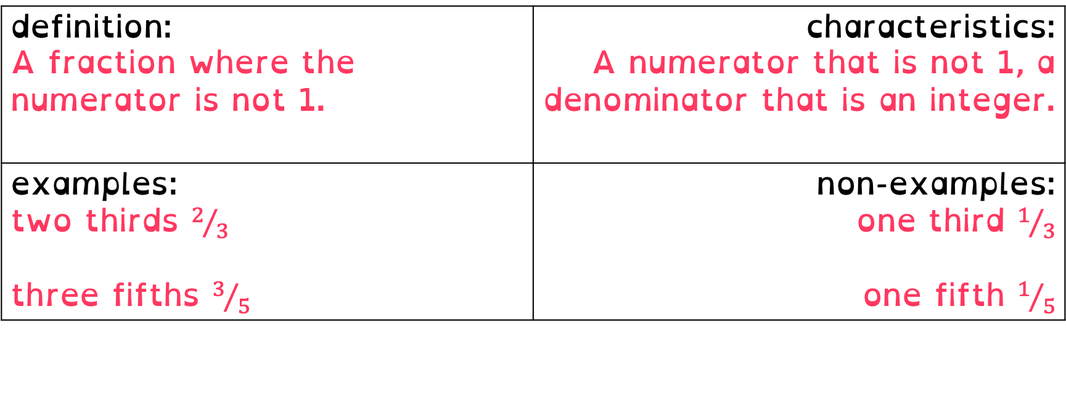
To be able to explore fractions in different representations
Activity 4:
Complete the Frayer model below.
definition: A fraction where the numerator is not 1. | characteristics: A numerator that is not 1, a denominator that is an integer.
examples: two thirds $2/3$ three fifths $3/5$ | non-examples: one third $1/3$ one fifth $1/5$
non-unit fraction

Slide 63
To be able to explore fractions in different representations
Activity 5:
Using Cuisenaire rods:
If purple represents one whole, what does a red rod represent?
If dark green represents one whole, what fraction is light green?
If brown represent one whole, what does dark green represent?
If orange represents one whole, what does brown represent?
Write your own questions!

Slide 64
To be able to explore fractions in different representations
Activity 5:
Using Cuisenaire rods:
If purple represents one whole, a red rod represents a half.
If dark green represents one whole, what fraction is light green?
If brown represent one whole, what does dark green represent?
If orange represents one whole, what does brown represent?
Write your own questions!

Slide 65
To be able to explore fractions in different representations
Activity 5:
Using Cuisenaire rods:
If purple represents one whole, a red rod represents a half.
If dark green represents one whole, a light green rod is half.
If brown represent one whole, what does dark green represent?
If orange represents one whole, what does brown represent?
Write your own questions!

Slide 66
To be able to explore fractions in different representations
Activity 5:
Using Cuisenaire rods:
If purple represents one whole, a red rod represents a half.
If dark green represents one whole, a light green rod is half.
If brown represent one whole, dark green represents three quarters.
If orange represents one whole, what does brown represent?
Write your own questions!

Slide 67
To be able to explore fractions in different representations
Activity 5:
Using Cuisenaire rods:
If purple represents one whole, a red rod represents a half.
If dark green represents one whole, a light green rod is half.
If brown represent one whole, dark green represents three quarters.
If orange represents one whole, brown represents four fifths.
Teacher / peer assessment

Slide 68

To be able to explore fractions in different representations
Activity 6:
Which of the following representations are not representations of $5/6$?
Explain your answer.

Slide 69
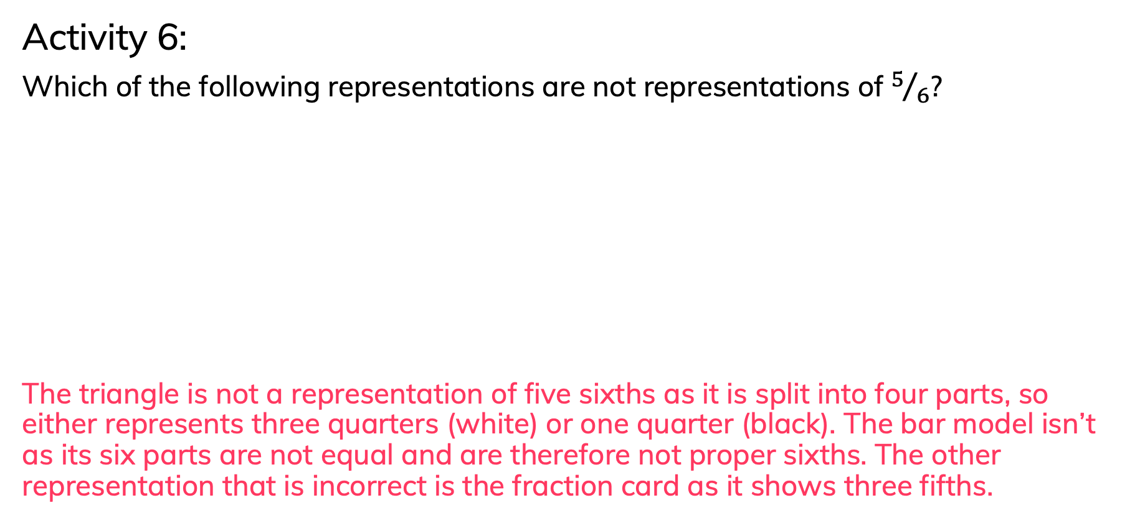
To be able to explore fractions in different representations
Activity 6:
Which of the following representations are not representations of $5/6$?
The triangle is not a representation of five sixths as it is split into four parts, so either represents three quarters (white) or one quarter (black). The bar model isn’t as its six parts are not equal and are therefore not proper sixths. The other representation that is incorrect is the fraction card as it shows three fifths.

Slide 70
To be able to explore fractions in different representations
Evaluation:
Is Astrobee’s statement always, sometimes or never true?
Explain your answer.
If I split a whole into three parts – a pizza, a piece of wood, anything - it will be split into thirds.

Slide 71
To be able to explore fractions in different representations
Evaluation:
Astrobee’s statement is only sometimes true. For example, the blue bar model does show thirds as it is split into equal parts. However, the red bar model does not as the parts are unequal.
If I split a whole into three parts – a pizza, a piece of wood, anything - it will be split into thirds.

Slide 72
To be able to explore fractions in different representations
Success criteria:
I can explore fractions presented within various forms, using terms like numerator, denominator, unit fraction and non-unit fraction
I can explain my reasoning when exploring fractions presented within various forms, and when using terms like numerator, denominator, unit fraction and non-unit fraction

