Slide 1
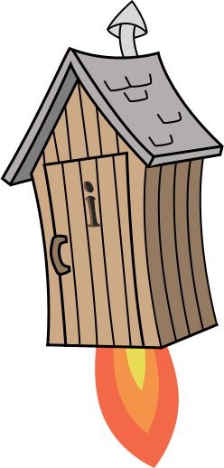
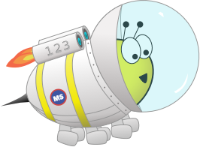
Quiz: QPNUKLM
Stage 2 Autumn Block 2: Addition and Subtraction
Lesson 1: To be able to use numbers bonds to 10
Autumn
Block 2 – Addition and Subtraction
1

Slide 2
To be able to use numbers bonds to 10
Success criteria:
I can use mathematical equipment to find and use number bonds to 10
I can explain my reasoning when finding and using number bonds to 10, with mathematical equipment

Slide 3
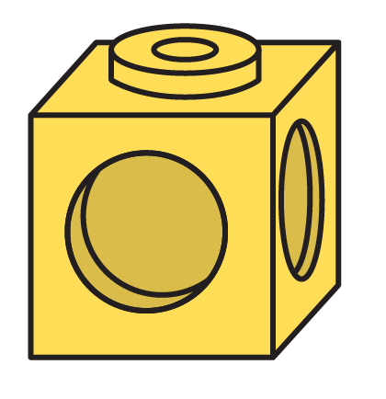
To be able to use numbers bonds to 10
Starter:
Which is the odd one out?
Explain your answer.
4

Slide 4
To be able to use numbers bonds to 10
Starter:
Which is the odd one out?
The hand is the odd one out as it shows zero and the rest show 4.
4

Slide 5
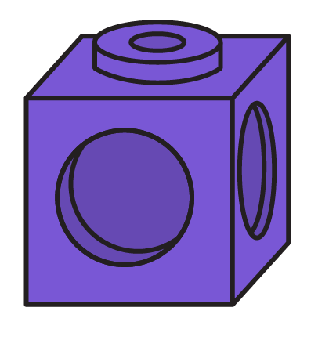
To be able to use numbers bonds to 10
Talking Time:
Ruth has these cubes.
How many purple cubes does Ruth have?
How many yellow cubes does Ruth have?
How many cubes does Ruth have altogether?

Slide 6
To be able to use numbers bonds to 10
Talking Time:
Ruth has these cubes.
How many purple cubes does Ruth have? 4
How many yellow cubes does Ruth have? 6
How many cubes does Ruth have altogether? 10

Slide 7
To be able to use numbers bonds to 10
Talking Time:
Ruth has these cubes.
How many purple cubes does Ruth have?
How many yellow cubes does Ruth have?
How many cubes does Ruth have altogether?

Slide 8
To be able to use numbers bonds to 10
Talking Time:
Ruth has these cubes.
How many purple cubes does Ruth have? 3
How many yellow cubes does Ruth have? 7
How many cubes does Ruth have altogether? 10

Slide 9
To be able to use numbers bonds to 10
Talking Time:
Ruth has these cubes.
How many purple cubes does Ruth have?
How many yellow cubes does Ruth have?
How many cubes does Ruth have altogether?

Slide 10
To be able to use numbers bonds to 10
Talking Time:
Ruth has these cubes.
How many purple cubes does Ruth have? 8
How many yellow cubes does Ruth have? 2
How many cubes does Ruth have altogether? 10

Slide 11
To be able to use numbers bonds to 10
Activity 1:
Ruth has these cubes.
How many purple cubes does Ruth have?
How many yellow cubes does Ruth have?
How many cubes does Ruth have altogether?

Slide 12
To be able to use numbers bonds to 10
Activity 1:
Ruth has these cubes.
How many purple cubes does Ruth have? 5
How many yellow cubes does Ruth have? 5
How many cubes does Ruth have altogether? 10

Slide 13
To be able to use numbers bonds to 10
Talking Time:
James is finding bonds to 10 using counters and a tens frame. What could come next in the pattern?
9 + 1 = 10
8 + 2 = 10
__ + __ = __

Slide 14
To be able to use numbers bonds to 10
Talking Time:
James is finding bonds to 10 using counters and a tens frame. What could come next in the pattern?
9 + 1 = 10
8 + 2 = 10
7 + 3 = 10

Slide 15
To be able to use numbers bonds to 10
Activity 2:
Can you continue the pattern and find all of the number bonds to 10?
1 + 9 = 10
2 + 8 = 10
3 + 7 = 10

Slide 16
To be able to use numbers bonds to 10
Activity 2:
Can you continue the pattern and find all of the number bonds to 10?
3+7=10
4+6=10
5+5=10
6+4=10
7+3=10
8+2=10
9+1=10
10+0=10

Slide 17
To be able to use numbers bonds to 10
Talking Time:
Ruth puts some counters on 3 tens frames.
How many more counters does she need to fill each of the tens frames?

Slide 18
To be able to use numbers bonds to 10
Talking Time:
Ruth puts some counters on 3 tens frames.
How many more counters does she need to fill each of the tens frames?
5
3
7

Slide 19
To be able to use numbers bonds to 10
Activity 3:
Ruth puts some counters on 3 tens frames.
How many more counters does she need to fill each of the tens frames?

Slide 20
To be able to use numbers bonds to 10
Activity 3:
Ruth puts some counters on 3 tens frames.
How many more counters does she need to fill each of the tens frames?
4
2
8

Slide 21
To be able to use numbers bonds to 10
Talking Time:
How many more are needed to make 10?
10 = __ + 2
10 = __ + 5
10 = __ + 0
6 + __ = 10
3 + __ = 10
__ + 9 = 10

Slide 22
To be able to use numbers bonds to 10
Talking Time:
How many more are needed to make 10?
10 = 8 + 2
10 = 5 + 5
10 = 10 + 0
6 + 4 = 10
3 + 7 = 10
1 + 9 = 10

Slide 23
To be able to use numbers bonds to 10
Activity 4:
How many more are needed to make 10?
10 = __ + 3
10 = __ + 1
10 = __ + 4
0 + __ = 10
2 + __ = 10
__ + 5 = 10

Slide 24
To be able to use numbers bonds to 10
Activity 4:
How many more are needed to make 10?
10 = 7 + 3
10 = 9 + 1
10 = 6 + 4
0 + 10 = 10
2 + 8 = 10
5 + 5 = 10

Slide 25
To be able to use numbers bonds to 10
Talking Time:
Chen has 10 counters in his hands.
He says, “I have 5 counters in one hand.”
How many counters are in Chen’s other hand?

Slide 26
To be able to use numbers bonds to 10
Talking Time:
Chen has 10 counters in his hands.
He says, “I have 5 counters in one hand”
How many counters are in Chen’s other hand? 10 – 5 = 5 so he has 5 counters in the other hand.

Slide 27
To be able to use numbers bonds to 10
Talking Time:
Chen has 10 counters in his hands.
He says, “I have 6 counters in one hand”
How many counters are in Chen’s other hand?

Slide 28
To be able to use numbers bonds to 10
Talking Time:
Chen has 10 counters in his hands.
He says, “I have 6 counters in one hand.”
How many counters are in Chen’s other hand? 10 – 6 = 4 so Chen has 4 counters left in his other hand.

Slide 29
To be able to use numbers bonds to 10
Talking Time:
Chen has 10 counters in his hands.
He says, “I have 4 counters in one hand.”
How many counters are in Chen’s other hand?

Slide 30
To be able to use numbers bonds to 10
Talking Time:
Chen has 10 counters in his hands.
He says, “I have 4 counters in one hand”
How many counters are in Chen’s other hand? 10 – 4 = 6 so Chen has 6 counters left in his other hand.

Slide 31
To be able to use numbers bonds to 10
Activity 5:
Chen has 10 counters in his hands.
He says, “I have 2 counters in one hand”
How many counters are in Chen’s other hand?

Slide 32
To be able to use numbers bonds to 10
Activity 5:
Chen has 10 counters in his hands.
He says, “I have 2 counters in one hand”
How many counters are in Chen’s other hand? 10 – 2 = 8 so Chen has 8 counters left in his other hand.

Slide 33
To be able to use numbers bonds to 10
Evaluation:
What 2 cards do you think Astrobee has picked?
5
8
7
2
1
I chose 2 cards which are number bonds to 10. Which cards might I have chosen?

Slide 34
To be able to use numbers bonds to 10
Evaluation:
What 2 cards do you think Astrobee has picked?
Astrobee must have picked 2 and 8 as these are the only two number bonds to 10 out of the selection.
5
8
7
2
1
I chose 2 cards which are number bonds to 10. Which cards might I have chosen?

Slide 35
To be able to use numbers bonds to 10
Success criteria:
I can use mathematical equipment to find and use number bonds to 10
I can explain my reasoning when finding and using number bonds to 10, with mathematical equipment

