Slide 1




Quiz: QQVOKNB
Stage 6
Autumn Block 2: Four Operations
Lesson 1: To be able to add and subtract integers
Autumn
Block 2 – Four Operations
1

Slide 2
To be able to add and subtract integers
Success criteria:
I can use column addition and subtraction as fluency practice and to solve word problems
I can explain my reasoning when using column addition and subtraction as fluency practice and to solve word problems

Slide 3







To be able to add and subtract integers
Starter:
What’s the same? What’s different?
Explain your answer.
three million, seven hundred and twenty-four thousand, one hundred and thirty-two

Slide 4
To be able to add and subtract integers
Starter:
What’s the same? What’s different?
The two representations have the same number of millions, ten thousands, thousands, hundreds, tens and ones; however, the worded form has 2 hundred thousands more as 3,724,132 is 200,000 more than the place value counters’ 3,524,132.
three million, seven hundred and twenty-four thousand, one hundred and thirty-two

Slide 5
To be able to add and subtract integers
Talking Time:
Complete the calculation below:
TTH
TH
H
T
O
3
1
2
3
7
+
4
1
1
9
4

Slide 6
To be able to add and subtract integers
Talking Time:
Complete the calculation below:
TTH
TH
H
T
O
3
1
2
3
7
+
4
1
1
9
4
7
2
4
3
1
1
1

Slide 7
To be able to add and subtract integers
Talking Time:
Complete the calculation below:
TTH
TH
H
T
O
5
6
3
5
5
+
3
7
1
7
3
9
3
5
2
8
1
1

Slide 8
To be able to add and subtract integers
Talking Time:
Complete the calculation below:
TTH
TH
H
T
O
5
6
3
5
5
+
3
7
1
7
3
9
3
5
2
8
1
1

Slide 9
To be able to add and subtract integers
Talking Time:
Complete the calculation below:
M
HTH
TTH
TH
H
T
O
8
5
3
1
2
3
7
-
6
3
4
1
1
9
4

Slide 10
To be able to add and subtract integers
Talking Time:
Complete the calculation below:
M
HTH
TTH
TH
H
T
O
4
1
1
1
8
5
3
1
2
3
7
-
6
3
4
1
1
9
4
2
1
9
0
0
4
3

Slide 11
To be able to add and subtract integers
Talking Time:
Complete the calculation below:
M
HTH
TTH
TH
H
T
O
8
1
2
1
8
1
9
3
4
3
1
9
4
-
4
5
3
2
2
3
7
4
8
1
0
9
5
7

Slide 12
To be able to add and subtract integers
Talking Time:
Complete the calculation below:
M
HTH
TTH
TH
H
T
O
8
1
2
1
8
1
9
3
4
3
1
9
4
-
4
5
3
2
2
3
7
4
8
1
0
9
5
7

Slide 13
To be able to add and subtract integers
Activity 1:
Complete the calculations below:
TTH
TH
H
T
O
M
HTH
TTH
TH
H
T
O
4
2
7
4
8
4
1
7
1
+
4
9
1
9
7
9
5
6
5
4
8
5
9
1
9
3
5
-
7
2
9
3
2
4
8
1
1
1
2
2
7
2
2
3
7

Slide 14
To be able to add and subtract integers
Activity 1:
Complete the calculations below:
TTH
TH
H
T
O
M
HTH
TTH
TH
H
T
O
4
2
7
4
8
4
1
7
1
+
4
9
1
9
7
9
5
6
5
4
8
5
9
1
9
4
5
-
7
2
9
3
2
4
8
1
1
1
2
2
7
2
2
3
7

Slide 15
To be able to add and subtract integers
Talking Time:
Solve the word problem below.
A second-hand sports car is listed online for £30,000.
When it was first sold as a new car, it had a list price £29,999 higher than its used price.
What was the cost of the sports car when it was first sold as a new car?
Which strategy did you use?

Slide 16
To be able to add and subtract integers
Talking Time:
Solve the word problem below.
A second-hand sports car is listed online for £30,000.
When it was first sold as a new car, it had a list price £29,999 higher than its used price.
The original price of the sports car when it was sold brand new was £59,999.
There are two efficient strategies. First, we could notice that only then ten thousands digit is going to change and use our number bonds to 5 knowledge to make £59,999. Otherwise, we could have added together £30,000 and £30,000 to make £60,000 then subtracting £1 to get to £59,999.

Slide 17
To be able to add and subtract integers
Talking Time:
Solve the word problem below.
A pair of designer shoes cost £350 brand new.
They are listed online second-hand for £99.
What is the difference in cost between buying the shoes new and buying a second-hand pair of the same shoes?
Which strategy did you use?

Slide 18
To be able to add and subtract integers
Talking Time:
Solve the word problem below.
A pair of designer shoes cost £350 brand new.
They are listed online second-hand for £99.
The difference in price between a brand new pair and a used pair is £251.
I subtracted £100 and then added £1 back on.

Slide 19
To be able to add and subtract integers
Talking Time:
Solve the word problem below.
The Jakoozi3000 hot tub sells for £4,500 brand new.
When sold second-hand, it has a price tag £1,999 less than its original price.
What is the cost of a used Jakoozi3000 hot tub?
Which strategy did you use?

Slide 20
To be able to add and subtract integers
Talking Time:
Solve the word problem below.
The Jakoozi3000 hot tub sells for £4,500 brand new.
When sold second-hand, it has a price tag £1,999 less than its original price.
What is the cost of a used Jakoozi3000 hot tub?
A used Jakoozi3000 will sell for £2,501.
I subtracted £2,000 then added £1 back on.

Slide 21
To be able to add and subtract integers
Talking Time:
Solve the word problem below.
A super car costs £350,000 brand new.
It has since gone down in value by £99,000.
What is the cost of the super car now?
Which strategy did you use?

Slide 22
To be able to add and subtract integers
Talking Time:
Solve the word problem below.
A super car costs £350,000 brand new.
It has since gone down in value by £99,000.
The super car now has a value of £251,000.
I subtracted £100,000 from £350,000 to get to £250,000 then added £1,000 back on to arrive at £251,000.

Slide 23
To be able to add and subtract integers
Activity 2:
Solve the word problems below:
An antique vase sold at an auction for £550,000.
It was damaged when it was delivered and has lost £199,000 in value.
How much is it worth now? Which strategy did you use?
The price of a 4-bedroom beach house in Bella Vista was £850,000 last year.
Prices have dropped by £249,999 over the past 12 months.
How much would the same beach house cost today? Which strategy did you use?

Slide 24
To be able to add and subtract integers
Activity 2:
Solve the word problems below:
An antique vase sold at an auction for £550,000.
It was damaged when it was delivered and has lost £199,000 in value.
How much is it worth now? Which strategy did you use?
£550,000 - £199,000 = £351,000 (subtract £200,000 add £1,000 back on)
The price of a 4-bedroom beach house in Bella Vista was £850,000 last year.
Prices have dropped by £249,999 over the past 12 months.
How much would the same beach house cost today? Which strategy did you use?
£850,000 - £249,999 = £600,001 (subtract £250,000, add £1 back on)

Slide 25
To be able to add and subtract integers
Talking Time:
What are the missing digits below?
TTH
TH
H
T
O
4
2
4
3
8
+
5
5
9
3
5
9
8
3
7
3
1
1

Slide 26
To be able to add and subtract integers
Talking Time:
What are the missing digits below?
TTH
TH
H
T
O
4
2
4
3
8
+
5
5
9
3
5
9
8
3
7
3
1
1

Slide 27
To be able to add and subtract integers
Talking Time:
What are the missing digits below?
TTH
TH
H
T
O
6
1
5
2
9
+
1
4
7
6
9
7
6
2
9
8
1
1

Slide 28
To be able to add and subtract integers
Talking Time:
What are the missing digits below?
TTH
TH
H
T
O
6
1
5
2
9
+
1
4
7
6
9
7
6
2
9
8
1
1

Slide 29
To be able to add and subtract integers
Talking Time:
What are the missing digits below?
TTH
TH
H
T
O
7
2
4
5
0
+
2
3
5
6
0
9
6
0
1
0
1
1

Slide 30
To be able to add and subtract integers
Talking Time:
What are the missing digits below?
TTH
TH
H
T
O
7
2
4
5
0
+
2
3
5
6
0
9
6
0
1
0
1
1

Slide 31
To be able to add and subtract integers
Activity 3:
What are the missing digits below?
TTH
TH
H
T
O
TTH
TH
H
T
O
6
3
5
4
9
5
6
3
0
5
+
3
5
9
4
5
+
3
8
5
0
5
9
9
4
9
4
9
4
8
1
0
1
1
1
1

Slide 32
To be able to add and subtract integers
Activity 3:
What are the missing digits below?
TTH
TH
H
T
O
TTH
TH
H
T
O
6
3
5
4
9
5
6
3
0
5
+
3
5
9
4
5
+
3
8
5
0
5
9
9
4
9
4
9
4
8
1
0
1
1
1
1

Slide 33
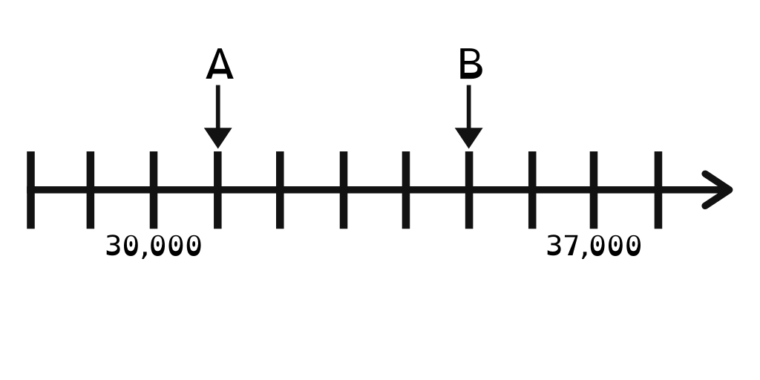
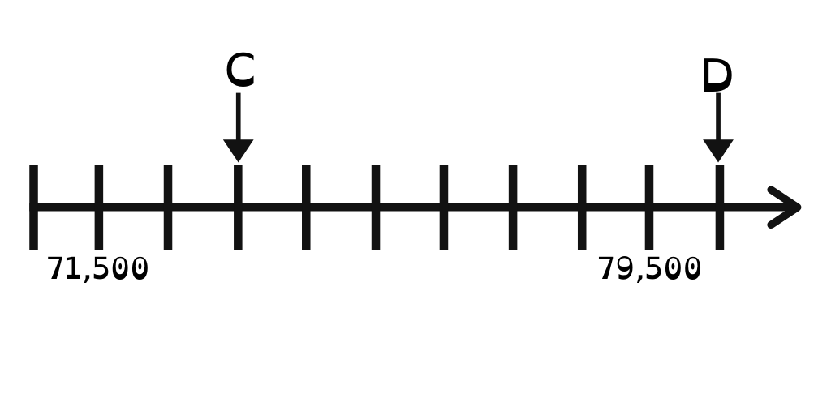
To be able to add and subtract integers
Talking Time:
Look at the number lines below.
What is the difference between A and B?

Slide 34
To be able to add and subtract integers
Talking Time:
Look at the number lines below.
What is the difference between A and B?
A is 31,000 and B is 35,000, so they have a difference of 4,000.

Slide 35
To be able to add and subtract integers
Talking Time:
Look at the number lines below.
What is the difference between C and D?

Slide 36
To be able to add and subtract integers
Talking Time:
Look at the number lines below.
What is the difference between C and D?
C is 73,500 and B is 80,500, so they have a difference of 7,000.

Slide 37
To be able to add and subtract integers
Talking Time:
Look at the number lines below.
What is the difference between A and C?

Slide 38
To be able to add and subtract integers
Talking Time:
Look at the number lines below.
What is the difference between A and C?
A is 31,000 and C is 73,500, so they have a difference of 42,500.

Slide 39
To be able to add and subtract integers
Talking Time:
Look at the number lines below.
What is the difference between A and D?

Slide 40
To be able to add and subtract integers
Talking Time:
Look at the number lines below.
What is the difference between A and D?
A is 31,000 and D is 80,500, so they have a difference of 49,500.

Slide 41
To be able to add and subtract integers
Talking Time:
Look at the number lines below.
What is the difference between B and C?

Slide 42
To be able to add and subtract integers
Talking Time:
Look at the number lines below.
What is the difference between B and C?
B is 35,000 and D is 73,500, so they have a difference of 38,500.

Slide 43
To be able to add and subtract integers
Talking Time:
Look at the number lines below.
What is the difference between B and D?

Slide 44
To be able to add and subtract integers
Talking Time:
Look at the number lines below.
What is the difference between B and D?
B is 35,000 and D is 80,500, so they have a difference of 45,500.

Slide 45
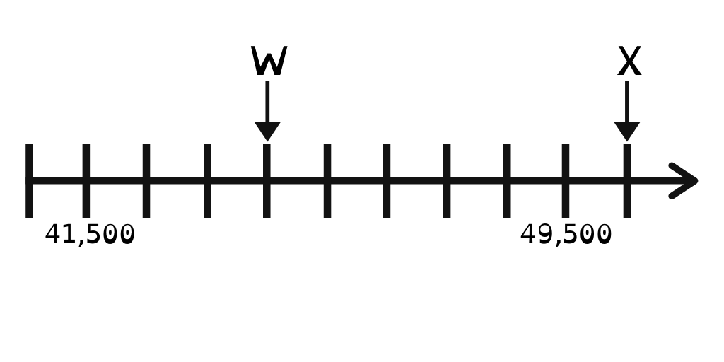
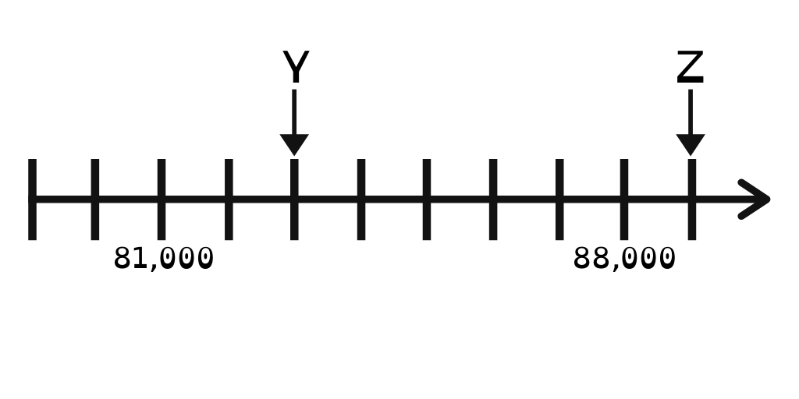
To be able to add and subtract integers
Activity 4:
Look at the number lines below.
What is the difference between W and Y?
What is the difference between W and Z?
What is the difference between X and Y?
What is the difference between X and Z?

Slide 46
To be able to add and subtract integers
Activity 4:
Look at the number lines below.
W is 44,500 and Y is 83,000. So, there is a difference of 38,500.
W is 44,500 and Z is 89,000. So, there is a difference of 44,500.
X is 50,500 and Y is 83,000. So, there is a difference of 32,500.
X is 50,500 and Z is 89,000. So, there is a difference of 38,500.

Slide 47
To be able to add and subtract integers
Activity 5:
Look at the part-whole model below.
X is an odd number that rounds to 600,000
to the nearest 100,000. It has a digit total of 11.
Y is an even number that rounds to 130,000 to
the nearest ten thousand. It has a digit total of 27.
How many combinations of X and Y can you find?
745,895
X
Y
Notes:
Strategy: make an X number that meets the rules, subtract that from 745,895, check if there is a number that fits the criteria for Y.

Slide 48
To be able to add and subtract integers
Activity 5:
Look at the part-whole model below.
X is an odd number that rounds to 600,000
to the nearest 100,000. It has a digit total of 11.
Y is an even number that rounds to 130,000 to
the nearest ten thousand. It has a digit total of 27.
Example:
If X is 611,111, Y would be 134,784.
745,895
X
Y

Slide 49
To be able to add and subtract integers
Evaluation:
Is Astrobee’s statement always, sometimes or never true?
Provide examples to help explain your answer.
When adding lots of hundred thousands together, you exchange for a million.

Slide 50
To be able to add and subtract integers
Evaluation:
Astrobee’s statement is sometimes true – for example, if I were adding together 2,597,321 and 2,802,324, there would be an exchange between the hundred thousands and millions; however, if I were adding together 2,397,321 and 2,402,324 there wouldn’t be an exchange.
When adding lots of hundred thousands together, you exchange for a million.

Slide 51
To be able to add and subtract integers
Success criteria:
I can use column addition and subtraction as fluency practice and to solve word problems
I can explain my reasoning when using column addition and subtraction as fluency practice and to solve word problems

