Slide 1
Quiz: QVMTFKB
Stage 5 Autumn Block 1: Place Value Lesson 1: To be able to use Roman Numerals up to 1,000
Autumn
Block 1 – Place Value
1

Slide 2
To be able to use Roman Numerals up to 1,000
Success criteria:
I can use Roman Numerals up to 1,000
I can use reasoning to explain my responses when using Roman Numerals up to 1,000

Slide 3
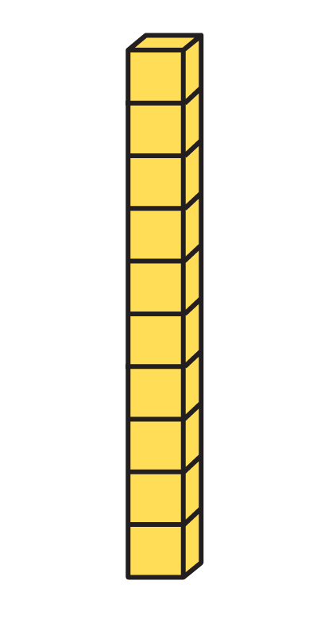
To be able to use Roman Numerals up to 1,000
Starter:
Which one doesn’t belong?
C

Slide 4
To be able to use Roman Numerals up to 1,000
Starter:
Which one doesn’t belong?
The number tile doesn’t belong as it is only worth 10. Otherwise, all the objects match as they all show values of 100.
C

Slide 5
To be able to use Roman Numerals up to 1,000
Talking Time:
Spend a couple of minutes revising some Roman Numerals facts…
1 = I 10 = X 100 = C 111 = CXI
2 = II 20 = XX 200 = CC 222 = CCXXII
3 = III 30 = XXX 300 = CCC 333 = CCCXXXIII
4 = IV 40 = XL 400 = CD 444 = CDXLIV
5 = V 50 = L 500 = D 555 = DLV
6 = VI 60 = LX 600 = DC 666 = DCLXVI
7 = VII 70 = LXX 700 = DCC 777 = DCCLXXVII
8 = VIII 80 = LXXX 800 = DCCC 888 = DCCCLXXXVIII
9 = IX 90 = XC 900 = CM 999 = CMXCIX
10 = X 100 = C 1,000 = M 1,111 = MCXI

Slide 6
To be able to use Roman Numerals up to 1,000
Talking Time:
Using sticks, twigs or rulers, make the following numbers as Roman Numerals…

Slide 7
To be able to use Roman Numerals up to 1,000
Talking Time:
Using sticks, twigs or rulers, make the following numbers as Roman Numerals…
II

Slide 8
To be able to use Roman Numerals up to 1,000
Talking Time:
Using sticks, twigs or rulers, make the following numbers as Roman Numerals…

Slide 9
To be able to use Roman Numerals up to 1,000
Talking Time:
Using sticks, twigs or rulers, make the following numbers as Roman Numerals…
V

Slide 10
To be able to use Roman Numerals up to 1,000
Talking Time:
Using sticks, twigs or rulers, make the following numbers as Roman Numerals…

Slide 11
To be able to use Roman Numerals up to 1,000
Talking Time:
Using sticks, twigs or rulers, make the following numbers as Roman Numerals…
IX

Slide 12
To be able to use Roman Numerals up to 1,000
Talking Time:
Using sticks, twigs or rulers, make the following numbers as Roman Numerals…

Slide 13
To be able to use Roman Numerals up to 1,000
Talking Time:
Using sticks, twigs or rulers, make the following numbers as Roman Numerals…
XIV

Slide 14
To be able to use Roman Numerals up to 1,000
Talking Time:
Using sticks, twigs or rulers, make the following numbers as Roman Numerals…

Slide 15
To be able to use Roman Numerals up to 1,000
Talking Time:
Using sticks, twigs or rulers, make the following numbers as Roman Numerals…
LXXVI

Slide 16
To be able to use Roman Numerals up to 1,000
Talking Time:
Using sticks, twigs or rulers, make the following numbers as Roman Numerals…

Slide 17
To be able to use Roman Numerals up to 1,000
Talking Time:
Using sticks, twigs or rulers, make the following numbers as Roman Numerals…
XCII

Slide 18
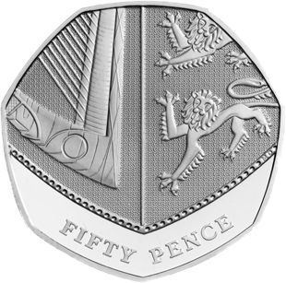
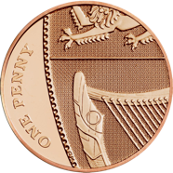
To be able to use Roman Numerals up to 1,000
Talking Time:
Using sticks, twigs or rulers, make the following numbers as Roman Numerals…

Slide 19
To be able to use Roman Numerals up to 1,000
Talking Time:
Using sticks, twigs or rulers, make the following numbers as Roman Numerals…
CI

Slide 20
To be able to use Roman Numerals up to 1,000
Talking Time:
Using sticks, twigs or rulers, make the following numbers as Roman Numerals…

Slide 21
To be able to use Roman Numerals up to 1,000
Talking Time:
Using sticks, twigs or rulers, make the following numbers as Roman Numerals…
XCIX

Slide 22
To be able to use Roman Numerals up to 1,000
Talking Time:
Using sticks, twigs or rulers, make the following numbers as Roman Numerals…

Slide 23
To be able to use Roman Numerals up to 1,000
Talking Time:
Using sticks, twigs or rulers, make the following numbers as Roman Numerals…
CCCXXI

Slide 24
To be able to use Roman Numerals up to 1,000
Talking Time:
Using sticks, twigs or rulers, make the following numbers as Roman Numerals…
eight hundreds, seven tens, six ones

Slide 25
To be able to use Roman Numerals up to 1,000
Talking Time:
Using sticks, twigs or rulers, make the following numbers as Roman Numerals…
eight hundreds, seven tens, six ones
DCCCLXXVI

Slide 26
To be able to use Roman Numerals up to 1,000
Talking Time:
Using sticks, twigs or rulers, make the following numbers as Roman Numerals…

Slide 27
To be able to use Roman Numerals up to 1,000
Talking Time:
Using sticks, twigs or rulers, make the following numbers as Roman Numerals…
DXL

Slide 28
To be able to use Roman Numerals up to 1,000
Talking Time:
Using sticks, twigs or rulers, make the following numbers as Roman Numerals…
nine hundred and eight

Slide 29
To be able to use Roman Numerals up to 1,000
Talking Time:
Using sticks, twigs or rulers, make the following numbers as Roman Numerals…
nine hundred and eight
CMVIII

Slide 30
To be able to use Roman Numerals up to 1,000
Talking Time:
The diagrams below show a number in Roman Numerals, numerals and words.
Complete the missing sections.
CXXIII
one hundred
and twenty-three
two hundred
and twenty-two
123
CDXXXII
444

Slide 31
To be able to use Roman Numerals up to 1,000
Talking Time:
The diagrams below show a number in Roman Numerals, numerals and words.
Complete the missing sections.
CXXIII
one hundred
and twenty-three
two hundred
and twenty-two
123
222
CDXXXII
444

Slide 32
To be able to use Roman Numerals up to 1,000
Talking Time:
The diagrams below show a number in Roman Numerals, numerals and words.
Complete the missing sections.
CXXIII
CCXXII
one hundred
and twenty-three
two hundred
and twenty-two
123
222
CDXXXII
444

Slide 33
To be able to use Roman Numerals up to 1,000
Talking Time:
The diagrams below show a number in Roman Numerals, numerals and words.
Complete the missing sections.
CXXIII
CCXXII
one hundred
and twenty-three
two hundred
and twenty-two
123
222
CDXLIV
CDXXXII
444

Slide 34
To be able to use Roman Numerals up to 1,000
Talking Time:
The diagrams below show a number in Roman Numerals, numerals and words.
Complete the missing sections.
CXXIII
CCXXII
one hundred
and twenty-three
two hundred
and twenty-two
123
222
CDXLIV
CDXXXII
four hundred
and forty-four
444

Slide 35
To be able to use Roman Numerals up to 1,000
Talking Time:
The diagrams below show a number in Roman Numerals, numerals and words.
Complete the missing sections.
CXXIII
CCXXII
one hundred
and twenty-three
two hundred
and twenty-two
123
222
CDXLIV
CDXXXII
four hundred
and forty-four
444
432

Slide 36
To be able to use Roman Numerals up to 1,000
Talking Time:
The diagrams below show a number in Roman Numerals, numerals and words.
Complete the missing sections.
CXXIII
CCXXII
one hundred
and twenty-three
two hundred
and twenty-two
123
222
CDXLIV
CDXXXII
four hundred
and forty-four
four hundred
and thirty-two
444
432

Slide 37
To be able to use Roman Numerals up to 1,000
Activity 1:
The diagrams below show a number in Roman Numerals, numerals and words.
Complete the missing sections.
DXV
five hundred
and fifteen
six hundred
and seventy-eight
515
DCCLXXXIX
987

Slide 38
To be able to use Roman Numerals up to 1,000
Activity 1:
The diagrams below show a number in Roman Numerals, numerals and words.
Complete the missing sections.
DCLXXVIII
DXV
five hundred
and fifteen
six hundred
and seventy-eight
515
678
CMLXXXVII
DCCLXXXIX
nine hundred
and eighty-seven
seven hundred
and eighty-nine
987
789

Slide 39
To be able to use Roman Numerals up to 1,000
Activity 2:
Complete the table below:
III |  | V |  | VII
 | XL | L
 |  |  | DC | DCC
 |  | DL | DCLX
CCCXXXIII |  |  |  | DCCLXXVII

Slide 40
To be able to use Roman Numerals up to 1,000
Activity 2:
Complete the table below:
III | IV | V | VI | VII
XXX | XL | L | LX | LXX
CCC | CD | D | DC | DCC
CCCXXX | CDXL | DL | DCLX | DCCLXX
CCCXXXIII | CDXLIV | DLV | DCLXVI | DCCLXXVII

Slide 41
To be able to use Roman Numerals up to 1,000
Talking Time:
Complete the function machines:
DCXLIV
+ 1
DCXLV
DCXLIV
- 1
DCXLIV
+ 10
DCLIV
DCXLIV
- 10

Slide 42
To be able to use Roman Numerals up to 1,000
Talking Time:
Complete the function machines:
DCXLIV
+ 1
DCXLV
DCXLIV
- 1
DCXLIII
DCXLIV
+ 10
DCLIV
DCXLIV
- 10

Slide 43
To be able to use Roman Numerals up to 1,000
Talking Time:
Complete the function machines:
DCXLIV
+ 1
DCXLV
DCXLIV
- 1
DCXLIII
DCXLIV
+ 10
DCLIV
DCXLIV
- 10
DCXXXIV

Slide 44
To be able to use Roman Numerals up to 1,000
Activity 3:
Complete the function machines:
DCCLXV
+ 1
DCCLXVI
DCCLXV
- 1
DCCLXV
+ 10
DCCLXV
- 10

Slide 45
To be able to use Roman Numerals up to 1,000
Activity 3:
Complete the function machines:
DCCLXV
+ 1
DCCLXVI
DCCLXV
- 1
DCCLXIV
DCCLXV
+ 10
DCCLXXV
DCCLXV
- 10
DCCLV

Slide 46
To be able to use Roman Numerals up to 1,000
Activity 4:
Complete the calculation below:
How many more Roman Numerals addition sentences that total the same amount can you think of? Can you think of other calculations (division, multiplication, subtraction) using Roman Numerals that share the same result?
DI
+
CDXCIX
=

Slide 47
To be able to use Roman Numerals up to 1,000
Activity 4:
Complete the calculation below:
How many more Roman Numerals addition sentences that total the same amount can you think of? Can you think of other calculations (division, multiplication, subtraction) using Roman Numerals that share the same result
DI
+
CDXCIX
=
M

Slide 48
To be able to use Roman Numerals up to 1,000
Activity 4:
Complete the calculation below:
Other addition calculations include: DCCC + CC = M; D + D = M; CMXCIX + I = M… Other calculations include: MM ÷ II = M: D x II = M; MC – C = M…
DI
+
CDXCIX
=
M
Notes:
Children to peer mark as a consolidation task.

Slide 49
To be able to use Roman Numerals up to 1,000
Evaluation:
Astrobee has made a mistake in his sequence.
Write a correct sequence to help explain your answer.
I am writing a number sequence in Roman Numerals.
DCLX, DCCCLXXX, MCXC, MC

Slide 50
To be able to use Roman Numerals up to 1,000
Evaluation:
The number sequence is going up by 110 each time. Astrobee has skipped 770. The sequence should be DCLX, DCCLXX, DCCCLXXX, MCXC, MC
I am writing a number sequence in Roman Numerals.
DCLX, DCCCLXXX, MCXC, MC

Slide 51
To be able to use Roman Numerals up to 1,000
Success criteria:
I can use Roman Numerals up to 1,000
I can use reasoning to explain my responses when using Roman Numerals up to 1,000

