Slide 1
Quiz: QOEDRJX
Stage 3 Autumn Block 1: Place Value Lesson 1: To be able to represent numbers to 100
Autumn
Block 1 – Place Value
1

Slide 2
To be able to represent numbers up to 100
Success criteria:
I can use concrete equipment to represent numbers up to 100 and say how many tens and ones the number has
I can explain my reasoning when representing my 2-digit numbers in different ways

Slide 3
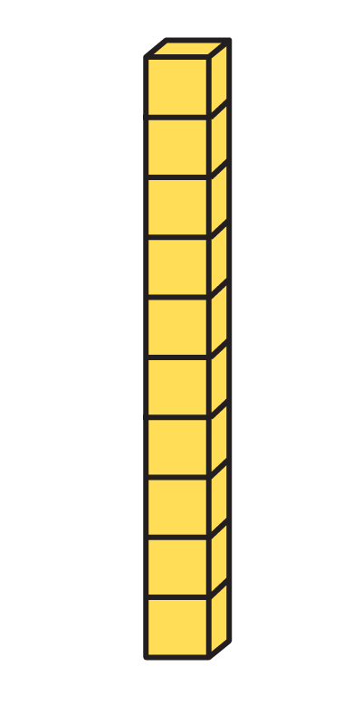
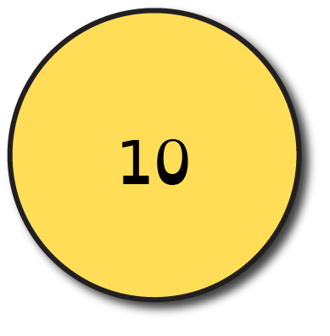
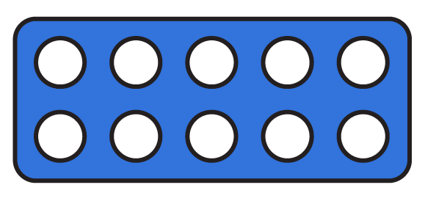
To be able to represent numbers up to 100
Starter:
Can you put these representations in order from smallest to largest?
Explain your answer.

Slide 4
To be able to represent numbers up to 100
Starter:
Number tile, place value counters, base 10, then bead strings
Smallest
1
2
3
4
Largest

Slide 5
To be able to represent numbers to 100
Talking Time:
Complete the sentences:
There are tens and ones
The number is

Slide 6
To be able to represent numbers to 100
Talking Time:
Complete the sentences:
333
2
There are tens and ones
324
The number is

Slide 7
To be able to represent numbers to 100
Talking Time:
Complete the sentences:
There are tens and ones
The number is

Slide 8
To be able to represent numbers to 100
Talking Time:
Complete the sentences:
4
3
There are tens and ones
43
The number is

Slide 9
To be able to represent numbers to 100
Talking Time:
Complete the sentences:
There are tens and ones
The number is

Slide 10
To be able to represent numbers to 100
Talking Time:
Complete the sentences:
7
3
There are tens and ones
73
The number is

Slide 11
To be able to represent numbers to 100
Activity 1:
Complete the sentences:
There are tens and ones
The number is

Slide 12
To be able to represent numbers to 100
Activity 1:
Complete the sentences:
6
6
There are tens and ones
66
The number is

Slide 13
To be able to represent numbers to 100
Talking Time:
How can we make 32 in two different ways using base 10?

Slide 14
To be able to represent numbers to 100
Talking Time:
How can we make 32 in two different ways using base 10?

Slide 15
To be able to represent numbers to 100
Talking Time:
How can we make 40 in two different ways using base 10?

Slide 16
To be able to represent numbers to 100
Talking Time:
How can we make 40 in two different ways using base 10?

Slide 17
To be able to represent numbers to 100
Talking Time:
How can we make 27 in two different ways using number tiles?

Slide 18
To be able to represent numbers to 100
Talking Time:
How can we make 27 in two different ways using number tiles?

Slide 19
To be able to represent numbers to 100
Activity 2:
How can we make 39 in two different ways using number tiles?

Slide 20
To be able to represent numbers to 100
Activity 2:
How can we make 39 in two different ways using number tiles?

Slide 21
To be able to represent numbers up to 100
Talking Time:
Which representation does not show the number 21?

Slide 22
To be able to represent numbers up to 100
Talking Time:
The beads do not show 21 - they show only 20.

Slide 23
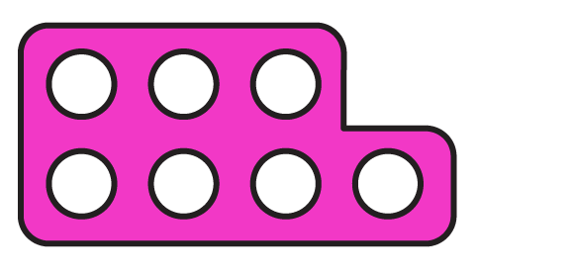
To be able to represent numbers up to 100
Talking Time:
Which representation does not show the number 43?

Slide 24
To be able to represent numbers up to 100
Talking Time:
The pink number tiles show 28 - the rest show 43.

Slide 25
To be able to represent numbers up to 100
Talking Time:
Which representation does not show the number 25?

Slide 26
To be able to represent numbers up to 100
Talking Time:
The base 10 show 16 - the rest show 25.

Slide 27
To be able to represent numbers up to 100
Activity 3:
Which representation does not show 34?

Slide 28
To be able to represent numbers up to 100
Activity 3:
The first group of base 10 show 32 - the rest show 34.

Slide 29
To be able to represent numbers up to 100
Talking Time:
Astrobee is thinking of a 2-digit number.
There are 2 more tens than ones.
There are an odd number of ones.
What number could Astrobee be thinking of? Find as many numbers as you can.

Slide 30
To be able to represent numbers up to 100
Talking Time:
Astrobee is thinking of a 2-digit number.
There are 2 more tens than ones.
There are an odd number of ones.
What number could Astrobee be thinking of? Find as many numbers as you can.
Numbers which fit Astrobee’s rule are: 31, 53, 75, 97

Slide 31
To be able to represent numbers up to 100
Talking Time:
Astrobee is thinking of a 2-digit number.
There are 3 more tens than ones.
There are an even number of ones.
What number could Astrobee be thinking of? Find as many numbers as you can.

Slide 32
To be able to count in hundreds up to 1,000
Talking Time:
Astrobee is thinking of a 2-digit number.
There are 3 more tens than ones.
There are an even number of ones.
What number could Astrobee be thinking of? Find as many numbers as you can.
Numbers which fit Astrobee’s rule are: 30, 52, 74, 96

Slide 33
To be able to represent numbers up to 100
Activity 4:
Astrobee is thinking of a 2-digit number.
There are 4 more tens than ones.
There are an even number of ones.
What number could Astrobee be thinking of? Find as many numbers as you can.
How many different ways can you make your answers?

Slide 34
To be able to represent numbers up to 100
Activity 4:
Astrobee is thinking of a 2-digit number.
There are 4 more tens than ones.
There are an even number of ones.
What number could Astrobee be thinking of? Find as many numbers as you can.
Numbers which fit Astrobee’s rule are: 40, 62, 84,
Peer/teacher assess different ways of making these numbers.

Slide 35
To be able to represent numbers up to 100
Evaluation:
Is Astrobee’s statement true or false?
Explain your answer.
This is the only way you can show 36 because it has 3 tens and 6 ones.

Slide 36
To be able to represent numbers up to 100
Evaluation:
Astrobee’s statement is false. 36 can be represented using base 10 in many ways: 36 ones, 2 tens + 16 ones, 1 ten + 26 ones.
This is the only way you can show 36 because it has 3 tens and 6 ones.

Slide 37
To be able to represent numbers up to 100
Success criteria:
I can use concrete equipment to represent numbers up to 100 and say how many tens and ones the number has
I can explain my reasoning when representing my 2-digit numbers in different ways

