Slide 1
Quiz: QWGNPXL
Stage 2 Autumn Block 1: Place Value Lesson 1: To be able to use numbers to 20
Autumn
Block 1 – Place Value
1

Slide 2
To be able to use numbers to 20
Success criteria:
I can write numbers to 20 in numerals and words, as well as represent these numerals using mathematic equipment
I can use reasoning to explain my responses when using and representing numbers 1 – 20 in numerals, words and mathematical equipment

Slide 3
To be able to use numbers to 20
Starter:
Which one is incorrect? Explain your answer.
3 > 5
5 = 5
9 < 10

Slide 4
To be able to use numbers to 20
Starter:
Which one is incorrect? Explain your answer.
The first number sentence is incorrect, as it states 3 is greater than 5. In fact, 3 is less than 5.
3 > 5
5 = 5
9 < 10

Slide 5
To be able to use numbers to 20
Talking Time:
Fill in the missing numbers in the number track.
1
3
4
6

Slide 6
To be able to use numbers to 20
Talking Time:
Fill in the missing numbers in the number track.
1
2
3
4
5
6

Slide 7
To be able to use numbers to 20
Talking Time:
Fill in the missing numbers in the number track.
10
11
13
15

Slide 8
To be able to use numbers to 20
Talking Time:
Fill in the missing numbers in the number track.
10
11
12
13
14
15

Slide 9
To be able to use numbers to 20
Talking Time:
Fill in the missing numbers in the number track.
20
19
17
15

Slide 10
To be able to use numbers to 20
Talking Time:
Fill in the missing numbers in the number track.
20
19
18
17
16
15

Slide 11
To be able to use numbers to 20
Talking Time:
Fill in the missing numbers in the number track.
one
two
six
seven
nine
ten
twelve

Slide 12
To be able to use numbers to 20
Talking Time:
Fill in the missing numbers in the number track.
one
two
three
four
five
six
seven
eight
nine
ten
eleven
twelve

Slide 13
To be able to use numbers to 20
Activity 1:
Fill in the missing numbers in the number track.
9
11
14
15
18
19

Slide 14
To be able to use numbers to 20
Activity 1:
Fill in the missing numbers in the number track.
9
10
11
12
13
14
15
16
17
18
19
20

Slide 15
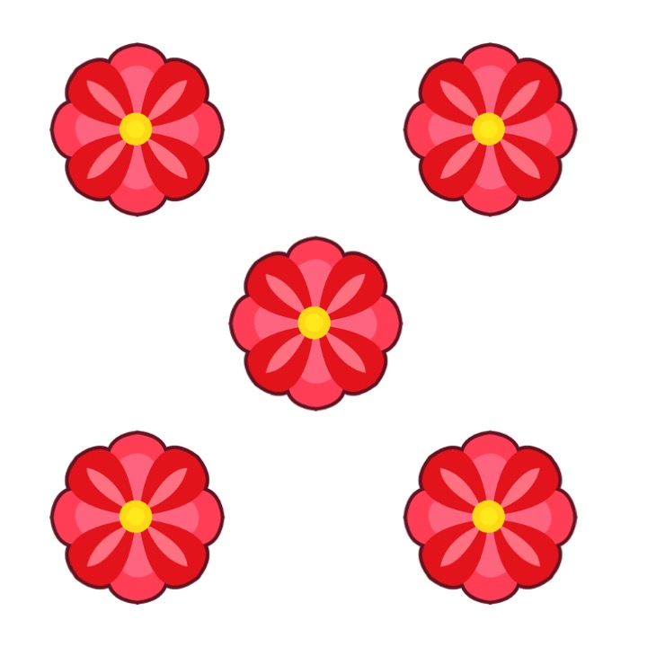
To be able to use numbers to 20
Talking Time:
What number is represented? Write the numeral and word.
________________________

Slide 16
To be able to use numbers to 20
Talking Time:
What number is represented? Write the numeral and word.
5
five

Slide 17
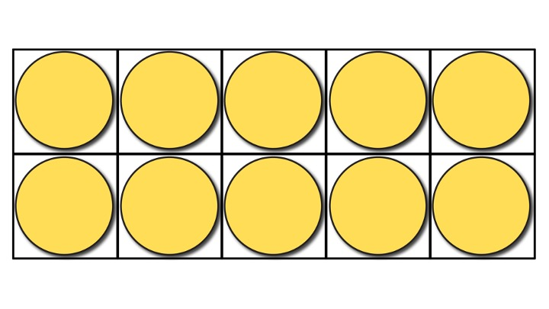
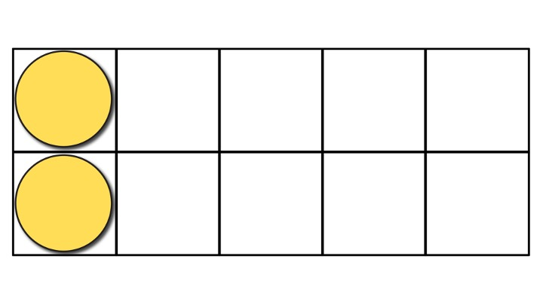
To be able to use numbers to 20
Talking Time:
What number is represented? Write the numeral and word.
________________________

Slide 18
To be able to use numbers to 20
Talking Time:
What number is represented? Write the numeral and word.
12
twelve

Slide 19
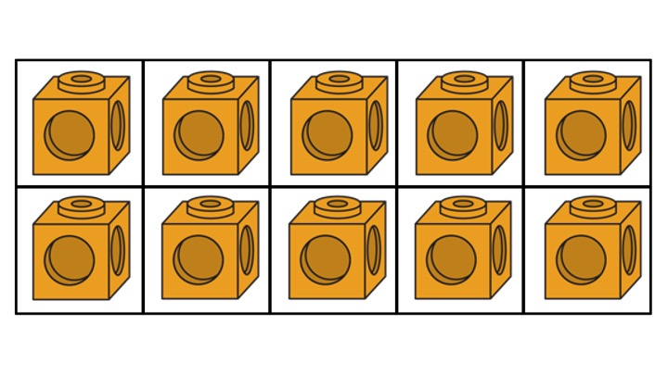
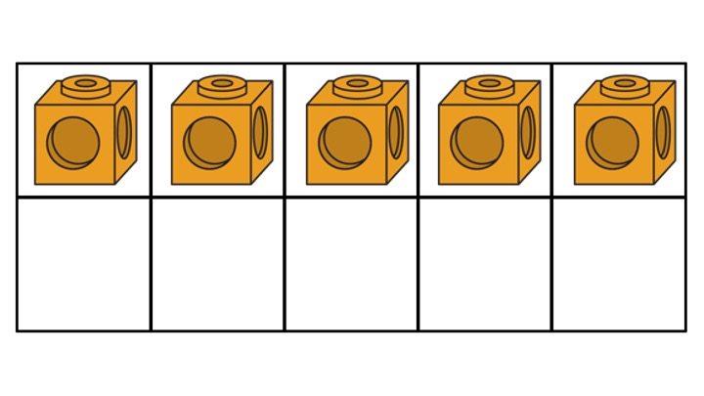
To be able to use numbers to 20
Talking Time:
What number is represented? Write the numeral and word.
________________________

Slide 20
To be able to use numbers to 20
Talking Time:
What number is represented? Write the numeral and word.
15
fifteen

Slide 21
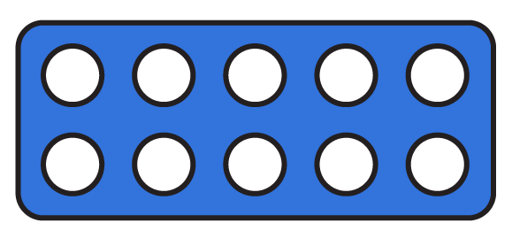
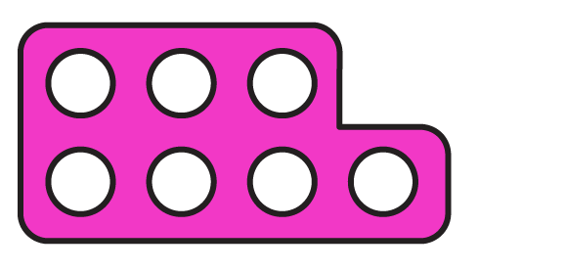
To be able to use numbers to 20
Activity 2:
What number is represented? Write the numeral and word.
________________________

Slide 22
To be able to use numbers to 20
Activity 2:
What number is represented? Write the numeral and word.
17
seventeen

Slide 23
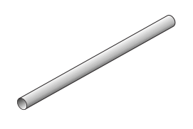
To be able to use numbers to 20
Activity 3:
Can you make each number 3 different ways using mathematical equipment?
12
20
seventeen

Slide 24
To be able to use numbers to 20
Activity 3:
You could have used number tiles, tens frames, straws, base 10 etc..
What did you notice about the tens and ones? Did you see any patterns? How did you make the numbers differently?
Peer/teacher assessment
12
20
seventeen

Slide 25
To be able to use numbers to 20
Talking Time:
Ruth has made a number – what do you think it is?
I have one full tens frame and another with one counter in it. What is my number?

Slide 26
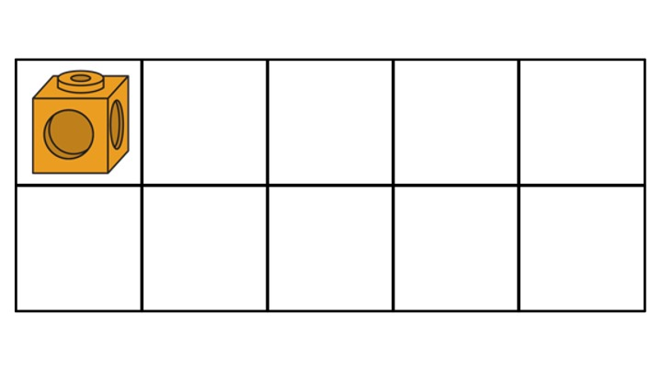
To be able to use numbers to 20
Talking Time:
Ruth has made a number – what do you think it is?
11
I have one full tens frame and another with one cube in. What is my number?

Slide 27
To be able to use numbers to 20
Talking Time:
Ruth has made a number – what do you think it is?
I have one full tens frame and another which is half full. What is my number?

Slide 28
To be able to use numbers to 20
Talking Time:
Ruth has made a number – what do you think it is?
15
I have one full tens frame and another which is half full. What is my number?

Slide 29
To be able to use numbers to 20
Activity 4:
Ruth has made a number – what do you think it is?
I have two tens frames. Both are half full. What is my number?

Slide 30
To be able to use numbers to 20
Activity 4:
How else could Ruth make 10 using the tens frames?
10
I have two tens frames. Both are half full. What is my number?

Slide 31
To be able to use numbers to 20
Evaluation:
Do you agree with Astrobee?
Explain your answer.
I have made the number 3.

Slide 32
To be able to use numbers to 20
Evaluation:
Astrobee is wrong. Although there are 3 number tiles, each represents 10. Astrobee has made 30.
I have made the number 3.

Slide 33
To be able to use numbers to 20
Success criteria:
I can write numbers to 20 in numerals and words, as well as represent these numerals using mathematic equipment
I can use reasoning to explain my responses when using and representing numbers 1 – 20 in numerals, words and mathematical equipment

