Slide 1
1
2
To be able to segment words into the correct syllables and phonemes
To spell words with the /k/ sound spelled ‘k’ and the ‘nk’ spelling pattern
This week’s words: bank, honk, tank, pink, think, kit, skin, mask, sketch, basket

Slide 2



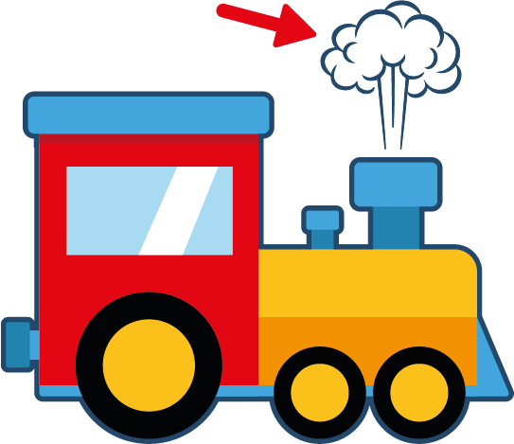

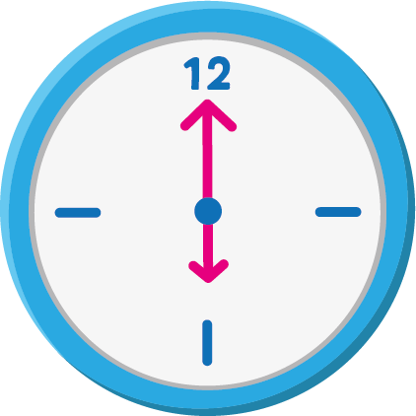

Starter
Can you write the words to match the pictures?
bell
grass
puff
fizz
z
z
z
kiss
clock
buzz

Slide 3

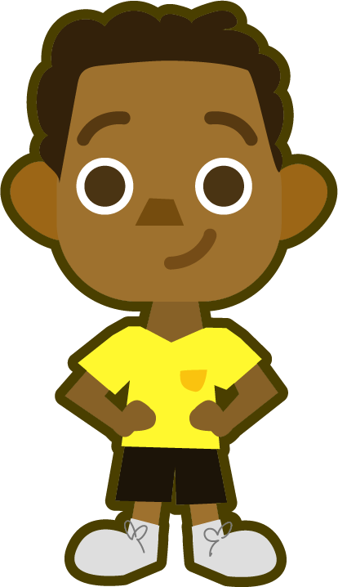
This Week’s Words
Do you know what they all mean?
What do the words have in common?
honk
tank
pink
basket
skin
think
kit
sketch
bank
mask
How many syllables are in each word?
‘basket’ has two syllables:
bas|ket
All other words have just one syllable.
This week’s words all have either a ‘k’ or an ‘nk’. Can you spot them?

Slide 4

Word Sort
Can you sort the words into those with a ‘k’
and those with an ‘nk’?
bank
honk
‘nk’
The adjacent consonants ‘nk’ only appears at the end of a base word and always follow a vowel.
‘k’ can appear anywhere in a word.
‘k’
kit
sketch
skin
pink
tank
think
mask
basket
Do you notice any patterns for where the ‘nk’ and ‘k’ occur in the words?

Slide 5
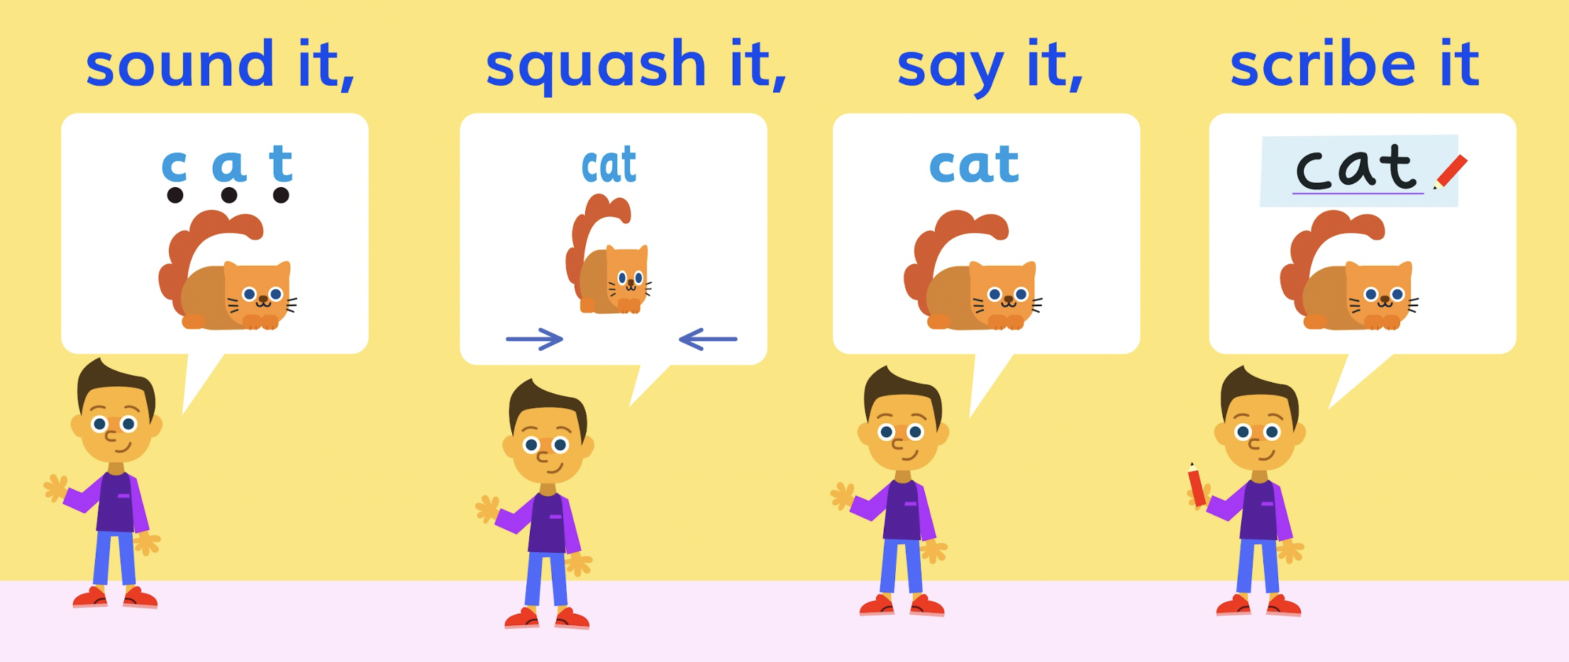
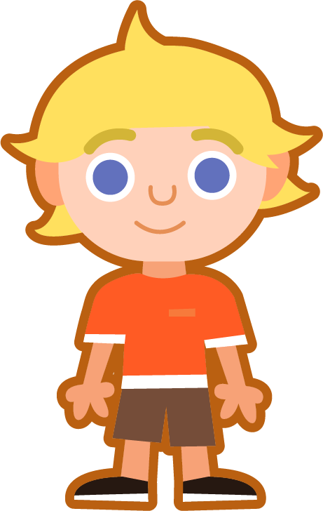
Sound It, Squash It, Say It, Scribe It
Can you sound out and write the word ‘bank’?
Can you add the sound buttons underneath?
bank
bank
Use sound buttons for each phoneme. Draw a dot for each single letter sound and a line when two or more letters make one sound.
‘nk’ contains two sounds, so will need two dots.

Slide 6
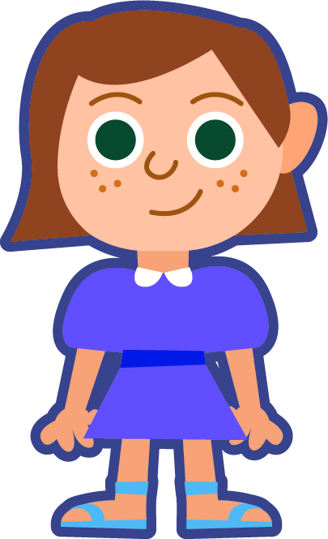
Sound It, Squash It, Say It, Scribe It
Can you sound out and write the words below?
Can you add the sound buttons underneath?
honk
tank
sketch
Here, three letters make one sound.
‘tch’ can make a /ch/ sound. Can you say /ch/?

Slide 7
Words with the /k/ sound spelled ‘k’ and the ‘nk’ spelling pattern
To be able to segment words into the correct syllables and phonemes
To spell words with the /k/ sound spelled ‘k’ and the ‘nk’ spelling pattern.
Write the word with the sound buttons underneath the phonemes and then rewrite the whole word.
Words | Phonemes | My Word
bank | bank | bank
pink
think
skin
sketch
basket

Slide 8
Words with the /k/ sound spelled ‘k’ and the ‘nk’ spelling pattern
Answers
Words | Phonemes | My Word
bank | bank | bank
pink | pink | pink
think | think | think
skin | skin | skin
sketch | sketch | sketch
basket | basket | basket

Slide 9





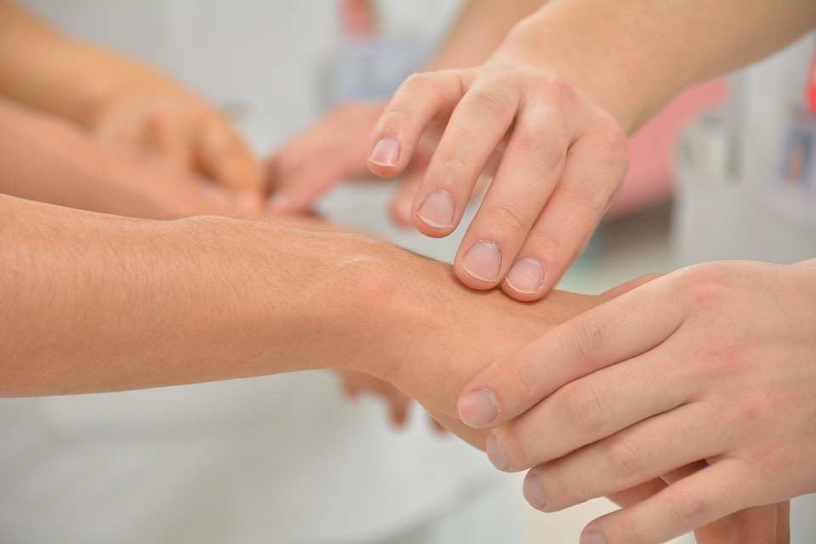

Words with the /k/ sound spelled ‘k’ and the ‘nk’ spelling pattern
To be able to segment words into the correct syllables and phonemes
To spell words with ‘k’ and ‘nk’
Write the word that matches the picture.

Slide 10
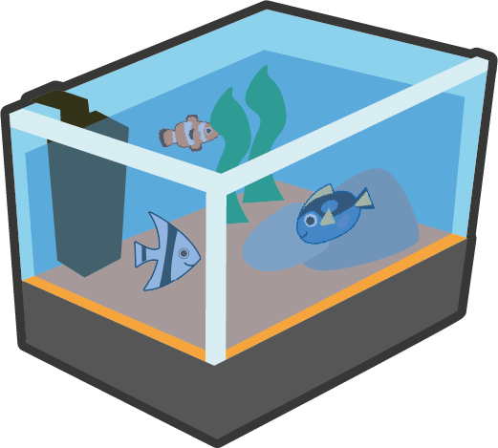

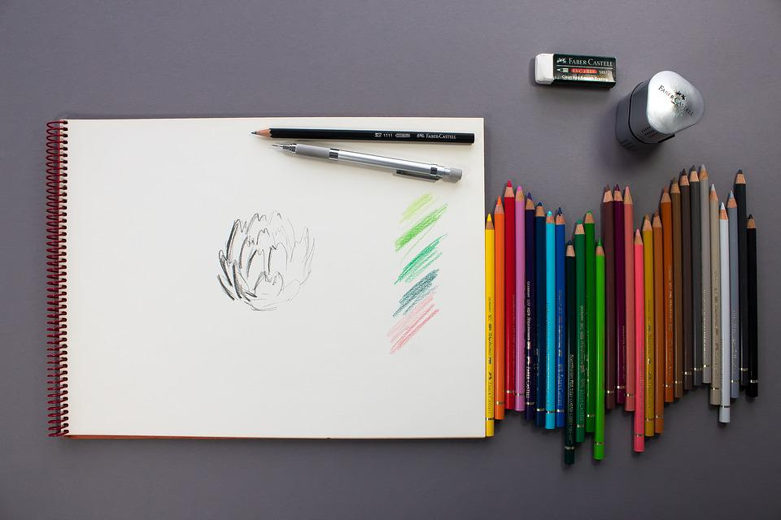
Words with the /k/ sound spelled ‘k’ and the ‘nk’ spelling pattern
To be able to segment words into the correct syllables and phonemes
To spell words with ‘k’ and ‘nk’
Write the word that matches the picture.
Choose one of this week’s words to write in a sentence.

Slide 11
Words with the /k/ sound spelled ‘k’ and the ‘nk’ spelling pattern
Answers
mask
kit
think
pink
bank
skin
basket

Slide 12
Words with the /k/ sound spelled ‘k’ and the ‘nk’ spelling pattern
Answers
tank
honk
sketch
Choose one of this week’s words to write in a sentence.
There is a fish in the tank.

Slide 13
Words with the /k/ sound spelled ‘k’ and the ‘nk’ spelling pattern
To be able to segment words into the correct syllables and phonemes
To spell words with ‘k’ and ‘nk’
Choose one of your words to complete the two sentences. Try to write three sentences of your own.
bank
honk
tank
pink
think
kit
skin
mask
sketch
basket
Your Word | Your Sentence
 | I need to go to the ________ .
 | I will _______ the horn.

Slide 14
Words with the /k/ sound spelled ‘k’ and the ‘nk’ spelling pattern
Possible Answers
bank
honk
tank
pink
think
kit
skin
mask
sketch
basket
Your Word | Your Sentence
 | I need to go to the ________ .
 | I will ________ the horn.
 | Tom puts eggs in his ________ .
 | I ________ Sam is in the garden.
 | We like to ________ the trees and flowers.
bank
bank
honk
honk
basket
basket
think
think
sketch
sketch

Slide 15
Missing Words
Can you write the missing word to finish the sentence?
tank
Did you spell
it like this? Did you remember ‘nk’ at the end?
The fish are in the ______ .
tank

Slide 16
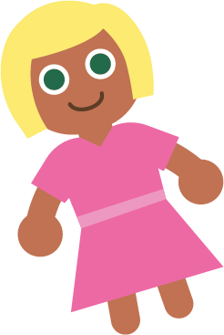
Missing Words
Can you write the missing word to finish the sentence?
pink
Did you spell
it like this? Did you remember ‘nk’ at the end?
The doll has a ______ dress.
pink

Slide 17
Missing Words
Can you write the missing word to finish the sentence?
think
Did you spell
it like this? Did you remember ‘nk’ at the end?
I ______ it is going to rain today.
think

Slide 18

Missing Words
Can you write the missing word to finish the sentence?
skin
Did you spell
it like this? Did you remember ‘k’ in the middle?
My ______ is sun burnt.
skin

Slide 19
Missing Words
Can you write the missing word to finish the sentence?
honk
Did you spell
it like this? Did you remember ‘nk’ at the end?
The car horn went ______ .
honk

Slide 20
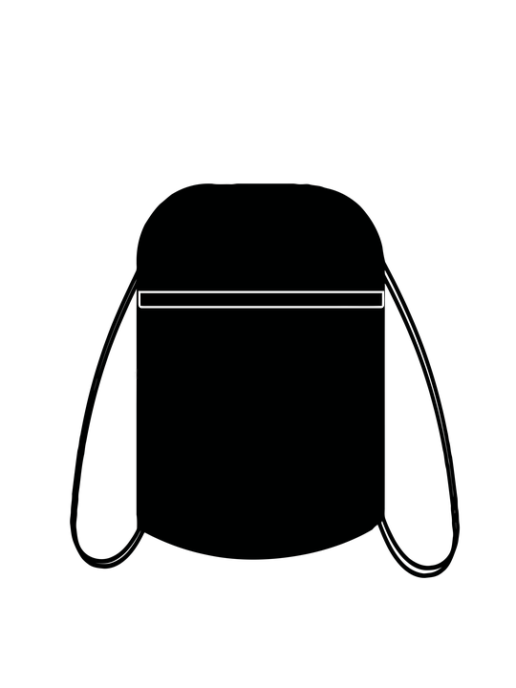
Missing Words
Can you write the missing word to finish the sentence?
kit
Did you spell
it like this? Did you remember ‘k’ at the start?
I have lost my PE ______ .
kit

Slide 21
Missing Words
Can you write the missing word to finish the sentence?
bank
Did you spell
it like this? Did you remember ‘nk’ at the end?
The money is in the ______ .
bank

Slide 22
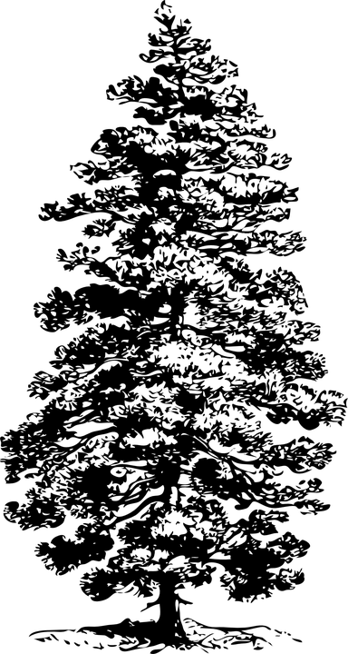
Missing Words
Can you write the missing word to finish the sentence?
sketch
I am going to ________ a picture of a tree.
Did you spell
it like this? Did you remember ‘k’ in the middle?
sketch

Slide 23
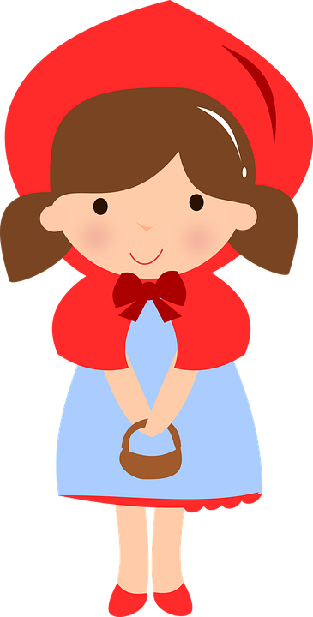
Missing Words
Can you write the missing word to finish the sentence?
Red Riding Hood had treats for Grandma in her ________ .
Did you spell
it like this? Did you remember ‘k’ in the middle?
basket
basket

Slide 24
Missing Words
Can you write the missing word to finish the sentence?
mask
Did you spell
it like this? Did you remember ‘k’ at the end?
The ______ has green feathers.
mask

