Slide 1
1
1
To be able to segment words into the correct syllables and phonemes
To spell words ending with ‘ff’, ‘ll’, ‘ss’, ‘zz’ and ‘ck’
This week’s words: puff, fluff, bell, doll, grass, kiss, buzz, fizz, clock, back

Slide 2
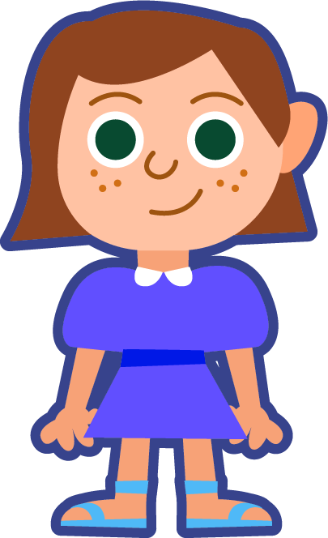
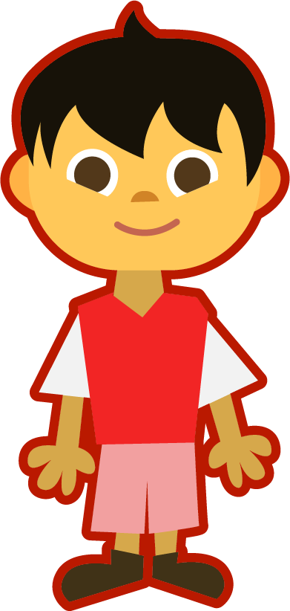
Starter
Where do the sound buttons go in these words?
sat
tap
cup
dog
snip
star
How many sounds are in the word ‘sat’?
You need a dot for each sound you can hear.
The digraph ‘ar’ makes one sound, so we draw a line beneath it.

Slide 3
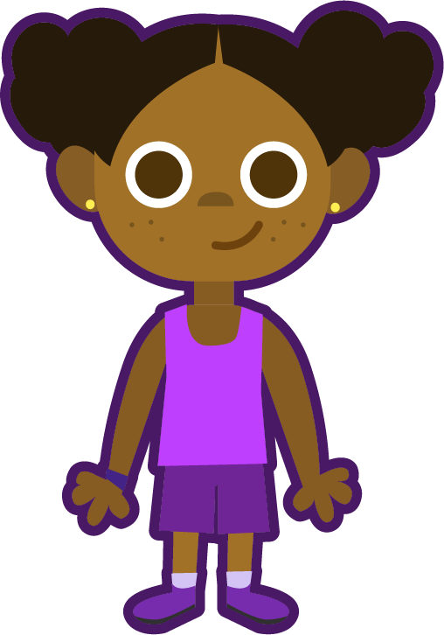
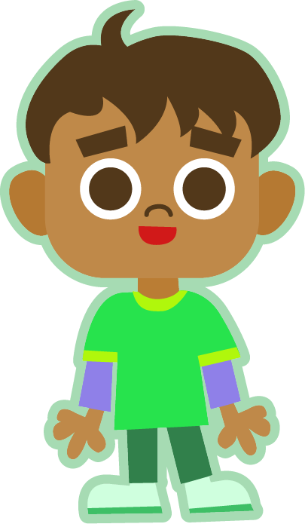
This Week’s Words
Do you know what they all mean?
How many syllables are in each word?
puff
clock
fluff
back
bell
grass
doll
kiss
buzz
fizz
This week’s words all have one syllable.
Look at the ends of the words.
A lot of our words have double letters
at the end.

Slide 4
Word Sort
Can you sort the words by their final sound?
clock
fluff
grass
doll
fizz
puff
back
bell
kiss
buzz
/f/
/l/
/s/
/z/
/k/

Slide 5
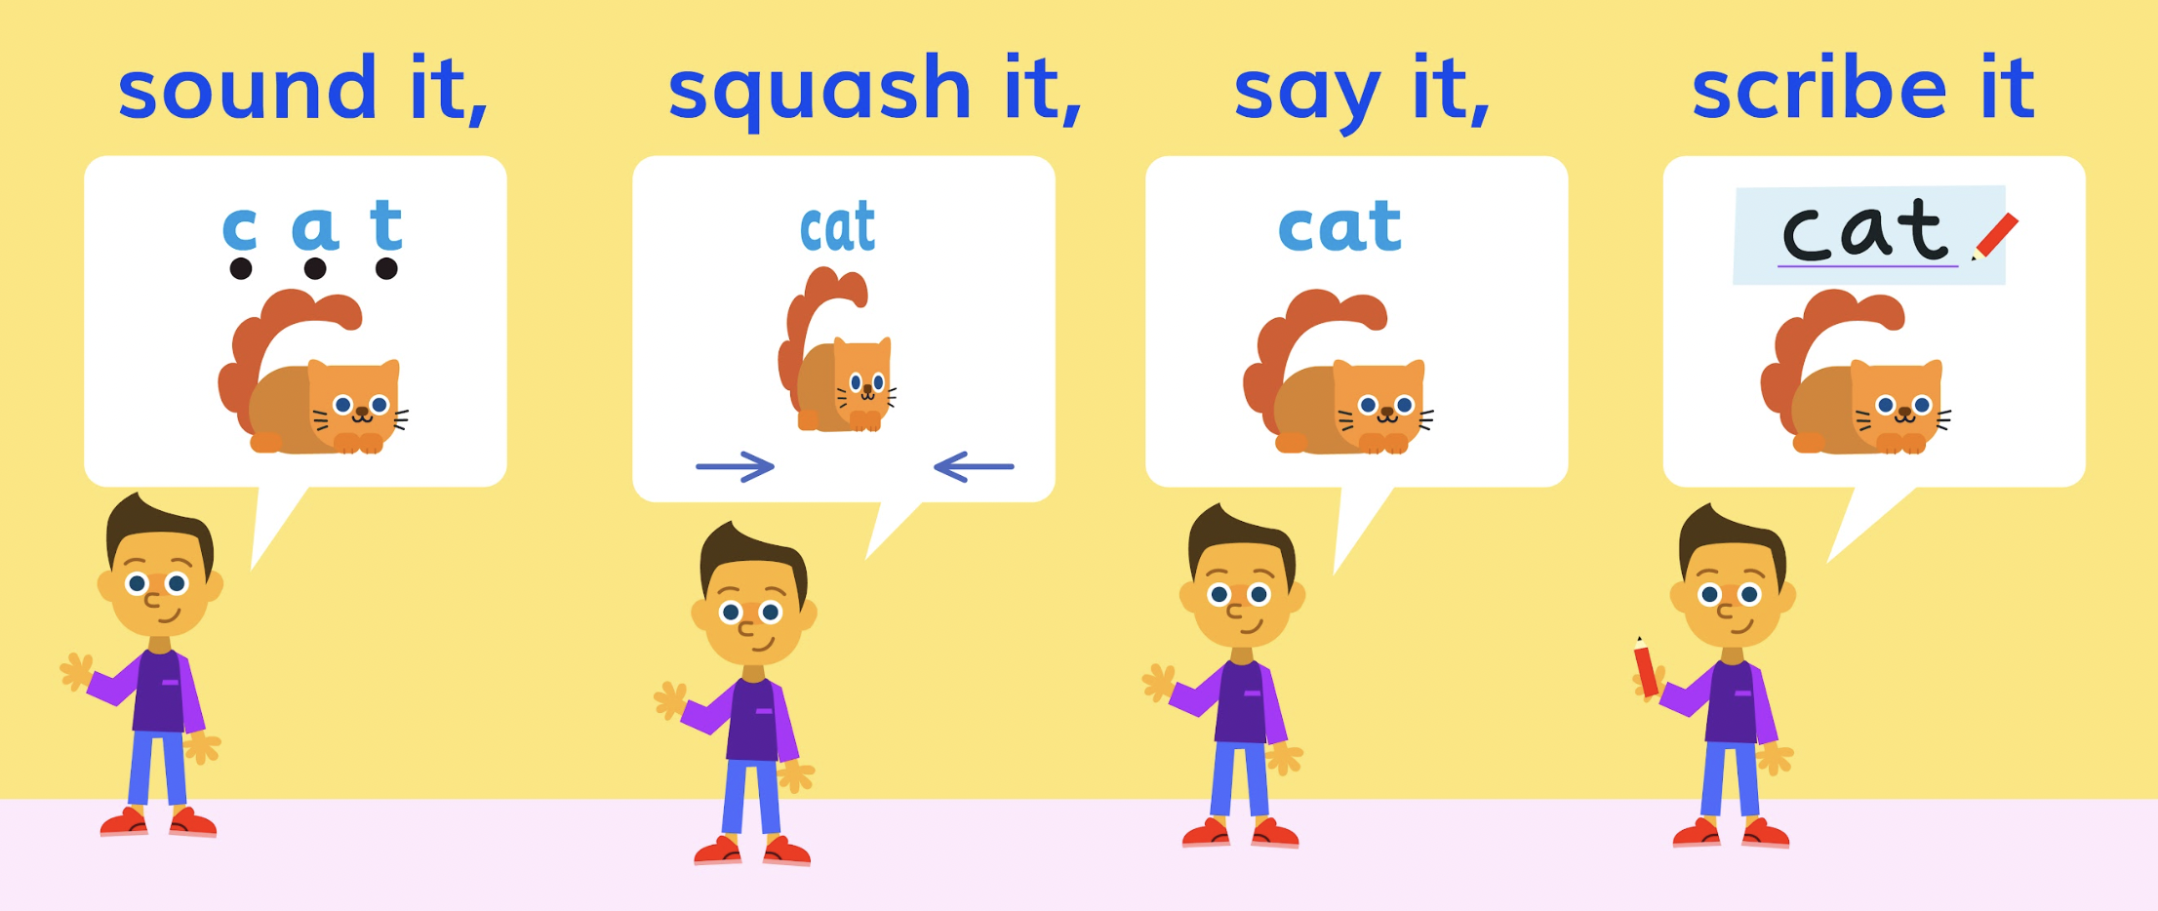
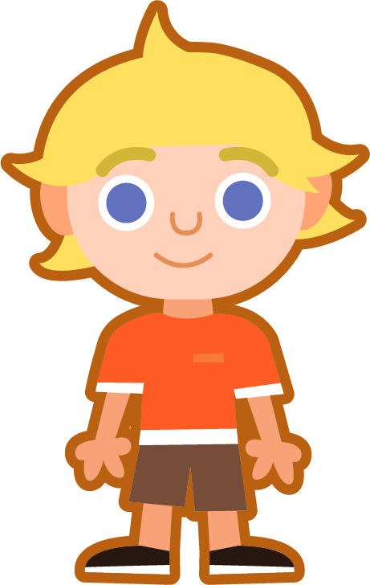
Sound It, Squash It, Say It, Scribe It
Can you sound out and write the word ‘puff’?
Can you add the sound buttons underneath?
puff
puff
Use sound buttons for each phoneme. Draw a dot for each single letter sound and a line when two or more letters make one sound.

Slide 6
Sound It, Squash It, Say It, Scribe It
Can you sound out and write the words below?
Can you add the sound buttons underneath?
bell
grass
fizz
clock
Use sound buttons for each phoneme. Draw a dot for each single letter sound and a line when two or more letters make one sound.

Slide 7
Words ending in ‘ff’, ‘ll’, ‘ss’, ‘zz’ and ‘ck’
To be able to segment words into the correct syllables and phonemes
To spell words ending in ‘ff’, ‘ll’, ‘ss’, ‘zz’ and ‘ck’
Read the word. Write each word out, adding the sound buttons for each phoneme.
Finally, rewrite the whole word.
Words | Phonemes | My Word
puff | puff | puff
fluff
doll
kiss
fizz
back

Slide 8
Words ending in ‘ff’, ‘ll’, ‘ss’, ‘zz’ and ‘ck’
Answers
Words | Phonemes | My Word
puff | puff | puff
fluff | fluff | fluff
doll | doll | doll
kiss | kiss | kiss
fizz | fizz | fizz
back | back | back

Slide 9
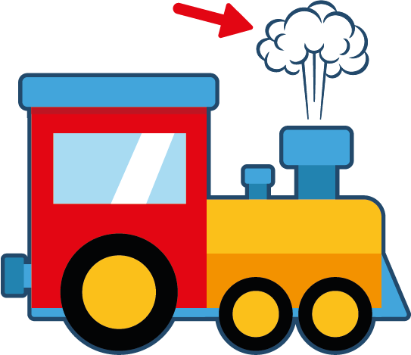
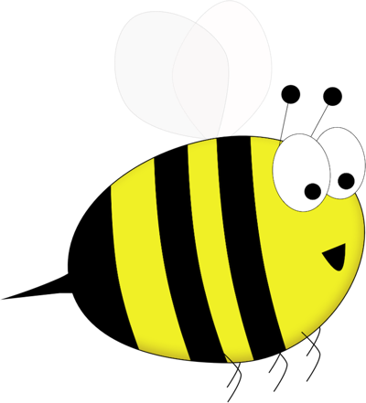
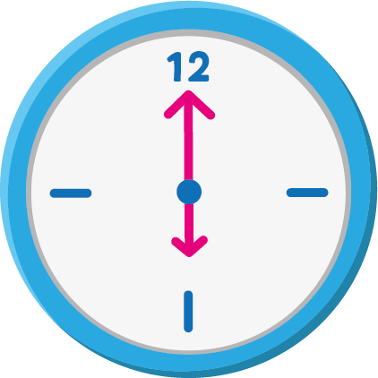
Words ending in ‘ff’, ‘ll’, ‘ss’, ‘zz’ and ‘ck’
To be able to segment words into the correct syllables and phonemes
To spell words ending in ‘ff’, ‘ll’, ‘ss’, ‘zz’ and ‘ck’
Write the word that matches the picture.
z
z
z

Slide 10
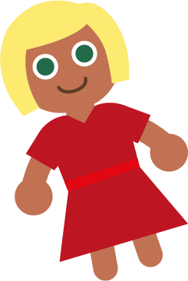
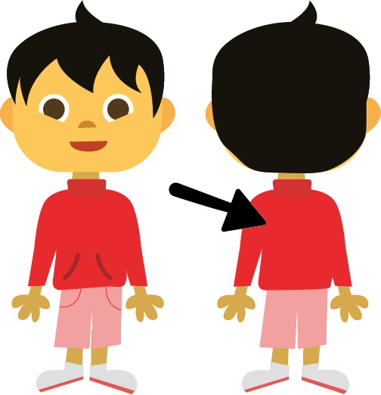
Words ending in ‘ff’, ‘ll’, ‘ss’, ‘zz’ and ‘ck’
To be able to segment words into the correct syllables and phonemes
To spell words ending in ‘ff’, ‘ll’, ‘ss’, ‘zz’ and ‘ck’
Write the word that matches the picture.
Choose one of this week’s words to write in a sentence.

Slide 11
Words ending in ‘ff’, ‘ll’, ‘ss’, ‘zz’ and ‘ck’
Answers
bell
grass
puff
fizz
z
z
z
kiss
clock
buzz

Slide 12
Words ending in ‘ff’, ‘ll’, ‘ss’, ‘zz’ and ‘ck’
Answers
fluff
doll
back
Choose one of this week’s words to write in a sentence.
I have a clock in my room.

Slide 13
Words ending in ‘ff’, ‘ll’, ‘ss’, ‘zz’ and ‘ck’
To be able to segment words into the correct syllables and phonemes
To spell words ending in ‘ff’, ‘ll’, ‘ss’, ‘zz’ and ‘ck’
Choose one of your words to complete the two sentences. Try to write three sentences of your own.
puff
fluff
bell
doll
grass
kiss
buzz
fizz
clock
back
Your Word | Your Sentence
 | The clouds looked like balls of ________ .
 | I will ring the _______ .

Slide 14
Words ending in ‘ff’, ‘ll’, ‘ss’, ‘zz’ and ‘ck’
Possible Answers
puff
fluff
bell
doll
grass
kiss
buzz
fizz
clock
back
Your Word | Your Sentence
 | The clouds looked like balls of ________ .
 | I will ring the ________ .
 | Bees can ________ all day.
 | I have a ________ in my room.
 | We like to play football on the ________ .
fluff
fluff
bell
bell
buzz
buzz
clock
clock
grass
grass

Slide 15
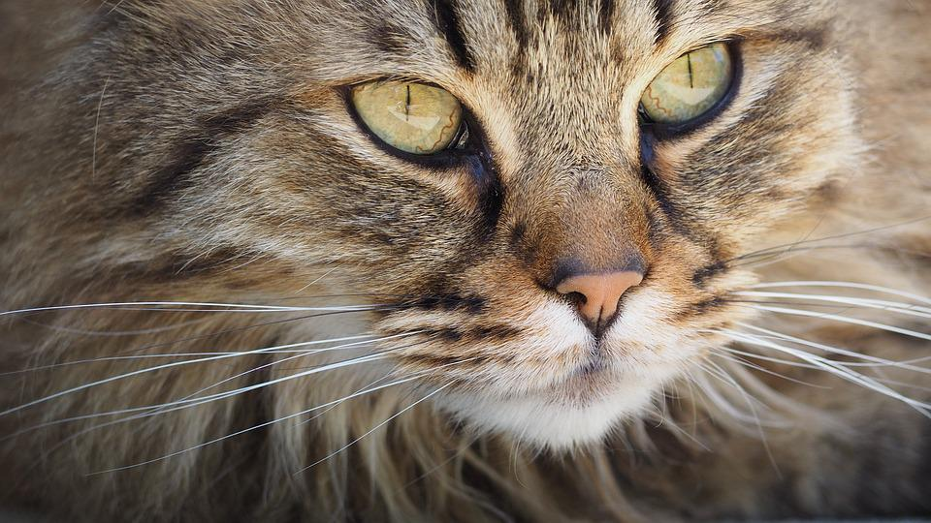
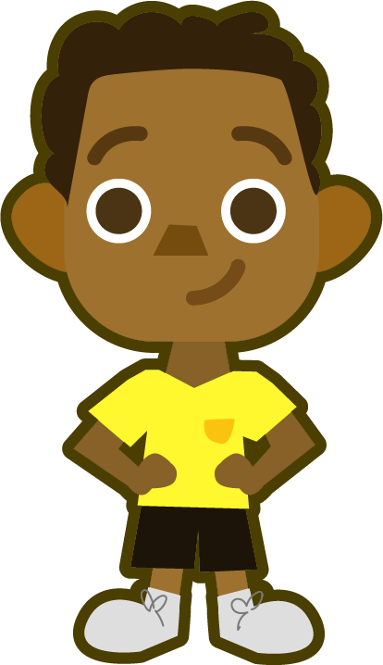
Missing Words
Can you write the missing word to finish the sentence?
Did you spell
it like this? Did you remember ‘ff’ at the end?
fluff
The cat’s fur has lots of ______ .
fluff

Slide 16
Missing Words
Can you write the missing word to finish the sentence?
Did you spell
it like this? Did you remember ‘ll’ at the end?
doll
The ______ has a red dress.
doll

Slide 17
Missing Words
Can you write the missing word to finish the sentence?
Did you spell
it like this? Did you remember ‘ll’ at the end?
bell
The teacher rang the ______ .
bell

Slide 18
Missing Words
Can you write the missing word to finish the sentence?
Did you spell
it like this? Did you remember ‘ss’ at the end?
grass
The ______ at the park is green.
grass

Slide 19
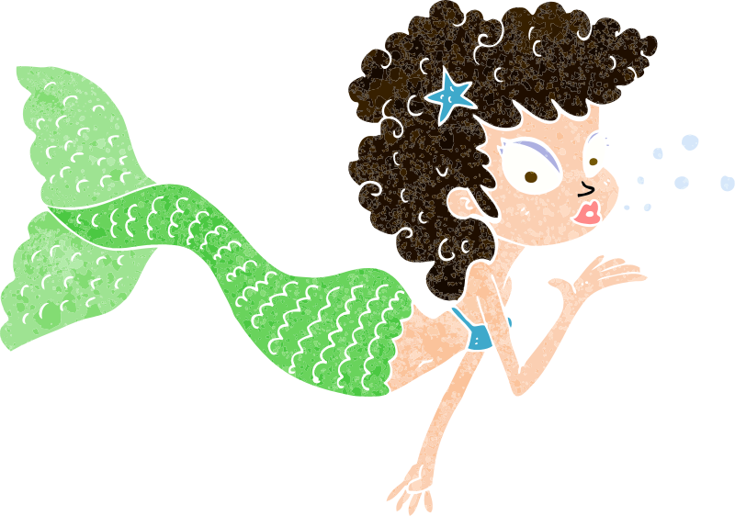
Missing Words
Can you write the missing word to finish the sentence?
Did you spell
it like this? Did you remember ‘ss’ at the end?
kiss
The mermaid blew a ______ .
kiss

Slide 20
Missing Words
Can you write the missing word to finish the sentence?
Did you spell
it like this? Did you remember ‘zz’ at the end?
buzz
Bumble’s wings ______ .
buzz

Slide 21
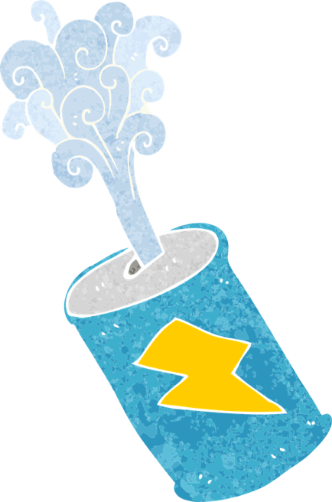
Missing Words
Can you write the missing word to finish the sentence?
Did you spell
it like this? Did you remember ‘zz’ at the end?
fizz
The can was full of ______ .
fizz

Slide 22
Missing Words
Can you write the missing word to finish the sentence?
Did you spell
it like this? Did you remember ‘ck’ at the end?
clock
You tell the time by using a ______ .
clock

Slide 23
Missing Words
Can you write the missing word to finish the sentence?
Did you spell
it like this? Did you remember ‘ck’ at the end?
back
The girl’s hair ran down her ______ .
back

Slide 24
Missing Words
Can you write the missing word to finish the sentence?
Did you spell
it like this? Did you remember ‘ff’ at the end?
puff
A ______ of smoke came from the train.
puff

