Slide 1
2
2
To be able to segment words into the correct syllables and phonemes
To spell words where ‘ge’ makes a /j/ sound
This week’s words: change, charge, range, orange, hinge, strange, dungeon, sponge, pigeon, fringe

Slide 2

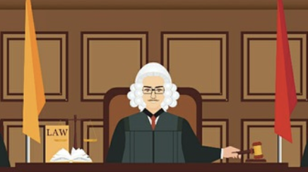



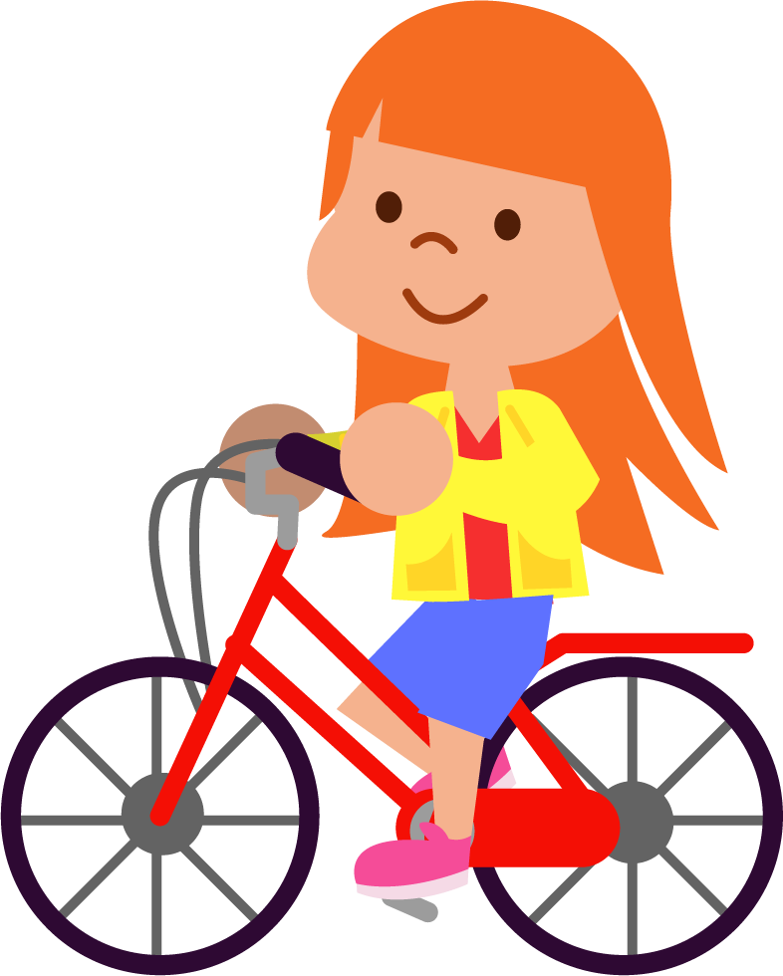

Starter
Can you write the word that matches the picture?
bridge
judge
wedge
badge
lodge
edge

Slide 3
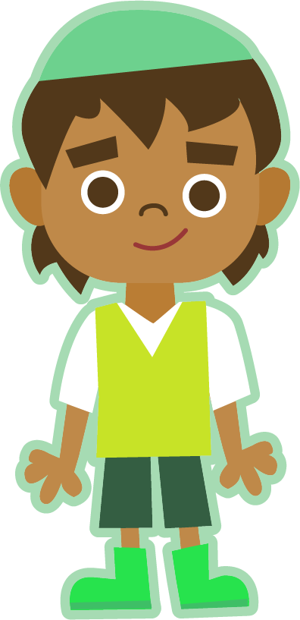

This Week’s Words
Do you know what they all mean?
What do the words have in common?
change
orange
sponge
charge
or/ange
pigeon
range
hinge
pi/geon
strange
fringe
This week’s words all have the
digraph ‘ge’.
What sound does
it make?
dungeon
How many
syllables does each word have?
dun/geon
Notes:
Most of this week’s words have one syllable. ‘Orange’, ‘pigeon’ and ‘dungeon’ have two syllables.

Slide 4
Word Sort
Can you sort this week’s words by how many
sounds are in each word?
charge
change
strange
orange
dungeon
‘Change’ has four sounds:
ch-a-n-ge.
pigeon
hinge
range
fringe
sponge
3
4
5
6

Slide 5
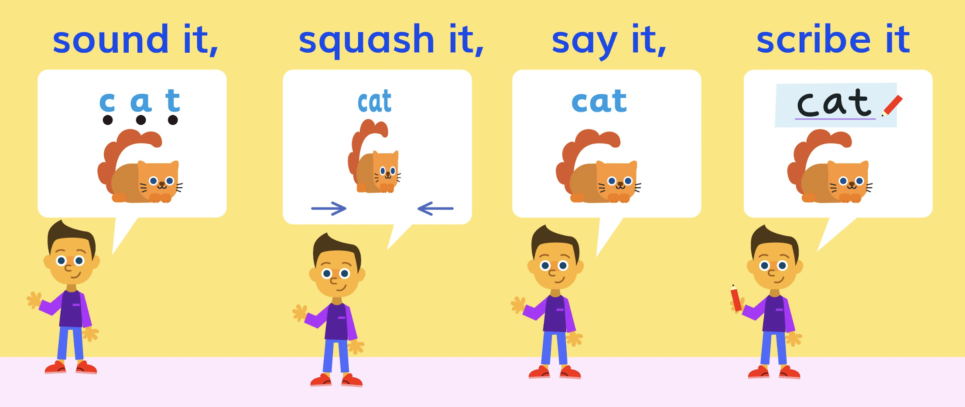
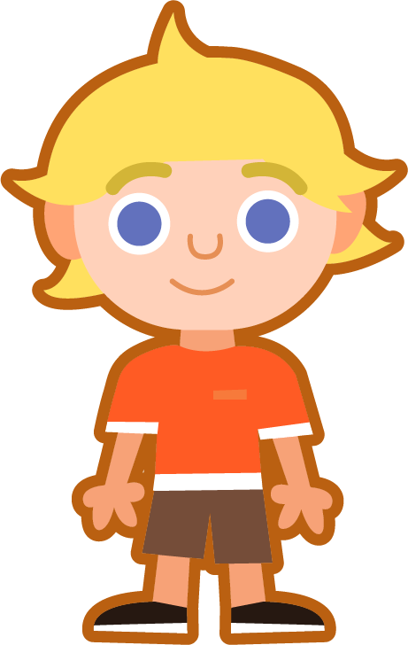

Sound It, Squash It, Say It, Scribe It
Can you sound out and write the words below?
Can you add the sound buttons underneath?
orange
Where were the syllable breaks in ‘orange’, ’pigeon’
and ‘dungeon’?
orange
or/ange
pigeon
charge
dungeon
Use sound buttons for each phoneme. Draw a dot for each single letter sound and a line when two or more letters make one sound.
pi/geon
dun/geon

Slide 6
Phoneme Maps
Look at the different phoneme maps.
Write all the words which share a map.

Slide 7
Phoneme Maps
Answers
orange
pigeon
sponge
charge
fringe
range
dungeon
hinge
strange
change

Slide 8
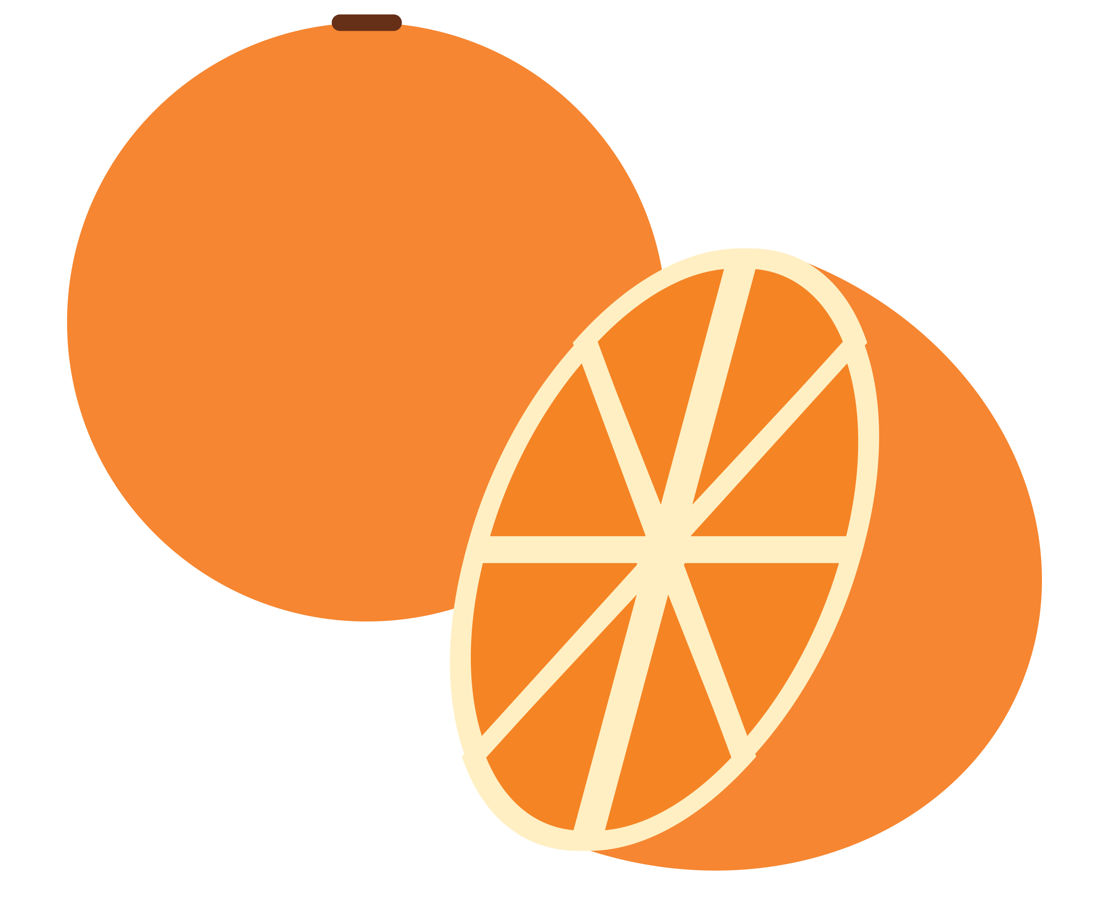
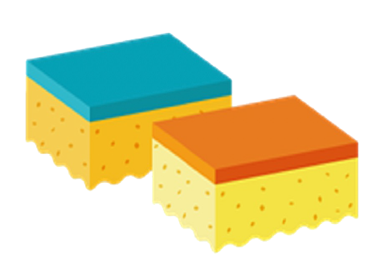
Sentences and Synonyms
Write a sentence about the pictures below. Remember to include the word in your sentence. Then read the sentences and replace the underlined word with one of the blue words.
orange
sponge
 | There was an unusual sound coming from the forest. | “Attack!” shouted Ben.
 | Can I swap seats with you? | The cell was cold and dark.
change
charge
strange
dungeon

Slide 9
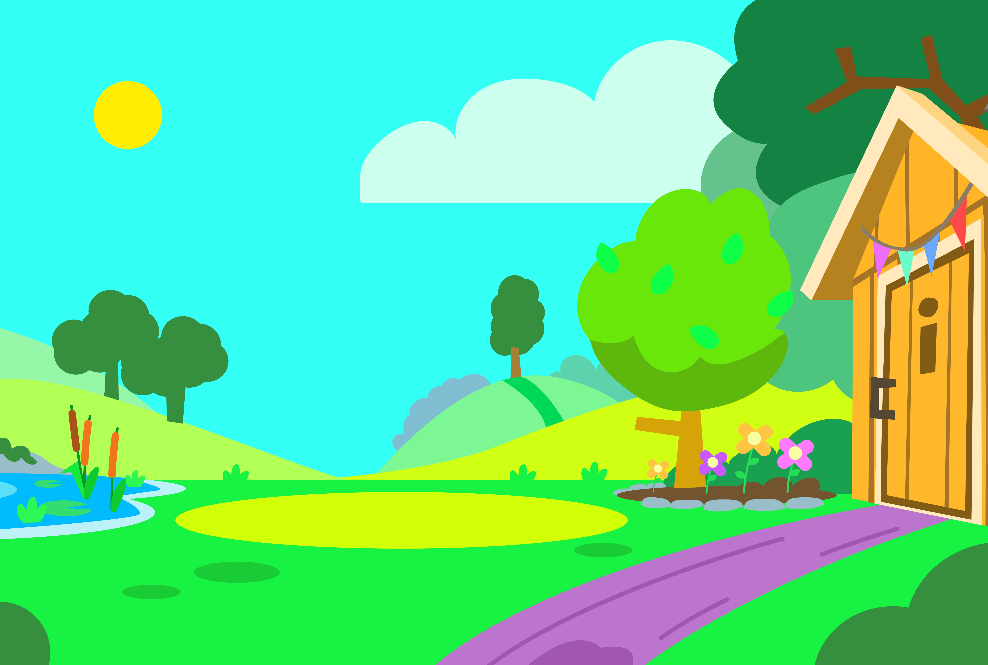



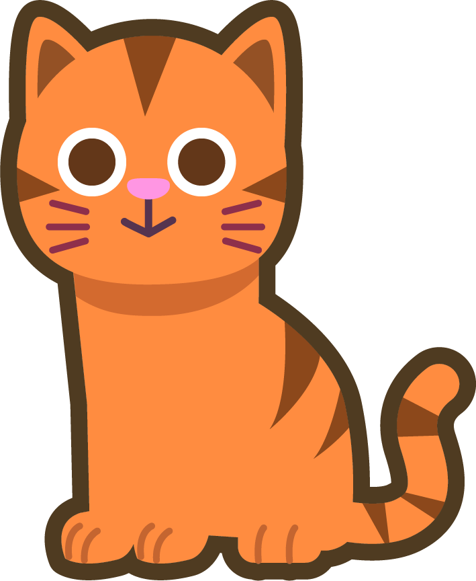
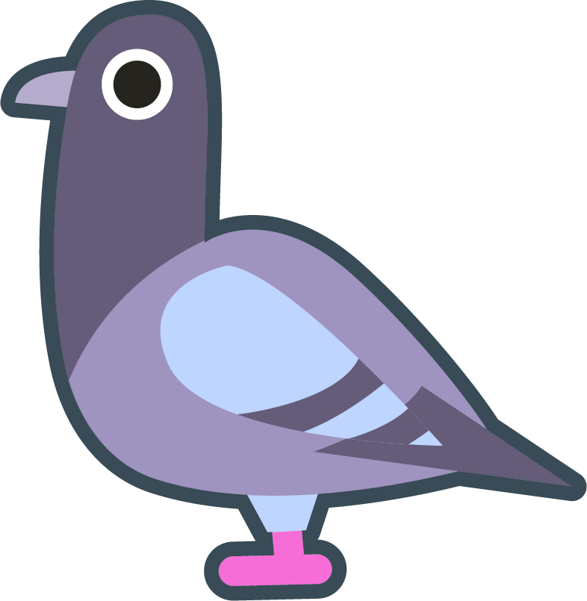
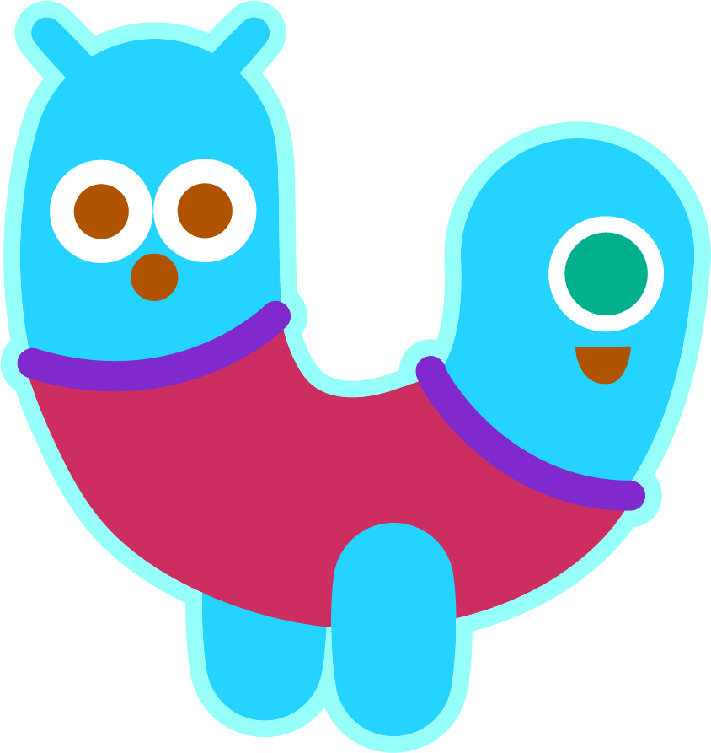
Words in Action
Can you write a description of this picture?
Words to include: orange, pigeon, strange

Slide 10
Sentences and Synonyms
Answers
orange
sponge
My favourite fruit is an orange, they’re so tasty.
You can use a sponge to clean things.
 | There was an unusual sound coming from the forest. | “Attack!” shouted Ben.
 | Can I swap seats with you? | The cell was cold and dark.
change
charge
strange
Charge
strange
dungeon
change
dungeon

Slide 11
Words in Action
Possible Answer
Words to include: orange, pigeon, strange
The pigeon and the orange cat saw some very strange things in the garden. Three cute aliens stopped by for tea and a slice of sponge cake. One alien was blue with two heads, another alien had four arms and the orange alien only had one eye.

Slide 12

Word Spotter
Clap your hands when you see one of this week’s words.
charge
orange
range
sponge
change
badge
dungeon
hinge
fringe
ridge
fudge
strange
smudge
lodge
wedge
pigeon

Slide 13
Words for Continuous Provision (Optional)
charge | orange | strange | sponge | fringe
change | range | hinge | dungeon | pigeon

Slide 14
Phoneme Maps for Continuous Provision (Optional)

