Slide 1
2
1
To be able to segment words into the correct syllables and phonemes
To spell words where ‘dge’ makes a /j/ sound
This week’s words: badge, edge, bridge, dodge, fudge, ridge, smudge, judge, wedge, lodge

Slide 2
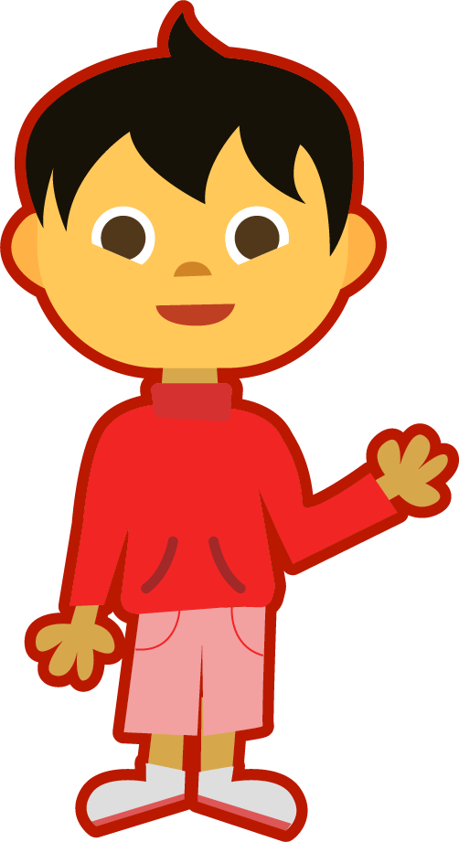
Starter
Where do the sound buttons go in these words?
wait
playground
clay
same
shouting
think
grass
A split digraph is represented by underlined letters joined by a curved line.
Use sound buttons for each phoneme. Draw a dot for each single letter sound and a line when two or more letters make one sound.

Slide 3
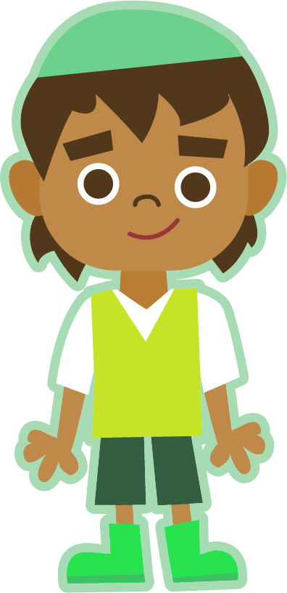
This Week’s Words
Do you know what they all mean?
What do the words have in common?
badge
edge
bridge
dodge
fudge
ridge
smudge
judge
wedge
lodge
This week’s words all have the trigraph ‘dge’. It makes a /j/ sound.
How many syllables does each word have?

Slide 4
Word Sort
Can you sort the words by the sound
heard before ‘dge’?
bridge
Can you think of any more words that fit these patterns?
badge
edge
dodge
judge
fudge
ridge
lodge
wedge
smudge
hedge
pledge
nudge
porridge
splodge
sledge
budge
fridge
/a/
/o/
/e/
/u/
/i/

Slide 5
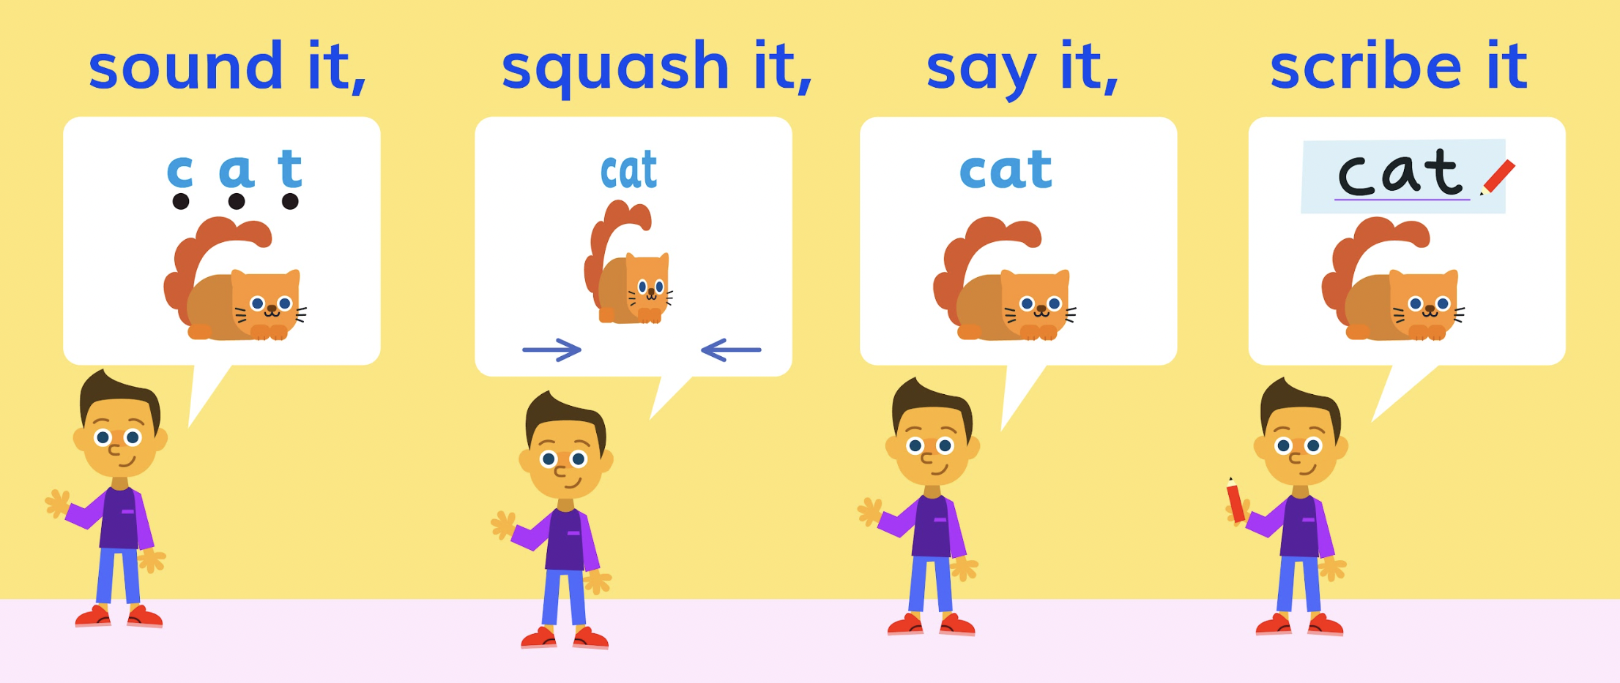
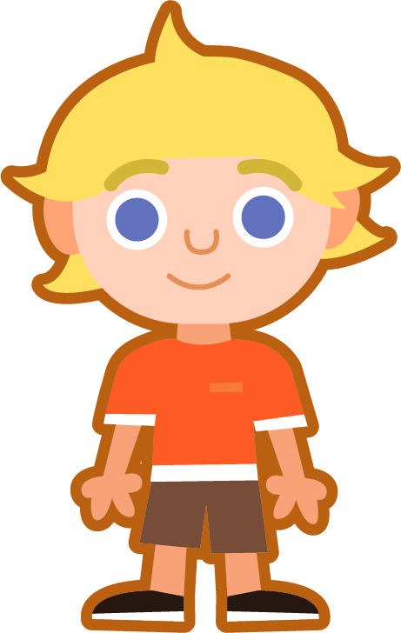
Sound It, Squash It, Say It, Scribe It
Can you sound out and write the words below?
Can you add the sound buttons underneath?
smudge
smudge
fudge
Use sound buttons for each phoneme. Draw a dot for each single letter sound and a line when two or more letters make one sound.
edge
bridge

Slide 6
Words where ‘dge’ makes a /j/ sound
To be able to segment words into the correct syllables and phonemes
To spell words where ‘dge’ makes a /j/ sound
Look at the different phoneme maps. Write all the words which share a map.

Slide 7
Words where ‘dge’ makes a /j/ sound
Answers
wedge
dodge
judge
fudge
lodge
badge
ridge
bridge
smudge
edge

Slide 8
Words where ‘dge’ makes a /j/ sound
To be able to segment words into the correct syllables and phonemes
To spell words where ‘dge’ makes a /j/ sound
Read the words. Put a tick if the word is spelled correctly and a cross if it is incorrect.
Correct the incorrect words, then complete the sentence activities.
Word |  | Spelled Correctly
badge
edje
brige
dodge
fuj
rijge
smudge
judje
wedge
lodje
Write the word ‘bridge’ in a sentence.
Choose another two words to write
in one sentence.

Slide 9
Words where ‘dge’ makes a /j/ sound
Answers
Word |  | Spelled Correctly
badge
edje |  | edge
brige |  | bridge
dodge
fuj |  | fudge
rijge |  | ridge
smudge
judje |  | judge
wedge
lodje |  | lodge
Write the word ‘bridge’ in a sentence.
The bridge crossed over the river.
Choose another two words to write
in one sentence.
The judge loved to eat vanilla fudge.

Slide 10
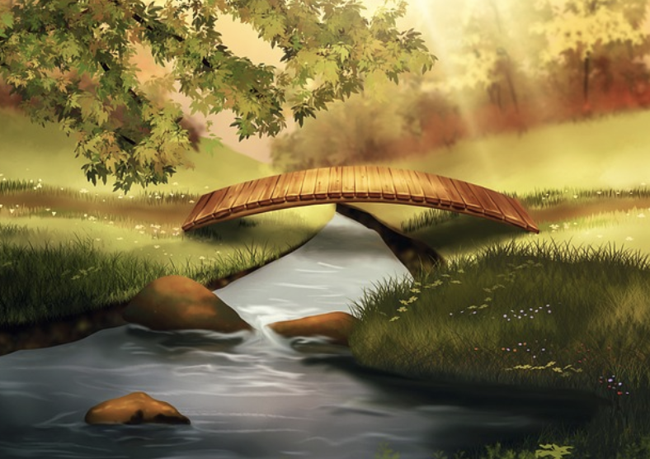
Words where ‘dge’ makes a /j/ sound
To be able to segment words into the correct syllables and phonemes
To spell words where ‘dge’ makes a /j/ sound
Write a sentence about the pictures below. Remember to include the word in your sentence. Then read the sentences and replace the underlined word with one of the blue words.
bridge
badge
 | The hikers stayed in the cabin on their long journey. | The mouse ate a huge chunk of cheese.
 | I was able to avoid the slow-moving cars. | The hill gave Nasiba the best view of the railway bridge.
dodge
ridge
wedge
lodge

Slide 11
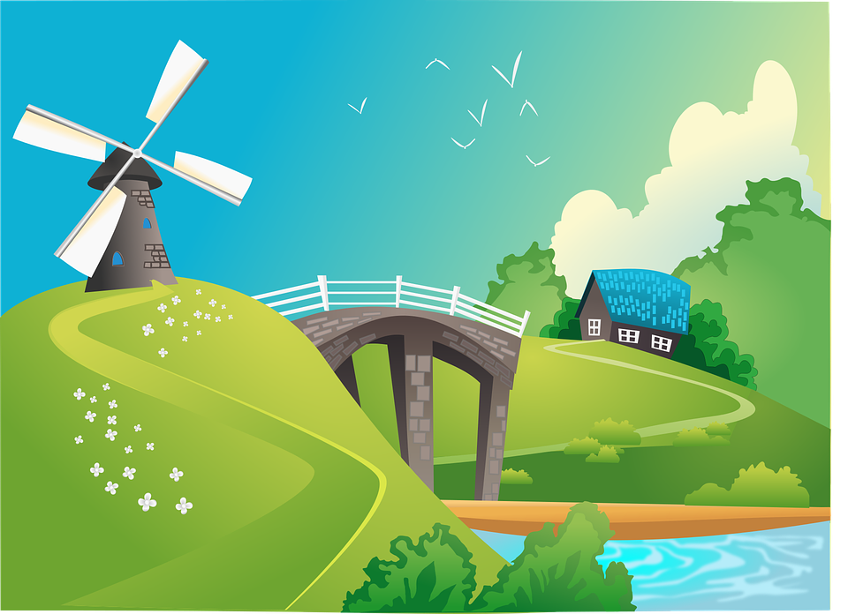
Words where ‘dge’ makes a /j/ sound
To be able to segment words into the correct syllables and phonemes
To spell words where ‘dge’ makes a /j/ sound
Can you write a description of this picture?
Words to include: bridge, lodge, edge

Slide 12
Words where ‘dge’ makes a /j/ sound
Answers
bridge
badge
The wooden bridge crossed the river.
I won a gold badge for finishing the race first.
 | The hikers stayed in the cabin on their long journey. | The mouse ate a huge chunk of cheese.
 | I was able to avoid the slow-moving cars. | The hill gave Nasiba the best view of the railway bridge.
dodge
ridge
lodge
wedge
wedge
lodge
dodge
ridge

Slide 13
Words where ‘dge’ makes a /j/ sound
Possible Answer
Can you write a description of this picture?
Words to include: bridge, lodge, edge
On the edge of the forest was a beautiful wooden lodge. The only way to reach it was by crossing a tall, stone bridge. On the ridge stood a huge windmill with white sails.

Slide 14
Missing Words
Can you write the missing words to finish the sentence?
badge
bridge
Our school _______ has a picture of a _______ on it.
Did
you spell
them like this? Did you remember the ‘dge’ trigraph?
badge
bridge

Slide 15
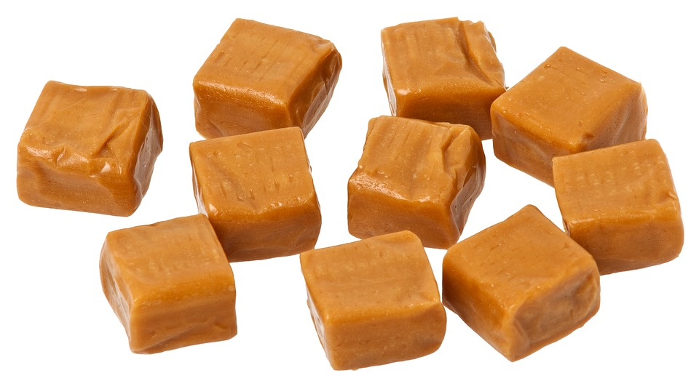
Missing Words
Can you write the missing words to finish the sentence?
judge
fudge
The competition _______ said my _______ tasted the best.
Did
you spell
them like this? Did you remember the ‘dge’ trigraph?
judge
fudge

Slide 16
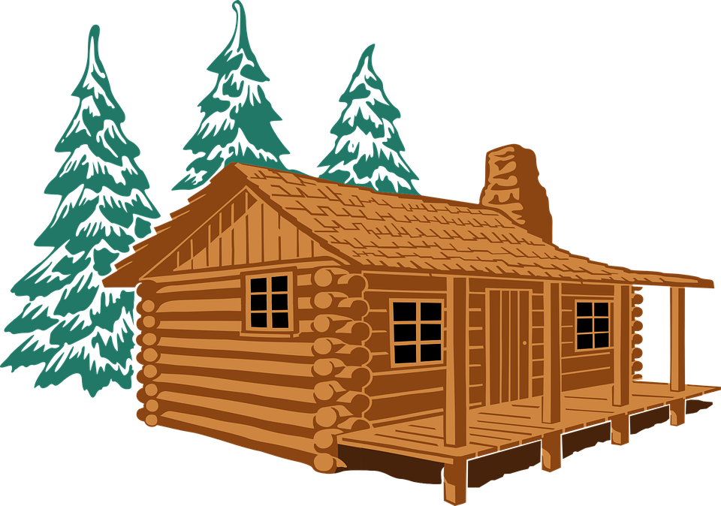
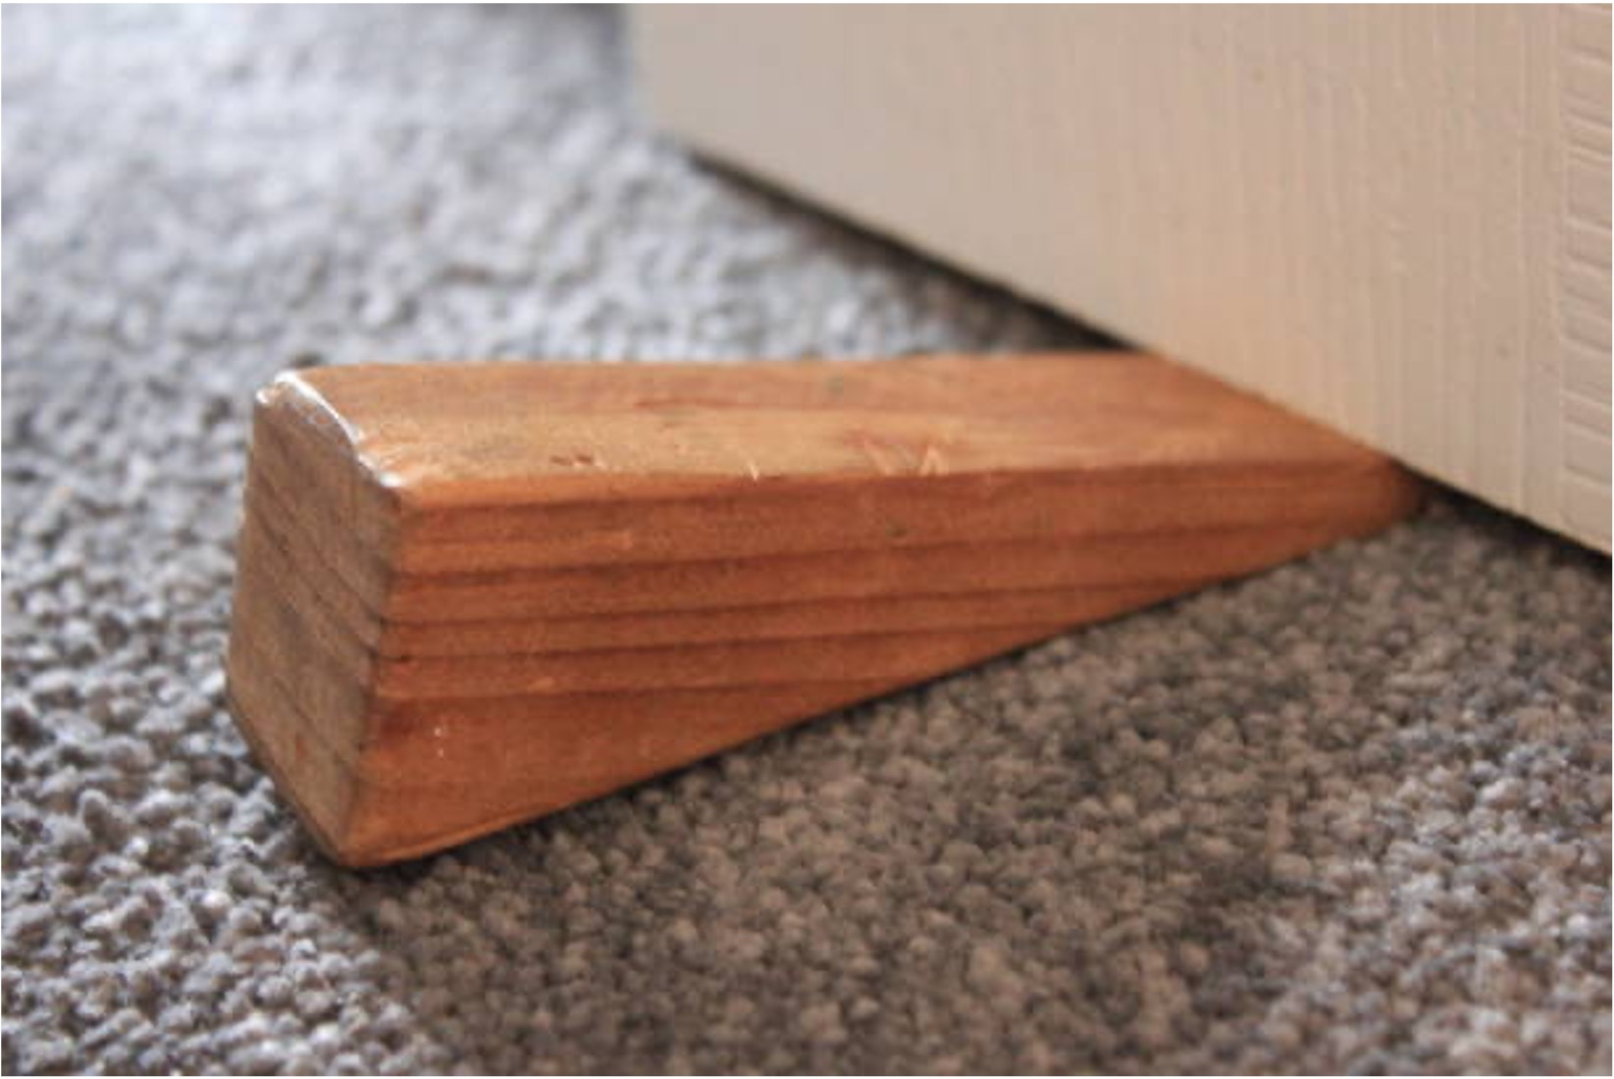
Missing Words
Can you write the missing words to finish the sentence?
wedge
lodge
I used a door _______ to hold the _______ door open.
Did
you spell
them like this? Did you remember the ‘dge’ trigraph?
wedge
lodge

Slide 17
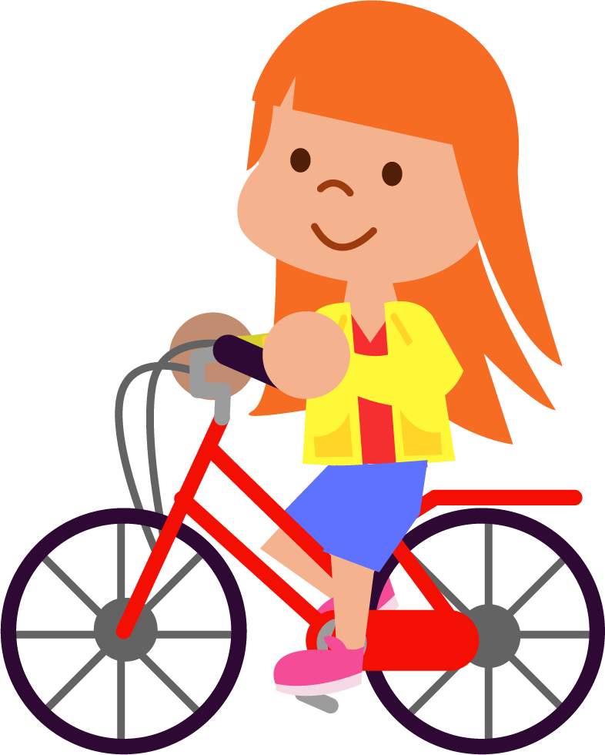
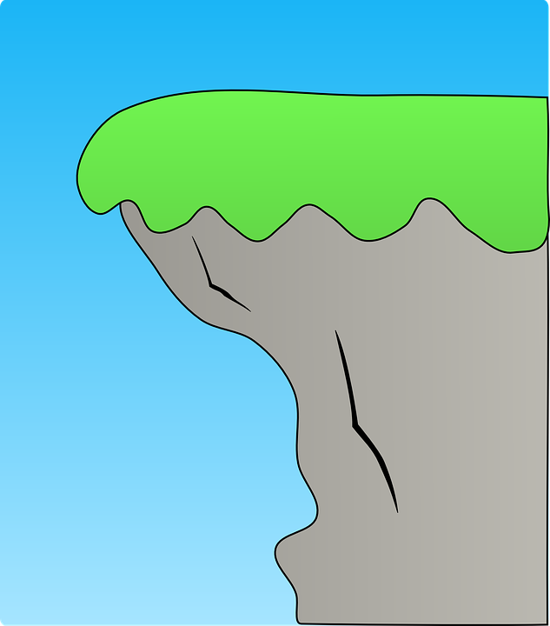
Missing Words
Can you write the missing words to finish the sentence?
edge
ridge
Dana had to be careful at the _______ of the _______ .
Did
you spell
them like this? Did you remember the ‘dge’ trigraph?
edge
ridge

Slide 18
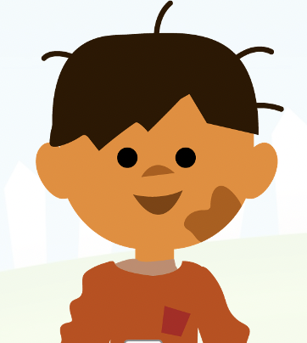
Missing Words
Can you write the missing words to finish the sentence?
dodge
Kai almost managed to _______ the ball,
but got a ________ of mud on his cheek.
smudge
Did
you spell
them like this? Did you remember the ‘dge’ trigraph?
dodge
smudge

Slide 19
Words for Continuous Provision (Optional)
edge | dodge | ridge | judge | lodge
badge | bridge | fudge | smudge | wedge

Slide 20
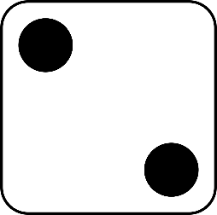
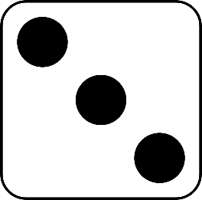
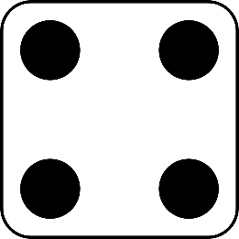
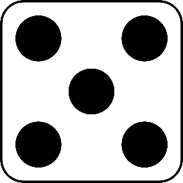
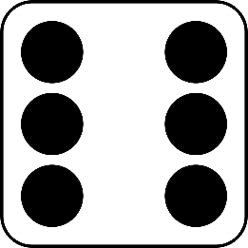
Roll and Read
Play with a partner
You will need a die and two different coloured counters
Take it in turns to roll a die
Whichever number you land on, read a word from that column
If you are correct, put a counter over the word
The first person to get four counters in a row wins
edge | bridge | wedge | bridge | budge | pledge
badge | ridge | lodge | lodge | hedge | porridge
dodge | smudge | bridge | pledge | nudge | sledge
fudge | judge | smudge | sledge | fridge | splodge

