Slide 1
3
2
To be able to segment words into the correct syllables and phonemes
To spell words where the digraph ‘ou’ makes an /u/ sound
This week’s words: touch, double, country, trouble, young, cousin, enough, couple, encourage, flourish

Slide 2
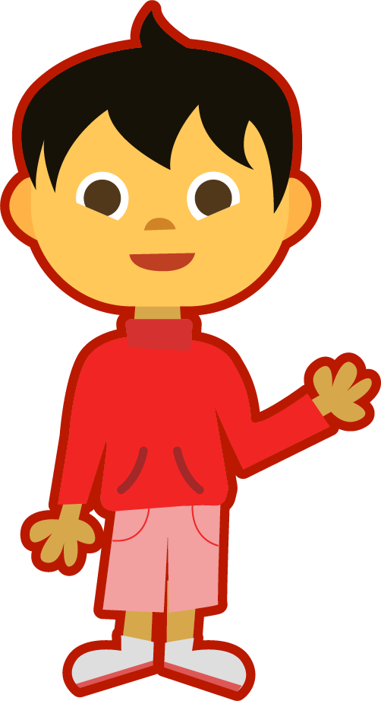
Starter
Can you add the sound buttons to these
words from last week?
sprout
ouch
found
mouth
around
Use sound buttons for each phoneme. Draw a dot for each single letter sound and a line when two or more letters make one sound.

Slide 3
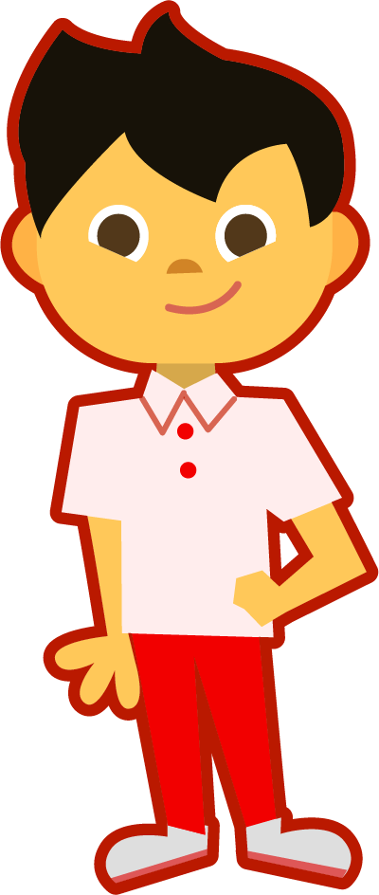
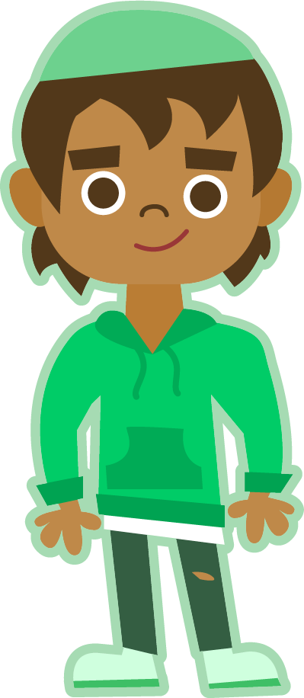
This Week’s Words
Do you know what they all mean?
What do they have in common?
touch
double
country
trouble
young
cousin
enough
couple
flourish
They all have the ‘ou’ digraph.
What sound does it make in these words?
encourage
Where does the ‘ou’ digraph appear most often in our spellings?

Slide 4
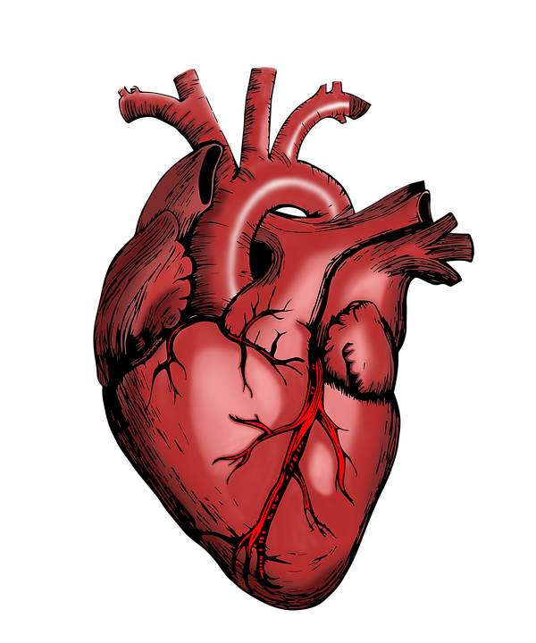
Etymology
What does it mean if you ‘encourage’ someone?
cheer on
empower
inspire
motivate
‘Encourage’ comes from the Old French word encoragier meaning ‘to make strong or hearten (give hope to)’.
The French word for
heart is cœur.
Can you see the link between cœur and encourage?
So, when you encourage someone, you are ‘heartening’ them; giving them hope and making them stronger.

Slide 5
Word Sort
Can you match the words to the correct
number of syllables?
double
country
flourish
trouble
young
cousin
enough
encourage
couple
touch
1 syllable
2 syllables
3 syllables

Slide 6
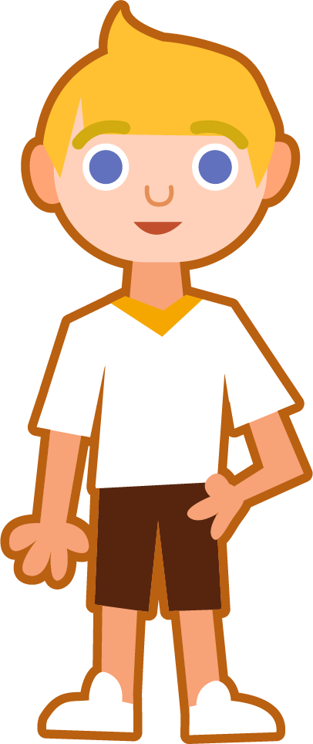
Syllable Maps
enough
Clap out
the ‘beats’ for each syllable.
e|nough
2
double
flourish
encourage
dou|ble
2
flour|ish
2
en|cour|age
3

Slide 7
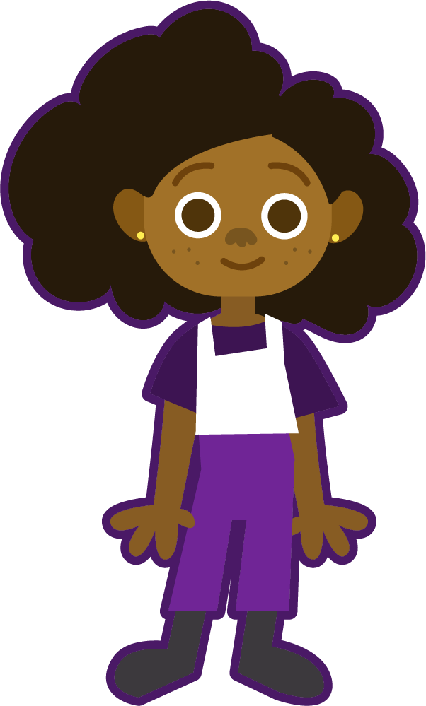
Phoneme Maps
Where do the sound buttons go in these words?
Use sound buttons for each phoneme. Draw a dot for each single letter sound and a line when two or more letters make one sound.
young
touch
cousin
couple

Slide 8
Words where the digraph ‘ou’ makes an /u/ sound
To be able to segment words into the correct syllables and phonemes
To spell words where the digraph ‘ou’ makes an /u/ sound
Read the word. Write each word out, drawing long lines for the syllable breaks. Write each word out again, adding the sound buttons for each phoneme. Finally, rewrite the whole word.
Words | Syllable Breaks | Phonemes | My Word
trouble
encourage
cousin
country

Slide 9
Words where the digraph ‘ou’ makes an /u/ sound
Answers
Words | Syllable Breaks | Phonemes | My Word
trouble | trou|ble | trouble | trouble
encourage | en|cour|age | encourage | encourage
cousin | cous|in | cousin | cousin
country | coun|try | country | country

Slide 10
Words where the digraph ‘ou’ makes an /u/ sound
To be able to segment words into the correct syllables and phonemes
To spell words where the digraph ‘ou’ makes an /u/ sound
Write a sentence about the pictures below. Remember to include the word in your sentence. Then read the sentences and replace the underlined word with one of the blue words.
touch
couple
 | Yusef thought that he had ample cake for his party. | Each nation has its own flag and anthem.
 | The plants began to thrive in their new pots. | Our teacher would always motivate us to do our best.
country
enough
encourage
flourish

Slide 11
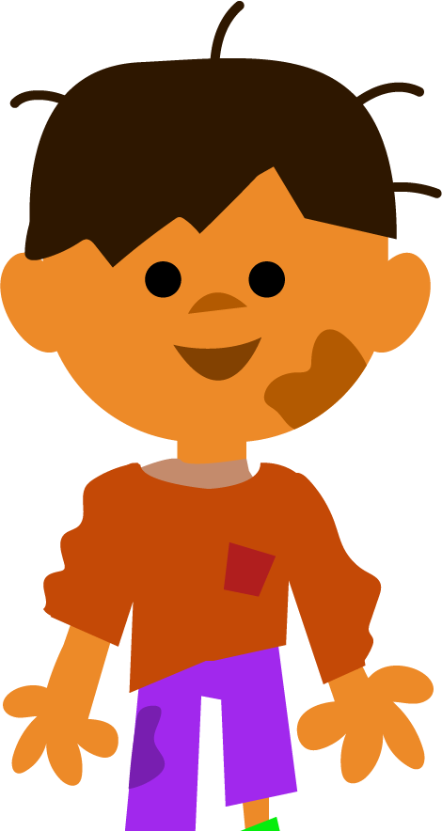
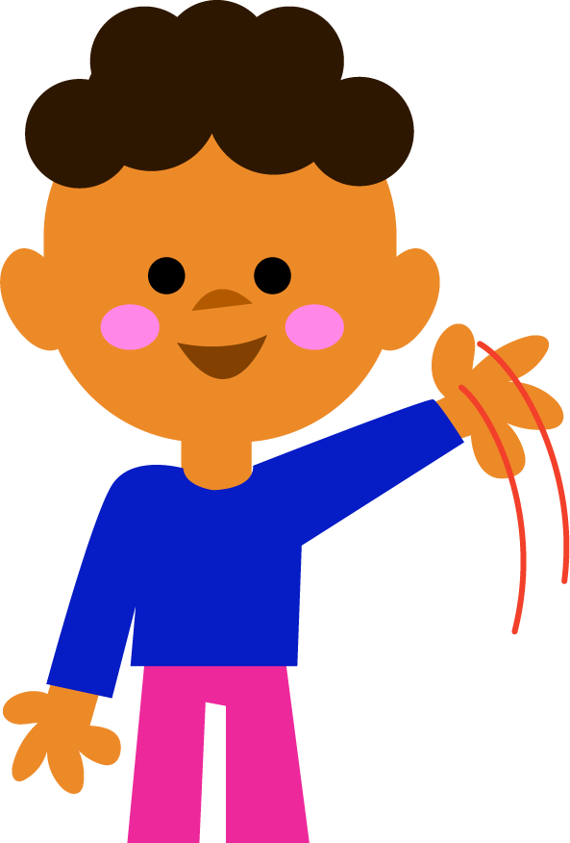
Words where the digraph ‘ou’ makes an /u/ sound
To be able to segment words into the correct syllables and phonemes
To spell words where the digraph ‘ou’ makes an /u/ sound
Can you write a description of this picture?
Words to include: double, trouble, young, cousin

Slide 12
Words where the digraph ‘ou’ makes an /u/ sound
Answers
touch
couple
We use our hands to touch things.
I need a couple of pegs to hang up my shirt.
 | Yusef thought that he had ample cake for his party. | Each nation has its own flag and anthem.
 | The plants began to thrive in their new pots. | Our teacher would always motivate us to do our best.
country
enough
enough
country
encourage
flourish
encourage
flourish

Slide 13
Words where the digraph ‘ou’ makes an /u/ sound
Possible Answer
Can you write a description of this picture?
Words to include: double, trouble, young, cousin
These are my young cousins, Alfie and Lucas. They are always getting into trouble. Last week, they went on a boat and found themselves surrounded by sharks! They are so funny and cheeky; my mum says they are "double trouble".

Slide 14
Definition
In a Sentence
enough
Synonyms
Antonyms

Slide 15
Definition
In a Sentence
As many or as much as somebody needs or wants.
Annabel had enough money to buy the game.
enough
Synonyms
Antonyms
adequate, ample, sufficient
insufficient, limited, sparce

Slide 16
Syllable Match
Which of this week’s words match each syllable map?
_ _ | _ __ _ | _ __
en|cour|age
_ _ __ _ | _ __
The blue lines are digraphs, where two letters make one sound.
flour|ish
_ __ _ | _ _
cous|in
_ | _ __ __
__
__
e|nough
_ __ | _ __
dou|ble
cou|ple
Notes:
Each line represents a missing letter.
The blue lines are digraphs, where two letters make one sound.

