Slide 1
3
1
To be able to segment words into the correct syllables and phonemes
To spell words where the digraph ‘ou’ makes an /ow/ sound
This week’s words: mouth, sprout, around, sound, spout, ouch, hound, trout, found, proud

Slide 2



Starter
Can you sort these words into the correct jar?
What sound does the ‘ou’ make in each word?
This week’s words all have this sound.
about
double
cousin
youth
shoulder
house
group
you
count
cougar
/ow/
/oa/
/oo/
/u/
Notes:
Read the words with the children, enunciating the sound the ‘ou’ digraph makes.

Slide 3
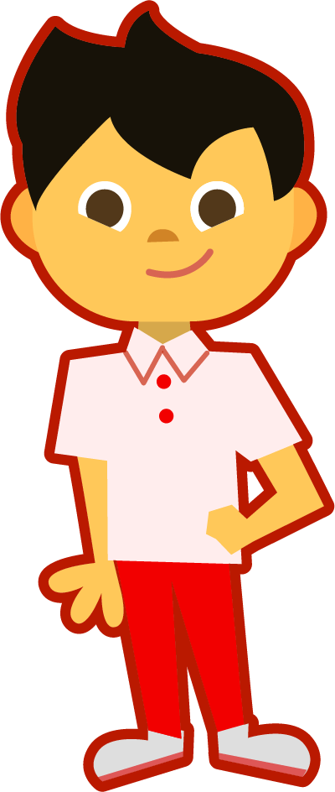
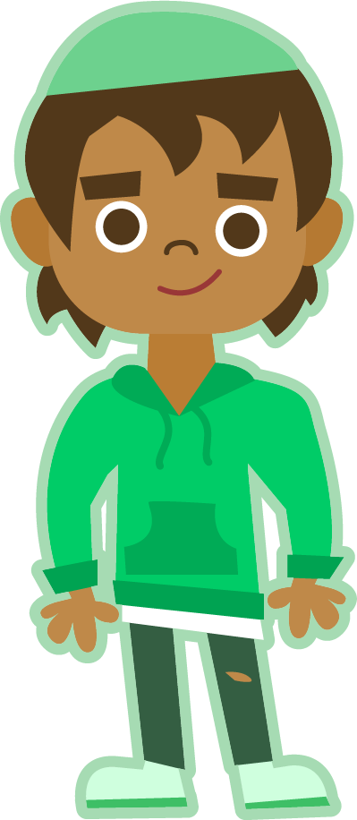
This Week’s Words
Do you know what they all mean?
What do the words have in common?
mouth
sprout
around
sound
spout
ouch
hound
trout
found
proud
Can you see the ‘ou’ digraph in each word?
Where does the ‘ou’ digraph appear most often in our words?

Slide 4
Etymology
How do you think these companies got their names?
Panasonic
Sony
Sonos
Clue: they all make music players.

Slide 5
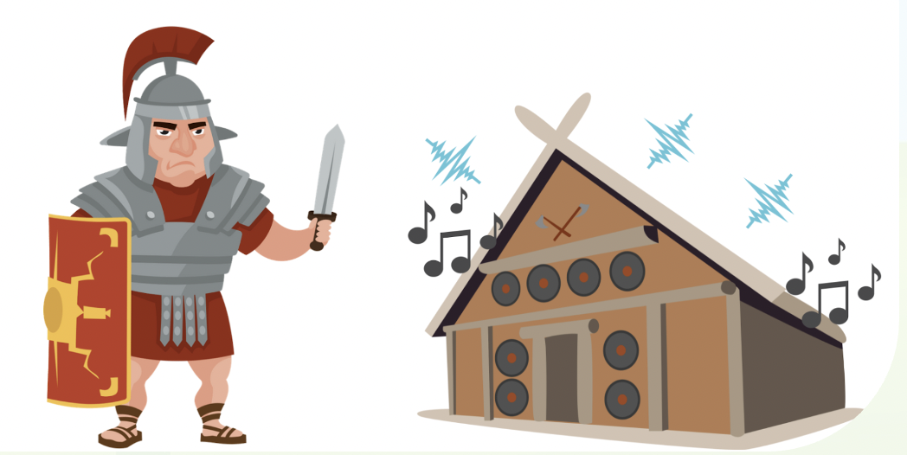
Etymology
sound
The word ‘sound’ comes from the Latin word sonus, which means ‘sound’ or ‘noise’.
This means Romans may have complained about their neighbours making too much sonus!

Slide 6
Word Sort
Can you match the words to the correct
number of sounds?
around
spout
hound
proud
trout
‘found’ has four sounds;
f-ou-n-d
sound
found
sprout
ouch
mouth
2
3
4
5

Slide 7


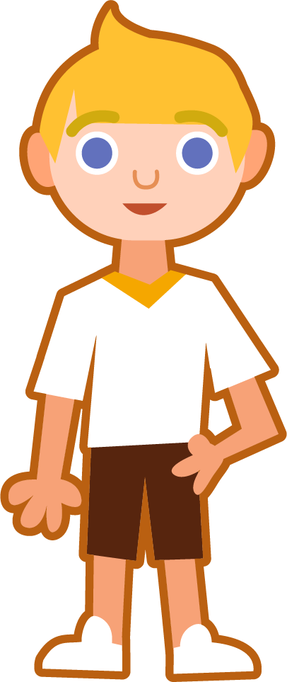
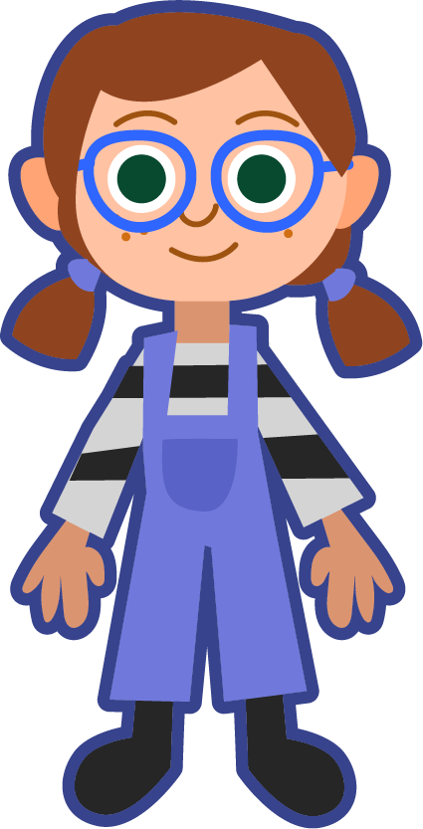
Syllable Maps
Can you clap out the syllables for the words below?
around
surrounded
a|round
2
sur|round|ed
3
account
county
loudspeaker
ac|count
2
coun|ty
2
loud|speak|er
3
Let’s practise counting syllables with these words instead.
Most of our new words only have one syllable.
outstanding
out|stand|ing
3

Slide 8
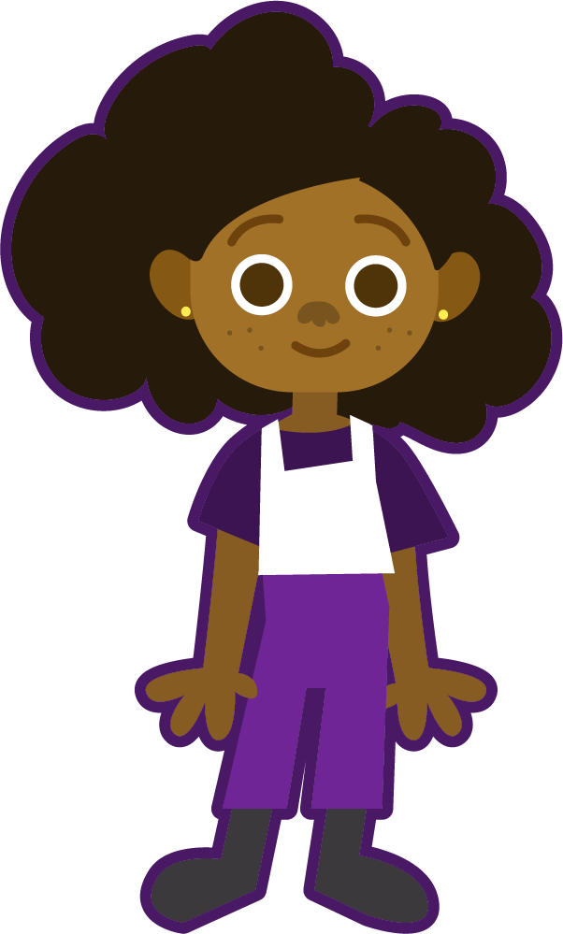

Phoneme Maps
Where do the sound buttons go in these words?
Use sound buttons for each phoneme. Draw a dot for each single letter sound and a line when two or more letters make one sound.
around
hound
sprout
ouch

Slide 9
Words where the digraph ‘ou’ makes an /ow/ sound
To be able to segment words into the correct syllables and phonemes
To spell words where the digraph ‘ou’ makes an /ow/ sound
Read the word. Write each word out, adding the sound buttons for each phoneme. Finally, rewrite the whole word.
Words | Phonemes | My Word
mouth
sprout
spout
around
proud
ouch

Slide 10
Words where the digraph ‘ou’ makes an /ow/ sound
Answers
Words | Phonemes | My Word
mouth | mouth | mouth
sprout | sprout | sprout
spout | spout | spout
around | around | around
proud | proud | proud
ouch | ouch | ouch

Slide 11
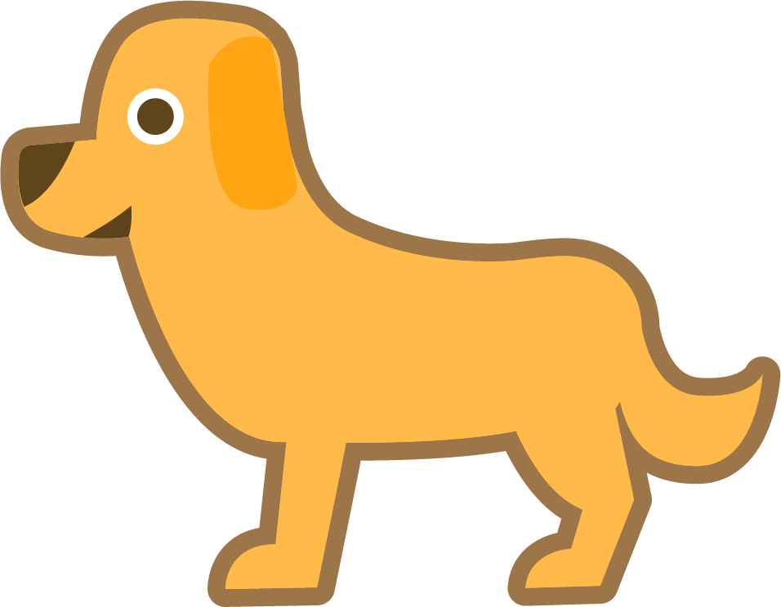
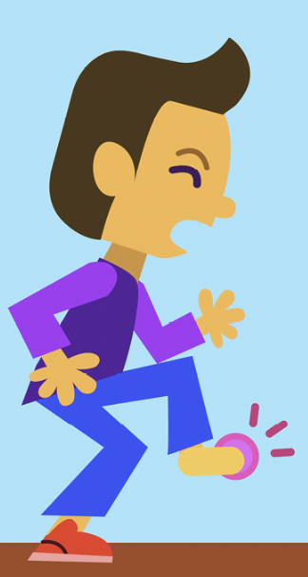
Words where the digraph ‘ou’ makes an /ow/ sound
To be able to segment words into the correct syllables and phonemes
To spell words where the digraph ‘ou’ makes an /ow/ sound
Write a sentence about the pictures below. Remember to include the word in your sentence. Then read the sentences and replace the underlined word with one of the blue words.
hound
ouch
 | Alex finally located his mum’s car keys. | The seed began to grow after a few weeks.
 | Water began to gush out of the hose pipe. | I heard a strange noise in the garden.
sprout
found
sound
spout

Slide 12
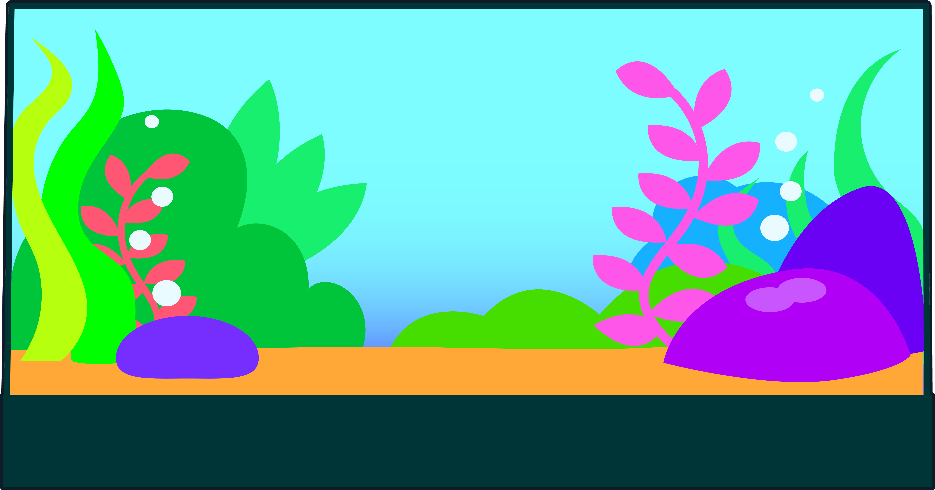


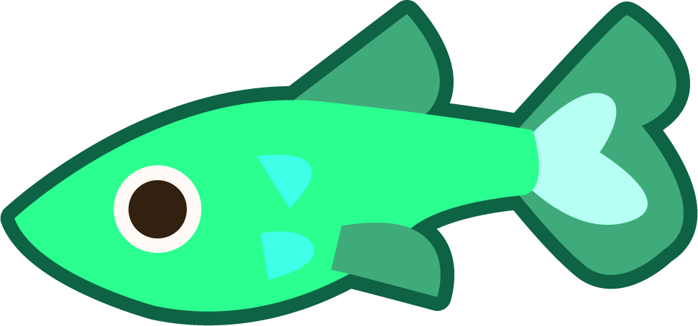

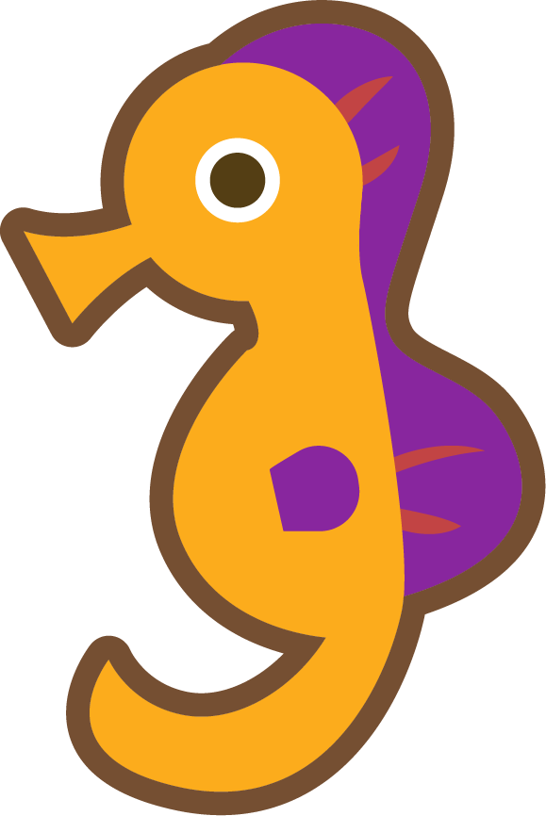




Words where the digraph ‘ou’ makes an /ow/ sound
To be able to segment words into the correct syllables and phonemes
To spell words where the digraph ‘ou’ makes an /ow/ sound
Can you write a description of this picture?
Words to include: trout, mouth, around

Slide 13
Words where the digraph ‘ou’ makes an /ow/ sound
Answers
hound
ouch
Carrie heard the howl of a hound in the distance.
“Ouch!” Joe cried as he stood on a pin.
 | Alex finally located his mum’s car keys. | The seed began to grow after a few weeks.
 | Water began to gush out of the hose pipe. | I heard a strange noise in the garden.
sprout
found
found
sprout
sound
spout
spout
sound

Slide 14
Words where the digraph ‘ou’ makes an /ow/ sound
Possible Answer
Can you write a description of this picture?
Words to include: trout, mouth, around
In my fish tank I have green guppies, bright pink starfish, sea horses and even an octopus. They all swim around, bubbles coming from their mouths. The one fish I don’t have is a trout.

Slide 15
Definition
In a Sentence
proud
Synonyms
Antonyms

Slide 16
Definition
In a Sentence
Feeling pleased about something you own or have done.
The teacher was proud of her class on the recent school trip.
proud
Synonyms
Antonyms
gratified, pleased, satisfied, content, delighted
embarrassed,
ashamed, humbled, defeated

Slide 17
Morphology Matrix
How many new words can you create by adding
a prefix and/or suffix(es)?
Prefix
Base Word
Suffix
s
a
est
ed
round
(on, in, into)
ing
sur
(circular in shape)
(above, over)
er
s
Which new words can you make by adding just a prefix?
Which new words can be made using just a suffix?
Can you make any words which use a prefix and a suffix?

Slide 18
Morphology Matrix
How many new words can you create by adding
a prefix and/or suffix(es)?
Prefix
Base Word
Suffix
s
a
est
ed
round
(on, in, into)
ing
sur
(circular in shape)
(above, over)
er
s
around, surround
roundest, rounder, rounded, rounding
surrounded, surrounding

