Slide 1
4
1
To be able to segment words into the correct syllables and phonemes
To spell words that are homophones or near homophones
This week’s words: accept, except, knot, not, peace, piece, plain, plane, weather, whether

Slide 2
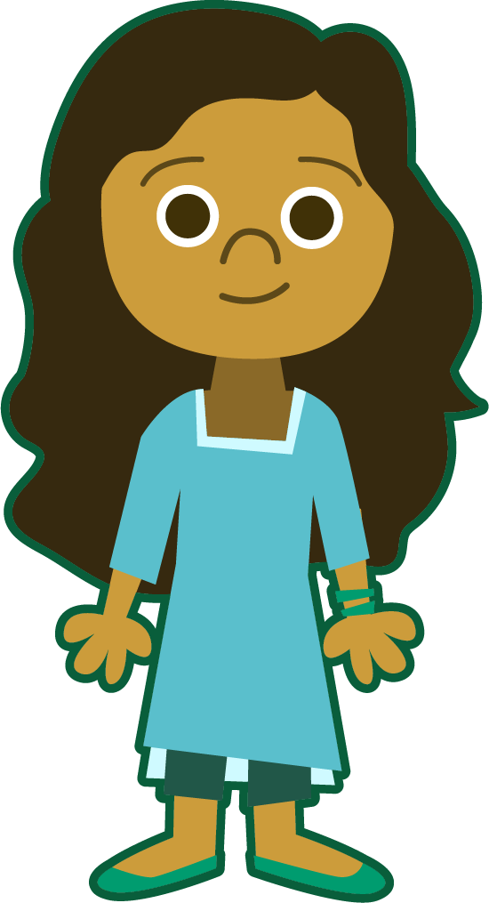
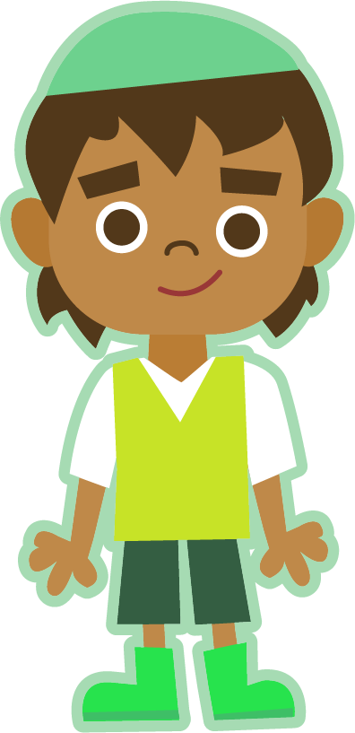

Starter
Can you add the sound buttons to these Stage 3 words?
Use sound buttons for each phoneme. Draw a dot for each single letter sound and a line when two or more letters make one sound.
A split digraph is represented by underlined letters joined by a curved line.
address
great
sprout
tongue
mane

Slide 3
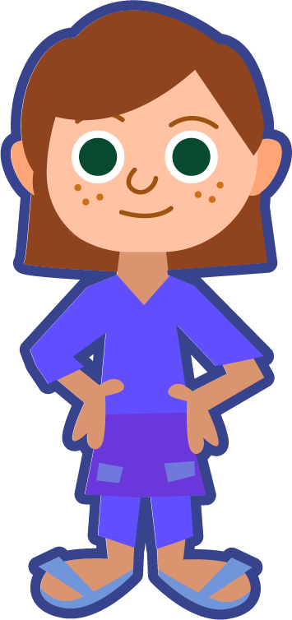
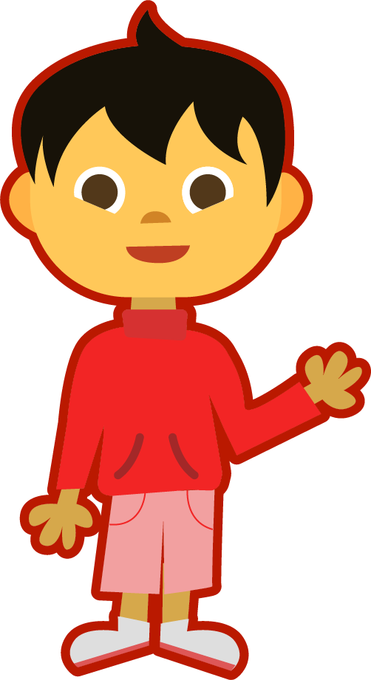
This Week’s Words
Do you know what they all mean?
What do the words have in common?
accept
except
knot
not
peace
piece
plain
plane
weather
whether
This week’s words are all homophones or near homophones.
Homophones sound the same (or nearly the same) as another word, but have different meanings and spellings.

Slide 4

Etymology
peace
Peace can be a state or feeling of calm and quiet or a state without fighting or war.
In the mid-1100s, the word pes, meant
‘freedom from civil disorder, internal peace of a nation’.
From the Old French word pais meaning
‘peace, reconciliation, silence, permission’.
The sense of ‘spiritual peace of the heart, soul or conscience;
peace of mind’ is from around 1200.

Slide 5
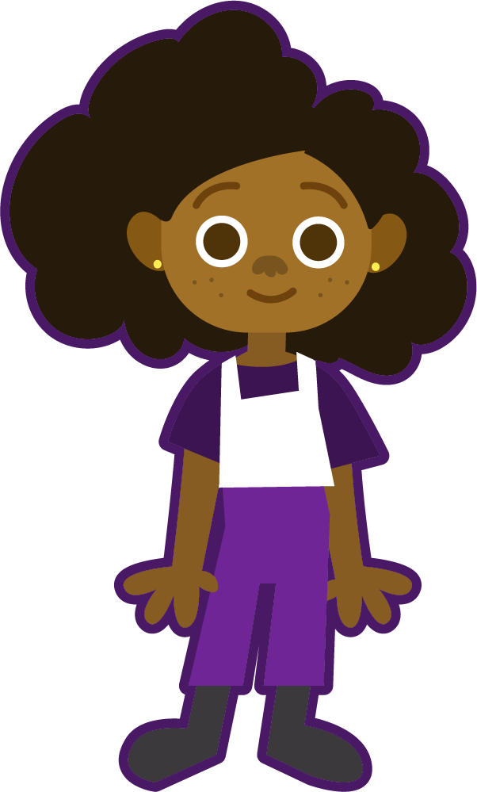
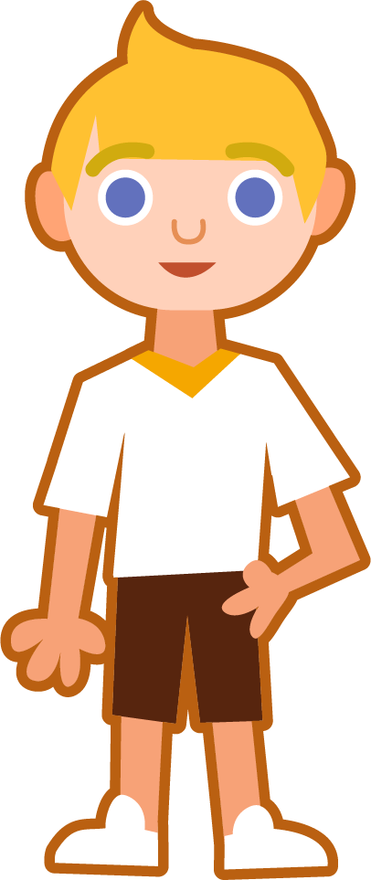
This Week’s Words
How many syllables are in each word?
accept
except
knot
not
2
2
1
1
peace
piece
plain
plane
1
1
1
1
weather
whether
2
2
z
z
What is the most common number of syllables?
Are there any words with three syllables?
Notes:
Most words have one syllable. There are no words with three syllables.

Slide 6

Syllable Maps
Can you clap out the ‘beats’ for each syllable?
z
Let’s look
at where the syllable breaks are in this
week’s two syllable words.
accept
weather
ac|cept
2
weath|er
2
z
except
whether
Separate each word into syllables using a long syllable break.
ex|cept
2
wheth|er
2

Slide 7
Phoneme Maps
Where do the sound buttons go in these words?
piece
knot
plane
whether
plain
weather
Use sound buttons for each phoneme. Draw a dot for each single letter sound and a line when two or more letters make one sound.
Let’s look at
the sounds made
by some of our
new words.

Slide 8



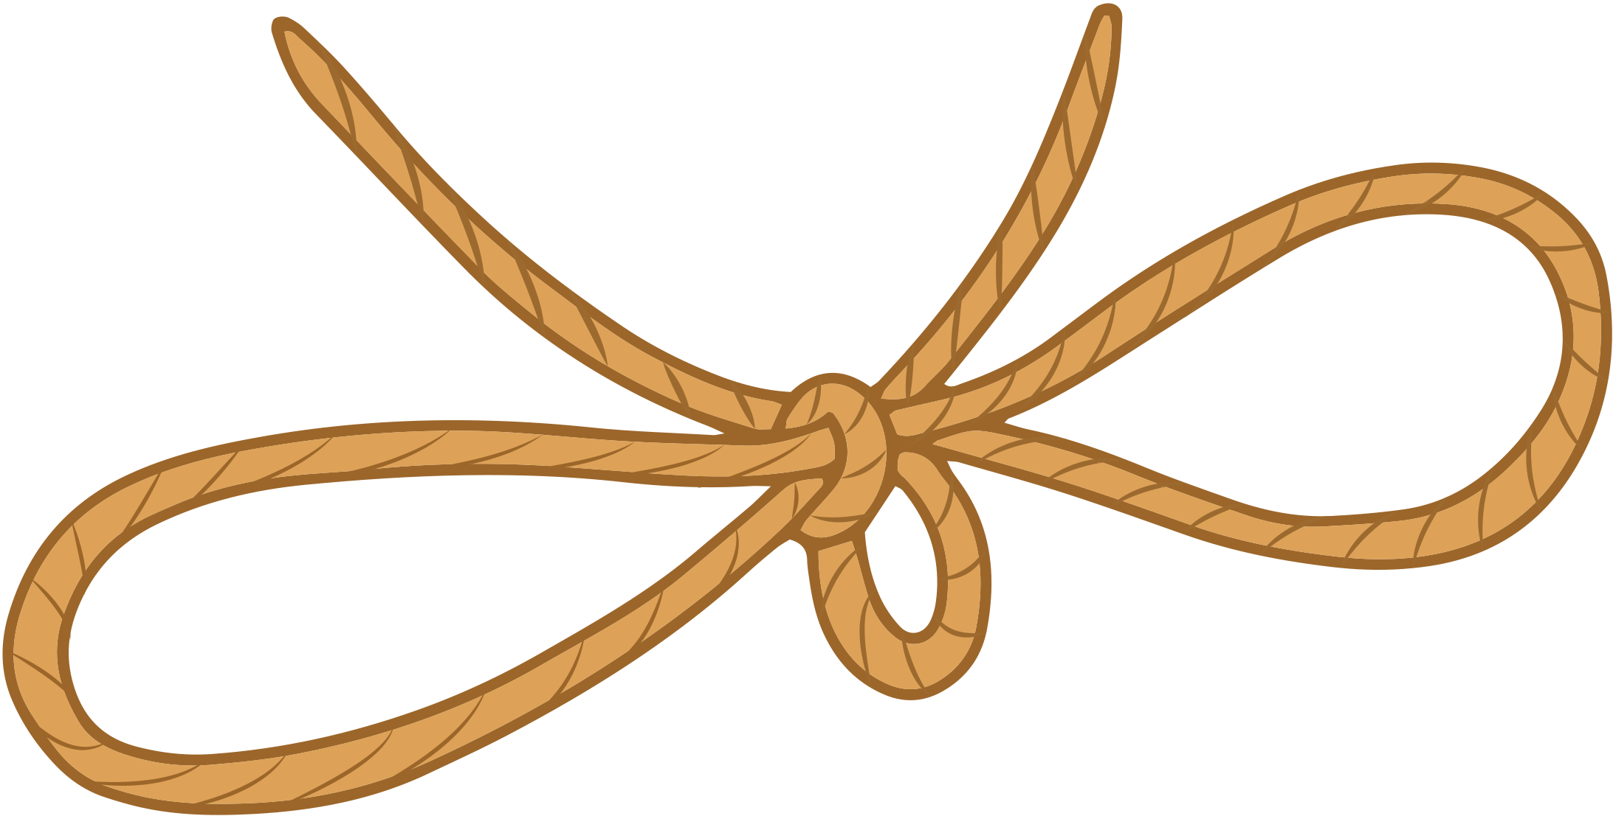
Word Meanings
Let’s look at what this week’s words mean.
accept
vs
except
knot
vs
not
Used to tie together
rope or string.
To say yes or receive something willingly.
Apart from, not including.
In no way, never.
Notes:
Click on the meanings to find out which word it belongs to.

Slide 9



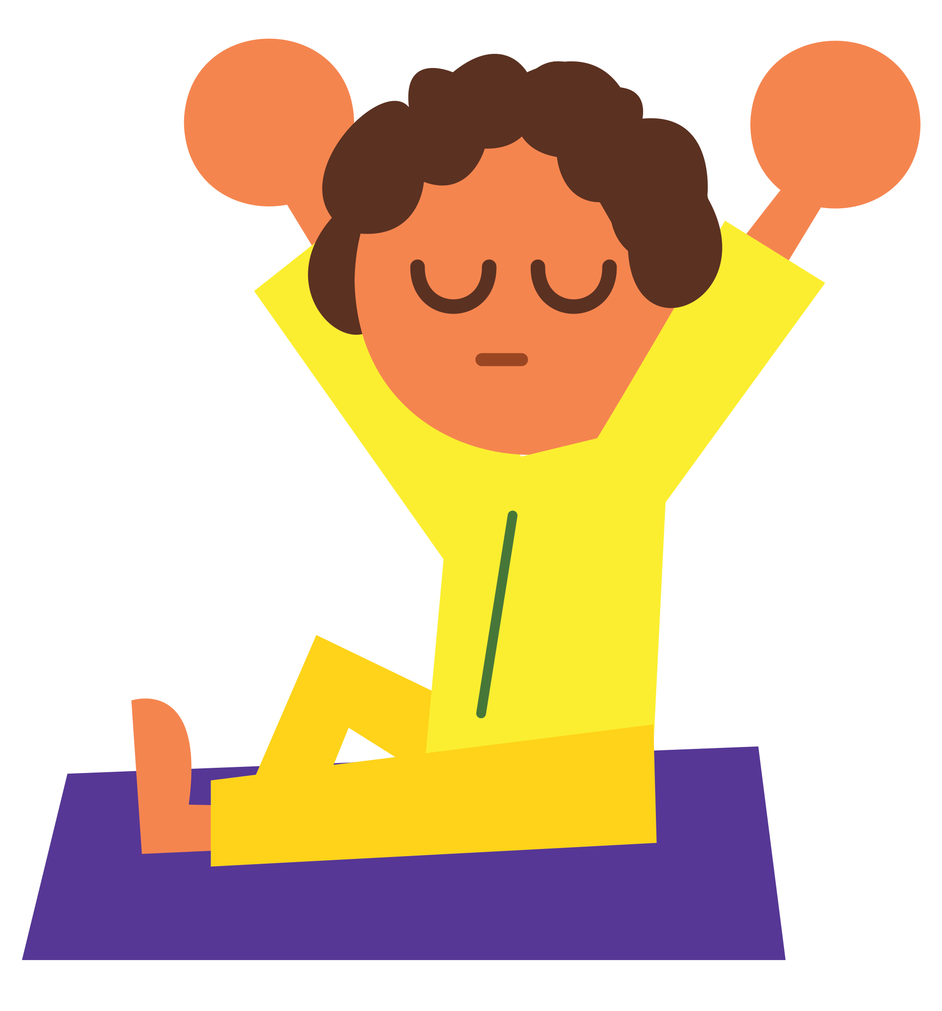
Word Meanings
Let’s look at what this week’s words mean.
peace
vs
piece
plain
vs
plane
A flying vehicle
with wings.
A small section or part of a whole.
A feeling of calm and quiet.
Blank; very simple
in style.
Notes:
Click on the meanings to find out which word it belongs to.

Slide 10




Word Meanings
Let’s look at what this week’s words mean.
weather
vs
whether
Used to express a doubt or choice between two possibilities.
The sunshine, wind, rain, temperature and clouds.
Notes:
Click on the meanings to find out which word it belongs to.

Slide 11
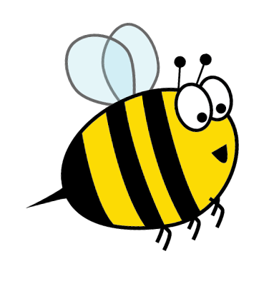
Which Word?
Choose the correct homophone for each sentence.
plain/plane
I used a piece of paper to sketch the landscape.
Think carefully because the homophones have different meanings.
accept/except
All classes went swimming Year 1.
weather/whether
Imogen was deciding she should go to the party or not.

Slide 12
Missing Words
Write the correct missing homophone for each sentence.
not
knot
peace
piece
Each child ate a of fruit at break time.
Think carefully because the homophones have different meanings.
My shoelaces were tied in a double .
Harry did want the piece of pizza with mushrooms on it.
He felt at as he watched the sun set over the sea.

Slide 13
Which Word?
Answers
plain/plane
I used a piece of paper to sketch the landscape.
plain
Think carefully because the homophones have different meanings.
accept/except
All classes went swimming Year 1.
except
weather/whether
Imogen was deciding she should go to the party or not.
whether

Slide 14
Missing Words
Answers
not
knot
peace
piece
Each child ate a of fruit at break time.
piece
Think carefully because the homophones have different meanings.
My shoelaces were tied in a double .
knot
not
Harry did want the piece of pizza with mushrooms on it.
peace
He felt at as he watched the sun set over the sea.

Slide 15

In a Sentence
Write a sentence to match the picture that includes the word.
knot
not

Slide 16
Alphabetical Order, Definitions and Sentences
Put this week’s words in alphabetical order. Then find the dictionary definition for the words below and write your own sentence for each word.
Word | Dictionary Definition | In a Sentence
weather
plane
except

Slide 17
In a Sentence
Possible Answers
knot
not
Eloise struggled to undo the knot in her
shoe laces.
"That is not what I meant," complained Jenna.

Slide 18
Alphabetical Order, Definitions and Sentences
Possible Answers
Word | Dictionary Definition | In a Sentence
weather | The sunshine, wind, rain, temperature and clouds. | Sports Day was called off because the weather was so bad.
plane | A vehicle that flies through the air (short for aeroplane). | The pilot tried hard to guide the plane through the storm.
except | Apart from; not including. | Manny liked all vegetables except carrots.
Word | Dictionary Definition | In a Sentence
weather
plane
except
accept
except
knot
not
peace
piece
plain
plane
weather
whether

Slide 19
Definition
In a Sentence
accept
Synonyms
Antonyms

Slide 20
Definition
In a Sentence
To agree to or approve of something.
To take willingly something that is offered; to say ‘yes’ to an offer, invitation, etc.
The local charity shop will accept donations
of books and clothes.
accept
Synonyms
Antonyms
take, allow, admit, get, obtain, welcome
reject, decline,
refuse, deny

Slide 21
Phoneme Match
Which words are represented by their phoneme maps?
accept
except
knot
peace
piece
not
plain
plane
z
Some of the words
have the same phoneme maps.
.
weather
whether

