Slide 1
5
1
To be able to segment words into the correct syllables and phonemes
To spell words ending in ‘-tious’ and ‘-ious’
This week’s words: ambitious, amphibious, curious, devious, fictitious, infectious, notorious, nutritious, repetitious, obvious

Slide 2
Starter
How would you sort the following
Stage 4 words?
precious
disadvantageous
serious
curious
spontaneous
victorious
advantageous
obvious
various
outrageous
furious
courageous
courteous
hideous
There are many ways to sort the words listed, such as whether each word starts with a vowel or a consonant, whether each word has more or fewer than a given number of letters, the number of syllables each word has, etc.
Look at the suffixes and you’ll notice that they fall into two groups…
Words ending in ‘ious’
Words ending in ‘eous’
Notes:
Click on the blue and red phrases to sort the words into the two groups.

Slide 3
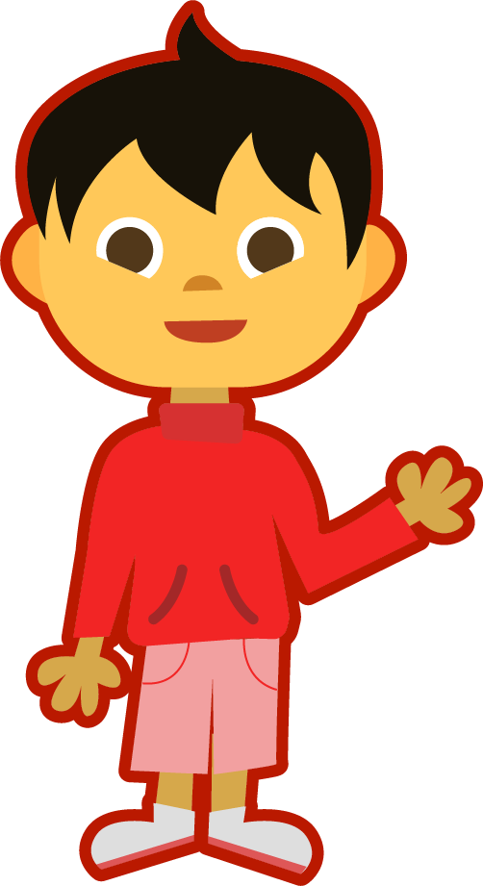
This Week’s Words
Do you know what they all mean?
What do the words have in common?
ambitious
amphibious
infectious
curious
fictitious
devious
nutritious
notorious
repetitious
obvious
They are all adjectives.
What do you notice about their suffixes?

Slide 4
Word Sort
Some words have the suffix ‘ious’, while others
end in ‘tious’. Can you sort them?
ambitious
amphibious
infectious
curious
fictitious
devious
nutritious
notorious
repetitious
obvious
Words ending in ‘-tious’
Words ending in ‘-ious’

Slide 5
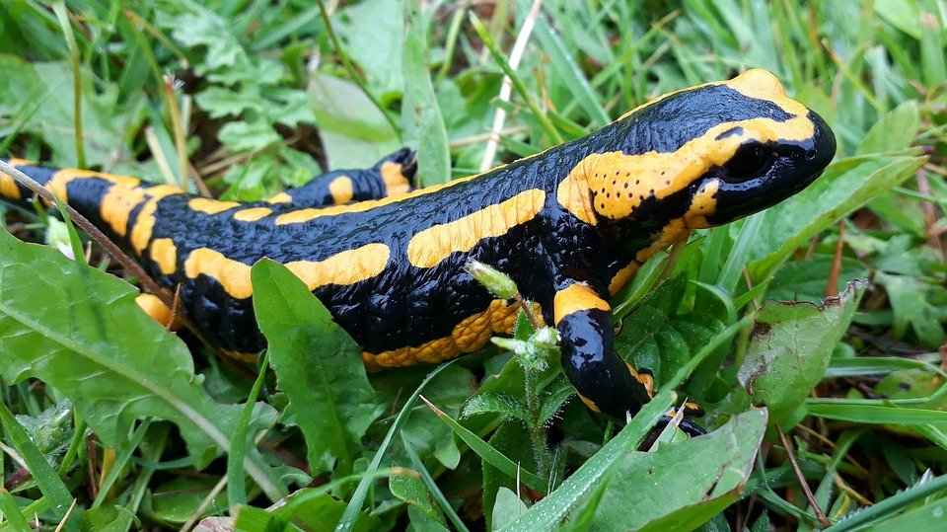
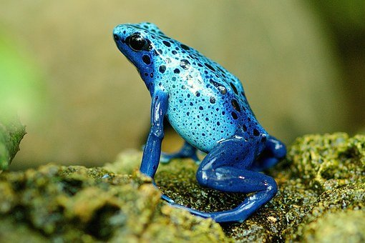
Etymology
Which of your new words is this?
In the 1640s, it meant ‘combining two qualities; having two modes of life’.
amphibious
This word describes frogs, toads, newts and salamanders.
This word means ‘living both on land and in water’.
amphi
bios
amphibious
From the Greek word
amphibios, meaning ‘having a double life; living on land and in water’.
means
‘of both
kinds’
means
‘life’

Slide 6
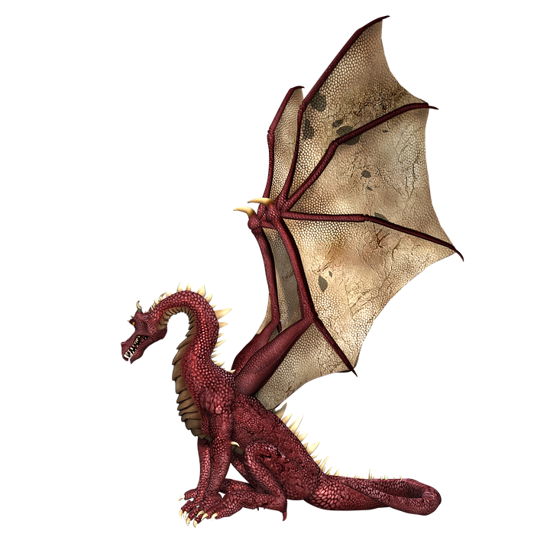
Etymology
fictitious
It means something that is false or that does not exist.
Fictitious is related to the words ‘figment’ as in ‘a figment of your imagination’, ‘feigned’ and ‘false’.
In the 1610s, it had the meaning ‘artificial or counterfeit’.
In the 1620s, it had the meaning ‘existing only in imagination’ from the Medieval Latin word ficticius.

Slide 7
Syllable Count
How many syllables are in each word?
ambitious
amphibious
infectious
3
4
3
fictitious
devious
nutritious
3
3
3
notorious
repetitious
obvious
4
4
3
curious
3
Notes:
Click the slide for the number syllables to be revealed.

Slide 8
Syllable Maps
Separate each word into syllables using a long syllable break.
infectious
in|fec|tious
3
amphibious
notorious
am|phib|i|ous
4
no|to|ri|ous
4
Notes:
Click on the slide to show the number of syllables and how it is written.

Slide 9
Words ending in ‘-tious’ and ‘-ious’
To be able to segment words into the correct syllables and phonemes
To spell words ending in ‘-tious’ and ‘-ious’
Read the word. Write each word out, drawing long lines for the syllable breaks. Finally, write the word out again.
Word | Syllable Breaks | Word
infectious | in|fec|tious | infectious
notorious
devious
ambitious
repetitious
curious
nutritious
amphibious
fictitious
obvious

Slide 10
Words ending in ‘-tious’ and ‘-ious’
Answers
Word | Syllable Breaks | Word
infectious | in|fec|tious | infectious
notorious | no|to|ri|ous | notorious
devious | de|vi|ous | devious
ambitious | am|bi|tious | ambitious
repetitious | rep|e|ti|tious | repetitious
curious | cu|ri|ous | curious
nutritious | nu|tri|tious | nutritious
amphibious | am|phib|i|ous | amphibious
fictitious | fic|ti|tious | fictitious
obvious | ob|vi|ous | obvious

Slide 11
Phoneme Maps
Where do the sound buttons go in these words?
Use sound buttons for each phoneme. Draw a dot for each single letter sound and a line when two or more letters make one sound.
obvious
ambitious
curious

Slide 12
Irregular Spelling Pattern
Which words end in /shus/ and which
end in /ee/-/us/?
1. Look closely, words with a /shus/ ending have the suffix ‘-tious’.
2. Also, if the noun form of that word ends in ‘-tion’, it is pronounced /shus/ when it becomes an adjective.
infection
infectious
/shus/
Which of this week’s words does this apply to?
repetition
repetitious
/shus/
ambition
ambitious
/shus/
nutrition
nutritious
/shus/
fiction
fictitious
/shus/

Slide 13
Irregular Spelling Pattern
Which words end in /shus/ and which
end in /ee/-/us/?
The remainder of this week’s words end in ‘-ious’.
The letter ‘i’ makes an /ee/ sound.
obvious
devious
amphibious
notorious
curious
Can you think of any other words that this applies to?
various
victorious
envious
glorious
rebellious
serious

Slide 14
Cloze Sentences
Can you identify the missing words in
these sentences?
infectious
notorious
devious
ambitious
repetitious
curious
nutritious
amphibious
fictitious
obvious
“We're interested in the source of these _________________ rumours.”
Flu is highly _________________, so it’s important to wash your hands often, and cover your mouth if you cough or sneeze.
Most frogs, newts, toads and salamanders are _________________.
Cheating is a _________________ way to win.
The thief was _________________ for stealing diamonds.
Notes:
Complete one sentence at a time. This slide provides the children with their words so that they are able to choose the appropriate missing word for each sentence.

Slide 15
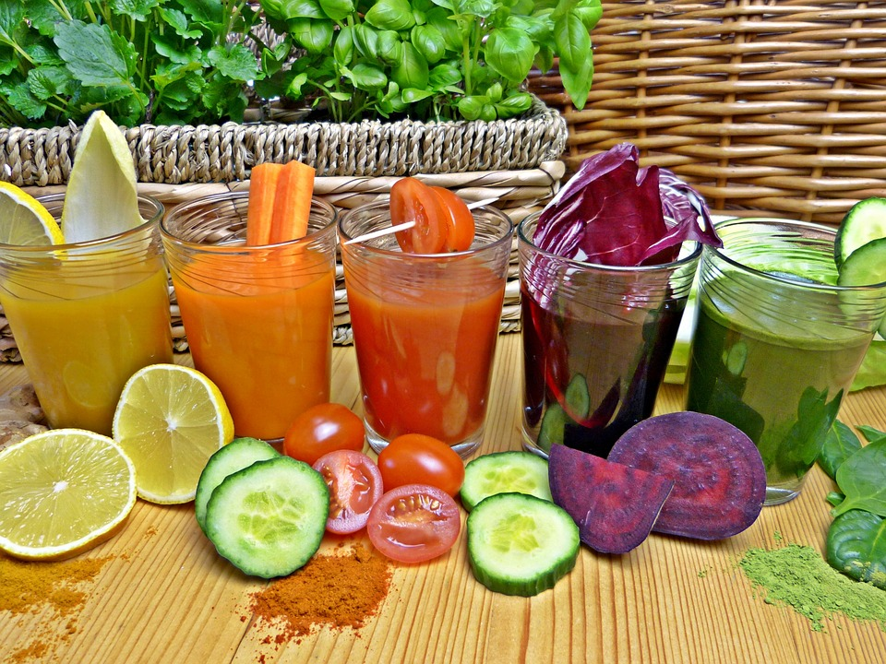
Cloze Sentences
Can you identify the missing words in
these sentences?
He gave a long and _____________ speech about how driven
and _____________ he was.
Fruits and vegetables are an ___________ choice when making a delicious and _____________ smoothie.
He is such a _____________ boy, always asking questions; he has a real thirst for knowledge.
Notes:
This slide removes the words so that the children are able to practise spelling them.
They could use whiteboards and 1-2-3-Show Me for instant assessment and the ability to address incorrect spelling of words.

Slide 16
Cloze Sentences
Answers
infectious
notorious
devious
ambitious
repetitious
curious
nutritious
amphibious
fictitious
obvious
fictitious
“We're interested in the source of these _________________ rumours.”
infectious
Flu is highly _________________, so it’s important to wash your hands often, and cover your mouth if you cough or sneeze.
Most frogs, newts, toads and salamanders are _________________.
amphibious
devious
Cheating is a _________________ way to win.
notorious
The thief was _________________ for stealing diamonds.

Slide 17
Cloze Sentences
Answers
He gave a long and _____________ speech about how driven
and _____________ he was.
repetitious
ambitious
Fruits and vegetables are an ___________ choice when making a delicious and _____________ smoothie.
obvious
nutritious
curious
He is such a _____________ boy, always asking questions; he has a real thirst for knowledge.

Slide 18
Words ending in ‘-tious’ and ‘-ious’
Find the dictionary definition for the words below.
Then write your own sentence for each.
Word | Dictionary Definition | In a Sentence
infectious
notorious
devious
ambitious
repetitious
curious
nutritious
amphibious
fictitious
obvious

Slide 19
Words ending in ‘-tious’ and ‘-ious’
Possible Answers
Word | Dictionary Definition | In a Sentence
infectious | A disease that is infectious can be caught by being near a person who has it. | ​We had to keep our cat by itself for six weeks because its disease was infectious.
notorious | To be well-known for something bad. | He lived in an area notorious for crime and violence.
devious | Behaving in a dishonest or indirect way, or tricking people, in order to get something. | Her devious nature was shown in half-lies and small dishonesties.
ambitious | Determined to be successful, rich, powerful, etc. | The fiercely ambitious young manager was determined to be the CEO of the company one day.
repetitious | Involving something that is often repeated, in a way that becomes boring. | This book is infuriatingly repetitious, so I’ve had to stop reading it.
curious | ​Having a strong desire to know about something. | Everyone was curious as to why Rahul was leaving.
nutritious | Very good for you; containing many of the nutrients which help the body to grow. | Our family loves to cook tasty and nutritious meals.
amphibious | Able to live both on land and in water. | Most frogs and toads are amphibious.
fictitious | Invented by somebody rather than true. | She invented a fictitious appointment to excuse herself from the meeting.
obvious | Clear and easy to see or understand. | Things aren’t working, so it's obvious a change is needed.

Slide 20
Definition
In a Sentence
amphibious
Examples of
Amphibious Animals
Examples of Non-
Amphibious Animals

Slide 21
Definition
In a Sentence
Due to their amphibious nature, frogs can be found in ponds and under rocks.
Suited to both land and water.
amphibious
Examples of
Amphibious Animals
Examples of Non-
Amphibious Animals
Fish – they spend all of their time in water.
Lizards – they spend all of their time on land.
Most mammals and birds, etc.
frogs, toads, newts
salamanders, platypus

Slide 22
Morphology Matrix
How many new words can you create by adding
a prefix and/or suffix(es)?
Prefix
Base Word
Suffix
un
s
tious
re
infect
(to make a disease or an illness spread to other people)
ed
super
ing
dis
tion
s
Can you make a word with two suffixes?

Slide 23
Morphology Matrix
How many new words can you create by adding
a prefix and/or suffix(es)?
Prefix
Base Word
Suffix
un
s
tious
re
infect
(to make a disease or an illness spread to other people)
ed
super
ing
dis
tion
s
Possible answers: uninfected, reinfect, reinfects, reinfected, reinfecting, reinfection, reinfections, superinfected, superinfection, superinfections, disinfect, disinfects, disinfected, disinfecting, disinfection, infects, infectious, infected, infecting, infection, infections

