Slide 1
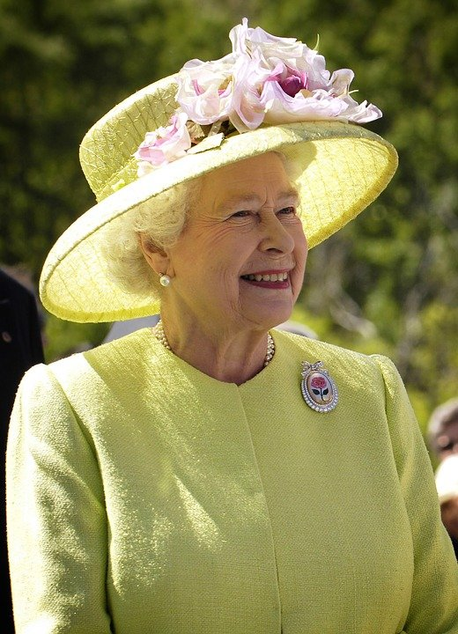
Queen Elizabeth II
Stage 2
Unit Focus: British Royalty
Text Focus: Information Text
What can you tell me about the title? What might the text be about?

Slide 2
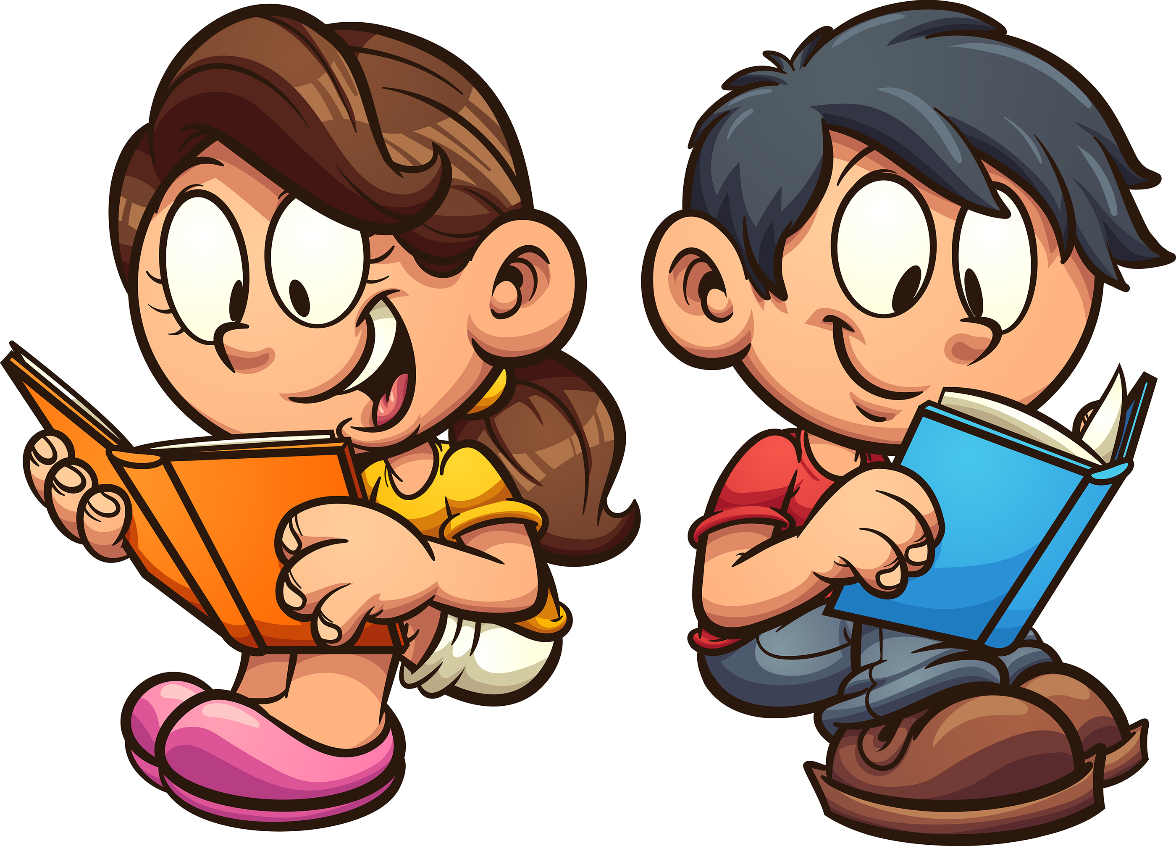
Today we are learning to…
identify new words and their meaning
sequence events and information
retrieve and record information from non-fiction

Slide 3
Before reading…
What do you think you already know about the life of Queen Elizabeth II?

Slide 4
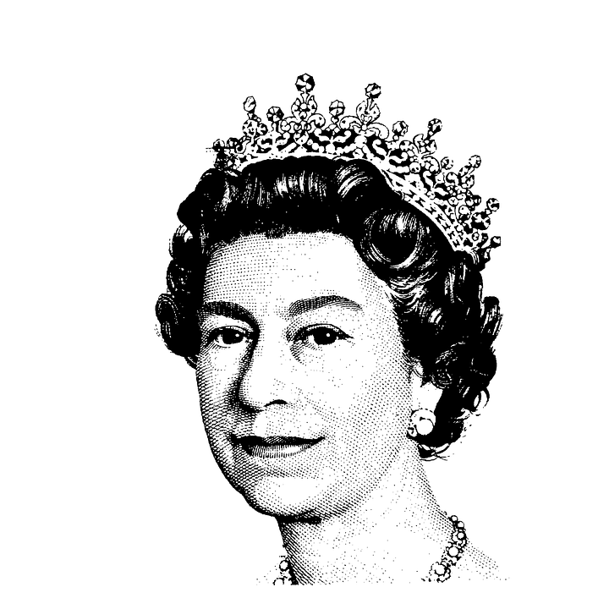
Useful words and phrases
reign
longest-reigning
abdicating
coronation

Slide 5
Can you find these features in your information text?
Yes/No | Feature
 | Introduction telling you what the text is about
 | Information sorted into paragraphs
 | Sub-titles
 | Pictures and diagrams
 | Technical vocabulary
 | Present tense
 | Third person

Slide 6
Read the first text on your own, with a partner or as a class
Underline any words that you are unsure of so we can discuss them at the end.
Jot down any questions you have about what you read.
Notes:
You may wish to read in groups, pairs or as a class. Discuss any points that children raise.

Slide 7
Task 1: Skim and Scan
While you are reading, you may wish to:
Skim and scan, and underline these words:
born, power, throne, pantomimes
Challenge:
Highlight three key facts.
Who might enjoy reading this text?
Notes:
You may wish to read this first and have the children follow along and then read on their own.

Slide 8
Task 2: Fluency and Expression Listen to your teacher read this! Can you copy their pace, volume and expression?
How long a King or Queen is in power is called their reign. Queen Elizabeth II has reigned since 1952. She is the longest-reigning monarch in British history. She was only 26 years old when she became Queen.
Notes:
Discuss pace, volume, expression. Do any words need emphasising?

Slide 9
Task 3: Vocabulary Check Discuss these words and phrases!
This means she is referred to as Queen Elizabeth the Second.
She is the longest-reigning monarch in British history.
It also meant that she was now next in line to the throne.
Notes:
Children could use a scale to indicate if they have heard the word before – 1 indicating no, I’ve never heard it before and 5 indicating yes, I know this word well.

Slide 10
Task 4: Word meanings
Can you match the word to its definition?
Word |  | Definition
formal |  | giving up the throne
abdicating |  | official
ceremony |  | a ritual or service
coronation |  | crowning of a king or queen
Can you write your own sentences with these words in?
Notes:
There is also a challenge activity for those who can write their own definitions.

Slide 11
Task 5: Word meanings
Can you write what each word means?
Word | Definition | My own sentence
pantomime
referred (to)
reign
celebrates
Notes:
Discuss the term – definition

Slide 12
Task 6: Rearrange these!
Queen reigned has Elizabeth II 1952 since
She when was 26 old she Queen years became
Queen coronation Imperial Elizabeth II the State Crown for her wore

Slide 13
Task 6: Rearrange these! ANSWERS
Queen Elizabeth II has reigned since 1952.
She was 26 years old when she became Queen.
Queen Elizabeth II wore the Imperial State Crown for her coronation.

Slide 14
Task 7: True or false? Tick which of these statements are true and which are false!
STATEMENT | TRUE | FALSE
King Edward VIII abdicated in 1936.
Queen Elizabeth II’s father was King George VI.
Queen Elizabeth II became Queen seven years after the Second World War started.
Notes:
Challenge: Can children make up their own true/false statements to test a partner?

Slide 15
Task 8: Multiple choice
30
29
28
27
26
25
24
23
22
21
20
19
18
17
16
15
14
13
12
11
10
9
8
7
6
5
4
3
2
1
End
Circle the correct answer!
1) When was Queen Elizabeth II born?
Click here for a 30 second challenge.
1953
1926

Slide 16
Task 8: Multiple choice
30
29
28
27
26
25
24
23
22
21
20
19
18
17
16
15
14
13
12
11
10
9
8
7
6
5
4
3
2
1
End
Circle the correct answer!
2) When did the Second World war begin?
Click here for a 30 second challenge.
1953
1939
1926

Slide 17
Task 8: Multiple choice
30
29
28
27
26
25
24
23
22
21
20
19
18
17
16
15
14
13
12
11
10
9
8
7
6
5
4
3
2
1
End
Circle the correct answer!
3) Where did Queen Elizabeth II’s coronation take place?
Click here for a 30 second challenge.
1953
Windsor Castle
Westminster Abbey
Notes:
You could set a timer and give the children 1 minute to find the answers.

Slide 18
Task 9: Sequence
Use a timeline to order the main events in Queen Elizabeth II’s life!
Notes:
Encourage children to justify and explain.

Slide 19
Task 10: Class discussion
Complete this grid!
What did you like about this text? | What did you dislike about this text?
Was there anything confusing or puzzling? | Did the text remind you of anything?
It reminded me of…
It made me feel…
Notes:
Looking after our coastlines? Diversity of creatures/habitats?

Slide 20
You have reached the end of the lesson!
Complete these!
Elizabeth wasn’t meant to be Queen because…
Elizabeth wasn’t meant to be Queen, but…
Notes:
Encourage children to justify and explain.

Slide 21
Now it is your turn.
Read the text and have a go at writing the answers on your own!

