Slide 1
6
1
To be able to segment words into the correct syllables and phonemes
To spell words with irregular spelling patterns
This week’s words: accommodate, available, competition, determined, existence, identity, muscle, prejudice, rhyme, suggest

Slide 2
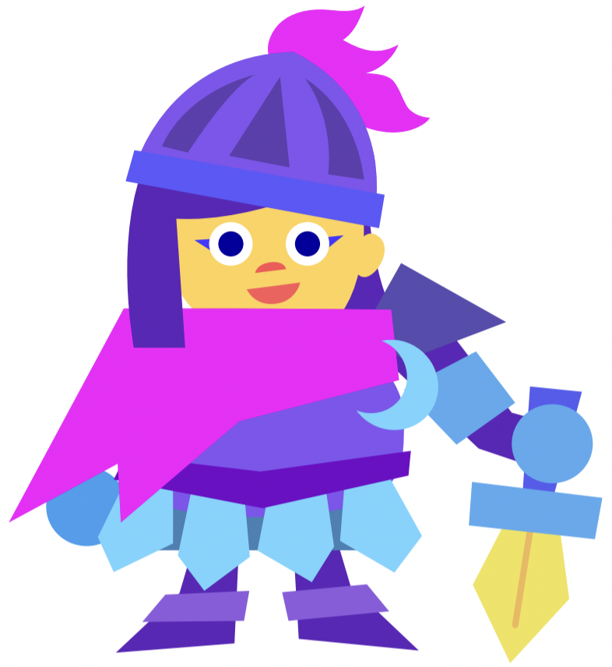
Starter
Can you help to correct my spelling mistakes
on these Stage 5 words?
Tell your partner what mistakes I have made.
sinceer
dout
knite
decieve
changable
Notes:
These are some of the Year 5 challenge words taken from Stage 5, Lesson 32.
Discuss why these may be tricky to learn.

Slide 3
Starter
Can you help to correct my spelling mistakes
on these Stage 5 words?
Tell your partner what mistakes I have made.
sinceer
sincere
dout
doubt
knite
knight
decieve
deceive
changable
changeable
Notes:
These are some of the Year 5 challenge words taken from Stage 5, Lesson 32.
Discuss why these may be tricky to learn.

Slide 4
This Week’s Words
Do you know what they mean?
accommodate
available
suggest
muscle
competition
existence
prejudice
determined
identity
rhyme

Slide 5
Word Facts
What is a muscle?
Muscle is tissue with the body which contracts and relaxes, allowing for movement.
Names of some muscles include:
biceps = a French and Latin word in origin and meaning two-headed.
triceps = derived from a Latin word meaning three-headed.
There are over 600 muscles in the human body.
Muscles are attached to your bones by tendons.
Muscles work in pairs; while one contracts, the other relaxes.

Slide 6
Etymology
muscle
The word ‘muscle’ was first introduced to the English language in 1392 and was spelled ‘mucell’.
‘Mucell’ was borrowed from the Latin word ‘musculus’ and means ‘little mouse’. This was because some muscles resembled the shape and movement of a mouse.
👍🏻
In Greek, the word ‘mys’ means both ‘mouse’ and ‘muscle’.
In German, ‘maus’ means ‘mouse’ and ‘the ball of the thumb’.

Slide 7
Etymology
existence
Latin ‘existere’
meaning ‘stand forth, come out, emerge’.
Medieval Latin
(4th-10th
centuries)
‘existential’.
In the late 14th
Century meaning ‘reality’ from
Old French word
‘existence’.
‘ex’ meaning ‘out’
‘sistere’ meaning ‘to stand’
existere
Can you think of any other words which may have derived
from the same meaning?

Slide 8
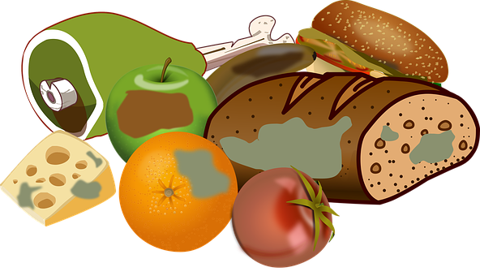
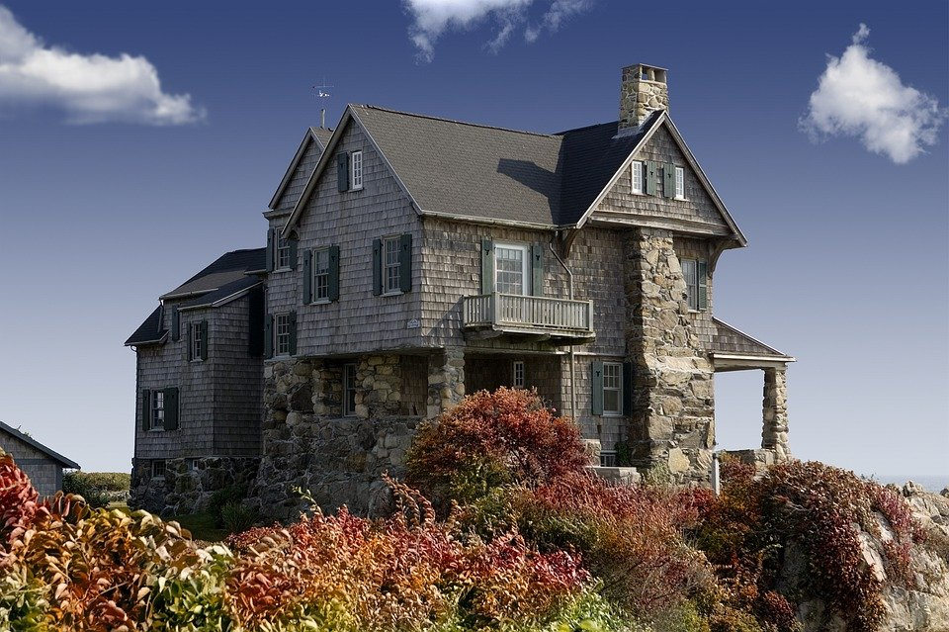
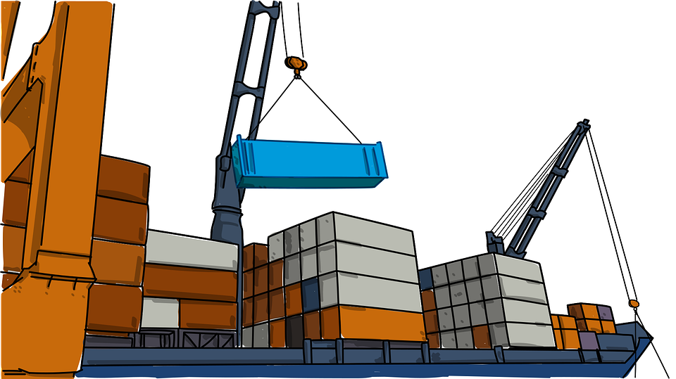
Words where ‘ex’ means ‘out’
exit
exhale
expire
external
export
explode

Slide 9
Word Sort
Can you sort these words according to the
number of syllables?
available
accommodate
suggest
determined
competition
muscle
identity
existence
rhyme
prejudice
1 syllable
2 syllables
3 syllables
4 syllables
Notes:
Click on each word for it to move into the correct circle.

Slide 10
Syllable Maps
How many syllables do these words have?
4
accommodate
ac|com|mo|date
4
available
a|vail|a|ble
Notes:
Click on the slide to show the number of syllables and how it is written.

Slide 11
Challenge Words
To be able to segment words into the correct syllables and phonemes
To spell words with irregular spelling patterns
Read the word. Write each word out, drawing long lines for the syllable breaks. Finally, write the word out again.
Word | Syllable Breaks | Word
accommodate | ac|com|mo|date | accommodate
available
competition
determined
suggest
existence
identity
muscle
prejudice
rhyme

Slide 12
Challenge Words
Answers
Word | Syllable Breaks | Word
accommodate | ac|com|mo|date | accommodate
available | a|vail|a|ble | available
competition | com|pe|ti|tion | competition
determined | de|ter|mined | determined
suggest | sug|gest | suggest
existence | ex|ist|ence | existence
identity | i|den|ti|ty | identity
muscle | mus|cle | muscle
prejudice | prej|u|dice | prejudice
rhyme | rhyme | rhyme

Slide 13
Phoneme Maps
Use a dot for each single letter sound and a line when two letters make one sound.
rhyme
muscle
suggest

Slide 14
Irregular Spelling Pattern
prejudice
Why might ‘prejudice’ be a difficult word to decode?
The ‘-ice’ suffix is pronounced ‘iss’.
Can you think of any other words that share this ending?
notice, office, service, practice, justice

Slide 15
Irregular Spelling Pattern
When a word ends with the /l/ sound, sometimes it is spelled ‘el’ and other times ’le’.
Can you decide which word has which ending?
le
el
little or littel
muscle
tunnel
bicycle or bicycel
little
example or exampel
travel
bicycle
bottle or bottel
camel
example
tunnle or tunnel
bottle
vegetable or vegetabel
travle or travel
vegetable
el used after the letters m, n, r, s, v and w.
camle or camel
dwindle
dwindle or dwindel
Notes:
Read the following words to the children and ask them to decide which box (le or el) it needs to be placed in. Ask them to look at the rule in order to make their decision.
The most common way is to spell it with ‘le’ and less common is ‘el’. )The –el spelling is used after m, n, r, s, v, w and more often than not after s.)

Slide 16
Cloze Sentences
Can you identify the missing words in
these sentences?
accommodate
available
competition
determined
suggest
existence
identity
muscle
prejudice
rhyme
The gluteus maximus is the largest in the human body.
Some people believe in the of extra-terrestrial beings.
May I we take a democratic vote on the issue?
Believe and deceive are words that .
The art was won by a sensational landscape painting.
Notes:
Complete one sentence at a time. This slide provides the children with their words so that they are able to choose the appropriate missing word for each sentence.

Slide 17
Cloze Sentences
Can you identify the missing words in
these sentences?
Local police cells are able to up to fifteen ‘guests’, with neighbouring stations’ lockups if necessary.
Whether a suspect is remanded in custody or not is by the custody sergeant, who will ask them for proof of their and where they reside.
Suspects are also entitled to legal representation, where a solicitor would be present in order to ensure that no occurs and that the law is followed appropriately.
Notes:
This slide removes the words so that the children are able to practise spelling them.
They could use whiteboards and 1-2-3-Show Me for instant assessment and the ability to address incorrect spelling of words.

Slide 18
Cloze Sentences
Answers
accommodate
available
competition
determined
suggest
existence
identity
muscle
prejudice
rhyme
muscle
The gluteus maximus is the largest in the human body.
existence
Some people believe in the of extra-terrestrial beings.
suggest
May I we take a democratic vote on the issue?
rhyme
Believe and deceive are words that .
competition
The art was won by a sensational landscape painting.

Slide 19
Cloze Sentences
Answers
accommodate
Local police cells are able to up to fifteen ‘guests’, with neighbouring stations’ lockups if necessary.
available
Whether a suspect is remanded in custody or not is by the custody sergeant, who will ask them for proof of their and where they reside.
determined
identity
Suspects are also entitled to legal representation, where a solicitor would be present in order to ensure that no occurs and that the law is followed appropriately.
prejudice

Slide 20
Challenge Words
Find the dictionary definition for the words below.
Then write your own sentence for each.
Word | Dictionary Definition | In a Sentence
accommodate
available
competition
determined
suggest
existence
identity
muscle
prejudice
rhyme

Slide 21
Challenge Words
Possible Answers
Word | Dictionary Definition | In a Sentence
accommodate | Providing somewhere to stay or something needed or desired. | The hotel can accommodate up to 500 guests.
available | Able to be used or possible to get. | We'll send you a copy as soon as it becomes available.
competition | An event in which people compete with each other to find out who is the best at something. | Hundreds of schools entered the competition.
determined | Making a decision and not changing it. | I'm determined to succeed.
suggest | Put forward an idea or plan. | I'd like to suggest a different explanation for the accident.
existence | The state or fact of being real or living or of being present. | The mere existence of these strange creatures fascinated him.
identity | Who or what somebody/something is. | Do you have any proof of identity?
muscle | Tissue within the body which contracts and relaxes. | This exercise will work the muscles of the lower back.
prejudice | A biased opinion not based on reason. | Their decision was based on ignorance and prejudice.
rhyme | Words with the same or similar end sounds. | The children made up a rhyme about a frog and a dog sitting on a log.

Slide 22
Definition
In a Sentence
determined
Synonyms
Antonyms

Slide 23
Definition
In a Sentence
After robbing the bank, the thief was determined to evade capture from the police.
Making a decision and not changing it.
determined
Synonyms
Antonyms
decisive, strong-willed,
serious, firm, resolute,
driven, stubborn
weak, unmotivated,
complacent, feeble, unsure, indecisive

Slide 24
Morphology Matrix
How many new words can you create by adding
a prefix and/or suffix(es)?
Prefix
Base Word
Suffix
s
d
ing
ion
un
(not)
accommodate
(to provide enough space for somebody/something)
Remember what happens to the final ‘e’ when adding certain suffixes.
Notes:
Children to create new words using their spelling word accommodate. Children could be asked to put these new word into a sentence to demonstrate their understanding.

Slide 25
Morphology Matrix
How many new words can you create by adding
a prefix and/or suffix(es)?
Prefix
Base Word
Suffix
s
d
ing
ion
un
(not)
accommodate
(to provide enough space for somebody/something)
Possible answers: accommodates, accommodated, accommodating, accommodation, unaccommodated, unaccommodating

