Slide 1
6
2
To be able to segment words into the correct syllables and phonemes
To spell words with the long vowel sound /igh/ spelled ‘y’
This week’s words: apply, hygiene, hyphen, identify, multiply, occupy, python, recycle, rhyme, supply

Slide 2
Starter
Which of last week’s words have two syllables?
Which words have three syllables?
rhythm
mystery
symptom
2
3
2
system
lyrics
typical
2
2
3
antonym
oxygen
crystal
3
3
2
symbol
2
2
3
Notes:
Click the number to reveal the spellings with that number of syllables.

Slide 3
Starter
Which of last week’s words have been split
into their syllables correctly?
✓
ox|y|gen
✗
anto|nym
✗
lyr|i|cs
ox|y|gen
an|ton|ym
ly|rics
✗
myste|ry
✓
typ|i|cal
✓
sym|bol
mys|ter|y
typ|i|cal
sym|bol
Notes:
Children to identify which words have been split into their syllables correctly and which have not, discussing why.
Click one at a time and click again for the answer to appear underneath.

Slide 4
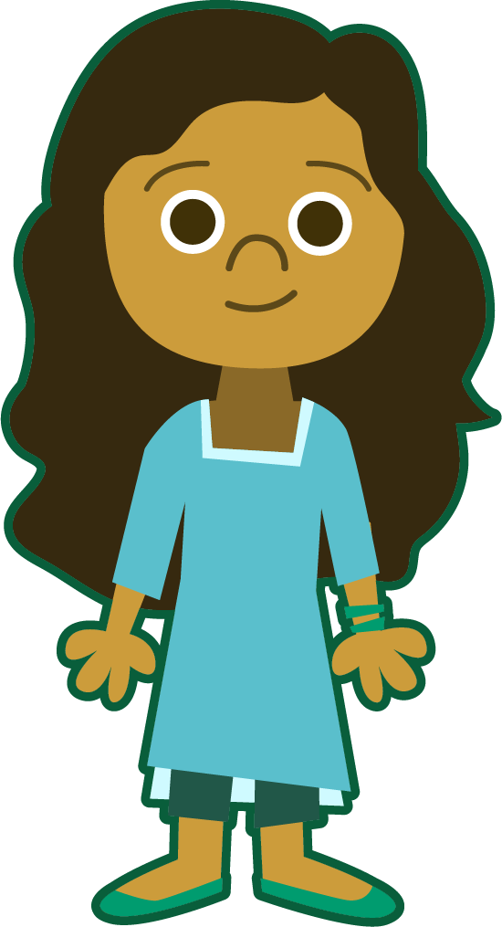
This Week’s Words
Do you know what they mean?
What do the words have in common?
rhyme
occupy
hygiene
identify
apply
python
multiply
hyphen
supply
What sound
does ‘y’ make in
these words?
recycle

Slide 5
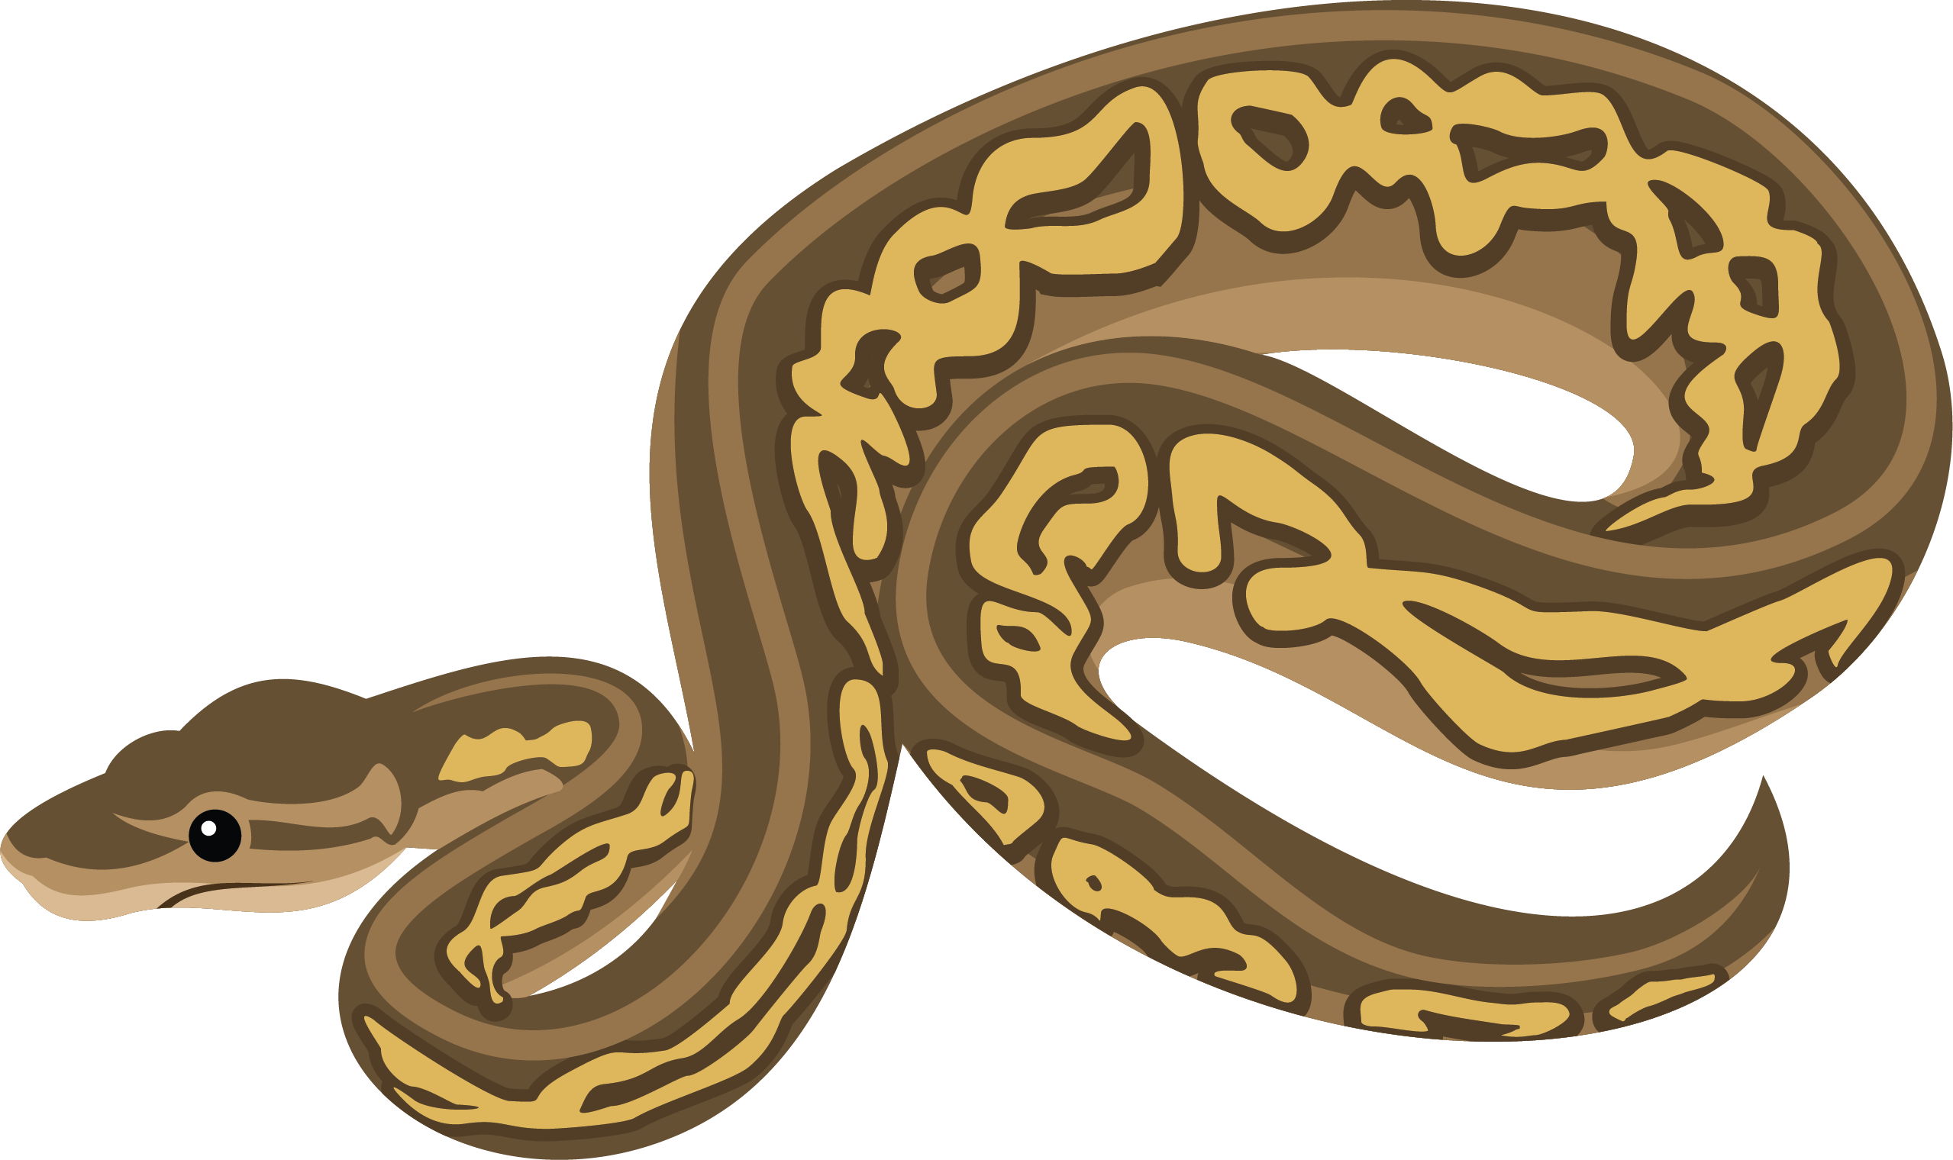
Etymology
python
A python is a large non-venomous snake that kills it prey by crushing them.
The word python comes from the Latin
python and also the Greek pythōn.
Pythōn means ‘serpent slain by Apollo’. It is probably related to Pythō, the old name of Delphi, the city where Apollo is said to have slain the serpent in Greek mythology.
The word ‘python’ was first recorded in English in 1590.

Slide 6

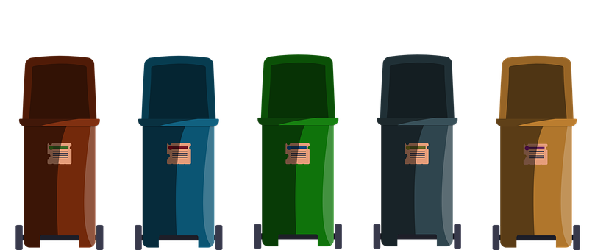
Etymology
recycle
Recycle is quite a recent addition to the English dictionary.
Formed from the prefix ‘re-’ and the verb ‘cycle’, ‘recycle’ was first used in 1926 as ‘reusing in an industrial process’.
That said, the process of converting waste materials back into a usable state was first recorded in 1960.
Recyclable was coined in
the 1970s.
Recycling was coined in
the 1920s.

Slide 7
Syllable Sort
How many syllables are in each word?
hyphen
occupy
rhyme
identify
multiply
python
apply
hygiene
supply
recycle
1 Syllable
2 Syllables
3 Syllables
4 Syllables

Slide 8
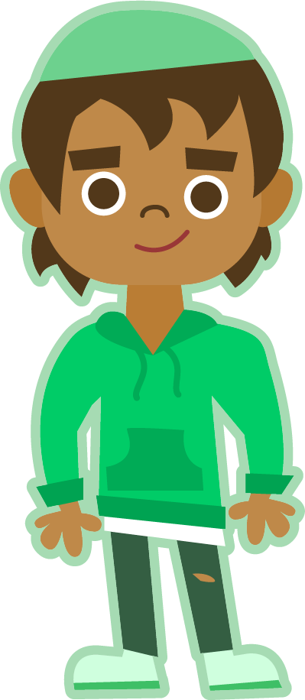


Syllable and Phoneme Maps
hygiene
Syllables are separated by
a long
syllable break.
Add a phoneme to each box. Digraphs and trigraphs make one sound so they should occupy the same box. Then count the number of phonemes.
hy|giene
2
h | y | g | ie | ne
multiply
5 Phonemes
identify
mul|ti|ply
3
i|den|ti|fy
4
m | u | l | t | i | p | l | y
i | d | e | n | t | i | f | y
8 Phonemes
8 Phonemes
Notes:
Click on the slide to show the number of syllables and how it is written.

Slide 9
Word Maps
Read each word. Split it into syllables. Then split it into phonemes, adding a phoneme to each box. Finally, count the number of phonemes.
Word | Syllable Breaks | Sound Boxes |  |  |  |  |  |  |  |  | Number of Phonemes
rhyme
occupy
apply
hyphen
hygiene
python
supply
identify
multiply
recycle

Slide 10
Word Maps
Answers
Word | Syllable Breaks | Sound Boxes |  |  |  |  |  |  |  |  | Number of Phonemes
rhyme | rhyme | rh | y | me |  |  |  |  |  |  | 3
occupy | oc|cu|py | o | cc | u | p | y |  |  |  |  | 5
apply | ap|ply | a | pp | l | y |  |  |  |  |  | 4
hyphen | hy|phen | h | y | ph | e | n |  |  |  |  | 5
hygiene | hy|giene | h | y | g | ie | ne |  |  |  |  | 5
python | py|thon | p | y | th | o | n |  |  |  |  | 5
supply | sup|ply | s | u | pp | l | y |  |  |  |  | 5
identify | i|den|ti|fy | i | d | e | n | t | i | f | y |  | 8
multiply | mul|ti|ply | m | u | l | t | i | p | l | y |  | 8
recycle | re|cy|cle | r | e | c | y | c | le |  |  |  | 6

Slide 11
Irregular Spelling Pattern
Can you sort this week’s words according
to where the /igh/ sound occurs?
rhyme
oc|cu|py
hy|giene
re|cyc|le
sup|ply
a|pply
hy|phen
py|thon
i|den|ti|fy
mul|ti|ply
Long /igh/ sound appears in the middle of the word
Long /igh/ sound appears at the end of the word
Notes:
Click on each word for it to move to the relevant box.

Slide 12
Adding Suffixes
What happens to the letter ‘y’ when a suffix is added?
suffix ‘-ed’
suffix ‘-es’
suffix ‘-ing’
apply
applied
applies
applying
supply
supplied
supplies
supplying
identify
identified
identifies
identifying
occupy
occupied
occupies
occupying
multiply
multiplied
multiplies
multiplying
Can you think of any other suffixes that can be added to any of these words? How are they spelled?
Some examples may include: application(s), applicable, identification, identifiable, occupation(s), occupancy, multiplication

Slide 13
Cloze Sentences
Can you identify the missing words in these sentences?
rhyme
occupy
apply
hyphen
hygiene
python
supply
identify
multiply
recycle
The carpet ________________ is a snake native to Australia that feeds on small prey such as lizards, birds and frogs.
If I were to ________________ six thousand by thirteen thousand, my answer should be 78,000,000. Am I right?
All households are actively encouraged to ________________ and place the different materials in different coloured bins.
Should I place a ________________ in the sentence below?

Slide 14
Cloze Sentences
Can you identify the missing words in these sentences?
In order to ensure that _______________ is a top priority, all restaurants need a good _______________ of cleaning products available in their kitchens.
When prospective employees _______________ for a job, they need to _______________ what their strengths and positive qualities are in the application form.
Personally, I prefer poetry which does not _______________.
All the day’s events _______________ my mind when I’m lying in bed at night,
trying to go to sleep.

Slide 15
Cloze Sentences
Answers
rhyme
occupy
apply
hyphen
hygiene
python
supply
identify
multiply
recycle
The carpet ________________ is a snake native to Australia that feeds on small prey such as lizards, birds and frogs.
python
If I were to ________________ six thousand by thirteen thousand, my answer should be 78,000,000. Am I right?
multiply
All households are actively encouraged to ________________ and place the different materials in different coloured bins.
recycle
Should I place a ________________ in the sentence below?
hyphen

Slide 16
Cloze Sentences
Answers
In order to ensure that _______________ is a top priority, all restaurants need a good _______________ of cleaning products available in their kitchens.
hygiene
supply
When prospective employees _______________ for a job, they need to _______________ what their strengths and positive qualities are in the application form.
apply
identify
Personally, I prefer poetry which does not _______________.
rhyme
All the day’s events _______________ my mind when I’m lying in bed at night,
trying to go to sleep.
occupy

Slide 17
Definitions and Sentences
Find the dictionary definition for the words below.
Then write your own sentence for each.
Word | Dictionary Definition | In a Sentence
rhyme
occupy
apply
hyphen
hygiene
python
supply
identify
multiply
recycle

Slide 18
Definitions and Sentences
Possible Answers
Word | Dictionary Definition | In a Sentence
rhyme | A word that has the same sound or ends with the same sound as another word. | Words which rhyme in poetry are usually found at the end of each line.
occupy | To take up or fill a space, a building or an amount of time. | Our cat will always occupy the seat we want to sit in.
apply | To make an official request for something. | As he was in his final year at sixth form, he now had to apply for a place at university.
hyphen | A punctuation mark used to join words. | I needed to put a hyphen in my writing as I ran out of space to complete the word at the end of the line.
hygiene | The activities of keeping clean, free from germs. | It is good hygiene practice to wash your hands after blowing your nose.
python | A type of non-venomous snake | A python likes to kill its prey by wrapping itself around them and crushing them.
supply | Stock or goods that is available for people to buy. | The shops had a good supply of essential items.
identify | Being able to recognise something or someone by their distinct features of qualities. | The witness was asked if she could identify the person she saw robbing the bank.
multiply | A number which increases. | If I multiply three by nine, I get twenty-seven.
recycle | The process of converting waste materials into something new so that it can be re-used. | There are different materials which people can recycle, such as metal, paper and plastic.

Slide 19
Definition
In a Sentence
rhyme
Words rhyming with
rhyme and ending ‘-me’
Words rhyming with
rhyme not ending ‘-me’

Slide 20
Definition
In a Sentence
Words that rhyme have the
same last sound, but may
not necessarily have the
same spelling.
Can you think of a rhyme for rocket?
rhyme
Words rhyming with
rhyme and ending ‘-me’
Words rhyming with
rhyme not ending ‘-me’
time, crime, prime,
lime, dime, slime, rime, mime, chime, thyme, pantomime, anytime, maritime, windchime
climb

Slide 21
Morphology Matrix
How many new words can you create by adding
prefix(es) and/or suffix(es)?
Prefix
Base Word
Suffix
s
identify
(to recognise what something is
or who someone is)
mis
ed
re
ing
un
cation
REMEMBER
What happens to the ‘y’ in identify
when adding some suffixes?
able
Which word is sometimes abbreviated to I.D?
Give two examples of I.D.
Notes:
You may wish to revise the prefix meanings before the children start the activity:
mis = wrong/false
re = repeat/again
un = not/opposite

Slide 22
Morphology Matrix
How many new words can you create by adding
prefix(es) and/or suffix(es)?
Prefix
Base Word
Suffix
s
identify
(to recognise what something is
or who someone is)
mis
ed
re
ing
un
cation
REMEMBER
What happens to the ‘y’ in identify
when adding some suffixes?
able
Possible answers: misidentify, misidentifies, misidentified, reidentify, reidentified, reidentifies, reidentification, unidentified, unidentifiable, identifies, identified, identifying, identification, identifiable
identification
Passport and Driving Licence
Notes:
You may wish to revise the prefix meanings before the children start the activity:
mis = wrong/false
re = repeat/again
un = not/opposite

