Slide 1
6
2
To be able to segment words into the correct syllables and phonemes
To spell words with irregular spelling patterns
This week’s words: accompany, average, conscience, develop, explanation, immediately, necessary, privilege, rhythm, symbol

Slide 2
Starter
How many syllables are in these
words from last week?
accommodate
available
suggest
4
4
2
muscle
competition
existence
2
4
3
prejudice
determined
identity
3
3
4
rhyme
1
Notes:
Recap last week’s challenge words.

Slide 3
Starter
Which words have been split into the
correct syllables?
✗
a|vail|able
✓
mus|cle
✓
prej|u|dice
a|vail|a|ble
mus|cle
prej|u|dice
✗
s|u|gge|st
✗
r|hyme
✗
ex|is|ten|ce
sug|gest
rhyme
ex|ist|ence
Notes:
Children to identify which words have been split into their syllables correctly and which have not, discussing why.
Click one at a time and click again for the answer to appear underneath.

Slide 4
This Week’s Words
Do you know what they mean?
accompany
average
immediately
explanation
conscience
necessary
rhythm
develop
privilege
symbol

Slide 5


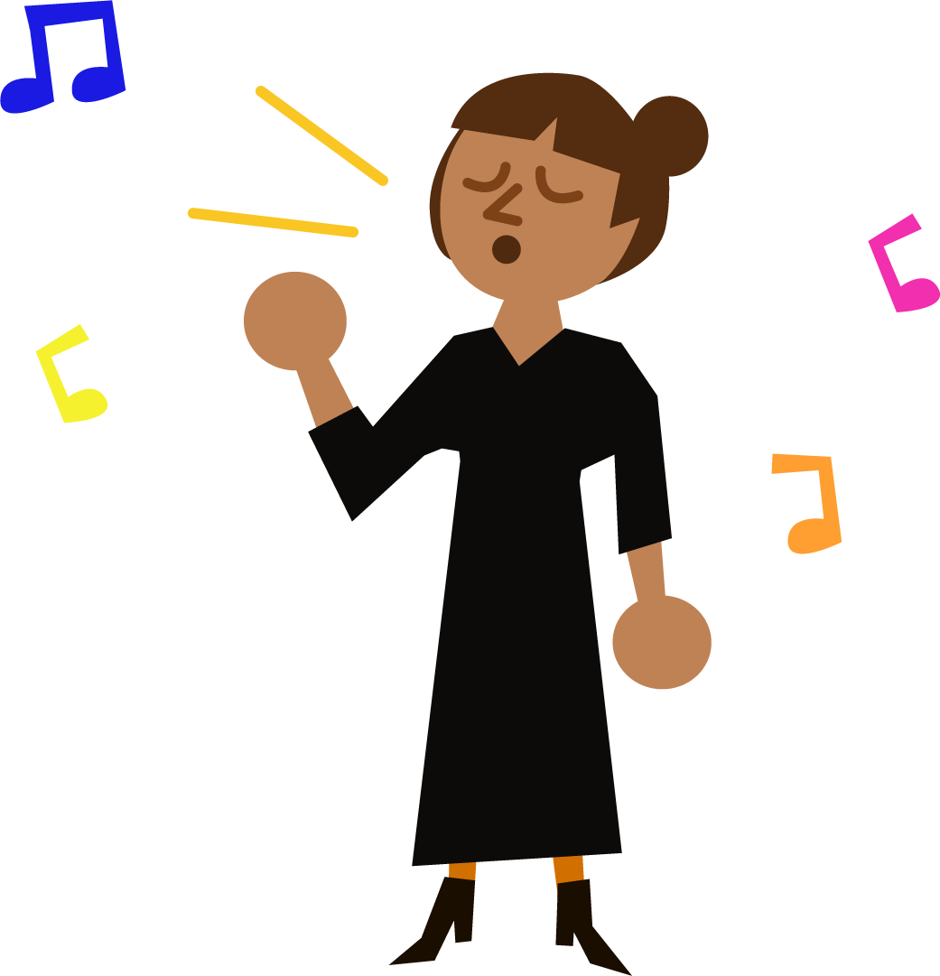
Etymology
rhythm
The term ‘rhymed’ or ‘rhyming verse’ entered the English language in the 1550s.
It was borrowed from rhythmus in Latin, meaning ‘movement in time’.
There’s also rhythmos from Greek, meaning ‘movement or a measured flow’.
Rhythm, associated with music, was first recorded in English in 1776.
Rhythm in music means the repeating sounds of beats.
The U.S. musical style, Rhythm and Blues, first got its name in 1949.

Slide 6

Etymology
develop
Some words change and evolve over time and now have different meanings.
Look at how the meaning of the word ‘develop’ developed.
desveloper
(Old French)
developper
(Old French)
develop
(French)
develop
(English–1650s)
‘Unfold’, ‘unfurl’ or ‘unwrap’ were the original words once used for develop.
‘des’ meaning ‘undo’
‘veloper’ meaning ‘wrap up’
desveloper
Linked to ‘envelop’ and ‘envelope’.

Slide 7
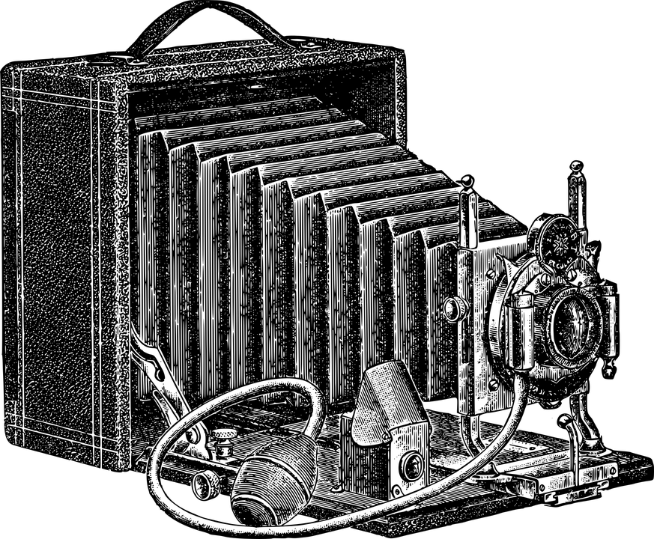
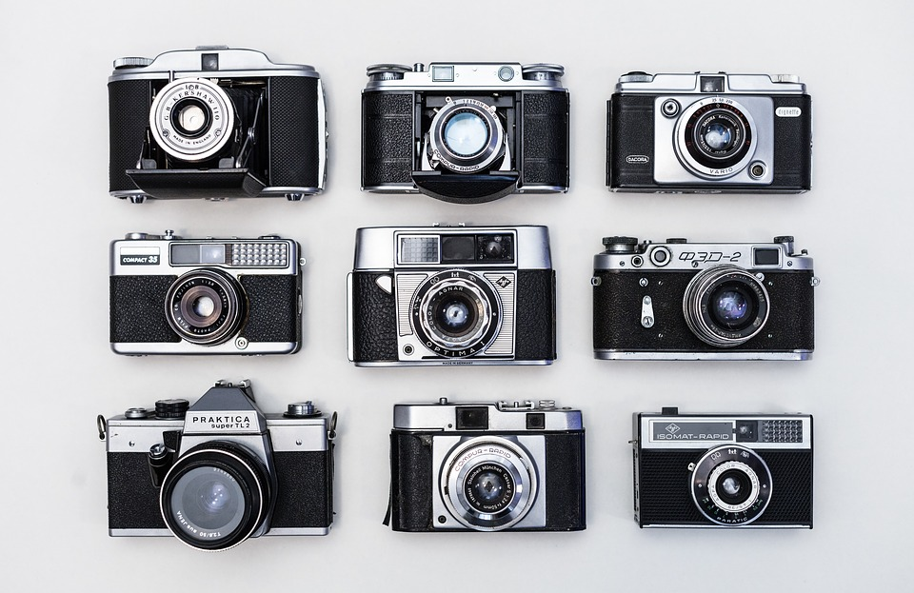




Etymology
develop
Develop: to gradually grow or become bigger, more advanced, stronger, etc.
Here is how the camera has developed into something we recognise today:
Vintage Camera
Mid 20th Century Camera and Film
Polaroid Camera
Digital Camera
Smartphone Camera
Modern-day cameras allow the photographer to view their photographs instantly.
This has not always been the case.
The first photograph was taken in the first half of the 19th Century, taking hours to develop.
By the late 1800s, camera film/roll had been invented, but photographs still took time to develop.
In the 1990s, digital cameras were invented which allowed for instant viewing.
Can you think of anything else that has changed or developed over time?

Slide 8
Syllables
How many syllables are in each word?
Which is the most/least common number of syllables?
accompany
average
immediately
4
3
5
explanation
conscience
necessary
4
2
4
rhythm
develop
privilege
2
3
3
symbol
2

Slide 9

Syllable Maps
Where are the syllable breaks in these words?
develop
conscience
accompany
de|vel|op
con|science
ac|com|pa|ny
3
2
4

Slide 10
Challenge Words
To be able to segment words into the correct syllables and phonemes
To spell words with irregular spelling patterns
Read the word. Write each word out, drawing long lines for the syllable breaks. Finally, write the word out again.
Word | Syllable Breaks | Word
accompany
average
conscience
develop
explanation | ex|pla|na|tion | explanation
immediately
necessary
privilege
rhythm
symbol

Slide 11
Challenge Words
Answers
Word | Syllable Breaks | Word
accompany | ac|com|pa|ny | accompany
average | av|er|age | average
conscience | con|science | conscience
develop | de|vel|op | develop
explanation | ex|pla|na|tion | explanation
immediately | im|me|di|ate|ly | immediately
necessary | nec|es|sar|y | necessary
privilege | priv|i|lege | privilege
rhythm | rhy|thm* | rhythm
symbol | sym|bol | symbol
* Syllables usually contain a vowel sound. Rhythm is an exception as our regional accents, and the way we form the /m/ sound, can mean it is pronounced as two syllables.

Slide 12
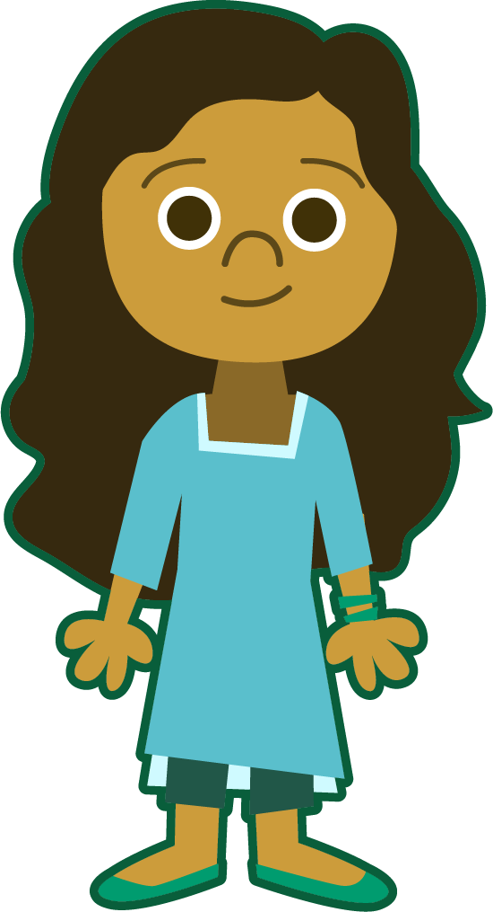
Phoneme Maps
Use a dot for each single letter sound and a line when two letters make one sound.
explanation
symbol
conscience

Slide 13
Word Sort
Can you sort these words according to the
class it belongs to?
accompany
average
immediately
explanation
conscience
necessary
rhythm
develop
privilege
symbol
Verbs
Nouns
Adjectives
Adverbs
Note: Some words fit into more than one word class.
Notes:
Click on each word for it to move into the correct circle.
Some are easier than others.
Some words fit in more than one class.
accompany — verb.
conscience — noun
explanation — noun
necessary — ADJECTIVE (an absolute must!) and NOUN (indispensable – more commonly used words may include: requirement, need or even the plural, necessities)
rhythm — noun
develop — verb
average — ADJECTIVE (in the middle of the scale – The average person spends approximately 26 years sleeping in their life or 9,490 days or 227,760 hours., NOUN (a scale regarded as normal – Last month’s rainfall was below the average.)
and VERB (achieve without loss or gain – She averaged 9 out of 10 in her spellings each week.)
immediately — adverb
privilege — NOUN (special advantage – One privilege someone can earn is half an hour on the X Box!) and VERB (favoured – Monarchs are privileged more than the everyday common person.)
symbol — noun

Slide 14
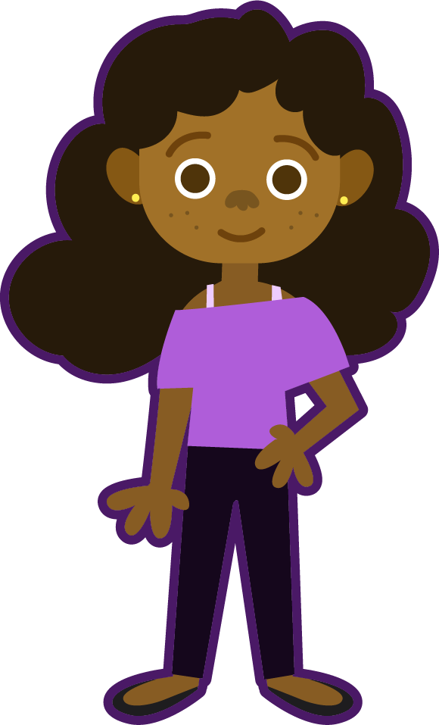
Word Classes
necessary
Words can belong to more than one word class depending on how they are used in the sentence.
ADJECTIVE (an absolute must)
Have you bought the necessary ingredients for the chocolate cake?
NOUN (indispensable)
More commonly used words for necessary may include requirement, need or even the plural, necessaries.
average
ADJECTIVE (in the middle of the scale)
The average person spends approximately 26 years sleeping in their life or 9,490 days or 227,760 hours.
NOUN (a scale regarded as normal)
Last month’s rainfall was below the average.
VERB (to achieve without loss or gain)
She averaged nine out of ten in her spellings each week.
privilege
NOUN (special advantage)
One kind of privilege a child could earn as a reward is extra time on the X-Box.
VERB (favoured)
The manager should not privilege one person over another.
Notes:
You may wish to focus on just one of the challenge words rather than all three and discuss how each have been used in the sentences.
E.g. The adjectives are placed in front of the nouns.
Nouns – discuss the subject of the sentence.

Slide 15
Irregular Spelling Pattern
There are different ways of spelling the /j/ sound. Can you think of any?
/j/ sound
ge
dge
j
g
The words, privilege and average, match with which grapheme?

Slide 16
Irregular Spelling Pattern
Can you think of any more examples that fit
this pattern?
Both ‘average’ and ‘privilege’ have a /j/ sound at the end.
average
privilege
percentage
sacrilege
message
allege
village
college
sausage

Slide 17
Irregular Spelling Pattern
How do we know which one to use?
Another way to spell the /j/ sound at the end of words is ‘dge’.
Pattern for ‘ge’
Follows long vowel sounds, consonants, the letter ‘e’ and the letter ‘a’ in words with more than one syllable.
dangerous
sponge
privilege
av|er|age
long vowel
consonant
letter ‘e’
three syllable word
Pattern for ‘dge’
Follows short vowel sounds in words generally containing one or two syllables.
knowledge
badge
short vowel
short vowel

Slide 18

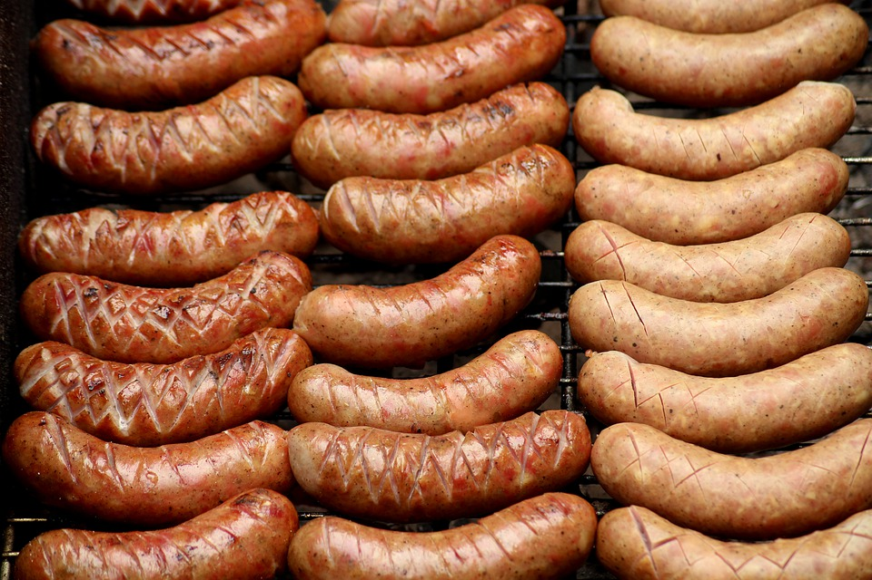
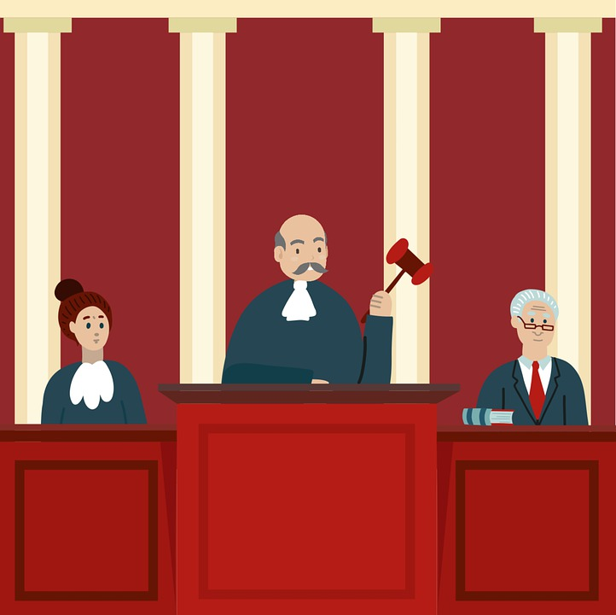
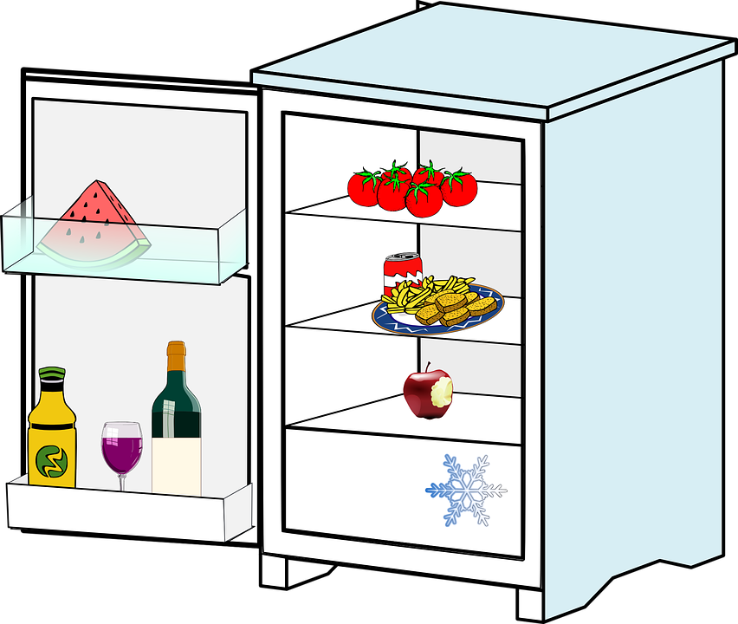
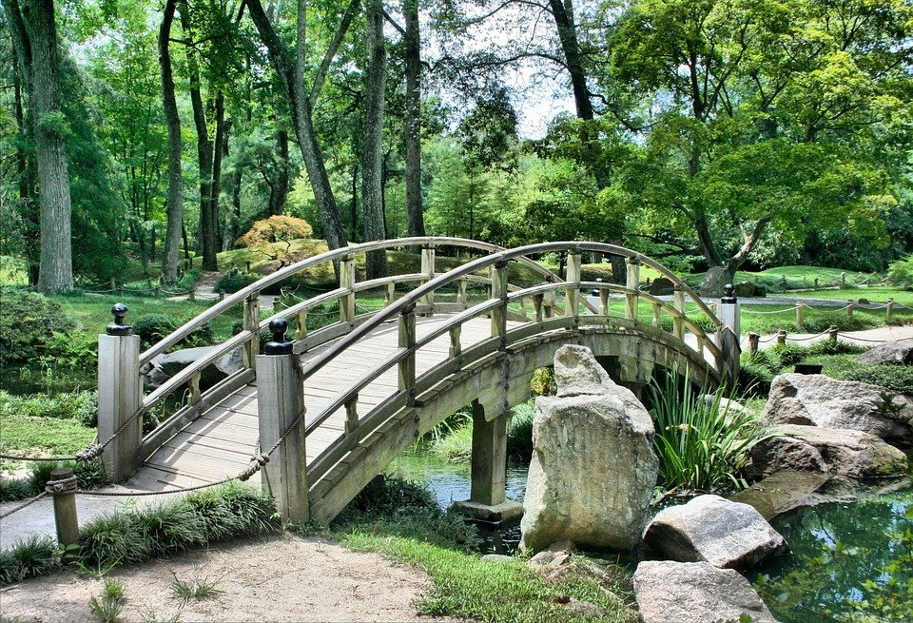
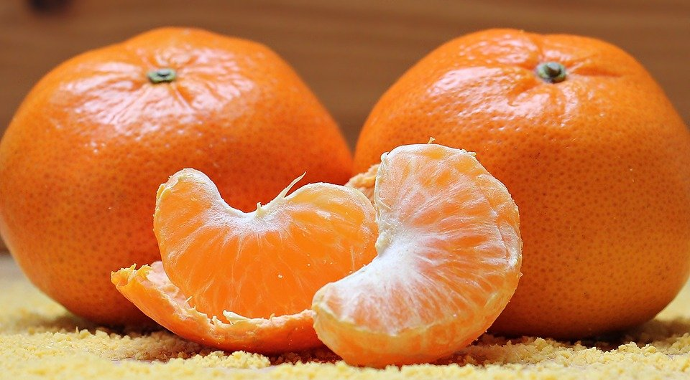
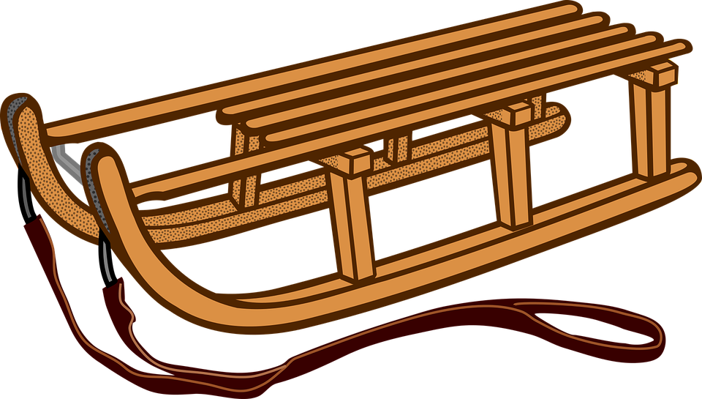
Choosing a Suffix
In which box would you place the following words?
Can you think of any other words which contain the graphemes ‘ge’ or ‘dge’?
Possible answers: acknowledge, drawbridge, knowledgeable, judgement, dodgeball, badges, nudged etc…
ge
dge

Slide 19
If the letter ‘g’ is followed by ‘e’, ‘i’, or ‘y’, then it can produce the /j/ sound.
genuine
imagine
Egypt
How do you think we say the following words?
education
produce
during
procedure
gradual
What do you notice?
They also produce the /j/ sound.

Slide 20
Cloze Sentences
Can you identify the missing words in
these sentences?
accompany
average
conscience
develop
explanation
immediately
necessary
privilege
rhythm
symbol
He had a guilty after eating his mum’s chocolates, especially when he was told not to touch them.
What a it was to be chosen for the award of best footballer.
I couldn’t help tapping my foot to
the of the beat.
The children offered no as to how the birthday cake was missing its top layer.
Notes:
This slide provides the children with their spellings so that they are able to choose the appropriate missing word for each sentence.

Slide 21
Cloze Sentences
Can you identify the missing words in
these sentences?
It is for parents to their children in the swimming pool for safety reasons.
“On , it rains in the month of October most of all here in the UK,” explained the weather forecaster as he pointed to the for rain on his weather map.
In order to a good hygiene routine, children should be taught to wash their hands after visiting the bathroom.
Notes:
This slide challenges the children to find two missing words in the sentences.
They could use whiteboards and 1-2-3-Show Me for instant assessment.

Slide 22
Cloze Sentences
Answers
accompany
average
conscience
develop
explanation
immediately
necessary
privilege
rhythm
symbol
conscience
He had a guilty after eating his mum’s chocolates, especially when he was told not to touch them.
privilege
What a it was to be chosen for the award of best footballer.
I couldn’t help tapping my foot to
the of the beat.
rhythm
explanation
The children offered no as to how the birthday cake was missing its top layer.

Slide 23
Cloze Sentences
Answers
necessary
accompany
It is for parents to their children in the swimming pool for safety reasons.
average
“On , it rains in the month of October most of all here in the UK,” explained the weather forecaster as he pointed to the for rain on his weather map.
symbol
In order to a good hygiene routine, children should be taught to wash their hands after visiting the bathroom.
develop
immediately

Slide 24
Challenge Words
Find the dictionary definition for the words below.
Then write your own sentence for each.
Read the word, decide if it is a noun (N), verb (V), adjective (ADJ) or AD (adverb).
Word |  | Dictionary Definition | In a Sentence
accompany
average
conscience
develop
explanation
immediately
necessary
privilege
rhythm
symbol

Slide 25
Challenge Words
Answers
Word |  | Dictionary Definition | In a Sentence
accompany | V | To go along or join in.
average | ADJ N V | In the middle of the scale. A scale regarded as normal. To achieve without loss or gain.
conscience | N | A feeling of right or wrong.
develop | V | Something which starts to exist, grow or mature.
explanation | N | A statement or account that makes something clear.
immediately | Ad | To do something straight away.
necessary | ADJ N | An absolute must. Indispensable, a requirement.
privilege | N V | Special advantage or benefit. Favoured over something or someone else.
rhythm | N | A regular and repeated pattern of sound.
symbol | N | A mark or object which represents something else.
Notes:
The sentence section has been left blank, because there are multiple answers for each word.

Slide 26
Definition
Sentence One – Adverb at the start (comma needed)
Sentence Two – Adverb in the middle of the sentence
immediately
Synonyms
Base Word
In a Sentence

Slide 27
Definition
Sentence One
Now, without hesitation.
Immediately, shivers pulsated down
his spine as he felt something
cold grip his shoulder.
Sentence Two
Flapping her wings with excitement, the three-headed dragon immediately glanced down at her nest as one of her eggs started to hatch.
immediately
Synonyms
Base Word
Instantly, promptly, rapidly, urgently, now, in a flash, in a jiffy, right now, instantaneously, straight away, without hesitation, at once, without delay, this instant, this minute, this second, on the double
immediate
In a Sentence
Touching down at
200mph, the tornado posed an immediate threat to
buildings and homes.

Slide 28
Morphology Matrix
How many new words can you create by adding
prefix(es) and/or suffix(es)?
Prefix
Base Word
Suffix
un
s
ed
under
ing
develop
over
ed
s
re
s
pre
ment
al
ly
Can you find a word that contains two suffixes?
Can you find ten words that contain both a prefix and a suffix?
Notes:
Children to create new words using their spelling word develop. Children could be asked to put these new words into a sentence to demonstrate their understanding.
Prefix meanings: over = too much; under = not enough; re = repeat; pre = before; and un = not/gives the word an opposite meaning.

Slide 29
Morphology Matrix
How many new words can you create by adding
prefix(es) and/or suffix(es)?
Prefix
Base Word
Suffix
un
s
ed
under
ing
develop
over
ed
s
re
s
pre
ment
al
ly
Possible answers: develops, developed, developing, developer, developers, development, developments, developmental, developmentally, undeveloped, underdeveloped, overdeveloped, overdevelops, redevelop, redevelops, redeveloped, redeveloping, redevelopment, redevelopments, predevelop, predeveloped, predevelops

