Slide 1
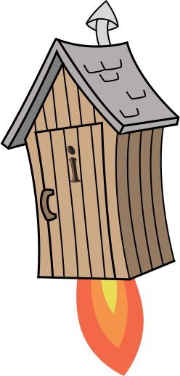
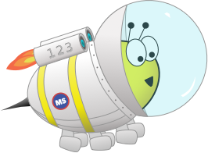
Quiz: QOVBUNE
Stage 4 Spring Block 1: Multiplication and Division
Lesson 1: To be able to explore the 11 and 12 times tables
Spring
Block 1 – Multiplication and Division
1

Slide 2
To be able to explore the 11 and 12 times tables
Success criteria:
I can use my knowledge of the 1, 2 and 10 times tables to explore multiplication and division requiring the 11 and 12 times tables
I can explain my reasoning when using my knowledge of the 1, 2 and 10 times tables to explore multiplication and division requiring the 11 and 12 times tables

Slide 3
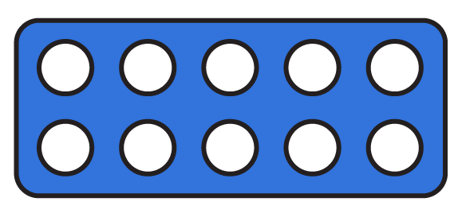
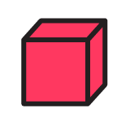
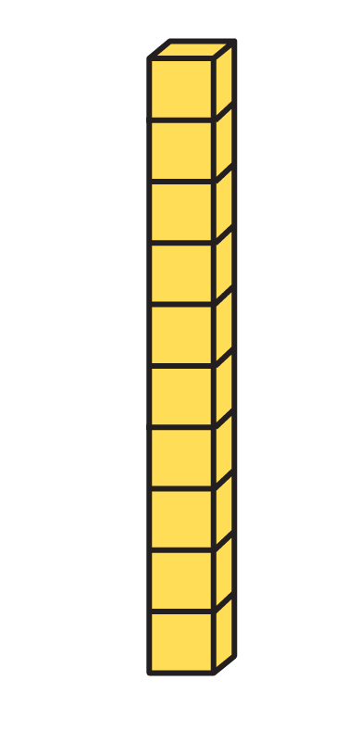
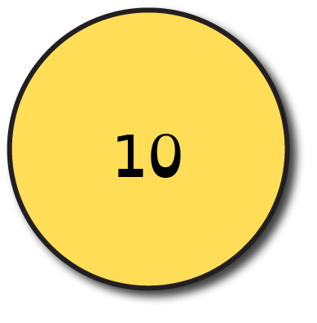
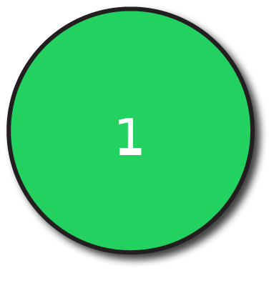
To be able to explore the 11 and 12 times tables
Starter:
Which one doesn’t belong?
Explain your answer.

Slide 4
To be able to explore the 11 and 12 times tables
Starter:
Which one doesn’t belong?
The Numicon shape representation doesn’t belong as it shows two lots of 12 or 2 x 12 = 24, whereas the Base 10 piece, place value counters and number bead strings show two lots of 11 or 2 x 11 = 22.

Slide 5
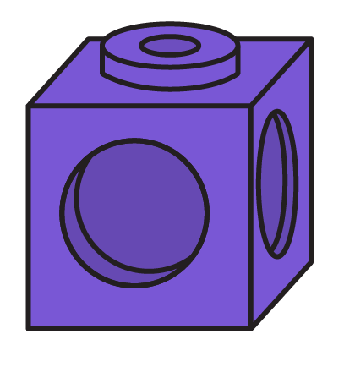
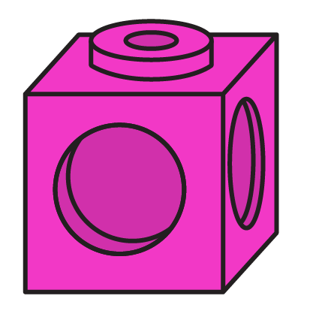
To be able to explore the 11 and 12 times tables
Talking Time:
Referring to the mathematical equipment, complete the sentences below:
2 x 10 = __ 2 x 1 = __
2 lots of 10 cubes = __ 2 lots of 1 cube = __
2 lots of 11 cubes = __
2 x 10 + 2 x 1 = 2 x 11 = __

Slide 6
To be able to explore the 11 and 12 times tables
Talking Time:
Referring to the mathematical equipment, complete the sentences below:
2 x 10 = 20 2 x 1 = 2
2 lots of 10 cubes = 20 2 lots of 1 cube = 2
2 lots of 11 cubes = 22
2 x 10 + 2 x 1 = 2 x 11 = 22

Slide 7
To be able to explore the 11 and 12 times tables
Talking Time:
Referring to the mathematical equipment, complete the sentences below:
2 x 10 = __ 2 x 2 = __
2 lots of 10 cubes = __ 2 lots of 2 cubes = __
2 lots of 12 cubes = __
2 x 10 + 2 x 2 = 2 x 12 = __

Slide 8
To be able to explore the 11 and 12 times tables
Talking Time:
Referring to the mathematical equipment, complete the sentences below:
2 x 10 = 20 2 x 2 = 4
2 lots of 10 cubes = 20 2 lots of 2 cubes = 4
2 lots of 12 cubes = 24
2 x 10 + 2 x 2 = 2 x 12 = 24

Slide 9
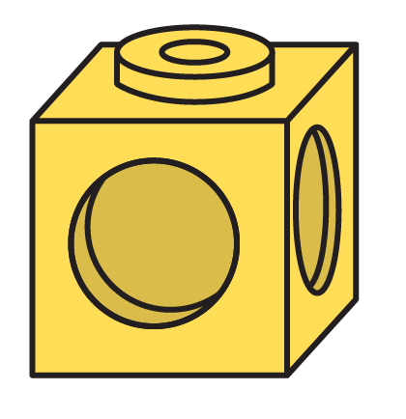
To be able to explore the 11 and 12 times tables
Talking Time:
Referring to the mathematical equipment, complete the sentences below:
3 x 10 = __ 3 x 1 = __
3 lots of 10 cubes = __ 3 lots of 1 cube = __
3 lots of 11 cubes = __
3 x 10 + 3 x 1 = 3 x 11 = __

Slide 10
To be able to explore the 11 and 12 times tables
Talking Time:
Referring to the mathematical equipment, complete the sentences below:
3 x 10 = 30 3 x 1 = 3
3 lots of 10 cubes = 30 3 lots of 1 cube = 3
3 lots of 11 cubes = 33
3 x 10 + 3 x 1 = 3 x 11 = 33

Slide 11
To be able to explore the 11 and 12 times tables
Activity 1:
Referring to the mathematical equipment, complete the sentences below:
3 x 10 = __ 3 x 2 = __
3 lots of 10 cubes = __ 3 lots of 2 cubes = __
3 lots of 12 cubes = __
3 x 10 + 3 x 2 = 3 x 12 = __

Slide 12
To be able to explore the 11 and 12 times tables
Activity 1:
Referring to the mathematical equipment, complete the sentences below:
3 x 10 = 30 3 x 2 = 6
3 lots of 10 cubes = 30 3 lots of 2 cubes = 6
3 lots of 12 cubes = 36
3 x 10 + 3 x 2 = 3 x 12 = 36

Slide 13
To be able to explore the 11 and 12 times tables
Talking Time:
Use a counting stick to practice the eleven times table as a class…
0
1
2
3
4
5
6
7
8
9
10
What are 0 x 11 and 10 x 11?

Slide 14
To be able to explore the 11 and 12 times tables
Talking Time:
Use a counting stick to practice the eleven times table as a class…
0
110
0
1
2
3
4
5
6
7
8
9
10
What is 1 x 11?

Slide 15
To be able to explore the 11 and 12 times tables
Talking Time:
Use a counting stick to practice the eleven times table as a class…
0
11
110
0
1
2
3
4
5
6
7
8
9
10
What is 2 x 11?

Slide 16
To be able to explore the 11 and 12 times tables
Talking Time:
Use a counting stick to practice the eleven times table as a class…
0
11
22
110
0
1
2
3
4
5
6
7
8
9
10
Should I put 33 in the 4 x 11 place?

Slide 17
To be able to explore the 11 and 12 times tables
Talking Time:
Use a counting stick to practice the eleven times table as a class…
0
11
22
44
110
0
1
2
3
4
5
6
7
8
9
10
If 8 is double 4, how can we use that information to work out what 8 x 11 is?

Slide 18
To be able to explore the 11 and 12 times tables
Talking Time:
Use a counting stick to practice the eleven times table as a class…
0
11
22
44
88
110
0
1
2
3
4
5
6
7
8
9
10
We know 2 x 1 and 4 x 11, what is 3 x 11?

Slide 19
To be able to explore the 11 and 12 times tables
Talking Time:
Use a counting stick to practice the eleven times table as a class…
0
11
22
33
44
88
110
0
1
2
3
4
5
6
7
8
9
10
If 6 is double 3, how can we use that information to work out what 6 x 11 is?

Slide 20
To be able to explore the 11 and 12 times tables
Talking Time:
Use a counting stick to practice the eleven times table as a class…
0
11
22
33
44
66
88
110
0
1
2
3
4
5
6
7
8
9
10
Where should I place 55 on the stick?

Slide 21
To be able to explore the 11 and 12 times tables
Talking Time:
Use a counting stick to practice the eleven times table as a class…
0
11
22
33
44
55
66
88
110
0
1
2
3
4
5
6
7
8
9
10
Where should I place 77 on the stick?

Slide 22
To be able to explore the 11 and 12 times tables
Talking Time:
Use a counting stick to practice the eleven times table as a class…
0
11
22
33
44
55
66
77
88
110
0
1
2
3
4
5
6
7
8
9
10
What is 9 x 11? How did you figure it out?

Slide 23
To be able to explore the 11 and 12 times tables
Talking Time:
Use a counting stick to practice the eleven times table as a class…
0
11
22
33
44
55
66
77
88
99
110
0
1
2
3
4
5
6
7
8
9
10
Notes:
Around the World is a game where the first child goes head to head with the next child in a race to be the first to give the product of a multiplication calculation, e.g. Teacher says, ”What is 3 x 11?” Child 1 responds, “33!” first.
Go up to 12 x 11.
The winner stays on until they are beaten when the winner continues going head to head with other class members until they are beaten.
Also include division sentences for extra challenge!

Slide 24
To be able to explore the 11 and 12 times tables
Talking Time:
Use a counting stick to practice the twelve times table as a class…
0
1
2
3
4
5
6
7
8
9
10
What are 0 x 12 and 10 x 12?

Slide 25
To be able to explore the 11 and 12 times tables
Talking Time:
Use a counting stick to practice the twelve times table as a class…
0
120
0
1
2
3
4
5
6
7
8
9
10
What is 1 x 12?

Slide 26
To be able to explore the 11 and 12 times tables
Talking Time:
Use a counting stick to practice the twelve times table as a class…
0
12
120
0
1
2
3
4
5
6
7
8
9
10
What is 2 x 12?

Slide 27
To be able to explore the 11 and 12 times tables
Talking Time:
Use a counting stick to practice the twelve times table as a class…
0
12
24
120
0
1
2
3
4
5
6
7
8
9
10
Should I put 36 in the 4 x 12 place?

Slide 28
To be able to explore the 11 and 12 times tables
Talking Time:
Use a counting stick to practice the twelve times table as a class…
0
12
24
48
120
0
1
2
3
4
5
6
7
8
9
10
If 8 is double 4, how can we use that information to work out what 8 x 12 is?

Slide 29
To be able to explore the 11 and 12 times tables
Talking Time:
Use a counting stick to practice the twelve times table as a class…
0
12
24
48
96
120
0
1
2
3
4
5
6
7
8
9
10
We know 2 x 12 and 4 x 12, what is 3 x 12?

Slide 30
To be able to explore the 11 and 12 times tables
Talking Time:
Use a counting stick to practice the twelve times table as a class…
0
12
24
36
48
96
120
0
1
2
3
4
5
6
7
8
9
10
If 6 is double 3, how can we use that information to work out what 6 x 12 is?

Slide 31
To be able to explore the 11 and 12 times tables
Talking Time:
Use a counting stick to practice the twelve times table as a class…
0
12
24
36
48
72
96
120
0
1
2
3
4
5
6
7
8
9
10
Where should I place 60 on the stick?

Slide 32
To be able to explore the 11 and 12 times tables
Talking Time:
Use a counting stick to practice the twelve times table as a class…
0
12
24
36
48
60
72
96
120
0
1
2
3
4
5
6
7
8
9
10
Where should I place 84 on the stick?

Slide 33
To be able to explore the 11 and 12 times tables
Talking Time:
Use a counting stick to practice the twelve times table as a class…
0
12
24
36
48
60
72
84
96
120
0
1
2
3
4
5
6
7
8
9
10
What is 9 x 12? How did you figure it out?

Slide 34
To be able to explore the 11 and 12 times tables
Talking Time:
Use a counting stick to practice the twelve times table as a class…
0
12
24
36
48
60
72
84
96
108
120
0
1
2
3
4
5
6
7
8
9
10
Notes:
Around the World is a game where the first child goes head to head with the next child in a race to be the first to give the product of a multiplication calculation, e.g. Teacher says, ”What is 3 x 12?” Child 1 responds, “36!” first.
Go up to 12 x 12.
The winner stays on until they are beaten when the winner continues going head to head with other class members until they are beaten.
Also include division sentences for extra challenge!

Slide 35
To be able to explore the 11 and 12 times tables
Talking Time:
Use mathematical equipment to represent the 11 times table, then complete:
11 x 3 = __
3 x __ = 33
__ x 11 = 77
11 x __ = 66
__ x 11 = 110
__ x 11 = 132
__ ÷ 11 = 9
__ ÷ 8 = 11
___ ÷ 11 = 11

Slide 36
To be able to explore the 11 and 12 times tables
Talking Time:
Use mathematical equipment to represent the 11 times table, then complete:
11 x 3 = 44
3 x 11 = 33
7 x 11 = 77
11 x 6 = 66
10 x 11 = 110
12 x 11 = 132
99 ÷ 11 = 9
88 ÷ 8 = 11
121 ÷ 11 = 11

Slide 37
To be able to explore the 11 and 12 times tables
Activity 2:
Use mathematical equipment to represent the 12 times table, then complete:
12 x 4 = __
4 x __ = 48
__ x 12 = 72
12 x __ = 60
__ x 12 = 144
__ x 12 = 120
__ ÷ 12 = 8
__ ÷ 7 = 12
___ ÷ 11 = 12

Slide 38
To be able to explore the 11 and 12 times tables
Activity 2:
Use mathematical equipment to represent the 12 times table, then complete:
12 x 4 = 48
4 x 12 = 48
6 x 12 = 72
12 x 5 = 60
12 x 12 = 144
10 x 12 = 120
96 ÷ 12 = 8
84 ÷ 7 = 12
132 ÷ 11 = 12

Slide 39
To be able to explore the 11 and 12 times tables
Activity 3:
Solve the word problems below.
Five teams are taking place in a swimming competition. There are eleven simmers in each team. How many swimmers are competing altogether?
There are twelve cupcakes in a box. Yasmin bought nine boxes of cupcakes for a party. How many cupcakes did Yasmin buy in total?

Slide 40
To be able to explore the 11 and 12 times tables
Activity 3:
Solve the word problems below.
Five teams are taking place in a swimming competition. There are eleven simmers in each team. How many swimmers are competing altogether?
There are twelve cupcakes in a box. Yasmin bought nine boxes of cupcakes for a party. How many cupcakes did Yasmin buy in total?
5 x 11 = 55
9 x 12 = 108

Slide 41
To be able to explore the 11 and 12 times tables
Activity 4:
Here is a selection box of assorted doughnuts from Berlin Bakery.
If Berlin Bakery bake 12 assorted boxes of doughnuts, how many donuts have they baked in total?
In each box of assorted doughnuts there are six vanilla doughnuts, three chocolate doughnuts, two strawberry doughnuts and one apple doughnut. How many of each type of doughnut are there in the twelve boxes?
If Berlin Bakery sell seven assorted boxes of doughnuts, how many doughnuts do they have left in their remaining assorted doughnut boxes?

Slide 42
To be able to explore the 11 and 12 times tables
Activity 4:
Here is a selection box of assorted doughnuts from Berlin Bakery.
If Berlin Bakery bake 12 assorted boxes of doughnuts, they will have baked 144 doughnuts in total as 12 x 12 = 144.
There are 72 vanilla doughnuts (6 x 12 – 72), 36 chocolate doughnuts (3 x 12 = 36), 24 strawberry doughnuts (2 x 12 = 24) and 12 apple doughnuts (1 x 12 = 12).
Berlin Bakery will have 60 donuts left if they sell seven assorted boxes as 12 x 12 = 144, 7 x 12 = 84 and 144 – 84 = 60. Alternatively, we can simply multiply 12 by 5 as we know there are 5 lots of 12 left… 5 x 12 = 60.

Slide 43
To be able to explore the 11 and 12 times tables
Activity 5:
James says, “I have used a bar model to represent 7 x 11 = 77.”
Do you agree with James’ representation?
Explain your answer.
77
7 | 7 | 7 | 7 | 7 | 7 | 7

Slide 44
To be able to explore the 11 and 12 times tables
Activity 5:
James says, “I have used a bar model to represent 7 x 11 = 77.”
No – I don’t agree with James’ representation. His bar model shows 7 lots of 7, which make 49 as 7 x 7 = 49. James should have either placed 11s in each of the seven parts or created a bar model with eleven parts with each part holding the digit 7:
77
7 | 7 | 7 | 7 | 7 | 7 | 7
77
11 | 11 | 11 | 11 | 11 | 11 | 11
77
7 | 7 | 7 | 7 | 7 | 7 | 7 | 7 | 7 | 7 | 7

Slide 45
To be able to explore the 11 and 12 times tables
Evaluation:
Is Astrobee’s statement true or false?
Explain your answer.
If you multiply a whole number by 12 you are more likely to get an odd number than if you multiply a whole number by 11.

Slide 46
To be able to explore the 11 and 12 times tables
Evaluation:
Astrobee’s statement is false. All numbers multiplied by 12 result in an even-numbered product. For example, 2 x 12 = 24, 5 x 12 = 60 and 7 x 12 = 84; however, if you multiply an odd number by 11, the product is an odd number. For example, 3 x 11 = 33, 5 x 11 = 55 and 9 x 11 = 99.
If you multiply a whole number by 12 you are more likely to get an odd number than if you multiply a whole number by 11.

Slide 47
To be able to explore the 11 and 12 times tables
Success criteria:
I can use my knowledge of the 1, 2 and 10 times tables to explore multiplication and division requiring the 11 and 12 times tables
I can explain my reasoning when using my knowledge of the 1, 2 and 10 times tables to explore multiplication and division requiring the 11 and 12 times tables

