Slide 1
Quiz: QURWPVI
Stage 3 Spring Block 1: Multiplication and Division
Lesson 1: To be able to compare statements
Spring
Block 1 – Multiplication and Division
1

Slide 2
To be able to compare statements
Success criteria:
I can use my knowledge of multiplication and division facts to compare statements using the comparison symbols (<, > and =)
I can explain my reasoning when using my knowledge of multiplication and division facts to compare statements using the comparison symbols (<, > and =)

Slide 3
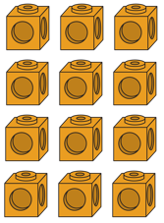
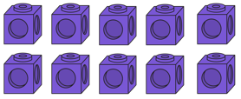
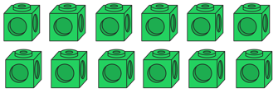
To be able to compare statements
Starter:
Which one doesn’t belong?
Explain your answer.

Slide 4
To be able to compare statements
Starter:
Which one doesn’t belong?
More than one possible response. Either the purple cubes do not belong as there are only 10 cubes, whereas the orange and green cubes both have totals of 12. Alternatively, the orange cubes do not belong as the array as 3 x 4, whereas the other arrays both have two rows.

Slide 5
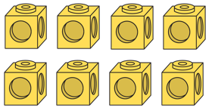
To be able to compare statements
Talking Time:
Looking at the array, complete the number sentences below.
2
x
4
=
8
4
x
2
=
8
8
÷
2
=
4
8
÷
4
=
2

Slide 6
To be able to compare statements
Talking Time:
Looking at the array, complete the number sentences below.
2
x
4
=
8
4
x
2
=
8
8
÷
2
=
4
8
÷
4
=
2

Slide 7
To be able to compare statements
Talking Time:
Looking at the array, complete the number sentences below.
2
x
4
=
8
4
x
2
=
8
8
÷
2
=
4
8
÷
4
=
2

Slide 8
To be able to compare statements
Talking Time:
Looking at the array, complete the number sentences below.
2
x
4
=
8
4
x
2
=
8
8
÷
2
=
4
8
÷
4
=
2

Slide 9
To be able to compare statements
Talking Time:
Looking at the array, complete the number sentences below.
2
x
4
=
8
4
x
2
=
8
8
÷
2
=
4
8
÷
4
=
2

Slide 10
To be able to compare statements
Talking Time:
Looking at the array, complete the number sentences below.
2
x
5
=
10
5
x
2
=
10
10
÷
2
=
5
10
÷
5
=
2

Slide 11
To be able to compare statements
Talking Time:
Looking at the array, complete the number sentences below.
2
x
5
=
10
5
x
2
=
10
10
÷
2
=
5
10
÷
5
=
2

Slide 12
To be able to compare statements
Talking Time:
Looking at the array, complete the number sentences below.
2
x
5
=
10
5
x
2
=
10
10
÷
2
=
5
10
÷
5
=
2

Slide 13
To be able to compare statements
Talking Time:
Looking at the array, complete the number sentences below.
2
x
5
=
10
5
x
2
=
10
10
÷
2
=
5
10
÷
5
=
2

Slide 14
To be able to compare statements
Talking Time:
Looking at the array, complete the number sentences below.
2
x
5
=
10
5
x
2
=
10
10
÷
2
=
5
10
÷
5
=
2

Slide 15
To be able to compare statements
Activity 1:
Looking at the array, complete the number sentences below.
3
x
5
=
15
5
x
3
=
15
15
÷
5
=
3
15
÷
3
=
5

Slide 16
To be able to compare statements
Activity 1:
Looking at the array, complete the number sentences below.
3
x
5
=
15
5
x
3
=
15
15
÷
5
=
3
15
÷
3
=
5

Slide 17
To be able to compare statements
Talking Time:
Use the comparison symbols (<, > or =) to compare:
2
x
4
=
3
x
4
=

Slide 18
To be able to compare statements
Talking Time:
Use the comparison symbols (<, > or =) to compare:
2
x
4
=
3
x
4
=

Slide 19
To be able to compare statements
Talking Time:
Use the comparison symbols (<, > or =) to compare:
2
x
4
=
8
3
x
4
=
12

Slide 20
To be able to compare statements
Talking Time:
Use the comparison symbols (<, > or =) to compare:
<
2
x
4
=
8
3
x
4
=
12

Slide 21
To be able to compare statements
Talking Time:
Use the comparison symbols (<, > or =) to compare:
2
x
6
=
12
3
x
4
=
12

Slide 22
To be able to compare statements
Talking Time:
Use the comparison symbols (<, > or =) to compare:
2
x
6
=
12
3
x
4
=
12

Slide 23
To be able to compare statements
Talking Time:
Use the comparison symbols (<, > or =) to compare:
2
x
6
=
12
3
x
4
=
12

Slide 24
To be able to compare statements
Talking Time:
Use the comparison symbols (<, > or =) to compare:
=
2
x
6
=
12
3
x
4
=
12

Slide 25
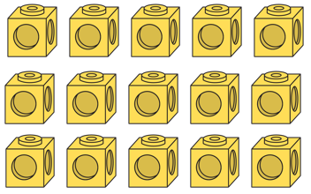
To be able to compare statements
Activity 2:
Use the comparison symbols (<, > or =) to compare:
x
=
x
=

Slide 26
To be able to compare statements
Activity 2:
Use the comparison symbols (<, > or =) to compare:
<
2
x
6
=
12
3
x
5
=
15

Slide 27
To be able to compare statements
Talking Time:
Use the comparison symbols <, > and = to complete the following statements.
9 x 5
10 x 7
4 x 5
10 x 2
35 ÷ 5
40 ÷ 10

Slide 28
To be able to compare statements
Talking Time:
Use the comparison symbols <, > and = to complete the following statements.
<
9 x 5
10 x 7
4 x 5
10 x 2
35 ÷ 5
40 ÷ 10

Slide 29
To be able to compare statements
Talking Time:
Use the comparison symbols <, > and = to complete the following statements.
<
9 x 5
10 x 7
=
4 x 5
10 x 2
35 ÷ 5
40 ÷ 10

Slide 30
To be able to compare statements
Talking Time:
Use the comparison symbols <, > and = to complete the following statements.
<
9 x 5
10 x 7
=
4 x 5
10 x 2
>
35 ÷ 5
40 ÷ 10

Slide 31
To be able to compare statements
Talking Time:
Use the comparison symbols <, > and = to complete the following statements.
10 x 9
4 x 10
3 x 6
4 x 8
45 ÷ 5
18 ÷ 2

Slide 32
To be able to compare statements
Talking Time:
Use the comparison symbols <, > and = to complete the following statements.
>
10 x 9
4 x 10
3 x 6
4 x 8
45 ÷ 5
18 ÷ 2

Slide 33
To be able to compare statements
Talking Time:
Use the comparison symbols <, > and = to complete the following statements.
>
10 x 9
4 x 10
<
3 x 6
4 x 8
45 ÷ 5
18 ÷ 2

Slide 34
To be able to compare statements
Talking Time:
Use the comparison symbols <, > and = to complete the following statements.
>
10 x 9
4 x 10
<
3 x 6
4 x 8
=
45 ÷ 5
18 ÷ 2

Slide 35
To be able to compare statements
Activity 3:
Use the comparison symbols <, > and = to complete the following statements.
3 x 8
4 x 6
4 x 8
5 x 6
48 ÷ 8
48 ÷ 4

Slide 36
To be able to compare statements
Activity 3:
Use the comparison symbols <, > and = to complete the following statements.
=
3 x 8
4 x 6
4 x 8
5 x 6
48 ÷ 8
48 ÷ 4

Slide 37
To be able to compare statements
Activity 3:
Use the comparison symbols <, > and = to complete the following statements.
=
3 x 8
4 x 6
>
4 x 8
5 x 6
48 ÷ 8
48 ÷ 4

Slide 38
To be able to compare statements
Activity 3:
Use the comparison symbols <, > and = to complete the following statements.
=
3 x 8
4 x 6
>
4 x 8
5 x 6
<
48 ÷ 8
48 ÷ 4

Slide 39
To be able to compare statements
Talking Time:
Are the following statements true or false?
=
2 x 3
2 x 3 + 2 x 3
=
4 + 4 + 4
3 x 4
<
4 x 2 + 2
4 x 4

Slide 40
To be able to compare statements
Talking Time:
Are the following statements true or false?
=
false
2 x 3
2 x 3 + 2 x 3
=
4 + 4 + 4
3 x 4
<
4 x 2 + 2
4 x 4

Slide 41
To be able to compare statements
Talking Time:
Are the following statements true or false?
=
false
2 x 3
2 x 3 + 2 x 3
=
4 + 4 + 4
3 x 4
true
<
4 x 2 + 2
4 x 4

Slide 42
To be able to compare statements
Talking Time:
Are the following statements true or false?
=
false
2 x 3
2 x 3 + 2 x 3
=
4 + 4 + 4
3 x 4
true
<
4 x 2 + 2
4 x 4
true

Slide 43
To be able to compare statements
Activity 4:
Are the following statements true or false?
=
5 x 4
5 x 2 + 5 x 2
>
4 + 4 + 4 + 4
6 x 4
<
4 x 3 + 2
7 x 4

Slide 44
To be able to compare statements
Activity 4:
Are the following statements true or false?
=
true
5 x 4
5 x 2 + 5 x 2
>
4 + 4 + 4 + 4
6 x 4
<
4 x 3 + 2
7 x 4

Slide 45
To be able to compare statements
Activity 4:
Are the following statements true or false?
=
true
5 x 4
5 x 2 + 5 x 2
>
4 + 4 + 4 + 4
6 x 4
false
<
4 x 3 + 2
7 x 4

Slide 46
To be able to compare statements
Activity 4:
Are the following statements true or false?
=
true
5 x 4
5 x 2 + 5 x 2
>
4 + 4 + 4 + 4
6 x 4
false
<
4 x 3 + 2
7 x 4
true

Slide 47
To be able to compare statements
Activity 5:
How many ways can you complete the sentences below?
<
7 x 3
_______
=
36 ÷ 6
_______

Slide 48
To be able to compare statements
Activity 5:
How many ways can you complete the sentences below?
<
7 x 3
_______
Teacher / peer assessment:
A range of multiplication and division number sentences.
=
36 ÷ 6
_______

Slide 49
To be able to compare statements
Evaluation:
Is Astrobee’s statement true or false?
Explain your answer.
10 x 5 has a product that is less than two lots of 5 x 5.

Slide 50
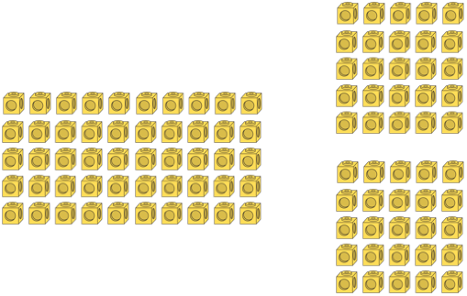
To be able to compare statements
Evaluation:
Astrobee’s statement is false – 10 x 5 = 50 and 5 x 5 = 25 and 2 x 25 = 50. So, 10 x 5 = 5 x 5 x 2. Demonstrated by the arrays above.
10 x 5 has a product that is less than two lots of 5 x 5.

Slide 51
To be able to compare statements
Success criteria:
I can use my knowledge of multiplication and division facts to compare statements using the comparison symbols (<, > and =)
I can explain my reasoning when using my knowledge of multiplication and division facts to compare statements using the comparison symbols (<, > and =)

