Slide 1




Quiz: QAZGJKZ
Stage 6
Spring Block 1: Decimals
Lesson 1: To be able to revise numbers with three decimal places
Spring
Block 1 – Decimals
1

Slide 2
To be able to revise numbers with three decimal places
Success criteria:
I can use mathematical equipment to support my understanding of the value of numbers with up to three decimal places and the value of digits within numbers with up to three decimal places
I can explain my reasoning when using mathematical equipment to support my understanding of the value of numbers with up to three decimal places and the value of digits within numbers with up to three decimal places

Slide 3
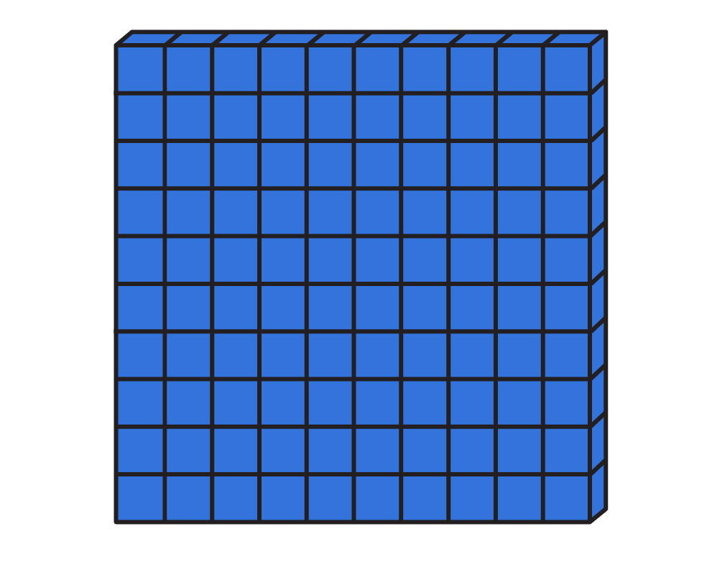
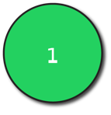
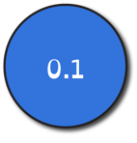
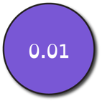

To be able to revise numbers with three decimal places
Starter:
What’s the same? What’s different?
Explain your answer.

Slide 4
To be able to revise numbers with three decimal places
Starter:
What’s the same? What’s different?
Look closely at the two numbers represented below.
Both numbers share the same digits 2, 3 and 6. However, the Base 10 pieces represent 236, whereas the place value counters represent the number 2.36.

Slide 5
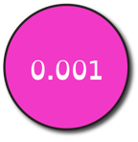
To be able to revise numbers with three decimal places
Talking Time:
Complete the sentences below:
There are _ ones, _ tenths, _ hundredths and _ thousandths.
The number in numeral form is …

Slide 6
To be able to revise numbers with three decimal places
Talking Time:
Complete the sentences below:
There are 2 ones, 4 tenths, 1 hundredth and 3 thousandths.
The number in numeral form is 2.413

Slide 7
To be able to revise numbers with three decimal places
Talking Time:
Complete the sentences below:
There are _ ones, _ tenths, _ hundredths and _ thousandths.
The number in numeral form is …

Slide 8
To be able to revise numbers with three decimal places
Talking Time:
Complete the sentences below:
There are 3 ones, 2 tenths, 3 hundredths and 5 thousandths.
The number in numeral form is 3.235

Slide 9
To be able to revise numbers with three decimal places
Talking Time:
Complete the sentences below:
There are _ ones, _ tenths, _ hundredths and _ thousandths.
The number in numeral form is …

Slide 10
To be able to revise numbers with three decimal places
Talking Time:
Complete the sentences below:
There are 2 ones, 3 tenths, 2 hundredths and 4 thousandths.
The number in numeral form is 2.324

Slide 11
To be able to revise numbers with three decimal places
Activity 1:
Complete the sentences below:
There are _ ones, _ tenths, _ hundredths and _ thousandths.
The number in numeral form is …

Slide 12
To be able to revise numbers with three decimal places
Activity 1:
Complete the sentences below:
There are 4 ones, 2 tenths, 5 hundredths and 3 thousandths.
The number in numeral form is 4.253

Slide 13
To be able to revise numbers with three decimal places
Talking Time:
Complete the sentences below:
There are 2 ones, 3 tenths, 2 hundredths and 4 thousandths.
The number in numeral form is 2.324

Slide 14

To be able to revise numbers with three decimal places
Talking Time:
Use a place value chart and counters to make 3.245

Slide 15
To be able to revise numbers with three decimal places
Talking Time:
Use a place value chart and counters to make 21.053

Slide 16
To be able to revise numbers with three decimal places
Talking Time:
Use a place value chart and counters to make 390.241

Slide 17
To be able to revise numbers with three decimal places
Activity 2:
Use a place value chart and counters to make 43.257
Use a place value chart and counters to make 407.532

Slide 18
To be able to revise numbers with three decimal places
Activity 2:
Use a place value chart and counters to make 43.257
Use a place value chart and counters to make 407.532

Slide 19
To be able to revise numbers with three decimal places
Talking Time:
What is the value of the digit 2 in the number below?
123.456
The digit 2 has the value 20 or 2 tens.

Slide 20
To be able to revise numbers with three decimal places
Talking Time:
What is the value of the digit 2 in the number below?
123.456
The digit 2 has the value 20 or 2 tens.

Slide 21
To be able to revise numbers with three decimal places
Talking Time:
What is the value of the digit 2 in the number below?
531.207
The digit 2 has the value 0.2 or 2 tenths.

Slide 22
To be able to revise numbers with three decimal places
Talking Time:
What is the value of the digit 2 in the number below?
531.207
The digit 2 has the value 0.2 or 2 tenths.

Slide 23
To be able to revise numbers with three decimal places
Talking Time:
What is the value of the digit 2 in the number below?
934.728
The digit 2 has the value 0.02 or 2 hundredths.

Slide 24
To be able to revise numbers with three decimal places
Talking Time:
What is the value of the digit 2 in the number below?
934.728
The digit 2 has the value 0.02 or 2 hundredths.

Slide 25
To be able to revise numbers with three decimal places
Talking Time:
What is the value of the digit 2 in the number below?
253.981
The digit 2 has the value 200 or 2 hundreds.

Slide 26
To be able to revise numbers with three decimal places
Talking Time:
What is the value of the digit 2 in the number below?
253.981
The digit 2 has the value 200 or 2 hundreds.

Slide 27
To be able to revise numbers with three decimal places
Talking Time:
What is the value of the digit 2 in the number below?
513.492
The digit 2 has the value 0.02 or 2 thousandths.

Slide 28
To be able to revise numbers with three decimal places
Talking Time:
What is the value of the digit 2 in the number below?
513.492
The digit 2 has the value 0.002 or 2 thousandths.

Slide 29
To be able to revise numbers with three decimal places
Activity 3:
What is the value of the digit 5 in the numbers below?
.
.
.
0.35
The digit 5 has the value 0.05 or 5 hundredths.
563.794
The digit 5 has the value 500 or 5 hundreds.
427.095
The digit 5 has the value 0.005 or 5 thousandths.

Slide 30
To be able to revise numbers with three decimal places
Activity 3:
What is the value of the digit 5 in the numbers below?
.
.
.
0.35
The digit 5 has the value 0.05 or 5 hundredths.
563.794
The digit 5 has the value 500 or 5 hundreds.
427.095
The digit 5 has the value 0.005 or 5 thousandths.

Slide 31
To be able to revise numbers with three decimal places
Activity 3:
What is the value of the digit 5 in the numbers below?
.
.
.
0.35
The digit 5 has the value 0.05 or 5 hundredths.
563.794
The digit 5 has the value 500 or 5 hundreds.
427.095
The digit 5 has the value 0.005 or 5 thousandths.

Slide 32
To be able to revise numbers with three decimal places
Activity 3:
What is the value of the digit 5 in the numbers below?
.
.
.
0.35
The digit 5 has the value 0.05 or 5 hundredths.
563.794
The digit 5 has the value 500 or 5 hundreds.
427.095
The digit 5 has the value 0.005 or 5 thousandths.

Slide 33
To be able to revise numbers with three decimal places
Activity 4:
Four friends are describing the different numbers they are thinking of…
Ruth says, “My number has five hundredths.”
Jamal says, “My hundredths digit is worth one more than my tenths digit and my thousandths digit is worth one more than my hundredths digit.”
Yasmin says, “My number has one decimal place.”
Ahmed says, “Both of my decimal digits are even-numbered digits.”
Who has which number?
Explain your answers.
57.68
84.567
8.756
465.7

Slide 34
To be able to revise numbers with three decimal places
Activity 4:
Four friends are describing the different numbers they are thinking of…
Ruth says, “My number has five hundredths.”
Jamal says, “My hundredths digit is worth one more than my tenths digit and my thousandths digit is worth one more than my hundredths digit.”
Yasmin says, “My number has one decimal place.”
Ahmed says, “Both of my decimal digits are even-numbered digits.”
Ruth has 8.756 as it’s the only number that has five hundredths. Jamal has 84.567 as the decimal digits are in ascending order from left to right. Yasmin has 465.7 as it has one decimal place. Ahmed has 57.68 as both decimal digits are even.
57.68
84.567
8.756
465.7

Slide 35
To be able to revise numbers with three decimal places
Activity 5:
James says, “4.35 can be written as 3 ones, 14 tenths and 5 hundredths.”
Do you agree?
How else can 4.35 be partitioned?
Explain your answer.

Slide 36
To be able to revise numbers with three decimal places
Activity 5:
James says, “4.35 can be written as 3 ones, 14 tenths and 5 hundredths.”
No, I do not agree, 3 ones, 14 tenths and 5 hundredths would make the number 4.45. You would partition 4.35 as 3 ones, 13 tenths and 5 hundredths.
Alternatively, 4.35 can be partitioned as:
4 ones, 3 tenths and 5 hundredths
2 ones, 23 tenths and 5 hundredths
43 tenths and 5 hundredths
435 hundredths…

Slide 37
To be able to revise numbers with three decimal places
Evaluation:
Is Astrobee’s statement always, sometimes or never true?
Explain your answer.
If one number has more decimal places than another number, then it is the smaller number.

Slide 38
To be able to revise numbers with three decimal places
Evaluation:
Astrobee’s statement is sometimes true. For example 1.324 has more decimal places and is smaller than 27.4. However, 549.237 has more decimal places and is a greater number than 234,19.
If one number has more decimal places than another number, then it is the smaller number.

Slide 39
To be able to revise numbers with three decimal places
Success criteria:
I can use mathematical equipment to support my understanding of the value of numbers with up to three decimal places and the value of digits within numbers with up to three decimal places
I can explain my reasoning when using mathematical equipment to support my understanding of the value of numbers with up to three decimal places and the value of digits within numbers with up to three decimal places

