Slide 1




Quiz: QKYFIRT
Stage 2
Autumn Block 4: Multiplication and Division
Lesson 1: To be able to identify equal groups
Autumn
Block 4 – Multiplication and Division
1

Slide 2
To be able to identify equal groups
Success criteria:
I can use stem sentences to describe equal groups, sorting equal groupings from unequal groupings
I can explain my reasoning when using stem sentences to describe equal groups, sorting equal groupings from unequal groupings

Slide 3


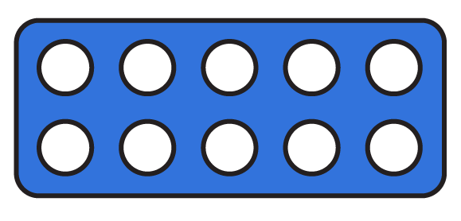
To be able to identify equal groups
Starter:
Which one doesn’t belong?
Explain your answer.

Slide 4
To be able to identify equal groups
Starter:
Which one doesn’t belong?
The hands representation doesn’t belong as they each represent five, whereas the other representations each show three lots of ten.

Slide 5

To be able to identify equal groups
Talking Time:
Describe the groups below.
There are _ equal groups of _.

Slide 6
To be able to identify equal groups
Talking Time:
Describe the groups below.
There are 3 equal groups of 2.

Slide 7

To be able to identify equal groups
Talking Time:
Describe the groups below.
There are _ equal groups of _.

Slide 8
To be able to identify equal groups
Talking Time:
Describe the groups below.
There are 3 equal groups of 5.

Slide 9
To be able to identify equal groups
Talking Time:
Describe the groups below.
There are _ equal groups of _.

Slide 10
To be able to identify equal groups
Talking Time:
Describe the groups below.
There are 4 equal groups of 2.

Slide 11

To be able to identify equal groups
Talking Time:
Describe the groups below.
There are _ equal groups of _.

Slide 12
To be able to identify equal groups
Talking Time:
Describe the groups below.
There are 5 equal groups of 4.

Slide 13
To be able to identify equal groups
Talking Time:
Describe the groups below.
There are _ equal groups of _.

Slide 14
To be able to identify equal groups
Talking Time:
Describe the groups below.
There are 3 equal groups of 10.

Slide 15
To be able to identify equal groups
Activity 1:
Describe the groups below.
There are _ equal groups of _.

Slide 16
To be able to identify equal groups
Activity 1:
Describe the groups below.
There are 4 equal groups of 10.

Slide 17
To be able to identify equal groups
Talking Time:
Describe the groups below.
There are _ counters in each group.
There are _ equal groups.
There are _ counters in total.

Slide 18
To be able to identify equal groups
Talking Time:
Describe the groups below.
There are 2 counters in each group.
There are 3 equal groups.
There are 6 counters in total.

Slide 19
To be able to identify equal groups
Talking Time:
Describe the groups below.
There are _ counters in each group.
There are _ equal groups.
There are _ counters in total.

Slide 20
To be able to identify equal groups
Talking Time:
Describe the groups below.
There are 5 counters in each group.
There are 3 equal groups.
There are 15 counters in total.

Slide 21
To be able to identify equal groups
Talking Time:
Describe the groups below.
There are _ counters in each group.
There are _ equal groups.
There are _ counters in total.

Slide 22
To be able to identify equal groups
Talking Time:
Describe the groups below.
There are 2 counters in each group.
There are 4 equal groups.
There are 8 counters in total.

Slide 23
To be able to identify equal groups
Talking Time:
Describe the groups below.
There are _ straws in each group.
There are _ equal groups.
There are _ straws in total.

Slide 24
To be able to identify equal groups
Talking Time:
Describe the groups below.
There are 10 straws in each group.
There are 4 equal groups.
There are 40 straws in total.

Slide 25
To be able to identify equal groups
Activity 2:
Describe the groups below.
There are _ counters in each group.
There are _ equal groups.
There are _ counters in total.

Slide 26
To be able to identify equal groups
Activity 2:
Describe the groups below.
There are 5 counters in each group.
There are 4 equal groups.
There are 20 counters in total.

Slide 27
To be able to identify equal groups
Activity 3:
Describe the groups below.
What’s the same? What’s different?
Explain your answer.
There are _ counters in each group.
There are _ equal groups.
There are _ counters in total.
There are _ counters in each group.
There are _ equal groups.
There are _ counters in total.

Slide 28
To be able to identify equal groups
Activity 3:
Describe the groups below.
Both groupings have ten counters in total; however, the right-hand representation is made up of five equal groupings of two counters, whereas the left-hand representation is made up of two equal groupings of five counters.
There are 2 counters in each group.
There are 5 equal groups.
There are 10 counters in total.
There are 5 counters in each group.
There are 2 equal groups.
There are 10 counters in total.

Slide 29
To be able to identify equal groups
Activity 4:
Sort the groupings into the unequal group or equal group columns in the table.
unequal groups | equal groups
Notes:
Extend children by asking them to come up with their own equal and unequal groupings to be sorted.

Slide 30
To be able to identify equal groups
Activity 4:
Sort the groupings into the unequal group or equal group columns in the table.
unequal groups | equal groups

Slide 31
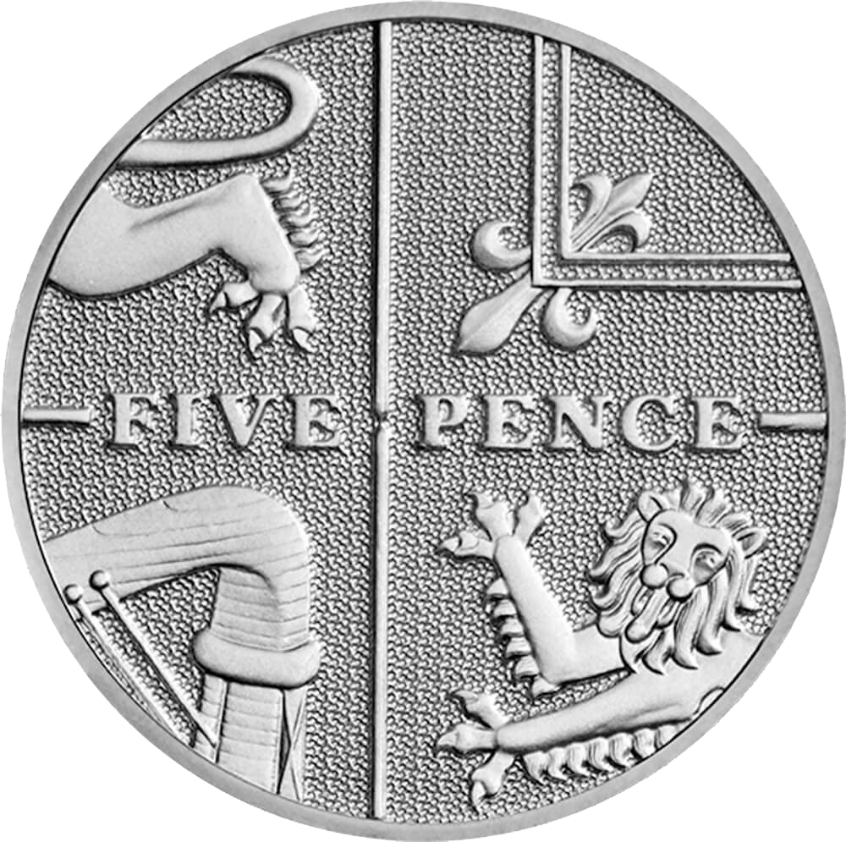

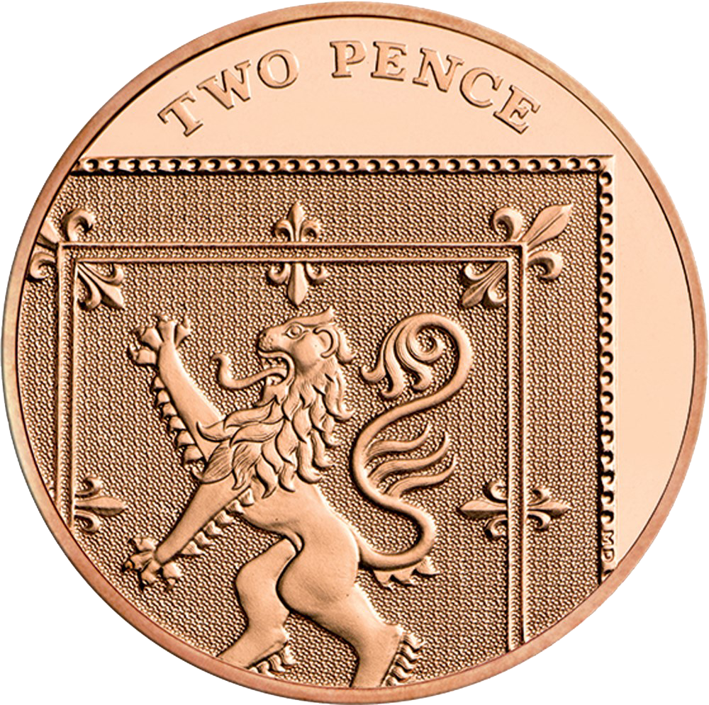
To be able to identify equal groups
Activity 5:
Circle the group that doesn’t belong.
Explain your answer.

Slide 32
To be able to identify equal groups
Activity 5:
Circle the group that doesn’t belong.
The first two groups each have 10 p in each box and 40 p in total. The final group has 2 p in each box and 8 p in total so doesn’t belong.

Slide 33
To be able to identify equal groups
Evaluation:
Do you agree?
Explain your answer.
I have made two equal groups with each group showing five counters.

Slide 34
To be able to identify equal groups
Evaluation:
Astrobee has made five equal groups with two counters in each. Although it uses the same total number of counters as two equal groups of five counters (ten counters) it isn’t as he described.
The correct representation is shown above.
I have made two equal groups with each group showing five counters.

Slide 35
To be able to identify equal groups
Success criteria:
I can use stem sentences to describe equal groups, sorting equal groupings from unequal groupings
I can explain my reasoning when using stem sentences to describe equal groups, sorting equal groupings from unequal groupings

