Slide 1




Quiz: QWRMCRK
Stage 1
Autumn Block 4: Place Value (Within 20)
Lesson 1: To be able to count and write numbers up to 20
Autumn
Block 4 – Place Value (Within 20)
1

Slide 2
To be able to count and write numbers up to 20
Success criteria:
I can count forwards using a variety of representations: concrete, pictorial, numeral and worded number sequences, exploring the numbers 11 - 20
I can explain my reasoning when counting forwards using a variety of representations: concrete, pictorial, numeral and worded number sequences, exploring the numbers 11 - 20

Slide 3
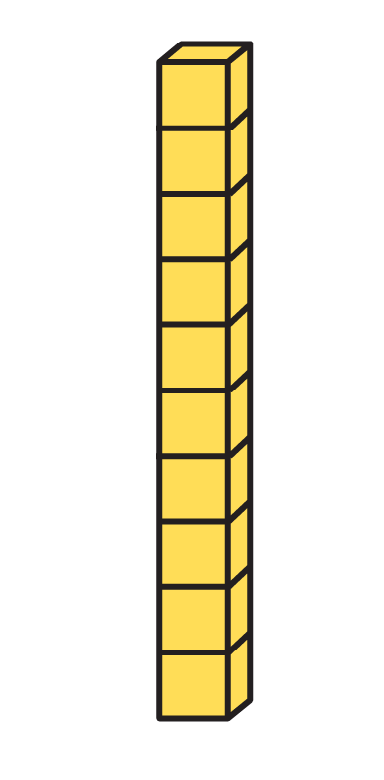

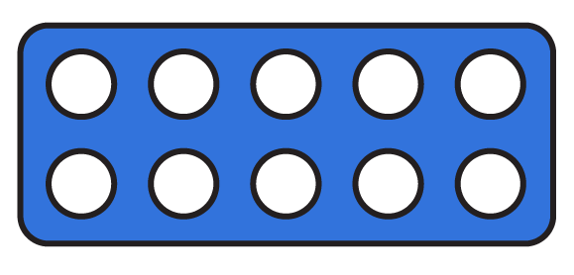
To be able to count and write numbers up to 20
Starter:
Which one doesn’t belong?
Explain your answer.

Slide 4
To be able to count and write numbers up to 20
Starter:
Which one doesn’t belong?
The hand doesn’t belong as it represents five, whereas the other representations all show total amounts of ten.

Slide 5



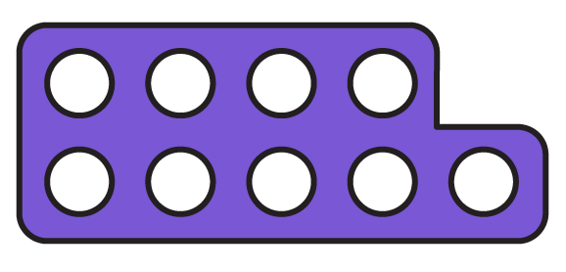
To be able to count and write numbers up to 20
Talking Time:
Match each of the numbers below to its representation:
5
11
9
4

Slide 6
To be able to count and write numbers up to 20
Talking Time:
Match each of the numbers below to its representation:
5
11
9
4

Slide 7
To be able to count and write numbers up to 20
Talking Time:
Match each of the numbers below to its representation:
5
11
9
4

Slide 8
To be able to count and write numbers up to 20
Talking Time:
Match each of the numbers below to its representation:
5
11
9
4

Slide 9
To be able to count and write numbers up to 20
Talking Time:
Match each of the numbers below to its representation:
5
11
9
4

Slide 10


To be able to count and write numbers up to 20
Talking Time:
Match each of the numbers below to its representation:
7
14
4
20

Slide 11
To be able to count and write numbers up to 20
Talking Time:
Match each of the numbers below to its representation:
7
14
4
20

Slide 12
To be able to count and write numbers up to 20
Talking Time:
Match each of the numbers below to its representation:
7
14
4
20

Slide 13
To be able to count and write numbers up to 20
Talking Time:
Match each of the numbers below to its representation:
7
14
4
20

Slide 14
To be able to count and write numbers up to 20
Talking Time:
Match each of the numbers below to its representation:
7
14
4
20

Slide 15

To be able to count and write numbers up to 20
Activity 1:
Match each of the numbers below to its representation:
19
10
18
11

Slide 16
To be able to count and write numbers up to 20
Activity 1:
Match each of the numbers below to its representation:
19
10
18
11

Slide 17
To be able to count and write numbers up to 20
Talking time:
Write the numeral and worded form for the number shown below.
11
eleven

Slide 18
To be able to count and write numbers up to 20
Talking time:
Write the numeral and worded form for the number shown below.
11
eleven

Slide 19
To be able to count and write numbers up to 20
Talking time:
Write the numeral and worded form for the number shown below.
12
twelve

Slide 20
To be able to count and write numbers up to 20
Talking time:
Write the numeral and worded form for the number shown below.
12
twelve

Slide 21
To be able to count and write numbers up to 20
Talking time:
Write the numeral and worded form for the number shown below.

Slide 22
To be able to count and write numbers up to 20
Talking time:
Write the numeral and worded form for the number shown below.
13
thirteen

Slide 23
To be able to count and write numbers up to 20
Talking time:
Write the numeral and worded form for the number shown below.

Slide 24
To be able to count and write numbers up to 20
Talking time:
Write the numeral and worded form for the number shown below.
14
fourteen

Slide 25
To be able to count and write numbers up to 20
Talking time:
Write the numeral and worded form for the number shown below.
15
fifteen

Slide 26
To be able to count and write numbers up to 20
Talking time:
Write the numeral and worded form for the number shown below.
15
fifteen

Slide 27
To be able to count and write numbers up to 20
Talking time:
Write the numeral and worded form for the number shown below.
16
sixteen

Slide 28
To be able to count and write numbers up to 20
Talking time:
Write the numeral and worded form for the number shown below.
16
sixteen

Slide 29
To be able to count and write numbers up to 20
Talking time:
Write the numeral and worded form for the number shown below.

Slide 30
To be able to count and write numbers up to 20
Talking time:
Write the numeral and worded form for the number shown below.
17
seventeen

Slide 31
To be able to count and write numbers up to 20
Talking time:
Write the numeral and worded form for the number shown below.

Slide 32
To be able to count and write numbers up to 20
Talking time:
Write the numeral and worded form for the number shown below.
18
eighteen

Slide 33
To be able to count and write numbers up to 20
Talking time:
Write the numeral and worded form for the number shown below.

Slide 34
To be able to count and write numbers up to 20
Talking time:
Write the numeral and worded form for the number shown below.
19
nineteen

Slide 35
To be able to count and write numbers up to 20
Talking time:
Write the numeral and worded form for the number shown below.
20
twenty

Slide 36
To be able to count and write numbers up to 20
Talking time:
Write the numeral and worded form for the number shown below.
20
twenty

Slide 37
To be able to count and write numbers up to 20
Activity Two:
Use the template below to write your own worded / numeral form numbers and draw counters to match.
18
eighteen
Notes:
Template for further practice.

Slide 38
To be able to count and write numbers up to 20
Talking time:
Complete the number track below.
8 | 9 |  | 11 |  | 13

Slide 39
To be able to count and write numbers up to 20
Talking time:
Complete the number track below.
8 | 9 | 10 | 11 | 12 | 13 | 14

Slide 40
To be able to count and write numbers up to 20
Talking time:
Complete the number track below.
14 | 13 |  | 11 |  | 9

Slide 41
To be able to count and write numbers up to 20
Talking time:
Complete the number track below.
14 | 13 | 12 | 11 | 10 | 9 | 8

Slide 42
To be able to count and write numbers up to 20
Talking time:
Complete the number track below.
10 | 11 |  | 13 |  | 15

Slide 43
To be able to count and write numbers up to 20
Talking time:
Complete the number track below.
10 | 11 | 12 | 13 | 14 | 15 | 16

Slide 44
To be able to count and write numbers up to 20
Talking time:
Complete the number track below.
16 | 15 |  | 13 |  | 11

Slide 45
To be able to count and write numbers up to 20
Talking time:
Complete the number track below.
16 | 15 | 14 | 13 | 12 | 11 | 10

Slide 46
To be able to count and write numbers up to 20
Talking time:
Complete the number track below.
14 | 15 |  | 17 |  | 19

Slide 47
To be able to count and write numbers up to 20
Talking time:
Complete the number track below.
14 | 15 | 16 | 17 | 18 | 19 | 20

Slide 48
To be able to count and write numbers up to 20
Talking time:
Complete the number track below.
20 | 19 |  | 17 |  | 15

Slide 49
To be able to count and write numbers up to 20
Talking time:
Complete the number track below.
20 | 19 | 18 | 17 | 16 | 15 | 14

Slide 50
To be able to count and write numbers up to 20
Activity 3:
Complete the number tracks below.
 | 11 | 12 |  | 14 |  | 16 | 17
 | 19 | 18 |  | 16 |  | 14 | 13

Slide 51
To be able to count and write numbers up to 20
Activity 3:
Complete the number tracks below.
10 | 11 | 12 | 13 | 14 | 15 | 16 | 17 | 18 | 19
20 | 19 | 18 | 17 | 16 | 15 | 14 | 13 | 12 | 11

Slide 52
To be able to count and write numbers up to 20
Talking Time:
Cross out the number that doesn’t belong.
Why doesn’t it belong?
Explain your answer.
12
13
14
15
16
71
18
19

Slide 53
To be able to count and write numbers up to 20
Talking Time:
Cross out the number that doesn’t belong.
The number that doesn’t belong is 71, as it is not part of the sequence, the other numbers are counting up from 12 to 19. The digits in the tens and ones places have been put in the wrong order, 17 should be in its place.
12
13
14
15
x
19
16
71
18

Slide 54
To be able to count and write numbers up to 20
Activity 4:
Cross out the number that doesn’t belong.
Why doesn’t it belong?
Explain your answer.
20
19
18
17
x
13
16
51
14

Slide 55
To be able to count and write numbers up to 20
Activity 4:
Cross out the number that doesn’t belong.
The number that doesn’t belong is 51 , as it is not part of the sequence, the other numbers are counting down from 20 to 13. The digits in the tens and ones places have been put in the wrong order, 15 should be in its place.
20
19
18
17
x
13
16
51
14

Slide 56
To be able to count and write numbers up to 20
Evaluation:
Do you agree with Astrobee?
Explain your answer.
If I start counting from 7 and count all the way to 20, I will say 14.

Slide 57
To be able to count and write numbers up to 20
Evaluation:
Yes, I agree with Astrobee. Fourteen comes between seven and twenty, so if you’re counting from seven to twenty, you will say fourteen (after thirteen and before fifteen when counting forwards).
If I start counting from 7 and count all the way to 20, I will say 14.

Slide 58
To be able to count and write numbers up to 20
Success criteria:
I can count forwards using a variety of representations: concrete, pictorial, numeral and worded number sequences, exploring the numbers 11 - 20
I can explain my reasoning when counting forwards using a variety of representations: concrete, pictorial, numeral and worded number sequences, exploring the numbers 11 - 20

