Slide 1




Festive Problems
16th December

Slide 2

Challenge 1:
Festive Problems | 16th December
Mrs Kringle has some ribbon.
She cuts off five equal pieces or ribbon, 9m long each.
There is 6m of ribbon leftover.
How long was the piece of ribbon originally?
Bar Modelling:
Number Sentences:
© EdShed, 2020-

Slide 3
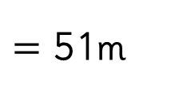

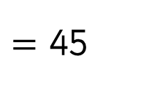
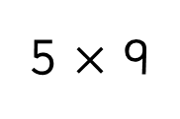
Challenge 1:
Festive Problems | 16th December
Mrs Kringle has some ribbon.
She cuts off five equal pieces or ribbon, 9m long each.
There is 6m of ribbon leftover.
How long was the piece of ribbon originally?
Bar Modelling:
Number Sentences:
5 $×$ 9
$=$ 45
51m
?
9m
9m
9m
9m
9m
6m
45 $+$ 6
$=$ 51m
45
?
51
Mrs Kringle’s ribbon was ____m long originally.
© EdShed, 2020-

Slide 4
Challenge 2:
Festive Problems | 16th December
Santa is thinking about two numbers.
Santa says, “The sum of the two numbers is 87.
The smaller number is 26.”
What is the difference between Santa’s two numbers?
Bar Modelling:
Number Sentences:
© EdShed, 2020-

Slide 5
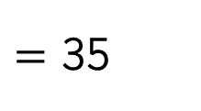

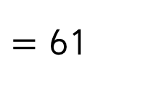

Challenge 2:
Festive Problems | 16th December
Santa is thinking about two numbers.
Santa says, “The sum of the two numbers is 87.
The smaller number is 26.”
What is the difference between Santa’s two numbers?
Bar Modelling:
Number Sentences:
87 $−$ 26
$=$ 61
87
26
?
61
61 $−$ 26
$=$ 35
61
26
35
?
35
The difference between Santa’s two numbers is ____.
© EdShed, 2020-

Slide 6
Challenge 3:
Festive Problems | 16th December
Santa’s reindeer collect the same amount of carrots in the first 12 countries they visit. They had collected 480kg of carrots after visiting just three of the countries.
How many kg of carrots did they collect from the 12 countries?
Bar Modelling:
Number Sentences:
© EdShed, 2020-

Slide 7


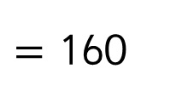

Challenge 3:
Festive Problems | 16th December
Santa’s reindeer collect the same amount of carrots in the first 12 countries they visit. They had collected 480kg of carrots after visiting just three of the countries.
How many kg of carrots did they collect from the 12 countries?
Bar Modelling:
Number Sentences:
480 $÷$ 3
$=$ 160
1,920kg
?
12 $×$ 160
$=$ 1,920
480kg
160kg
1,920
The reindeers collected _______kg of carrots.
© EdShed, 2020-

Slide 8
Challenge 4:
Festive Problems | 16th December
Rudolph and Comet are thinking of different numbers.
Two thirds of Rudolph’s number is equal to two fifths of Comet’s number. The difference between their two numbers is 84.
What is the sum of their numbers?
Bar Modelling:
Number Sentences:
© EdShed, 2020-

Slide 9
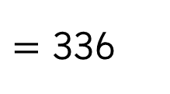

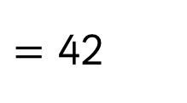

Challenge 4:
Festive Problems | 16th December
Rudolph and Comet are thinking of different numbers.
Two thirds of Rudolph’s number is equal to two fifths of Comet’s number. The difference between their two numbers is 84.
What is the sum of their numbers?
Bar Modelling:
Number Sentences:
84 $÷$ 2
$=$ 42
84
Rudolph
42
42
42
8 $×$ 42
$=$ 336
Comet
42
42
42
42
42
336
The sum of the two reindeers’ numbers is _____.
© EdShed, 2020-

