Slide 1
Festive Problems
13th December

Slide 2
Challenge 1:
Festive Problems | 13th December
Ruth has 8 gingerbread.
She buys 7 more gingerbread.
Jamal has 11 gingerbread.
How many more gingerbread does Ruth have than Jamal?
Bar Modelling:
Number Sentences:
© EdShed, 2020-

Slide 3
Challenge 1:
Festive Problems | 13th December
Ruth has 8 gingerbread.
She buys 7 more gingerbread.
Jamal has 11 gingerbread.
How many more gingerbread does Ruth have than Jamal?
Bar Modelling:
Number Sentences:
8 $+$ 7
$=$ 15
15
?
Ruth
8
7
15 $−$ 11
$=$ 4
4
?
Jamal
11
4
Ruth has ____ more gingerbread than Jamal.
© EdShed, 2020-

Slide 4
Challenge 2:
Festive Problems | 13th December
70kg of presents are shared between Sack 1 and Sack 2.
Sack 1 contains 43kg of presents.
How many more kg is Sack 1 holding than Sack 2?
1
2
Bar Modelling:
Number Sentences:
© EdShed, 2020-

Slide 5
Challenge 2:
Festive Problems | 13th December
70kg of presents are shared between Sack 1 and Sack 2.
Sack 1 contains 43kg of presents.
How many more kg is Sack 1 holding than Sack 2?
1
2
Bar Modelling:
Number Sentences:
70 $−$ 43
$=$ 27
70kg
43kg
27kg
? kg
43 $−$ 27
$=$ 16
43kg
27kg
16 kg
? kg
16
Sack 1 has ____kg more presents than Sack 2.
© EdShed, 2020-

Slide 6
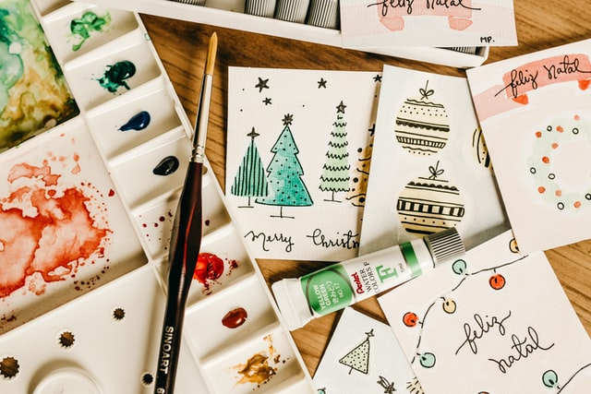
Challenge 3:
Festive Problems | 13th December
Yasmin and Chen have made 492 Christmas charity cards. Yasmin has a box with 3 times as many cards as Chen. Yasmin puts some of her cards into Chen’s box. They now have the same amount of cards each. How many cards did Yasmin put in Chen’s box?
Bar Modelling:
Number Sentences:
© EdShed, 2020-

Slide 7
Challenge 3:
Festive Problems | 13th December
Yasmin and Chen have made 492 Christmas charity cards. Yasmin has a box with 3 times as many cards as Chen. Yasmin puts some of her cards into Chen’s box. They now have the same amount of cards each. How many cards did Yasmin put in Chen’s box?
Bar Modelling:
Number Sentences:
Yasmin
123
?
123
?
?
123
492 $÷$ 4
$=$ 123
123
Chen
?
123
Yasmin put _____ cards into Chen’s box.
© EdShed, 2020-

Slide 8
Challenge 4:
Festive Problems | 13th December
Farmer Pine plants eight Christmas trees in a row.
She spaces the trees out equidistantly.
The distance between the 3rd and 6th tree is 12.9m.
What is the total distance between the first and last tree?
Bar Modelling:
Number Sentences:
© EdShed, 2020-

Slide 9
Challenge 4:
Festive Problems | 13th December
Farmer Pine plants eight Christmas trees in a row.
She spaces the trees out equidistantly.
The distance between the 3rd and 6th tree is 12.9m.
What is the total distance between the first and last tree?
Bar Modelling:
Number Sentences:
12.9m
12.9 $÷$ 3
$=$ 4.3
7 $×$ 4.3
$=$ 30.1
?
?
?
4.3
4.3
4.3
4.3
4.3
4.3
4.3
30.1m
?
30.1
The distance between the first and last trees is ______m.
© EdShed, 2020-

