Slide 1




Festive Problems
8th December

Slide 2

Challenge 1:
Festive Problems | 8th December
Yasmin buys 17 candy canes.
She eats 4 candy canes.
She gives some to friends as gifts.
She has 8 candy canes left.
How many candy canes did she give to her friends?
Bar Modelling:
Number Sentences:
© EdShed, 2020-

Slide 3
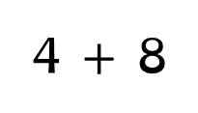
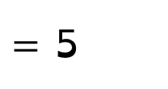

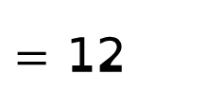
Challenge 1:
Festive Problems | 8th December
Yasmin buys 17 candy canes.
She eats 4 candy canes.
She gives some to friends as gifts.
She has 8 candy canes left.
How many candy canes did she give to her friends?
Bar Modelling:
Number Sentences:
17
4 $+$ 8
$=$ 12
4
8
?
17 $−$ 12
$=$ 5
5
eat
left
gift
5
Yasmin gave ____ candy canes to her friends as gifts.
© EdShed, 2020-

Slide 4

Challenge 2:
Festive Problems | 8th December
Rudolph and Prancer have collected the same weight of carrots.
Rudolph gives Prancer 14kg of carrots.
How many more kg of carrots does Prancer now have than Rudolph?
Bar Modelling:
Number Sentences:
© EdShed, 2020-

Slide 5

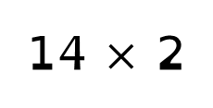
Challenge 2:
Festive Problems | 8th December
Rudolph and Prancer have collected the same weight of carrots.
Rudolph gives Prancer 14kg of carrots.
How many more kg of carrots does Prancer now have than Rudolph?
Bar Modelling:
Number Sentences:
Rudolph
14 $×$ 2
$=$ 28
14kg
28kg
?
Prancer
14kg
28
Prancer now has ____kg more carrots than Rudolph.
© EdShed, 2020-

Slide 6



Challenge 3:
Festive Problems | 8th December
There are 95 children in a Christmas show.
Two thirds as many children chose to dance as sing.
How many children chose to dance in the Christmas show?
Bar Modelling:
Number Sentences:
© EdShed, 2020-

Slide 7


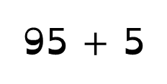

Challenge 3:
Festive Problems | 8th December
There are 95 children in a Christmas show.
Two thirds as many children chose to dance as sing.
How many children chose to dance in the Christmas show?
Bar Modelling:
Number Sentences:
38
?
95 $+$ 5
$=$ 19
dance
19
19
19 $×$ 2
$=$ 38
95
sing
19
19
19
38
____ children chose to dance in the Christmas show.
© EdShed, 2020-

Slide 8
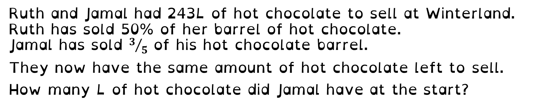
Challenge 4:
Festive Problems | 8th December
Ruth and Jamal had 243L of hot chocolate to sell at Winterland.
Ruth has sold 50% of her barrel of hot chocolate.
Jamal has sold $3/5$ of his hot chocolate barrel.
They now have the same amount of hot chocolate left to sell.
How many L of hot chocolate did Jamal have at the start?
Bar Modelling:
Number Sentences:
© EdShed, 2020-

Slide 9
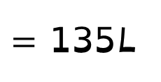
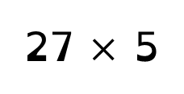


Challenge 4:
Festive Problems | 8th December
Ruth and Jamal had 243L of hot chocolate to sell at Winterland.
Ruth has sold 50% of her barrel of hot chocolate.
Jamal has sold $3/5$ of his hot chocolate barrel.
They now have the same amount of hot chocolate left to sell.
How many L of hot chocolate did Jamal have at the start?
Bar Modelling:
Number Sentences:
243 $÷$ 9
$=$ 27L
Ruth
27
27
27
27
243L
27 $×$ 5
$=$ 135L
Jamal
27
27
27
27
27
135
?
135
Jamal had ____L of hot chocolate to sell originally.
© EdShed, 2020-

