Slide 1




Festive Problems
5th December

Slide 2

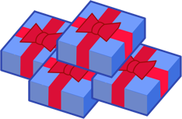
Challenge 1:
Festive Problems | 5th December
Miss Bell hands out some gifts to her class.
At midday, she hands out 7 gifts.
At 3pm, she hands out 8 more.
She still has 9 gifts left to hand out at the end of the day.
How many gifts did she have before midday?
Bar Modelling:
Number Sentences:
© EdShed, 2020-

Slide 3
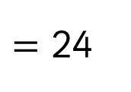

Challenge 1:
Festive Problems | 5th December
Miss Bell hands out some gifts to her class.
At midday, she hands out 7 gifts.
At 3pm, she hands out 8 more.
She still has 9 gifts left to hand out at the end of the day.
How many gifts did she have before midday?
Bar Modelling:
Number Sentences:
7 $+$ 8 $+$ 9
$=$ 24
7
8
9
24
?
24
Miss Bell ___ had gifts before midday.
© EdShed, 2020-
Notes:
NB: You could discuss near doubles and showing this as 3 x 8 too as an alternative solution.

Slide 4
Challenge 2:
Festive Problems | 5th December
Yasmin has two Christmas crackers. She has hidden numbers in each of the crackers. The number in the green cracker is bigger than the purple cracker’s number. The two numbers have a sum of 100. One of the numbers is 32 greater than the other number.
What number is hidden in each of the two crackers?
Bar Modelling:
Number Sentences:
© EdShed, 2020-

Slide 5


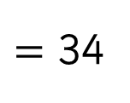
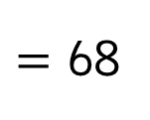

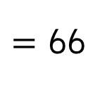
Challenge 2:
Festive Problems | 5th December
Yasmin has two Christmas crackers. She has hidden numbers in each of the crackers. The number in the green cracker is bigger than the purple cracker’s number. The two numbers have a sum of 100. One of the numbers is 32 greater than the other number.
What number is hidden in each of the two crackers?
Bar Modelling:
Number Sentences:
100 $−$ 32
$=$ 68
purple
34
68 $÷$ 2
$=$ 34
100
32
34 $+$ 32
$=$ 66
green
34
34
66
The purple cracker contains ____. The green cracker contains ____.
© EdShed, 2020-

Slide 6

Challenge 3:
Festive Problems | 5th December
Mr and Mrs Kringle have 1,000 baubles in their shed.
She is carrying 3 times as many baubles as him.
Mrs Kringle gives Mr Kringle 90 more baubles to carry.
How many baubles is Mr Kringle carrying now?
Bar Modelling:
Number Sentences:
© EdShed, 2020-

Slide 7
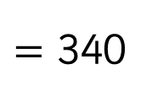

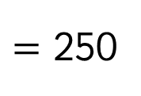

Challenge 3:
Festive Problems | 5th December
Mr and Mrs Kringle have 1,000 baubles in their shed.
She is carrying 3 times as many baubles as him.
Mrs Kringle gives Mr Kringle 90 more baubles to carry.
How many baubles is Mr Kringle carrying now?
Bar Modelling:
Number Sentences:
1,000
1,000 $÷$ 4
$=$ 250
1,000
1,000
250 | 250 | 250 | 250
250 $+$ 90
$=$ 340
250 | 90
340
250 | 90
340
Mr Kringle is now carrying ______ baubles.
© EdShed, 2020-

Slide 8

Challenge 4:
Festive Problems | 5th December
One year, Mr Snow spent 25% of the money saved up for a Christmas trip to Florida on his flights. Of the money left, he spends a third of it on hotel rooms.
He then spends $550 on tickets to theme parks and eating at restaurants.
He has $100 left of the holiday savings at the end of the trip.
How much money did he save for his trip to Florida?
Bar Modelling:
Number Sentences:
© EdShed, 2020-

Slide 9

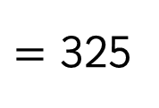

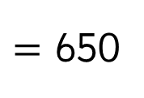

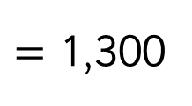
Challenge 4:
Festive Problems | 5th December
One year, Mr Snow spent 25% of the money saved up for a Christmas trip to Florida on his flights. Of the money left, he spends a third of it on hotel rooms.
He then spends $550 on tickets to theme parks and eating at restaurants.
He has $100 left of the holiday savings at the end of the trip.
How much money did he save for his trip to Florida?
Bar Modelling:
Number Sentences:
$1,300
550 $+$ 100
$=$ 650
650 $÷$ 2
$=$ 325
total
flights
hotels
food/tickets
325 $×$ 4
$=$ 1,300
$325
$650
1,300
Mr Snow saved $_______ for his trip to Florida.
© EdShed, 2020-

